Slide 1
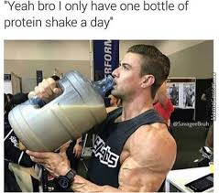
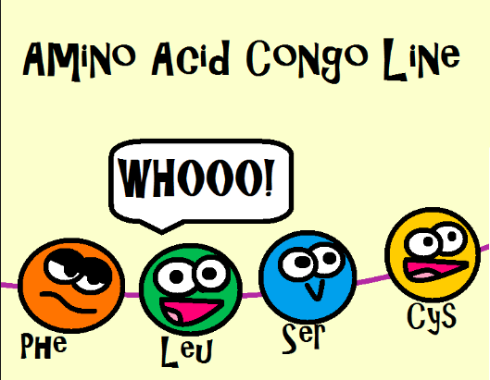
LI: To understand the functional diversity and hierarchical structure of proteins.
SC: I can- list functions of proteins.
- explain structures of proteins that allow them to be diverse.
- differentiate the four hierarchical levels of proteins
Unit 3 AoS1

Slide 2
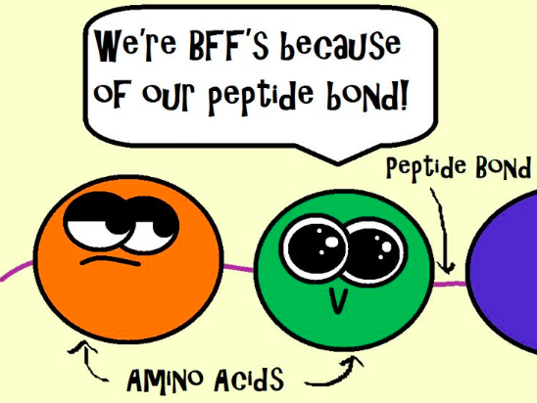
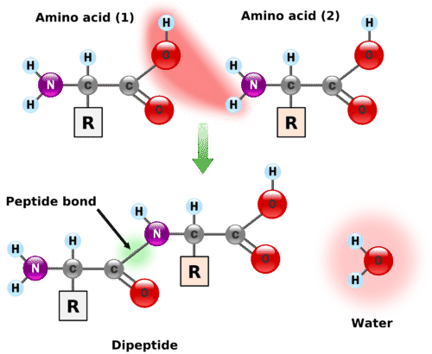
What is a protein?
An organic compound (contains carbon-hydrogen bonds) consisting of one or more amino acids connected by peptide bonds. They are in every living thing.
Amino acids join via condensation reactions
Proteome: The complete set of proteins in a set of genes in an organism.

Slide 3
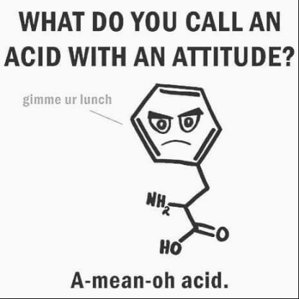
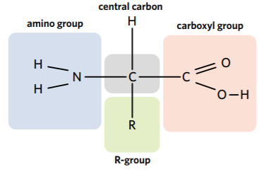
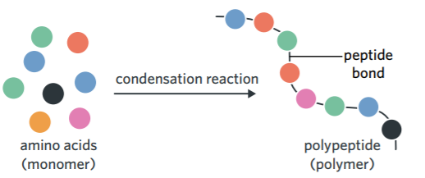
Amino Acids
Building blocks of proteins.
20 different types of amino acids, the R group is the variable region.
Are joined together by a peptide bond

Slide 4
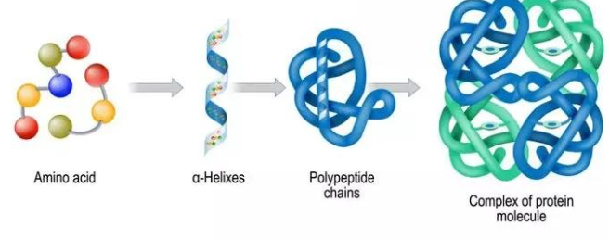
Protein Structure
Can contain thousands of amino acids and can have one or several polypeptide chains
The shape they fold into is vital for correct function
Most proteins are required to bind to other molecules
A change to one amino acid can alter the shape and consequently the function

Slide 5
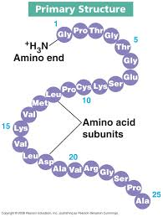
Primary structure:
This is the specific linear sequence of amino acids in the protein.
Primary structure determines protein function.
determined by the DNA nucleotide sequences.

Slide 6
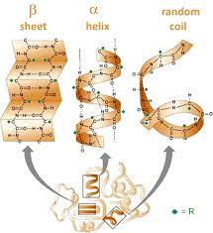
SECONDARY STRUCTURE
Amino acid chains fold and coil in 3 different ways by forming hydrogen bonds between amino acids
Alpha helix
Beta-pleated sheet
Random coiling: where the portions do not conform to the shape of an alpha helix or a beta-pleated sheet.

Slide 7
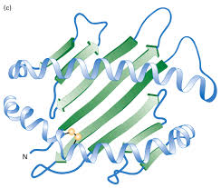
TERTIARY STRUCTURE
For a protein to function it must have a minimum of a tertiary structure
Further twisting and folding of secondary structures creates a 3D configuration by attractions between R groups and amino acids
Contain disulphide bonds (very strong), ionic and hydrogen bonds
This structure is critical for the protein function, if altered the protein can no longer function as it is meant to

Slide 8
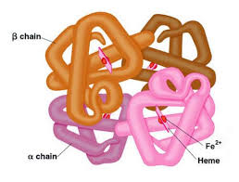
QUATERNARY STRUCTURE
Consists of more than one polypeptide chain, each with it’s own primary, secondary and tertiary structure (not all proteins have a quaternary structure)
Globular - hemoglobin
Fibrous: - collagen

Slide 9
Functional Diversity
Roles include: (write down 3 that you will remember)
Structural: provides physical support or protection.
Catalytic: enzymes that catalyse chemical reactions.
Regulatory: control of the timing and occurrence of biological processes example, hormones (insulin).
Immune defense: antibodies to identify and kill pathogenic organisms.
Movement: contractile components in muscles and cell cytoskeletons.
Transport: movement of substances across membranes or around the body, example haemoglobin.

Slide 10
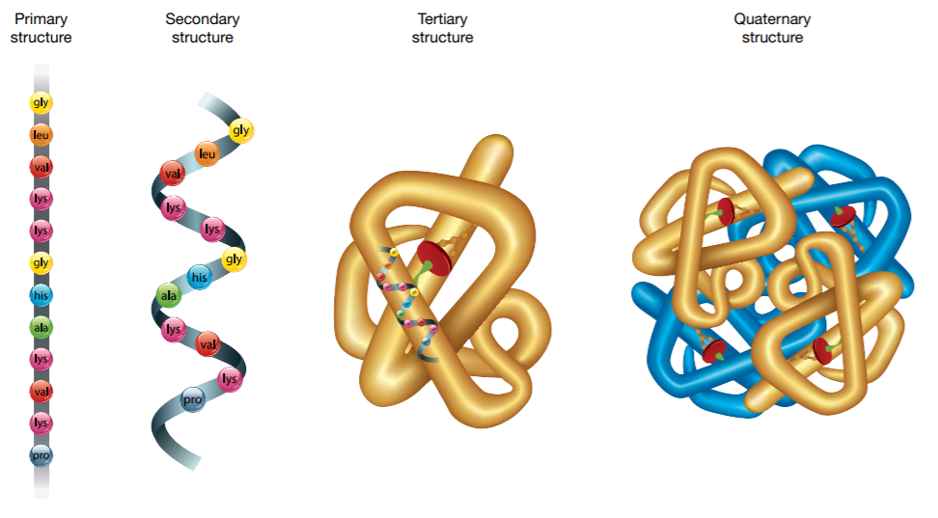
Review
Proteins demonstrate functional diversity through the various roles that they serve in living organisms. Amino acids are the monomers of proteins, and they join together via condensation reactions to form polypeptide chains. The primary level of protein structure refers to the sequence of amino acids, the secondary level of protein structure involves alpha helices, beta-pleated sheets, and random coils, the tertiary level is the functional 3D structure of a protein, and when there are two or more polypeptides in a protein it is said to have a quaternary structure.

Slide 11
ACTIVITY
Edrolo 2A
Question 10 - 16

Slide 12
Reflection
Write a summary from this lesson
Choose a straight line with vocab words

