Slide 1
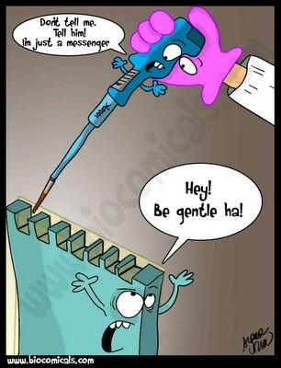
Unit 3, AOS1 PCR
LI: To understand the process and purpose of PCR
SC: I can describe the process of PCR and gel electrophoresis.
amplification of DNA using polymerase chain reaction and the use of gel electrophoresis in sorting DNA fragments, including the interpretation of gel runs for DNA profiling

Slide 2
POLYMERASE CHAIN REACTION
The process to create vast quantities of dna identical to trace/original samples
This process is also known as DNA amplification (making copies of dna).
***NOW THINK
Why would Scientists need to use this?
Think, pair then share. How many can we think of!?

Slide 3
Procedures
Many procedures in dna technology require substantial amounts of dna to work with, these include:
DNA sequencing
DNA profiling/fingerprinting
gene cloning
transformation
making artificial genes

Slide 4
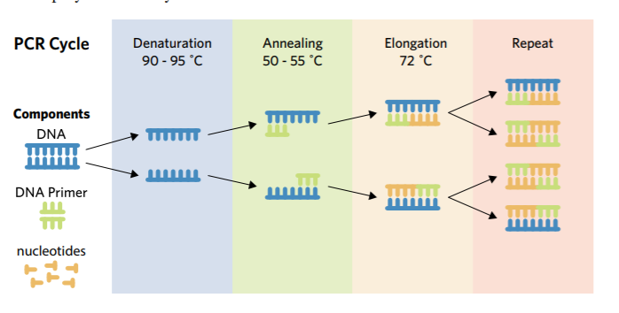
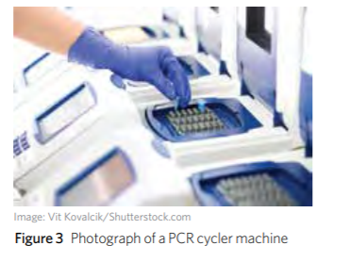

Slide 5
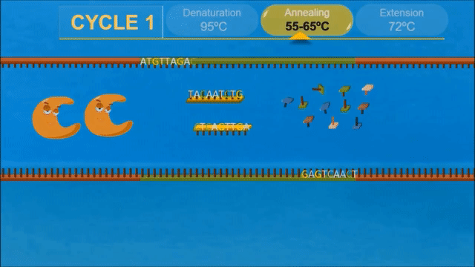
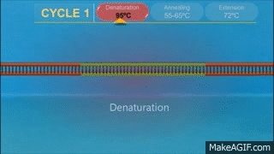
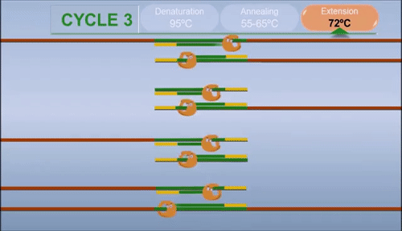
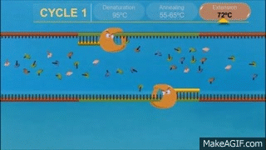
Think… Put in order (as a class write on board).

Slide 6
POLYMERASE CHAIN REACTION
PCR cycles | No. of target DNA strands
1 | 2
2 | 4
3 | 8
4 | 16
5 | 32
6 | 64
7 | 128
8 | 256
9 | 512
10 | 1024
11 | 2048
12 | 4096
13 | 8192
14 | 16 384
15 | 32 768
16 | 65 536
17 | 131 072
18 | 262 144
19 | 524 288
20 | 1 048 576
21 | 2 097 152
22 | 4 194 304
23 | 8 388 608
24 | 16 777 216
25 | 33 554 432
Although only three cycles of replication are shown here, following cycles replicate DNA at an exponential rate and can make literally billions of copies in only a few hours.
Original DNASample
Cycle 1
Cycle 2
Cycle 3

Slide 7
THE PROCESS OF PCR
A DNA sample called the target DNA is obtained
DNA is denatured (DNA strands are separated) by heating the sample for 5 minutes at 90-95°C
Primers (short strands of mRNA) are annealed (bonded) to the DNA at 55°C
Primer annealed

Slide 8
THE PROCESS OF PCR
Nucleotides
The sample is heated to 72°C. A thermally stable DNA polymerase (eg. Taq Polymerase) enzyme binds to the primers on each side of the exposed DNA strand.
This enzyme synthesizes a complementary strand of DNA using free nucleotides.
Nucleotides
After one cycle, there are now two copies of the original sample.

Slide 9
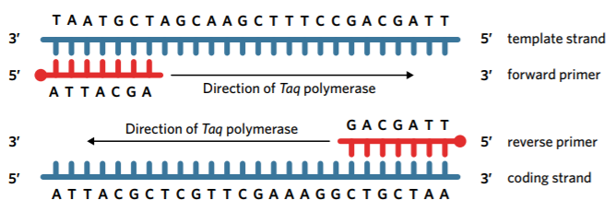
Primers
Forward Primer- Bind to the start codon at the 3’ end of template strand. Taq polymerase synthesises new DNA strand like RNA polymerase would.
Reverse primer- Binds to the stop codon at the 3’ end of the coding strand. Causes Taq polymerase to synthesise DNA in the reverse direction that RNA polymerase would normally run.

Slide 10
ACTIVITY
4C 1-5, 10-13

