Slide 1
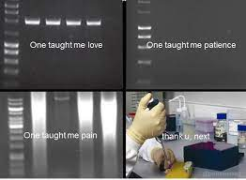
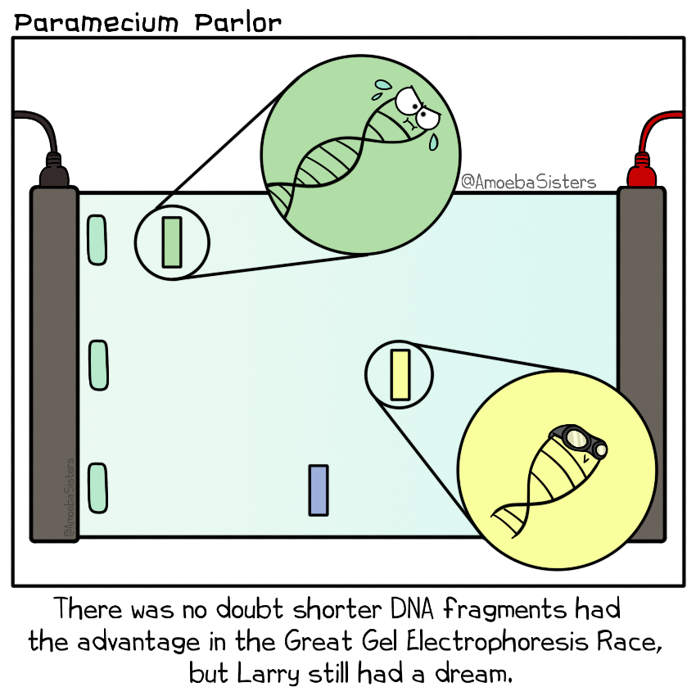
Unit 3, AOS1 Gel electrophoresis
LI: To understand how to separate pieces of DNA using gel electrophoresis and how to interpret results.
SC: I can:
identify steps of gel electrophoresis
explain results
describe the process of PCR and gel electrophoresis.
amplification of DNA using polymerase chain reaction and the use of gel electrophoresis in sorting DNA fragments, including the interpretation of gel runs for DNA profiling

Slide 2
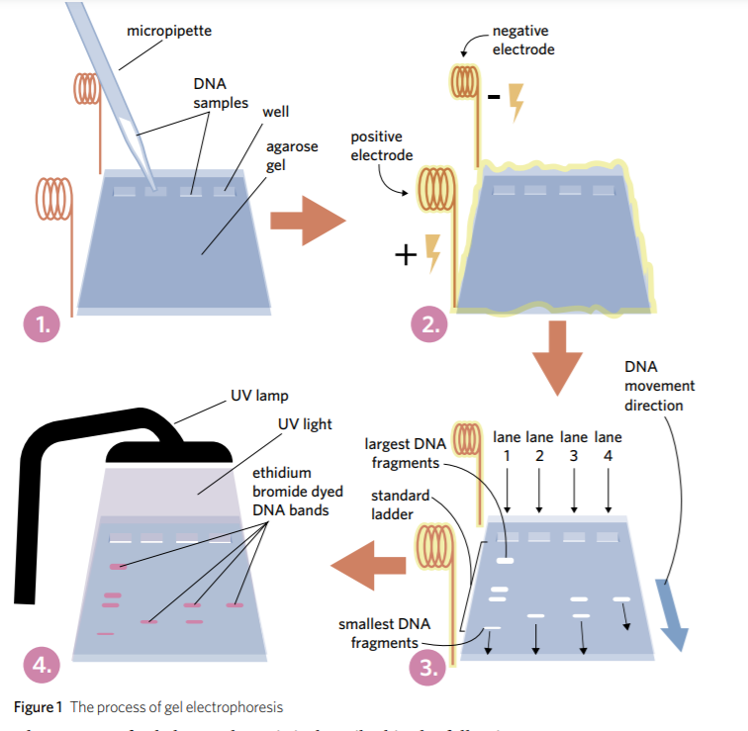
GEL ELECTROPHORESIS
Used to separate large molecules (including nucleic acids or proteins) on the basis of:
size
electric charge
other physical properties
Preparation of dna for gel electrophoresis involves the dna being cut up into smaller pieces done by restriction enzymes
Notes:
1 The DNA samples are placed in the wells at one end of the gel using a micropipette. A standard ladder is typically loaded into one well which helps with estimating the size of the unknown DNA fragments by comparing them to the known fragments in the standard ladder. The gel is made of agarose, a sponge-like jelly that is filled with tiny pores. This agarose gel is immersed in a buffer solution which helps carry an electric current. 2 An electric current is passed through the gel using two electrodes – one positive, one negative. The negative electrode is near the wells and the positive electrode is at the opposite end of the gel. Since DNA is negatively charged, it is attracted to the positive electrode. DNA fragments will move from the wells, through the tiny pores in the agarose gel, towards the positive electrode. 3 Smaller DNA fragments move faster through the gel and so travel further than larger fragments, which don’t move as easily through the pores in the agarose. After a few hours, the current is switched off and the DNA fragments stop moving in the gel and settle into bands. The DNA fragments are now separated based on size. 4 The DNA is difficult to see with the naked eye and so the gel must be stained with a fluorescent dye such as ethidium bromide, allowing the bands of DNA to be visualised under an ultraviolet (UV) lamp. This dye can be included in the gel before the experiment or applied after.

Slide 3
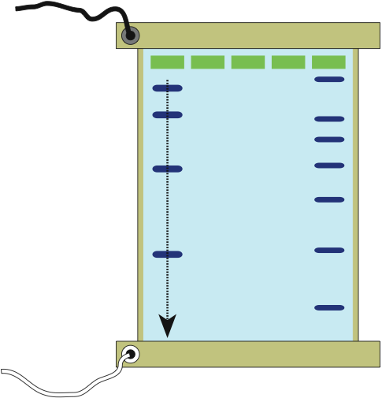
GEL ELECTROPHORESIS
Apply an electric field to the solution, the molecules move to opposite electrode.
DNA is negatively charged because the phosphates have a negative charge.
Therefore DNA moves from negative electrode to positive electrode
Can be visualized by applying dyes or radio-labeled probes.
Wells: Holes created in the gel with a comb.
-ve terminal
DNA solutions: Mixtures of different sizes of DNA fragments are loaded into each well.
Large fragments
DNA markers:
A mixture of DNA molecules with known molecular weights. They are used to estimate the sizes of the DNA fragments in the sample lanes.
DNA fragments: The gel matrix acts as a seive for the DNA molecules.
Small fragments
+ve terminal
Tray: Contains the set gel.

Slide 4
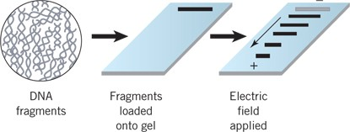
Separate DNA fragments according to size
Electrophoresis sorts DNA fragments according to their lengths
Involves the following steps:
A mixture of DNA fragments with dye and is loaded into a “well” in a gel.
Agarose gel is immersed in suffer solution (salt)
An electrical current is passed through the gel (+ on far side, - on starting well).
Negatively charged DNA fragments move towards the positive pole
The shorter the DNA fragment, the quicker it moves through the gel.
Interpret results, sometimes with UV.
Notes:
We will go over this in detail in another lesson.

Slide 5
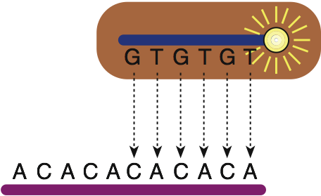
HOW DNA PROBES WORK
A DNA probe is a small fragment of nucleic acid (either cloned or artificially synthesized), that is labeled with an enzyme, a radioactive tag, or a fluorescent dye tag.
Fluorescent dye tag: Shows up as fluorescent bands when gel is exposed to ultraviolet light source.
or
Radioactive tag: Shows up as a dark band when the gel is exposed to photographic film.
Under appropriate conditions, the probe will bind to a complementary DNA sequence by base pairing, identifying the presence and location of the target DNA sequence for further analysis.
Target DNA strand (such as a tandem repeat) with a complementary sequence that is being searched for by the probe.

Slide 6
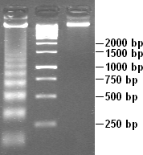
Gel electrophoresis
Molecules of different sizes (molecular weights) become separated on the gel surface. - Smaller fragments travel further in the gel
There is a molecular ladder which is DNA sequences of known lengths that are used to help identify the lengths of unknown samples
There is often also a negative control which checks for contamination (It is a sample that is run without any DNA)
Each band has thousands of DNA strands
bp refers to how many base pairs are in the DNA sample

Slide 7
What can affect results?
Voltage- stronger the electric force the further the DNA travels
Gel composition- the thicker the gel is, the slower the DNA moves
Buffer concentration- the greater concentration of ions, the more electric current is conducted through the gel (if more, it can move further)
Time- the longer the current is applied, the further it travels

Slide 8
Applications
Forensic investigations
examining disease
paternity disputes
identifying people in mass disasters
how closely related species are
match for organ donors

Slide 9
What DNA is used?
Short tandem repeats- small section of repeated nucleotides that vary in length from person to person.
Found in non-coding regions
If two pieces of STD’s match they then they are the same person

Slide 10
ACTIVITY
4D 1-12

