Slide 1
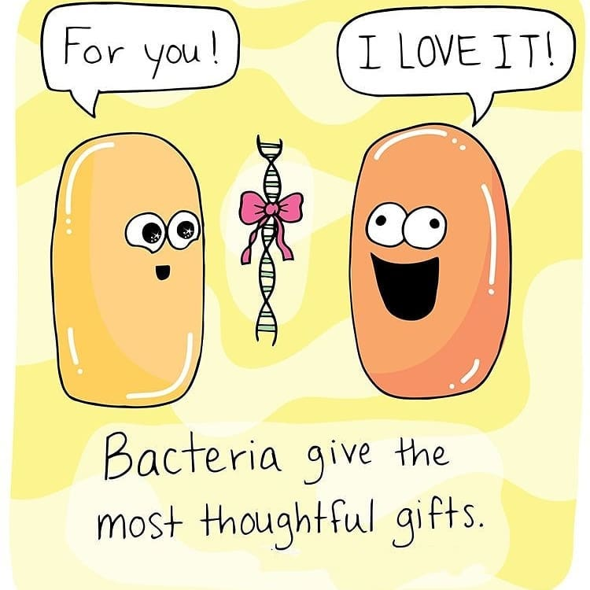
Unit 3, AOS1 Recombinant Plasmids
LI: To understand how DNA manipulation techniques can produce recombinant plasmids.
SC: I can identify DNA manipulation techniques used.
I can describe the steps to create recombinant plasmids.
the use of recombinant plasmids as vectors to transform bacterial cells as demonstrated by the production of human insulin

Slide 2
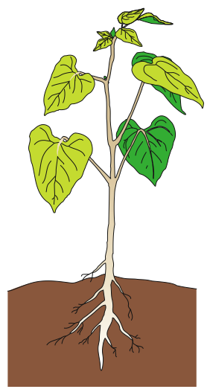
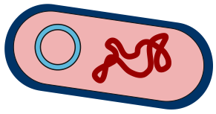
PLASMIDS
plasmids: A small, circular, double-stranded DNA molecule that is separate from a cell's chromosomal DNA. It occurs naturally in bacteria (loop of dna).
Some bacteria have none, some have many.
e.g’s include antibiotic resistance genes, poison resistance genes and col plasmids – produce proteins that kill other bacteria
Bacterium: Agrobacterium tumefaciens
Plasmid
Plant infected by bacterium with foreign gene
Plasmid with foreign gene

Slide 3
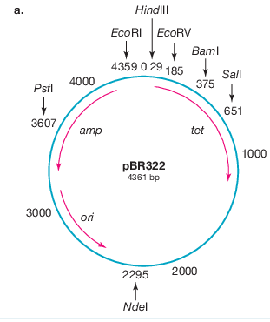
Plasmid features | Function
Origin of replication (ORI) | Sequence found in prokaryotes that signal the start site of DNA replication.
Antibiotic resistance gene | Gene which confers antibiotic resistance, such as ampicillin (AmpR).
Promoter region | Promoters are found upstream of their target genes. The sequence of the promoter region controls the binding of the RNA polymerase; therefore, promoters play a large role in determining where and when your gene of interest will be expressed.
Reporter gene | A gene with easily identifiable phenotype that can be used to identify whether a plasmid has taken up the gene of interest. Eg: Fluorescent protein
Plasmid pBR322 with many cloning sites present throughout the plasmid (the numbers represent the distance clockwise from the origin in base pairs).

Slide 4
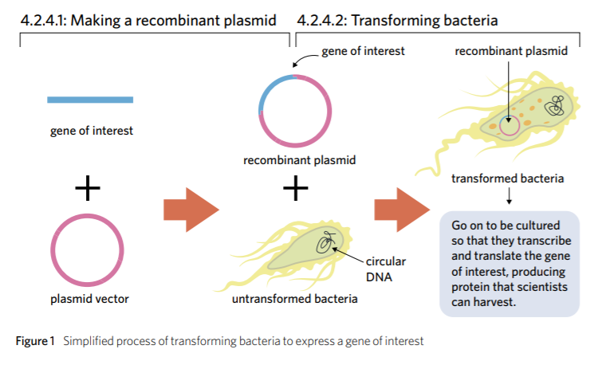

Slide 5
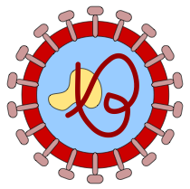
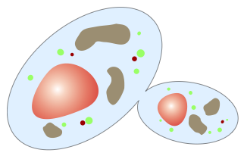
VECTORS FOR GENE CLONING
VECTOR = a means of introducing foreign DNA into an organism; plasmids are a popular vector in bacterial transformation
all vectors must have the following properties:
be able to replicate inside their host organism.
have one or more sites at which a restriction enzyme can cut.
have some kind of genetic marker that allows them to be easily identified.
organisms such as bacteria, viruses and yeasts have DNA which behaves in this waY.

Slide 6
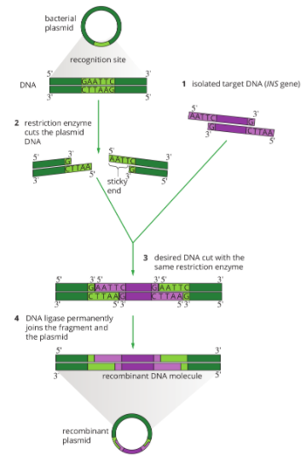
Steps for Recombinant Plasmid
1 The target DNA (eg: insulin gene), is cut out using a sticky-end restriction enzyme and then isolated.
2 The bacterial plasmid is cut by the same restriction enzyme. The plasmid and
the target DNA now have the same sticky ends with exposed bases that are
complementary to each other.
3 The INS gene and plasmids are placed together. Some plasmids will simply
close back up (known as non-recombinant plasmids), while other plasmids will
incorporate the INS gene by complementary base pairing (known as recombinant
plasmids). Reporter genes are necessary to distinguish recombinant plasmids
from non-recombinant plasmids.
4 DNA ligase is added to rejoin the sugar–phosphate backbone of the DNA

Slide 7
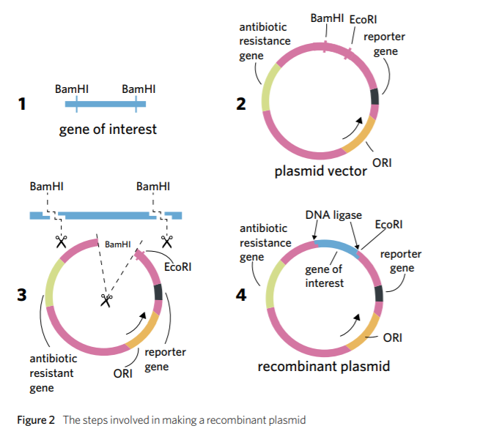

Slide 8
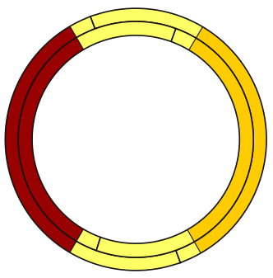
RECOMBINANT DNA PLASMID
The fragments of DNA are joined together by the enzyme DNA ligase, producing a molecule of recombinant DNA.
DNA ligase
A
A
T
T
Detail of Restriction Site
G
C
C
T
T
A
A
G
Recombinant Plasmid DNA
Fragments linked permanently by DNA ligase
No break in DNA molecule
G
A
A
T
T
C
The fragments are able to join together under the influence of DNA ligase.
C
G
T
T
A
A

Slide 9
ACTIVITY
Biozone 23

