Slide 1
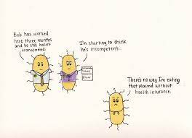
Unit 3, AOS1 Recombinant Plasmids
LI: To understand how recombinant plasmids are used to transform bacteria.
SC: I can list steps involved in transforming bacteria.
I can describe how bacteria can produce insulin.
the use of recombinant plasmids as vectors to transform bacterial cells as demonstrated by the production of human insulin

Slide 2
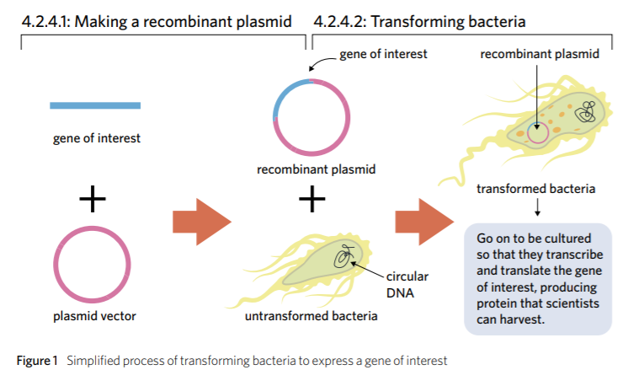

Slide 3
Uptake of Plasmid
Involves the plasmid being inserted into the cytoplasm of bacteria.
Two methods to promote uptake:
Heat shock
Electroporation
Bacteria can then be cultured/grown and then further isolated by the addition of antibiotics
Those that have taken up the recombinant plasmid containing the human gene and the antibiotic resistant genes will grow on ampicillin disc and those without it will be destroyed

Slide 4
Heat shock
Bacteria placed in calcium ion solution on ice (positive calcium ions make plasma membrane more permeable to the negatively charged DNA).
Solution is then heated to 37-42 C for 25-45 seconds and then placed on ice.
Sudden change in temp makes the plasma membrane even more permeable, allowing vectors to cross the phospholipid bilayer.

Slide 5
Electroporation
Mixture of recombinant and non-recombinant plasmids are subjected to electrical current that creates holes in the membrane which helps the plasmids enter the bacteria.

Slide 6
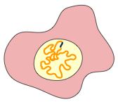
USING PLASMIDS
Escherichia coli bacterial cell
Human cell
Preparation of the Clone
Human gene
Plasmid
DNA in chromosome
Sticky end
Sticky end
Chromosome
A gene of interest (DNA fragment) is isolated from human tissue cells
Restriction enzyme recognition sequence
Plasmid
vector
Ampicillin-resistance gene
Human DNA and plasmid are treated with the same restriction enzyme to produce identical sticky ends
Gene disrupted
An appropriate plasmid vector is isolated from a bacterial cell
Sticky ends
Restriction enzyme cuts the plasmid DNA at its single recognition sequence
Mix the DNAs together and add the enzyme DNA ligase to bond the sticky ends
Recombinant DNA
molecule
Human gene
Recombinant plasmid is introduced into a bacterial cell by simply adding the DNA to a bacterial culture where some bacteria take up the plasmid from solution

Slide 7
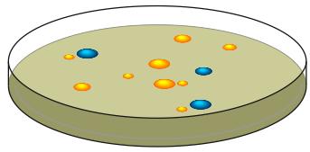
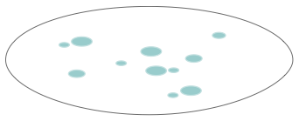
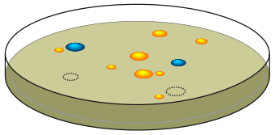
Finding Transformed Bacteria
Bacterium
Bacteria containing the recombinant plasmid are spread onto an agar plate containing ampicillin (type of antibiotic).
Human gene
Recombinant plasmid
The only bacteria to
survive will be those that have taken up the plasmid, whether it is a recombinant
or non-recombinant plasmid. These bacteria have the ampicillin resistance (ampR)
gene. All other bacteria will be killed.
All colonies look identical but only some have the plasmid with the human gene.
Agar containing ampicillin allows only bacterial colonies with the plasmid to grow.
Dish A
Filter paper is pressed against the agar plate thereby transferring colonies of bacteria to the paper.
Filter paper
Dish B
Colonies with the human gene can be located according to their position on the original dish A.

Slide 8
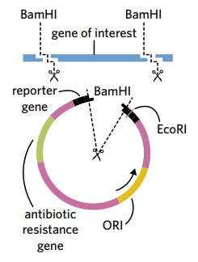
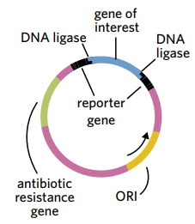
Finding transformed bacteria with recombinant plasmids
Use of a reporter gene, such as lacZ that makes the bacteria blue. .
Non-Recombinant:
The reporter gene is continuous and WILL be blue
Recombinant
The reporter gene is split by the gene of interest, which disrupts the gene and it will NOT be blue.

Slide 9
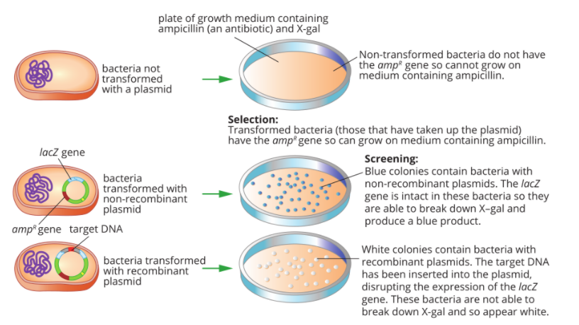

Slide 10
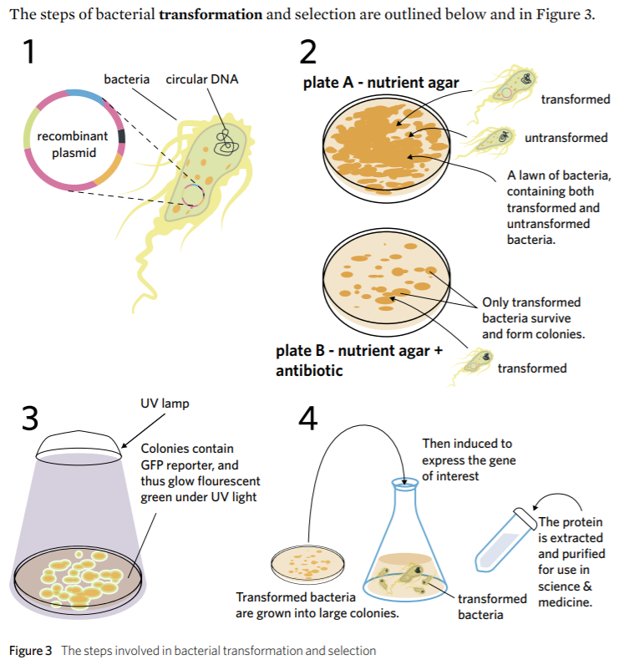

Slide 11
Examples of why this is done
Protein production – the transformed bacteria are cultured and induced to transcribe and translate the gene of interest. Then, because bacteria make lots of different proteins, the protein of interest is extracted and purified. Commonly used proteins that are made from transformed bacteria include:
• Insulin – manages diabetes
• Erythropoietin – for treatment of anaemia
• Growth hormone – manages growth disorders
• Interferon – for treatment of some cancers
• Hepatitis B surface antigen – for use in hepatitis B vaccine
• Chymosin – for cheese production
• Alpha-amylase – for ethanol and high fructose corn syrup production.

Slide 12
Summary
Plasmids are used as vectors to transform bacterial cells.
Cut out gene that you want to insert into plasmid
look for a 6 base palindrome (read same forwards and backwards) which will be cut by restriction enzymes
Now that we have the cut out DNA, We want to get a plasmid
Mix plasmids with bacteria
Testing - If bacteria don’t grow when introduced with second antibiotic - recombinant plasmid has been taken up
Gene cloning - copying of bacteria and extracting what we want

Slide 13
If you’re still confused here is a lovely simple video with great diagrams
https://www.youtube.com/watch?v=GNMJBMtKKWU

Slide 14
Reflection
Explain the steps to the person next to you

Slide 15
ACTIVITY
4E 1-4, 11-15 & worksheet 8 heinerman

