Slide 1
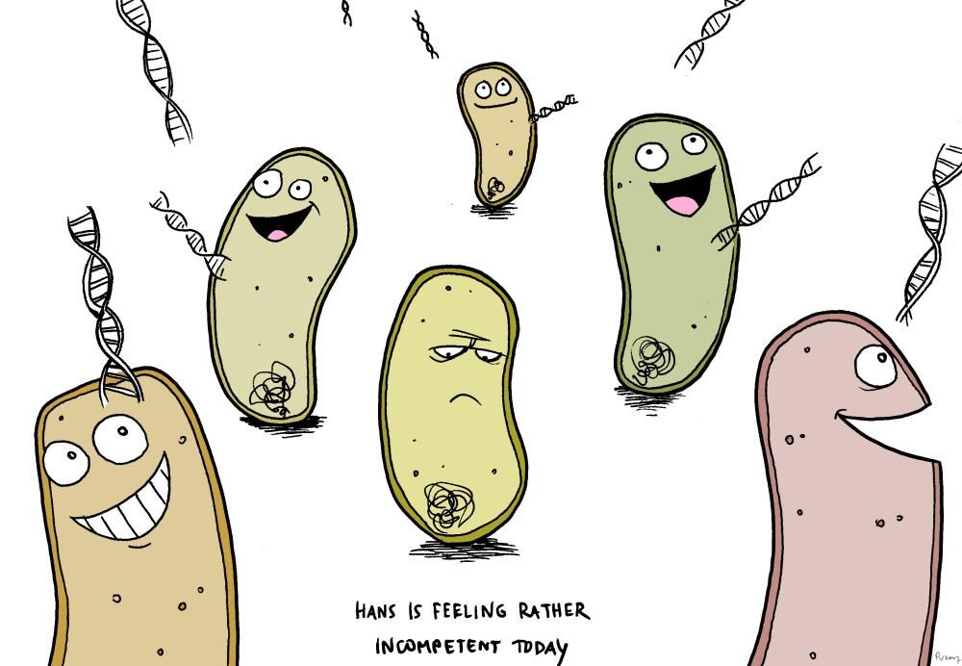
Unit 3, AOS1 Recombinant Plasmids
LI: To understand how transformed bacteria can produce human insulin.
SC:
I can describe how bacteria can produce insulin.
the use of recombinant plasmids as vectors to transform bacterial cells as demonstrated by the production of human insulin

Slide 2
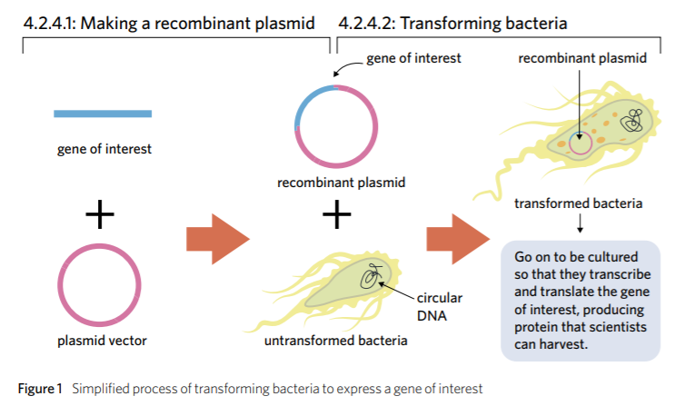

Slide 3
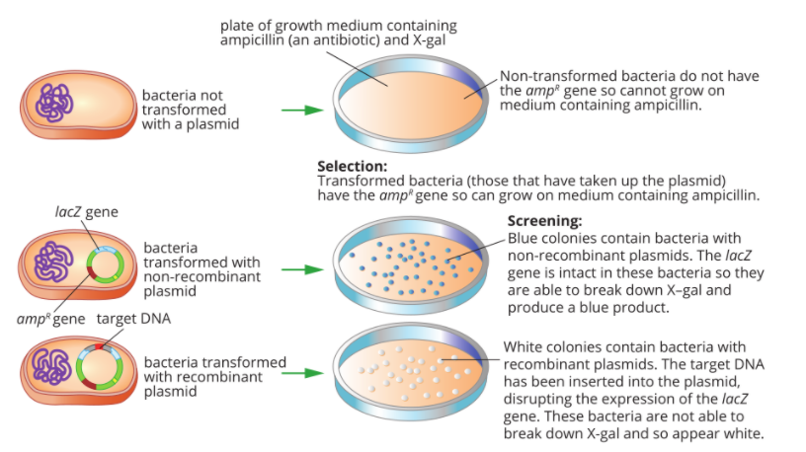

Slide 4
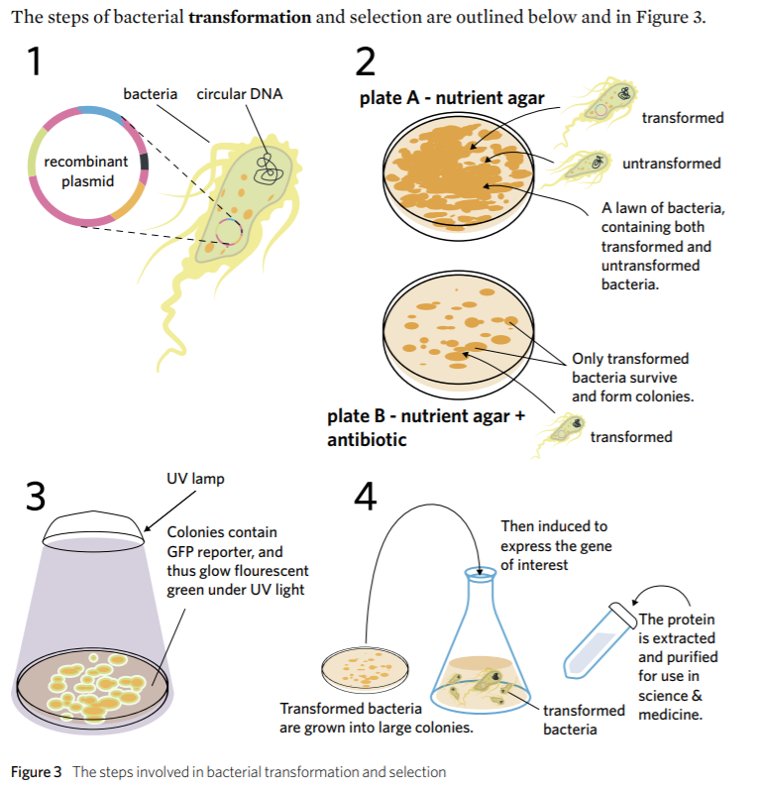

Slide 5
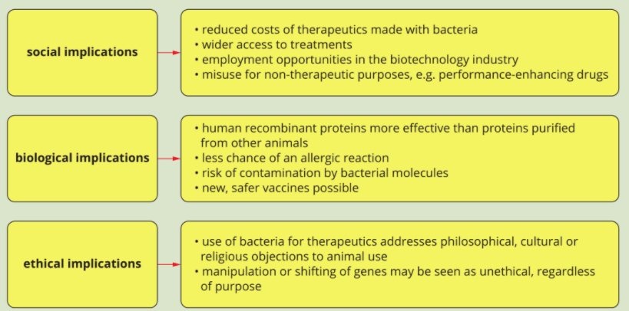
Ethics

Slide 6
ACTIVITY
Modelling Insulin Production

Slide 7
Reflection
1 thing you found interesting
1 thing you are still curious about

