Slide 1
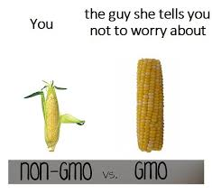
LI: To understand the difference between genetically modified organisms and transgenic organisms.
SC: I can:
- define GMO and transgenic organism
- explain the difference between GMO transgenic organism
- describe the use in agriculture
Unit 3- AoS1 GMO and Transgenic Organisms
the use of genetically modified and transgenic organisms in agriculture to increase crop productivity and to provide resistance to disease.

Slide 2
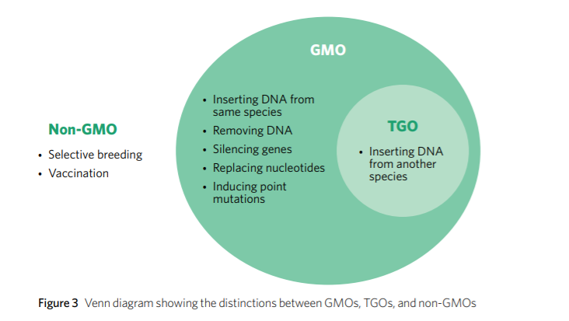
Genetic Modification
Genetic modification, alteration of an organism’s genome using technology in order to give them desirable traits. Genetic modification may involve genes being:
• inserted into the genome
• removed from the genome
• silenced post-transcriptionally
• altered by replacing single nucleotides.

Slide 3
Genetically Modified Organisms
An organism that has had its DNA artificially modified to produce a desired characteristic
Organisms, whose genomes have been altered using genetic engineering technology
They have gene combinations that do not occur naturally within populations
Can involve:
- The addition of a gene or DNA segment
- The silencing of a gene = loss of function
The gene must be heritable – passed onto the next generation
Added DNA can come from the same species (cisgenic)
Eg. Flavr Savr tomato → Modified to be not rotten/squishy
Canola → modified against being affected by pestisides

Slide 4
Transgenic Organism - type of GMO
Organisms that have genes/ DNA added from another unrelated species
E.G. Transgenic mice – used in research of human disease and can be achieved via
Micro-injecting DNA into fertilised eggs
Modifying embryonic stem cells
Transgenic plants can be achieved by
Physical uptake of DNA
Agrobacterium-mediated uptake of DNA
Eg. Glo Fish (gene taken from jellyfish and inserted into fish to make them glow)
All transgenic organisms are GMO’s but not all GMO’s are transgenic organisms

Slide 5
Uses of GMOs in Agriculture
Increasing crop productivity- to keep up with rising population food demands
Increasing disease resistance- to stop food wastage
Foreign genes for insect and virus resistance or tolerance to herbicides have been used to increase crop yield and value.
Produce own natural pesticide
E.g. Cotton, Maize, potato, canola and golden rice

Slide 6
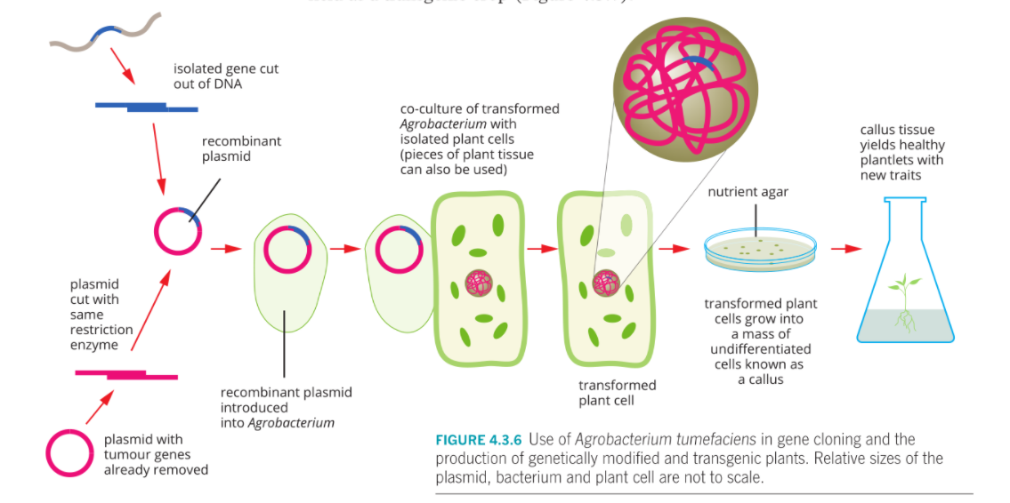

Slide 7
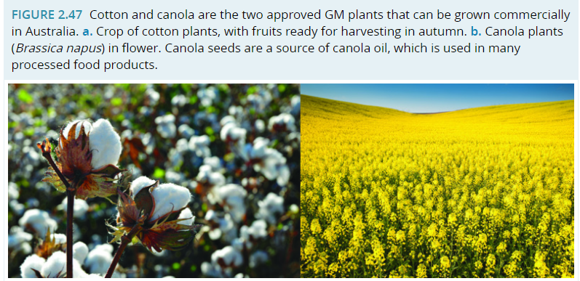
GMOs in Aus
In Australia, two genetically engineered crops grown on a large scale are cotton (Gossypium hirsutum) and canola (Brassica napus).

Slide 8
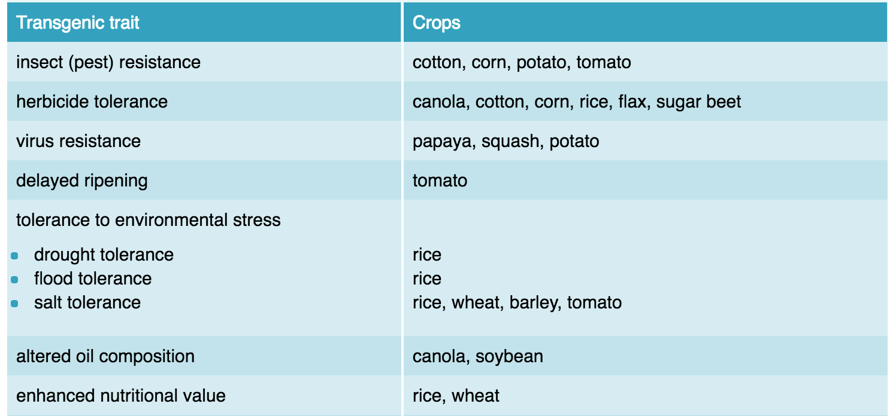

Slide 9
Ethics

Slide 10
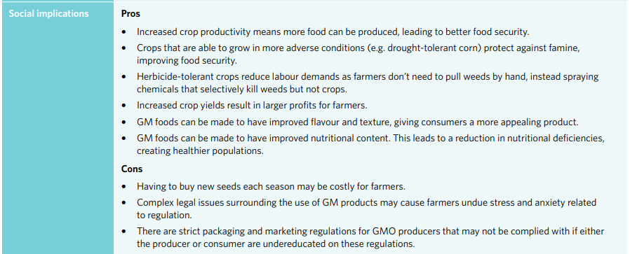
Ethics

Slide 11
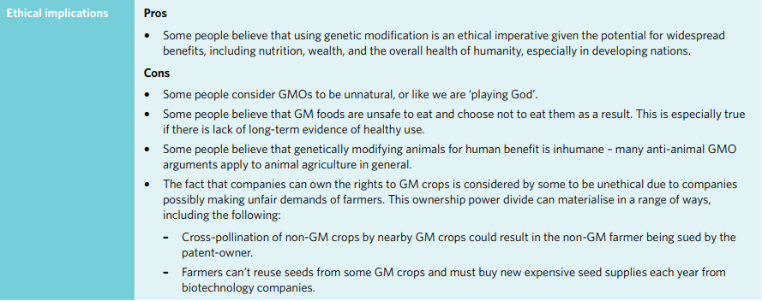

Slide 12
Activity:
4F 1-5, 12-15

