Slide 1
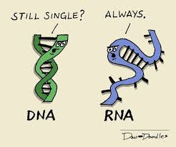
To understand how nucleic acids are monomers of nucleotides that store genetic information and help produce proteins.
I can:
- define a nucleotide and nucleic acid.
- explain the difference between DNA and RNA
- describe the structure of DNA and RNA
Unit 3 AoS1- Nucleic Acids
- nucleic acids as information molecules that encode instructions for the synthesis of proteins: the structure of DNA, the three main forms of RNA (mRNA, rRNA and tRNA) and a comparison of their respective nucleotides

Slide 2
Monomers & Polymers
Monomers
Smaller subunits of a polymer. The building blocks of cells
E.g. Sugars, amino acids and nucleotides
Polymers
Large molecules made up of identical or similar units.
Polymers are made when monomers are joined
E.g. Starch, proteins and DNA/RNA

Slide 3
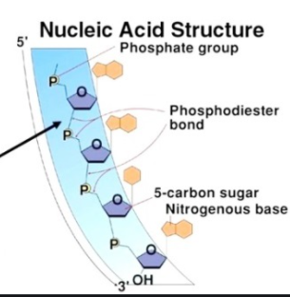
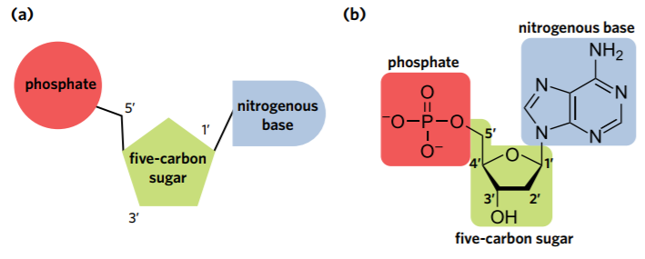
Nucleotide
Nucleic Acid
DNA- code for production of RNA
RNA- can carry copy of DNA (mRNA) or translate DNA (tRNA). Major role in protein synthesis.
Join together with strong phosphodiester bonds, creates the sugar-phosphate backbone
• a phosphate group
• a five-carbon (pentose) sugar
• a nitrogen-containing base.

Slide 4
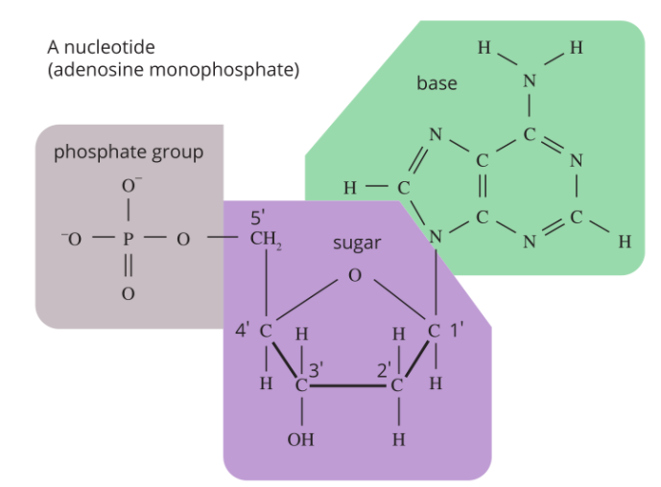
Counting Carbon
Each Carbon has a number
1’ attaches to the nitrogenous base
3’ attaches to the phosphate of the following nucleotide
5’ attaches the 5-carbon sugar to the phosphate group of the nucleotide
* Important for recognising direction of DNA and RNA

Slide 5
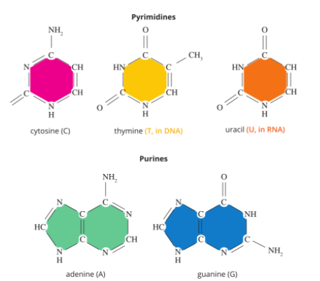
Nitrogenous Base
5 Bases
Adenine (A)
Guanine (G)
Cytosine (C)
Thymine (T) - in DNA only
Uracil (In RNA only)

Slide 6
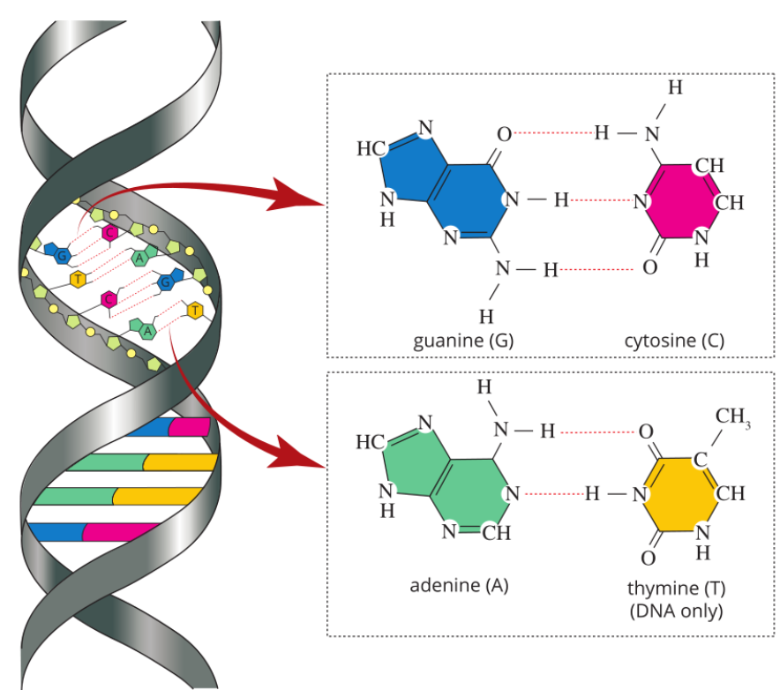
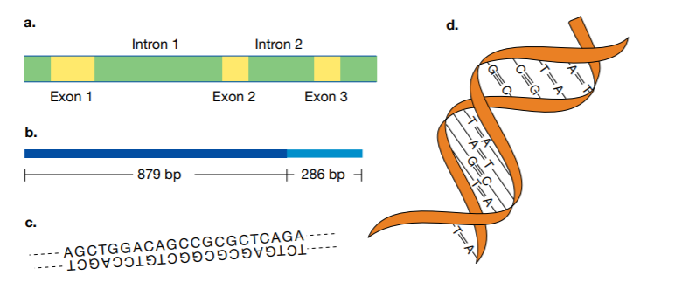
DNA (Deoxyribonucleic acid)
2 strands (double helix)
2 strands are antiparallel (run in opposite directions, with 3’ end matching with 5’ end of the other strand.
Complementary base pairing occurs between nitrogenous bases (A & T, two weak hydrogen bonds) and (G & C, three weak hydrogen bonds)

Slide 7
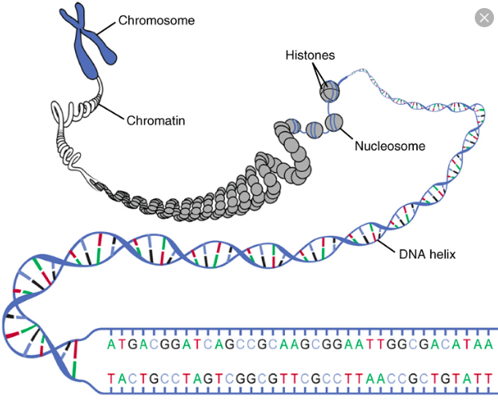
Label as many things as you can :)
Notes:
Chromosome→ Chromatin→ Nucleosome (chromatin wrapped around histone)→ Histone (protein that chromatin wraps around) → DNA double helix → Nucleotide → Phosphate group + Pentose sugar + Nitrogenous base (A, T, G, C)

Slide 8
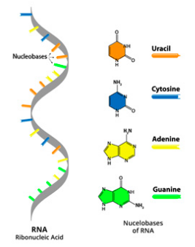
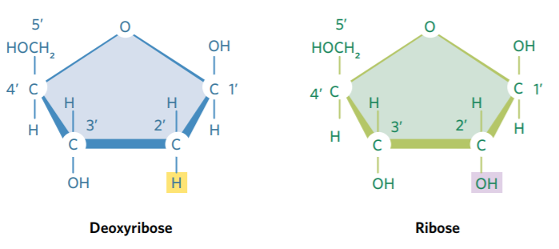
RNA (Ribonucleic acid)
The sugar is ribose instead of deoxyribose
Single stranded
Uracil replaces Thymine (still pairs with Adenine)

Slide 9
Three types
Messenger RNA (mRNA): carries genetic message to ribosomes for protein synthesis
Ribosomal RNA (rRNA): makes up ribosomes
Transfer RNA (tRNA): carries amino acids to ribosomes to make proteins (polypeptide chains).

Slide 10
Review

Slide 11
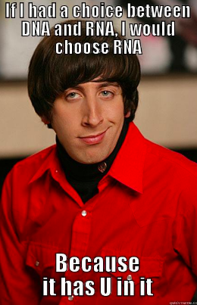
ACTIVITY
Edrolo 2B Question 9-15

