Slide 1
To understand how the genetic code enables nucleic acids to encode information for protein synthesis.
I can:
- list two structures of genes
- explain why the genetic code is degenerate
- draw a gene with exons, introns, promoter and operator regions
Unit 3 AoS1- Genes
- the genetic code as a universal triplet code that is degenerate and the steps in gene expression, including transcription, RNA processing in eukaryotic cells, and translation by ribosomes
- the structure of genes: exons, introns, and promoter and operator regions

Slide 2
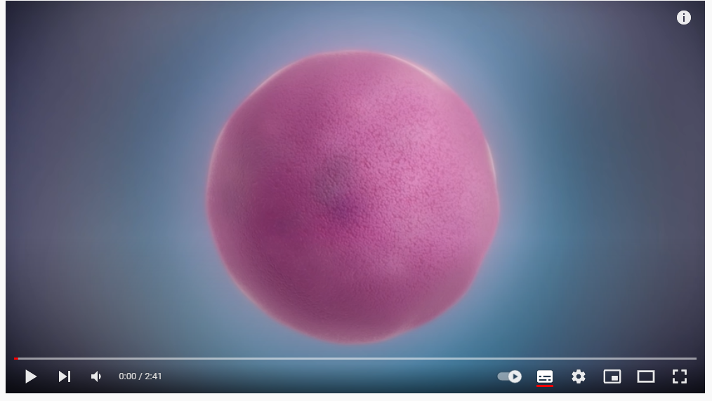
Making a protein from genes
Take notes as you watch :D

Slide 3
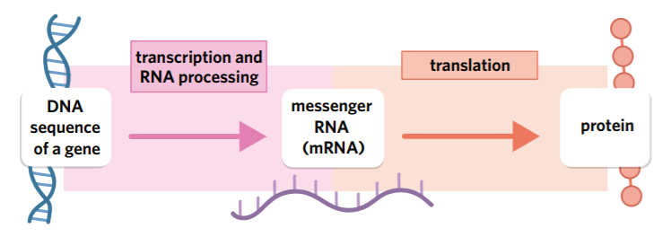
Genes
A section of DNA that carries the code to make a protein (can be millions of nucleotides)

Slide 4
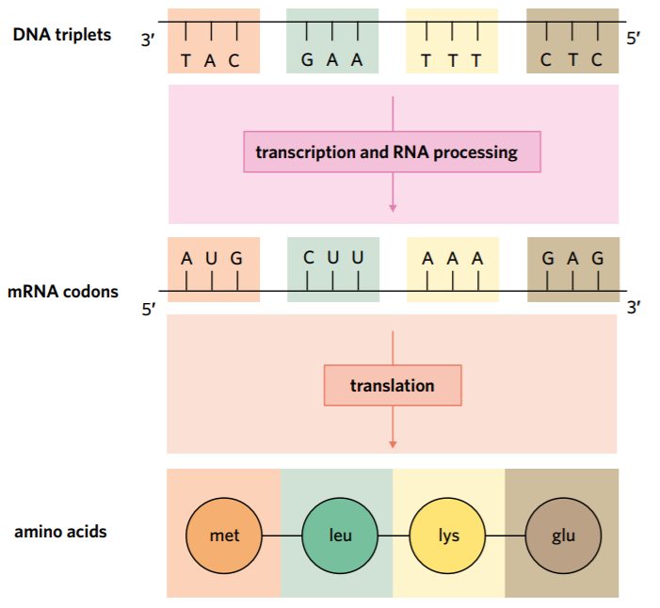
Genetic code
Stored in three-letter code of nucleotides, called a triplet. When DNA triplet is transcribed into mature messenger RNA, through transcription, the triplet is called a codon.
AUG- the initiating translation
Stop codons end translation without attaching an amino acid

Slide 5
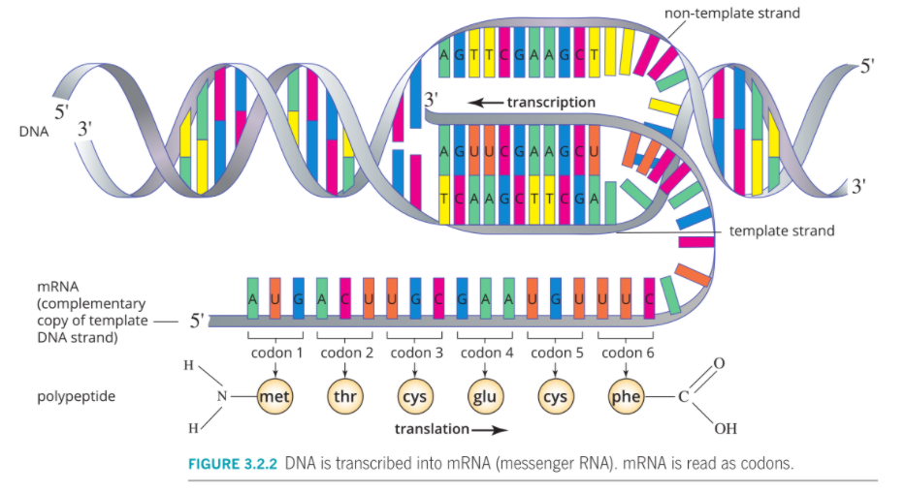

Slide 6
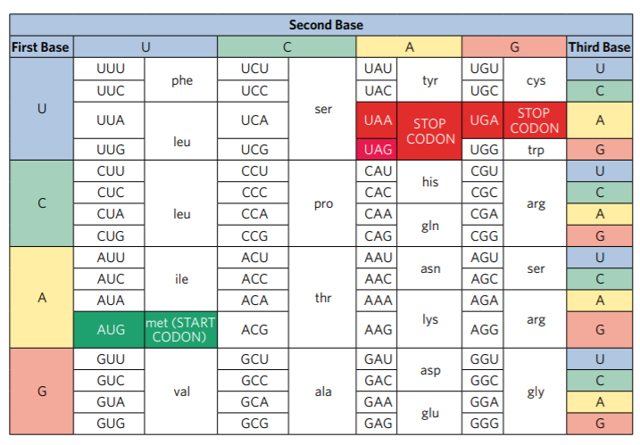
Reading the code
Notes:
Give many random codons and students list them as the amino acids

Slide 7
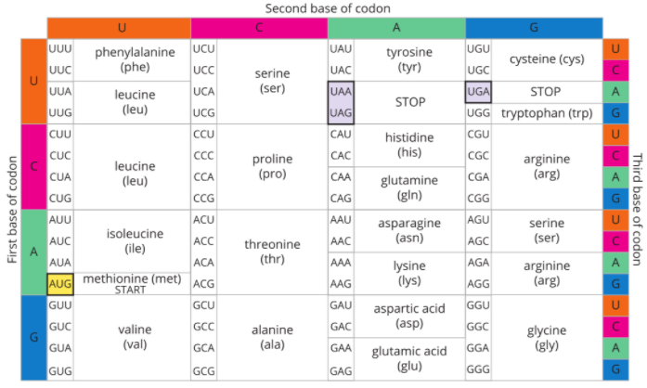
Degenerate
More than one codon can code for the same amino acid
There are 64 possible codons, to code for the 20 amino acids.
Why is this important?
It acts as a buffer for genetic mutations, in that a single change in one base does not always lead to a change in an amino acid.

Slide 8
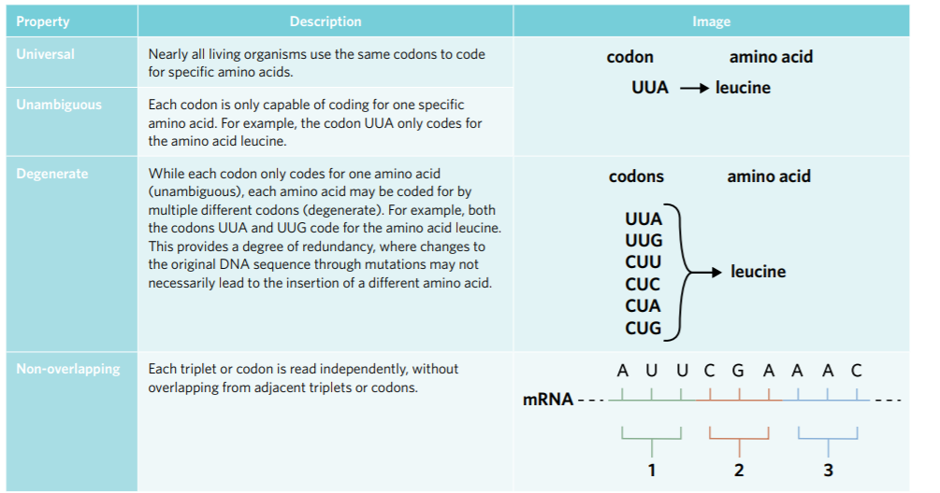

Slide 9
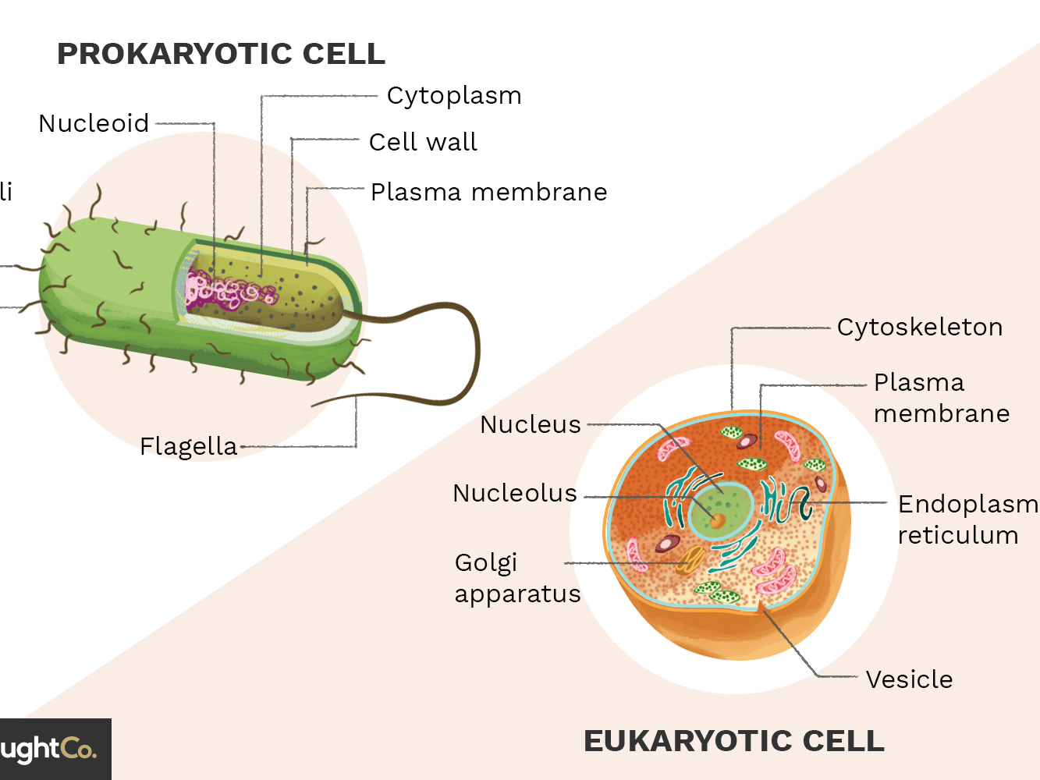
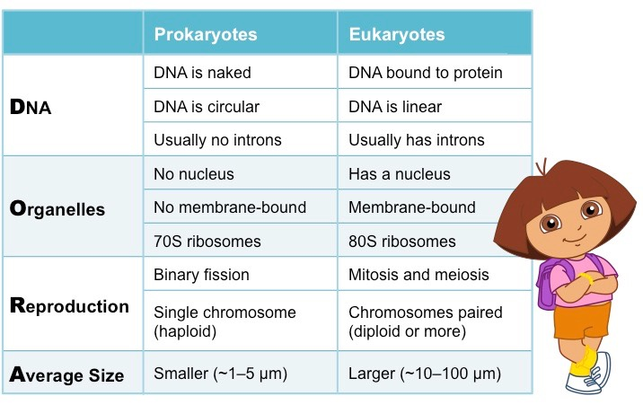
Eukaryotic vs prokaryotic

Slide 10
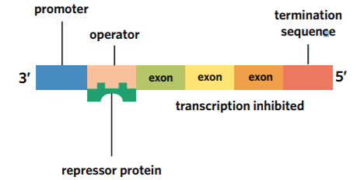
Structure of genes
Promotor: Upstream (5’ end) binding site for RNA polymerase, which is an enzyme responsible for transcription. When RNA polymerase binds to the promoter region of a gene, it allows for the transcription of that particular gene.
Introns: regions of non-coding DNA that do not contribute to the final protein as they are removed during RNA processing (only in eukaryotes)
Exons: regions of coding DNA, which are transcribed and translated into the final protein. These can be found in both eukaryotes and prokaryotes
Termination sequence: The termination sequence represents a sequence of DNA that signals for the end of transcription- no amino acid is added.
Operator: binding site for repressor proteins, which can then inhibit gene expression (only in prokaryotes)

Slide 11
Summary
The information required to produce proteins is stored within genes in the form of DNA triplets. Through the process of transcription, these DNA triplets are used as a template to produce mRNA codons. Then, through the process of translation, these mRNA codons are used to code for specific amino acids within a polypeptide chain. Key features of the genetic code include its universal, unambiguous, degenerate, and non-overlapping nature.

Slide 12
Activity
Edrolo 2C 9-14

Slide 13
Reflection
Finish crossword

