Slide 1
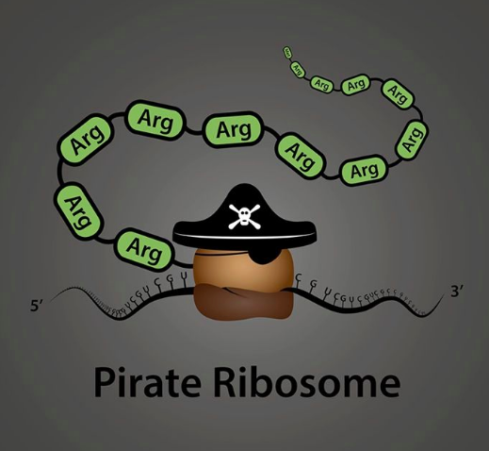
To understand how genes are expressed to produce proteins.
I can:
- list enzymes involved
- explain post transcriptional processing
- describe the steps of transcription and translation
Unit 3 AoS1- Transcription and Translation
- the genetic code as a universal triplet code that is degenerate and the steps in gene expression, including transcription, RNA processing in eukaryotic cells, and translation by ribosomes

Slide 2
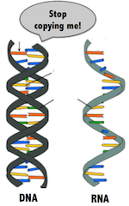
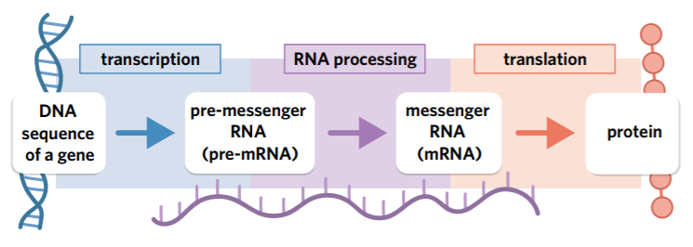
Gene expression
Formation of functional gene products such as proteins or non-coding strands of RNA
The stages:
• transcription: copying of DNA into pre-mRNA
• RNA processing: modifies the pre-mRNA molecule to produce mRNA
• translation: decoding of the mRNA strand into a polypeptide chain

Slide 3
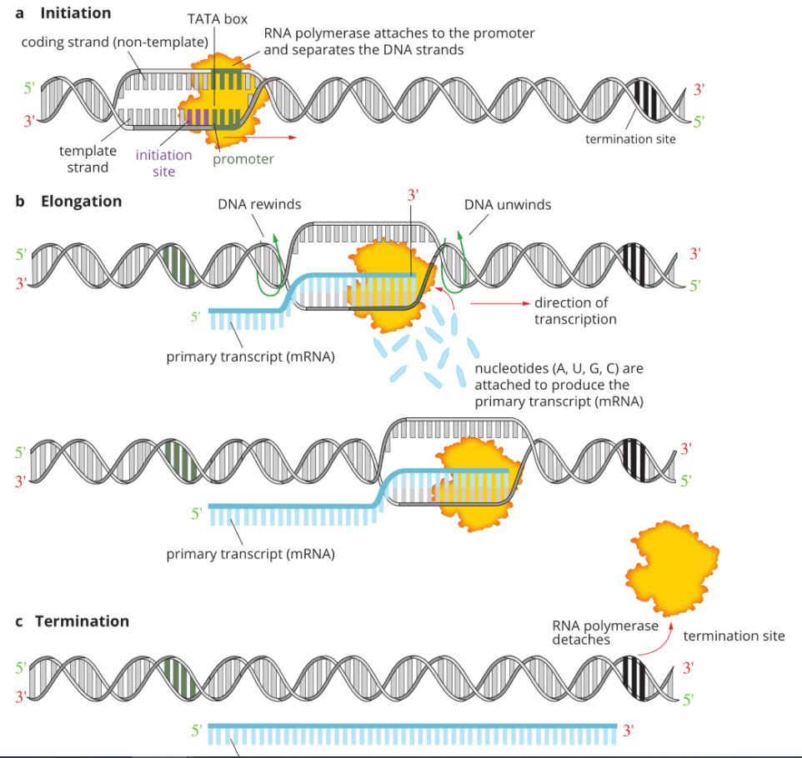
Transcription

Slide 4
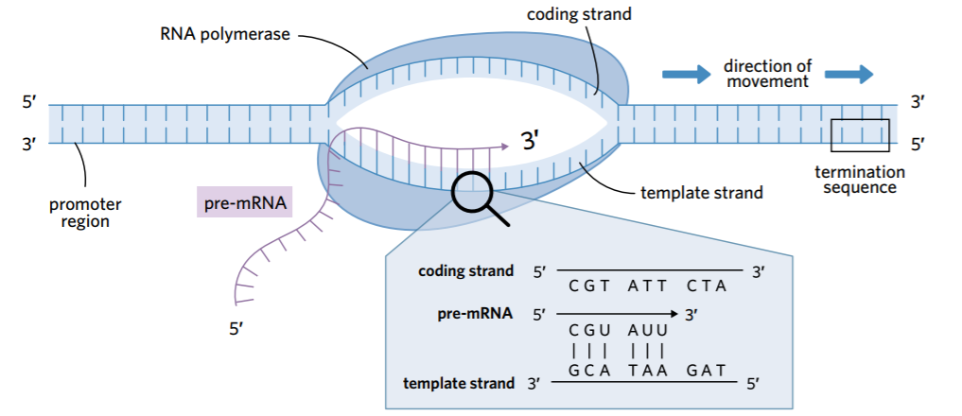
Transcription
Creation of pre-mRNA.
Initiation: RNA polymerase binds to promoter region. This signals for the weak H bonds between the DNA to break, making the DNA helix unwind
Elongation: RNA polymerase moves along the template strand of DNA from 3’ to 5’, reading the nucleotide sequence and uses free floating RNA nucleotides to produce pre-mRNA
Synthesised in a 5’ to 3’ direction, so new RNA are added to the 3’ end. The mRNA has complementary nucleotides to the template strand, the coding strand is identical to the pre-mRNA (with U instead of T).
Termination: Transcription ends when RNA polymerase researches the termination sequence

Slide 5
RNA Processing
pre-mRNA undergoes processing to turn it into mature mRNA
Addition of 5’ cap- increases stability and prevent it from degrading. Helps the binding of the ribosome
Addition of poly-A tail- increases stability and prevent it from degrading
Splicing (removal) of introns- (not in prokaryotes). Spliceosome removes introns and joins exons together.
It then exits the nuclear pore.

Slide 6
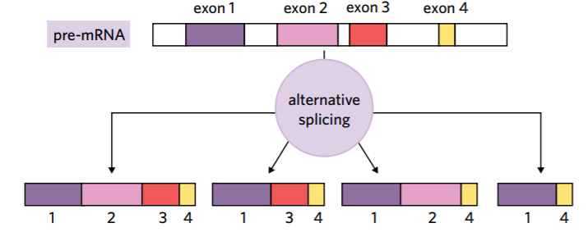
Alternative splicing
Sometimes, exons can also be removed during the splicing process. This means that a single pre-mRNA strand can produce many different mRNA molecules depending on which exons are spliced out or kept

Slide 7
Translation
Codons on mRNA are translated into a sequence of amino acids, resulting in a polypeptide. Occurs at the ribosomes, which act as docking stations for tRNA to deposit a specific amino acid.
Initiation: The 5’ of the mRNA binds to the ribosome and is read until it reaches the start codon (AUG). A tRNA with a complementary anticodon (UAC) binds to the ribosome and delivers the amino acid.
Elongation: The mRNA is fed through the ribosome so the next codon can be matched to the complementary tRNA anticodon. This delivers a specific amino acid and binds to the previous amino acid with a peptide bond.
Termination: The growing polypeptide chain continues until the ribosome reaches the stop codon, this signals the end of translation and the polypeptide chain is released into the cytosol or ER.

Slide 8
Put it all together! Annotate your notes and highlight

Slide 9
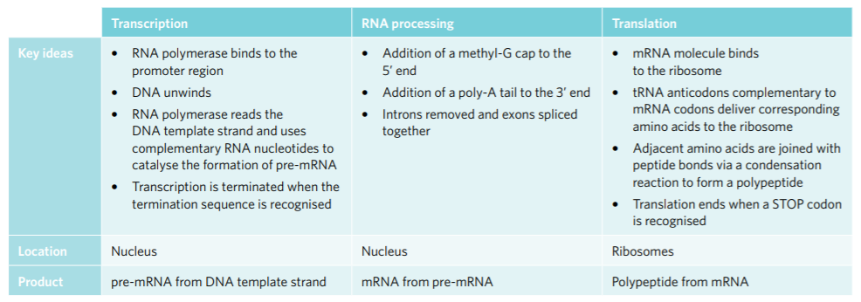
Summary

Slide 10
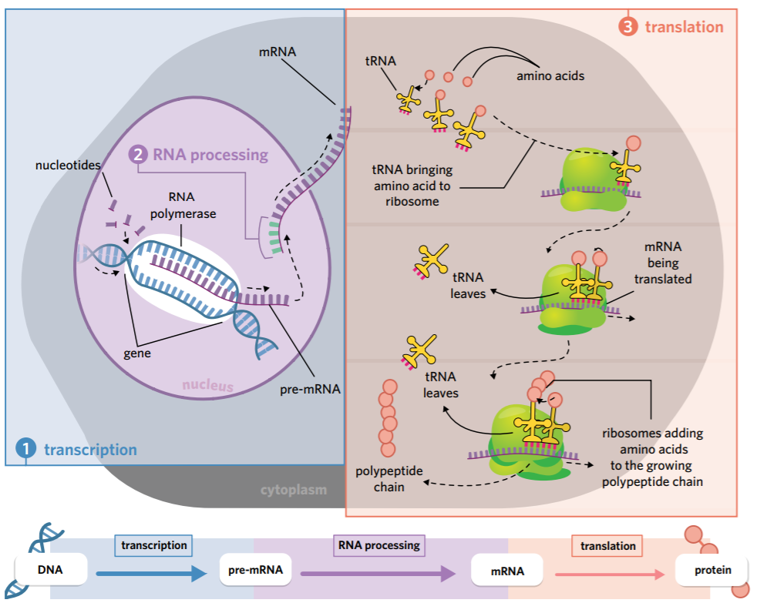
Summary

Slide 11
Activity
Questions 2D 10-17

