Slide 1
LI: To understand how regulatory genes initiate or inhibit transcription
I can:
- explain why gene regulation is important
- draw the trp operon
- describe how the trp operon is switched on and off
Unit 3 AoS1- Gene regulation (trp)
the basic elements of gene regulation: prokaryotic trp operon as a simplified example of a regulatory process

Slide 2
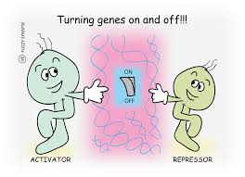
Gene regulation
Either inhibiting or activating gene expression (turning on or off genes).
Saves energy by only synthesising proteins needed at the time.
Very complex in eukaryotes, we are only learning about an example of prokaryotes (E. Coli).
Notes:
Discuss how very cell in our body contains all our DNA, Our DNA contains all our genes SO….What would happen if every, gene in every cell was active?

Slide 3
Structural genes
A segment of DNA that doesn’t code for regulatory genes
Codes for proteins that play a role in the structure or function of a cell or organism
Can you think of any functional proteins?
Hormones, enzymes, transport proteins, haemoglobin, ect.

Slide 4
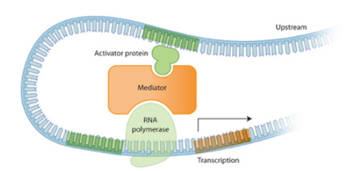
Regulatory genes
A segment of DNA that produces proteins that control the expression of other genes
Example:
Repressor proteins- prevents gene expression by binding to the operator
Activator protein- increases gene expression

Slide 5
Operators
Located downstream of the promoter region, they are used as a binding site for repressor or activator proteins (produced by regulatory genes)
Operator region bound with repressor protein- RNA polymerase cannot move downstream and transcription cannot occur

Slide 6
Operon
In some prokaryotes multiple structural genes are transcribed together.
These are called operons

Slide 7
Trp operator
Series of 5 genes that produce enzymes needed to make the amino acid. Tryptophan that is used to produce proteins
Found in E. Coli
Regulates structural genes as tryptophan should only be made when required (to conserve energy)

Slide 8
How does the Trp Operator get turned “off”?
High levels of tryptophan = transcription of trp structural genes are unable to be transcribed
tryptophan binds to the repressor and changes it shape, making it able to bind to the operator which blocks the RNA polymerase.

Slide 9
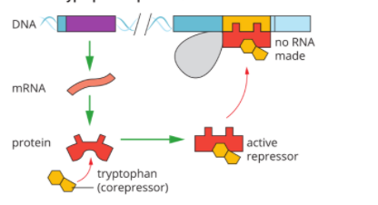
How does the Trp Operator get turned “on”?
Low levels of tryptophan = transcription of trp structural genes is activated because there is no tryptophan present to bind to the repressor and it cannot bind to the operator

Slide 10
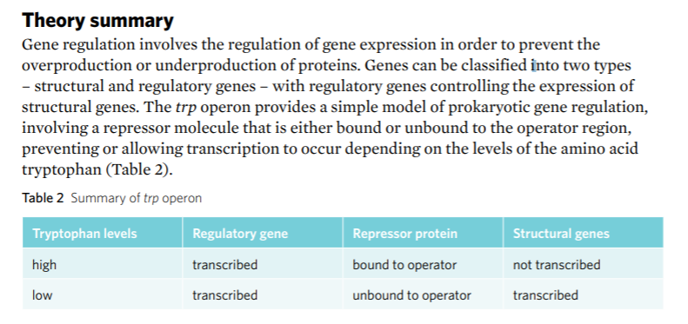
Summary

Slide 11
Activity:
Heinermann Worksheet 5
2E question 9-11 & 14

