Slide 1
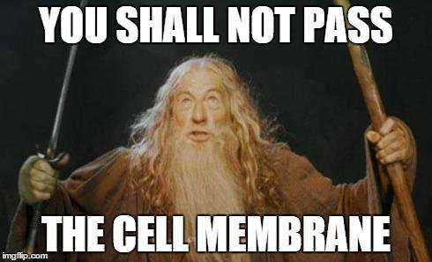
To understand how proteins are exported from cells through the process of exocytosis and the various organelles involved
I can:
- List organelles involved in the protein secretory pathway
-explain the roles of organelles in the secretory pathway
- apply this knowledge to scenarios
the role of rough endoplasmic reticulum, Golgi apparatus and associated vesicles in the export of proteins from a cell via the protein secretory pathway

Slide 2
Protein secretory pathway
The proteins that ribosomes make via protein synthesis often need to be exported from the cell. There are organelles that fold, modify and package the proteins for exportation.

Slide 3
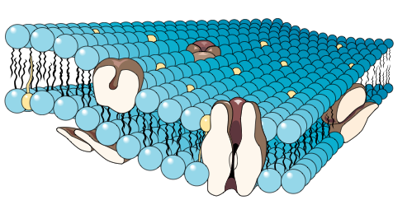
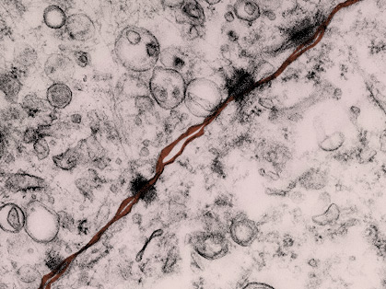
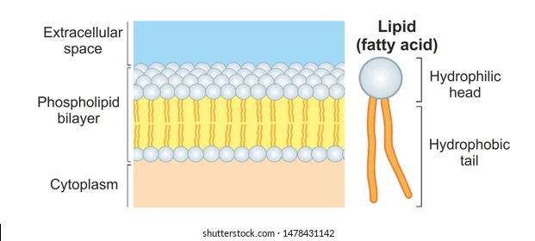
Plasma membrane
Located: Surrounds the cell forming a boundary between the cell contents and the extracellular environment.
Structure: The plasma membrane has two major components:
phospholipids
proteins. Most proteins are embedded in the plasma membrane, while others are attached at the membrane surface (see further below).
Function:
Forms the boundary between the cell and the extracellular environment.
Regulates movement of substances in and out of the cell.

Slide 4
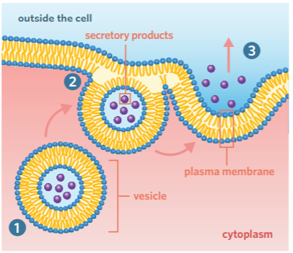
Exocytosis
- A type of bulk transport that moves large substances out of a cell
- Content is in a vesicle
- A type of active transport (required energy)
Steps:
Vesicle containing the secretory products is transported to the plasma membrane
Membrane of vesicle fuses with the plasma membrane
Secretory products are released from the cell

Slide 5
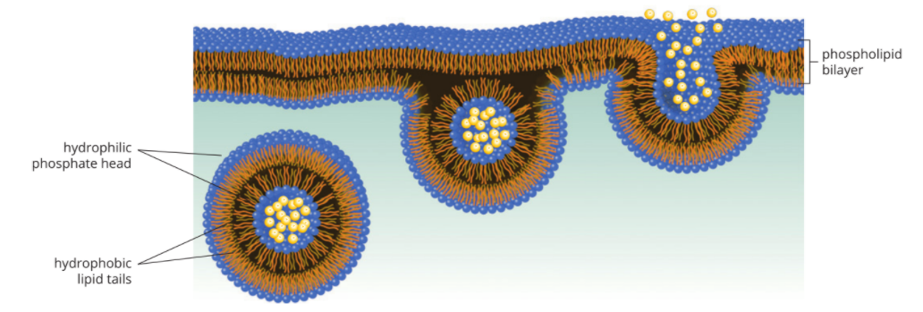

Slide 6
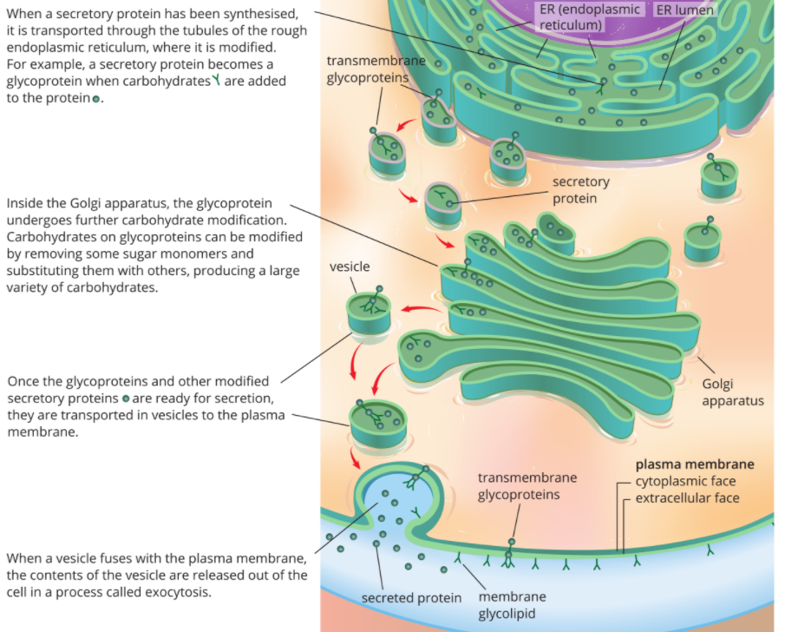

Slide 7
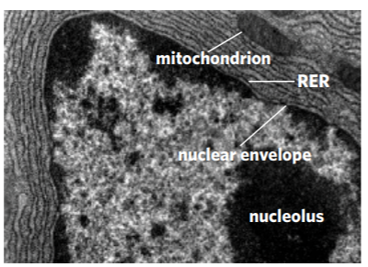
Organelles involved
Ribosome: Synthesises proteins
Rough Endoplasmic Reticulum: Has ribosomes attached. The ER folds and transports proteins.
Transport vesicle: Contains the protein, buds off the Rough ER and travels to the golgi apparatus to fuse and pass on the protein
Golgli apparatus: Modifies and packages the proteins into secretory vesicles for export.
Secretory vesicle: Contains the proteins for export, they bud off the golgi apparatus, travel through cytoplasm and fuse with plasma membrane. They are then released.
Mitochondria: Site of ATP synthesis which provides the energy needed to move vesicles and modify proteins.
Nucleus: Contains DNA which has instructions for mRNA and making the protein.

Slide 8
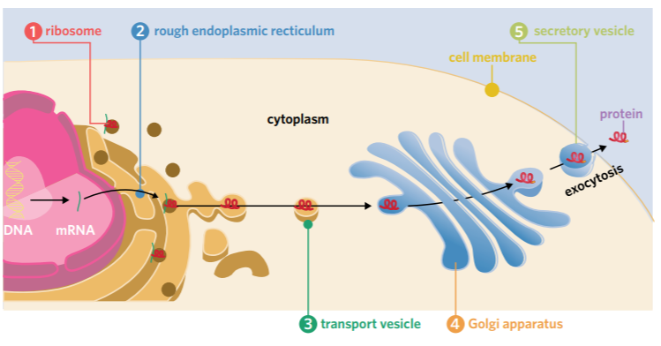

Slide 9
Activity:
2F 1-4, 9-13, 15

