Slide 1
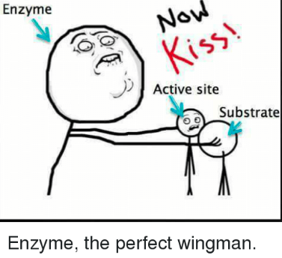
Learning Intention: To understand enzymes and their role in biochemical pathways. Success Criteria: I can define an enzyme, substrate, product, coenzyme I can state features of enzyme
Study design dot point:
proteins as a diverse group of molecules that collectively make an organism’s proteome, including enzymes as catalysts in biochemical pathways
the general role of enzymes and coenzymes in facilitating steps in photosynthesis and cellular respiration (AoS2)

Slide 2
What is an Enzyme
Enzyme is an organic molecule, typically a protein, that catalyses (speeds up) specific reactions.
Enzymes speed up biochemical reactions by lowering the activation energy required to initiate a given reaction.
Because the enzyme is considered neither a reactant nor a product,
it is written above the arrow in an equation.

Slide 3
Activation energy
The energy required to initiate a reaction is called activation energy.
It is defined as the minimum amount of energy required to energise atoms or molecules to a state where they can undergo a chemical transformation.
Enzymes function to lower the activation energy of chemical reactions by bringing reactants closer to the state they need to be in order to react

Slide 4
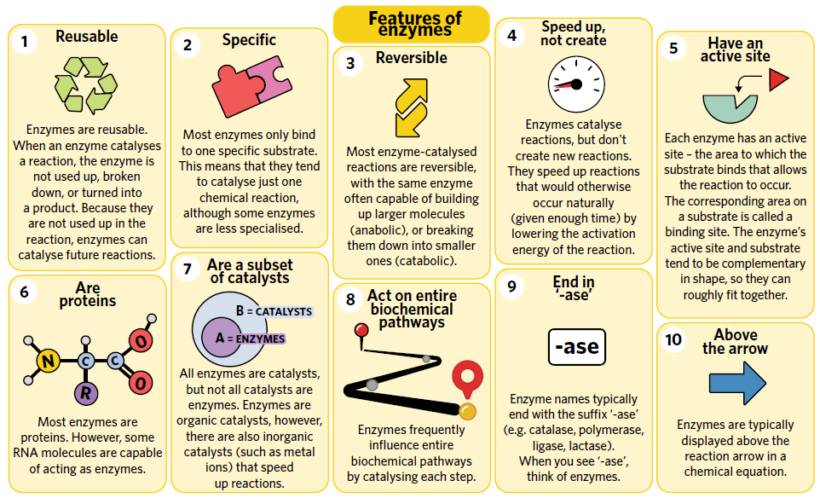

Slide 5
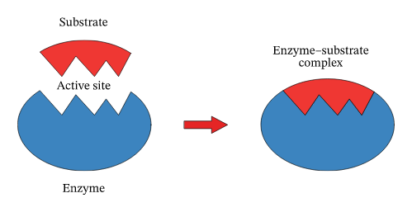
Enzyme-substrate complex
Enzymes bind to a molecule called a substrate.
Substrate is the name given to the reactant undergoing the reaction.
Upon binding, the substrate
undergoes a chemical reaction and forms a product(s), which then leaves the enzyme.

Slide 6
Enzyme- substrate interaction models
Two models to describe the Enzyme-substrate interaction:
The lock and key model
The induced fit model
The induced-fit model is more accurate because active site is flexible and capable of changing its shape in order to conform to the shape of the substrate and have a proper fit.

Slide 7
How enzymes work
Step 1: Substrate binds to an enzyme’s active site, together they form an enzyme-substrate
Complex.
Step 2: Active site and substrate undergo conformational change for stronger connection.
Step 3: Many chemical bonds (e.g. hydrogen bonds, hydrophobic interactions) hold
the substrate and active site together in the enzyme-substrate complex.
Step 4: The reaction then occurs
and the products (blue and red) leave the enzyme so that it can continue to catalyse
future reactions.

Slide 8
How do enzymes speed up the reaction??
Enzymes function to lower the activation energy of chemical reactions by bringing reactants closer to the state they need to be in order to react.
Enzymes are capable of catalysing reactions continuously, and frequently ‘team up’ to work in chains of reactions. In a biochemical pathway, one enzyme will function to catalyse a substrate into a product, which will then become the substrate of a second Enzyme.
Enzymes can sometimes work in both directions of a reaction, and can catalyst each step of entire metabolic pathways.

Slide 9
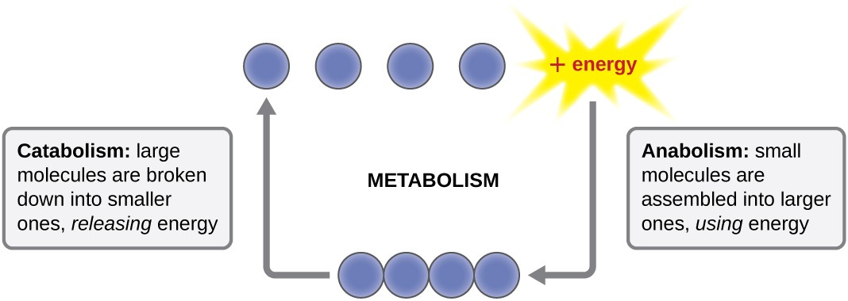
Enzymatic reaction can be:
Catabolic: releases energy when compounds are metabolised. Eg: Glycolysis (broken down)
Anabolic: a series of cellular reactions that require energy to synthesise complex molecules. Eg: Protein synthesis or building new cells/muscles (made more)

Slide 11
Summary
Enzymes increase the rate of reaction by lowering the activation energy.
Most enzymes are globular proteins, but some are made of RNA and are called Ribozymes.
Catabolic- breaking substrate down
Anabolic- building a product (joining)

Slide 12
ACTIVITY
3A Q1-10

