Slide 1
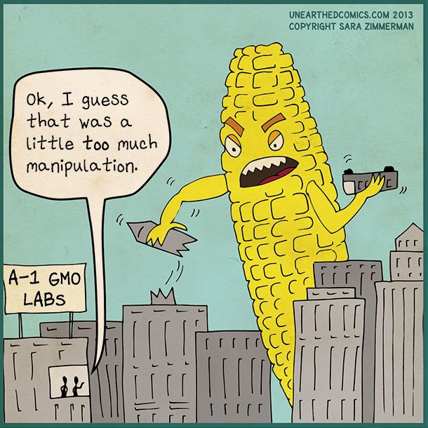
LI: To understand how genetic material can be manipulated by enzymes.
Unit 3 AoS1- Enzymes that manipulate DNA
SC: I can:
-list the three types of enzymes involved in manipulating DNA
- describe the role of each enzyme in DNA manipulation
the use of enzymes to manipulate DNA, including polymerase to synthesise DNA, ligase to join DNA and endonucleases to cut DNA

Slide 2
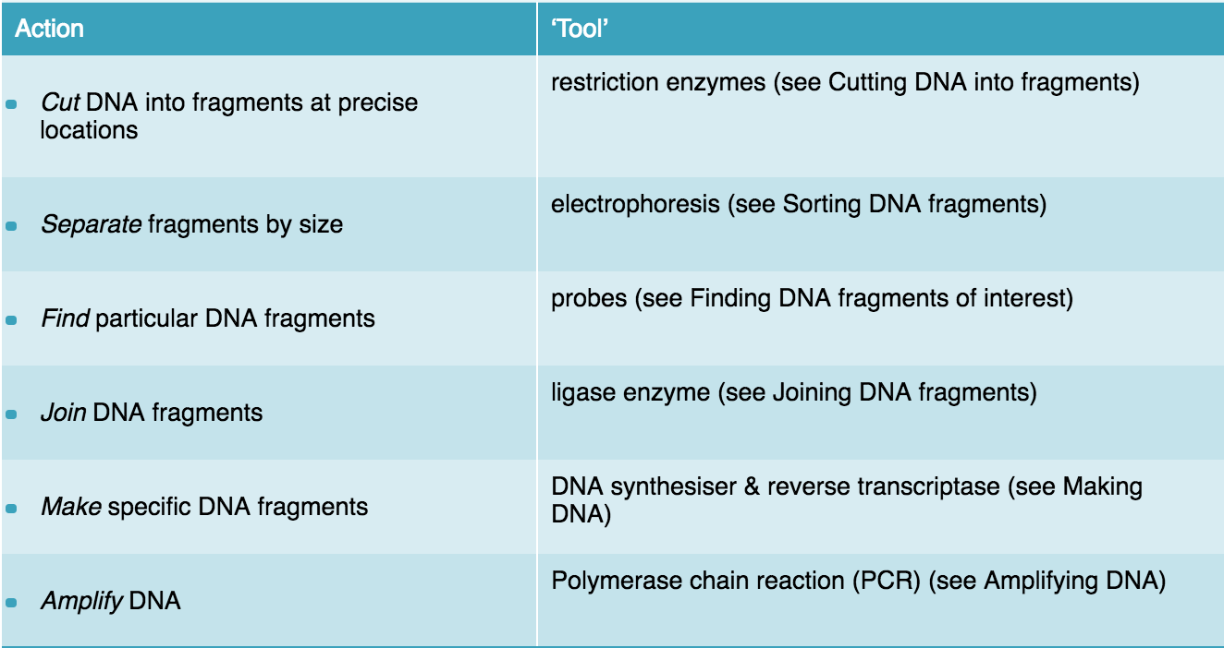

Slide 3
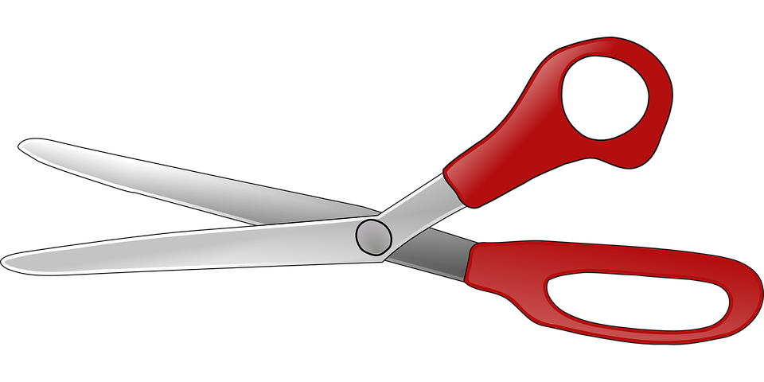
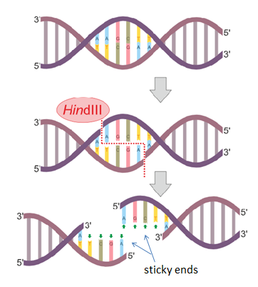
Cut- Endonuclease
Cut double stranded DNA into smaller fragments at very precise sequences of 4 to 8 base pairs called recognition sites.
By using a ‘tool kit’ of over 400 restriction enzymes recognising about 100 recognition sites, genetic engineers are able to isolate and sequence DNA

Slide 4
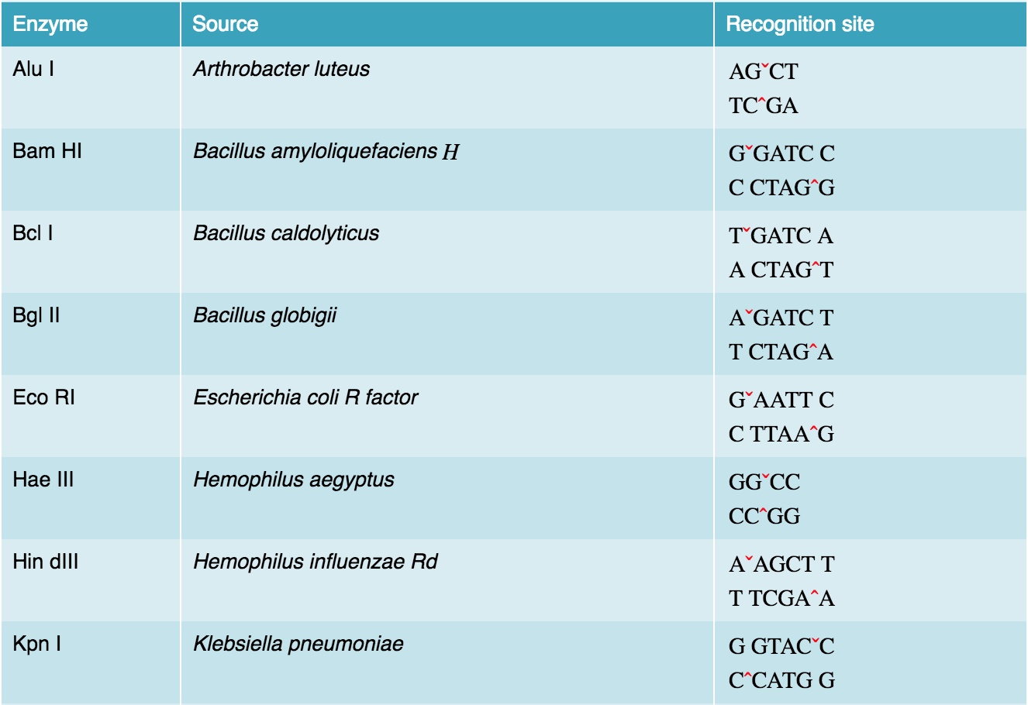

Slide 5
BLUNT ENDS
Restriction enzymes that cut leaving no overhang; a so-called “blunt end”.
DNA cut in such a way is able to be joined to any other blunt end fragment, but tends to be non-specific because there are no sticky ends as recognition sites.
Recognition Site
Recognition Site
C C C
G G G
C C C
G G G
C C C
G G G
C C C
G G G
DNA
cut
cut
C C C
G G G
C C C
C C C
G G G
C C C
G G G
Restriction enzyme cuts here
C C C
G G G
The cut by this type of restriction enzyme leaves no overhang
G G G
C C C
G G G
C C C
DNA from another source
C C C
G G G
A special group of enzymes can join the pieces together
Notes:
Some restriction enzymes cut the two strands of a DNA molecule at points directly opposite each other to produce cut ends that are ‘blunt’. Other cutting enzymes cut one strand at one point, but cut the second strand at a point that is not directly opposite. The overhanging cut ends made by these cutting enzymes are called ‘sticky’. These sticky ends are complementary.

Slide 6
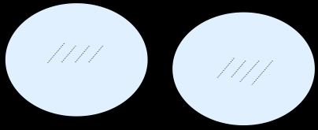
STICKY ENDS
Leaving an overhang; a so-called “sticky end”.
Can only be joined to other sticky ends with a complementary base sequence.
A restriction enzyme cuts the double-stranded DNA molecule at its specific recognition site
Restriction enzyme: EcoRI
Fragment
A A T T C
A A T T C
G
G
C T T A A
C T T A A
G
G
Restriction enzyme: EcoRI
Sticky end
The cuts produce a DNA fragment with two “sticky” ends
A A T T C
G
A A T T C
G
G
The two different fragments cut by the same restriction enzyme have identical sticky ends and are able to join together
G
C T T A A
DNA from another source
When two fragments of DNA cut by the same restriction enzyme come together, they can join by base-pairing

Slide 7
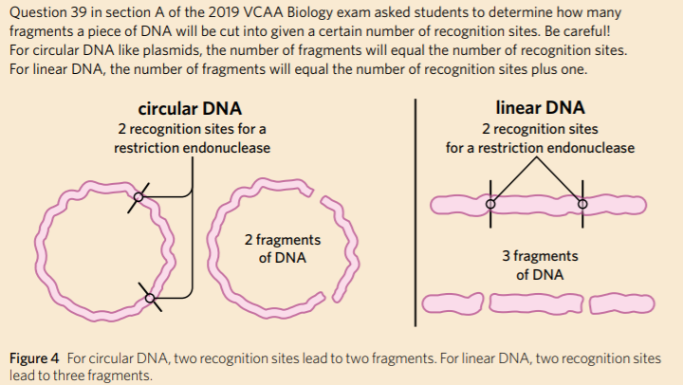

Slide 8
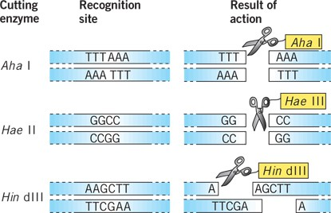
Notes:
Many hundreds of restriction enzymes have now been isolated from microorganisms and purified. Genetic engineers simply buy a container of the required enzyme from a commercial supplier.
For cutting, a sample of DNA is dissolved and a restriction enzyme is added. Provided a recognition site is present, the DNA molecules are cut into two or more fragments. The lengths of the fragments depend on the relative positions of the recognition sites.

Slide 9
WHAT WILL BE BLUNT AND WHAT WILL BE STICKY?

Slide 10
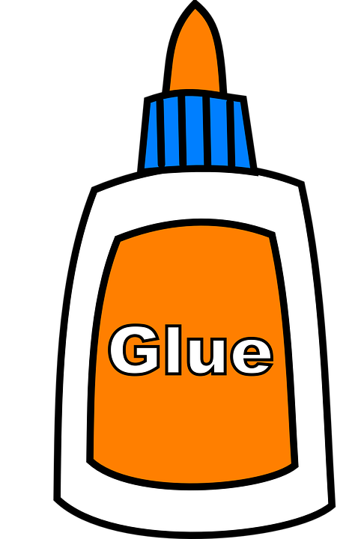
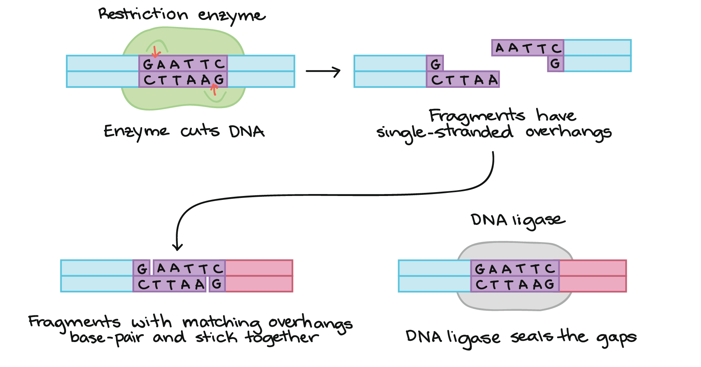
LIGASES
An enzyme that catalyzes the joining of pieces of double stranded DNA at their sugar-phosphate backbones. Creating phosphodiester bonds
the process of joining two or more segments of DNA together is called ligation
DNA of different origins produced in this way is called recombinant DNA because it is dna that has been recombined from different sources.
2.
3.
4

Slide 11
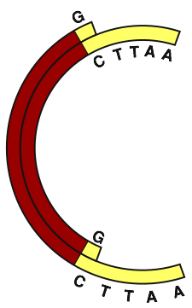
LIGATION
Two pieces of DNA are cut using the same restriction enzyme.
This other end of the foreign DNA is attracted to the remaining sticky end of the plasmid.
Plasmid DNA fragment
A A T T C
G
G
Foreign DNA fragment
C T T A A
The two different DNA fragments are attracted to each other by weak hydrogen bonds.
Notes:
In both 1 and 2, the DNA fragments have sticky ends created with the same cutting enzyme. (Why?) Ligase enzyme forms strong covalent bonds so that the fragments are joined permanently. Why is the result a circular DNA molecule in the next slide.

Slide 12
ANNEALING
When the two matching “sticky ends” come together, they join by complementary base pairing. this process is called annealing
this can allow DNA fragments from a different source, perhaps a plasmid, to be joined to the DNA fragment.
the joined fragments will usually form either a linear molecule or a circular one, as shown here for a plasmid.

Slide 13
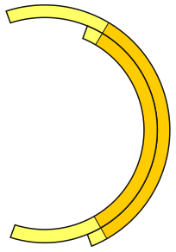
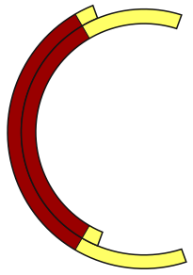
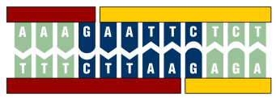
ANNEALING
A
A
T
T
C
Detail of Restriction Site
G
G
C
T
T
A
A
Foreign DNA fragment
Plasmid DNA fragment
A
A
T
T
C
Restriction sites on the fragments are attracted by base pairing only
Gap in DNA molecule’s ‘backbone’
G
G
C
T
A
T
A

Slide 14
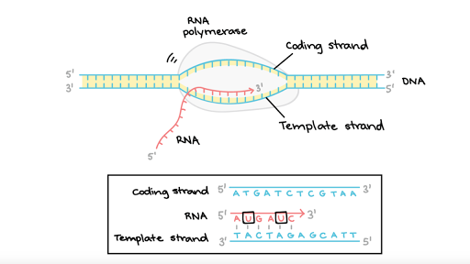
POLYMERASES
Polymerases are enzymes that synthesize DNA or RNA molecules from deoxyribonucleotides or ribonucleotides, the building blocks of DNA and RNA
These enzymes are essential for DNA and RNA replication and usually work in pairs to create two identical DNA or RNA strands from a single original DNA or RNA molecule
DNA synthesis: making copies of DNA from DNA
RNA synthesis: making RNA from a DNA template strand
Reverse transcriptase: making complementary DNA from a mRNA strand

Slide 15
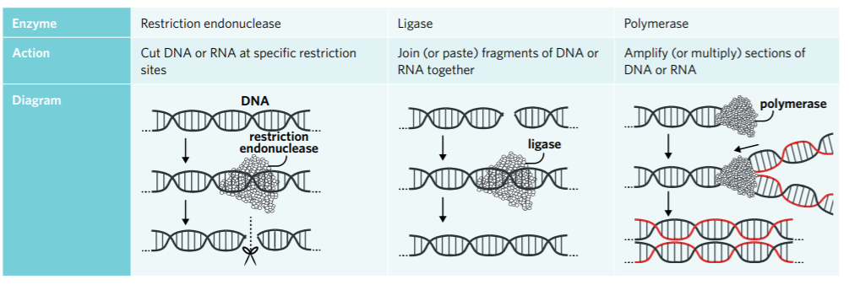
Summary

Slide 16
ACTIVITY
4A Q 1-14

