Slide 1
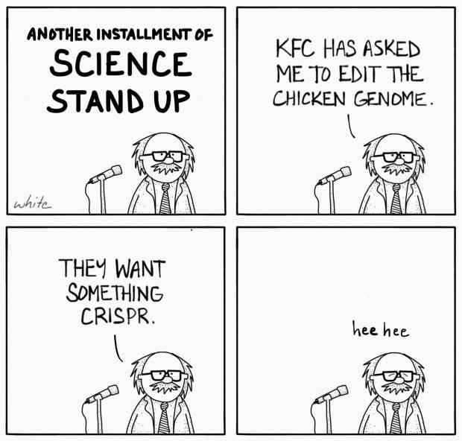
LI: To understand how CRISPR-Cas9 can cut target DNA.
SC: I can: define CRISPR-Cas9
Explain the importance for bacterial defence
Describe how this can be used for genetic engineering
the function of CRISPR-Cas9 in bacteria and the application of this function in editing an organism’s genome

Slide 2
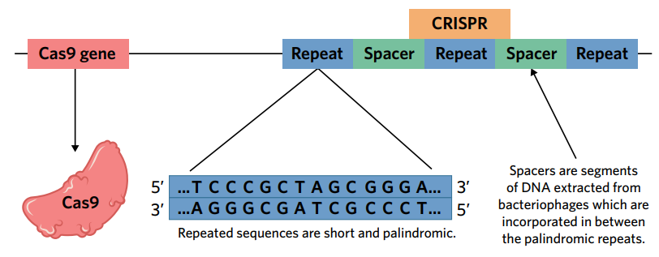
What is CRISPR?
Clustered Regularly Interspaced Short Palindromic Repeats (CRISPR)
Used to protect bacteria from bacteriophages (virus) to cut up the viral DNA. It then stores some of the viral DNA within the bacterium's own genome. When the same virus attacks again, the bacterium transcribes RNA sequences that are complementary to the virus’s DNA and inserts it into endonuclease enzymes (Cas9) to cut the viral DNA.
Scientists can use it to modify genes.

Slide 3
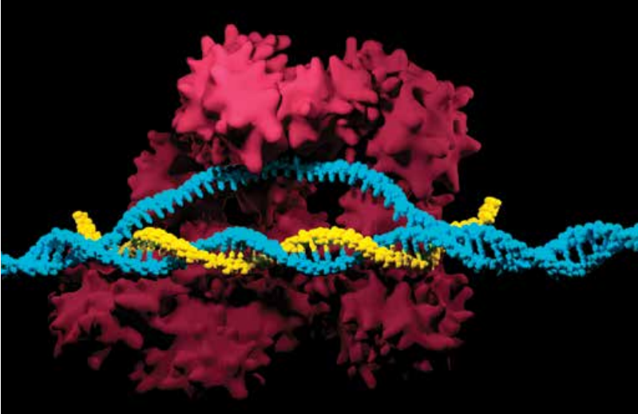
How can it be used to edit genomes?
By combining the Cas9 enzyme with artificially made guide RNA (gRNA) that consists of a short length of genetic code that is complementary to the target DNA.
Eukaryotic cells automatically repair the damage by repairing base pair deletions or insertions that are known mutations or by inserting new DNA sequences.

Slide 5
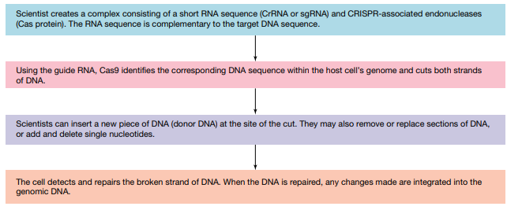
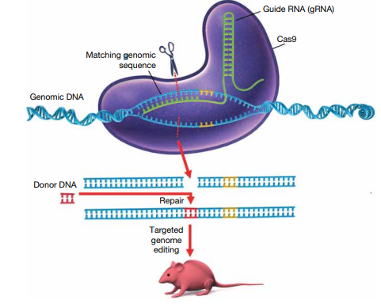

Slide 6
What can it be used for?
to ‘knock out’ genes, one at a time, in order to identify their function
• to introduce specific mutations in a DNA sequence.
• to edit a faulty allele of a gene in a person with a severe inherited disease
• to snip out the faulty segment of a gene and replace it with a working copy
• to activate or to repress a gene • to add a new gene to the genome.
• to advance animal welfare (e.g. hornless dairy cows)
• to modify crops to increase nutritional value.

Slide 7
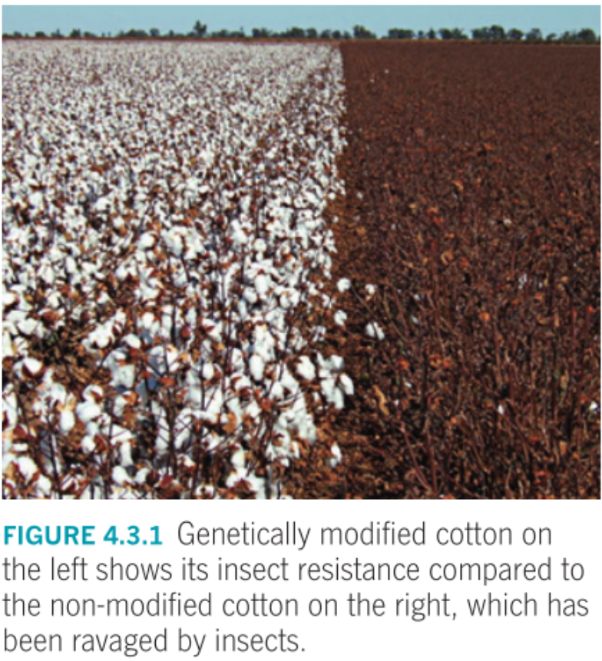
Benefits?
Cheap
Easy to use
Gene editing
Can be applied to eukaryotic cells- including humans
Can add, delete, disable or modify DNA

Slide 8
What are the concerns?
Low success rate.
Not every position in the gRNA needs to match the target DNA, leading to unintended sites being cut.
Bioethical concerns, any edits made in embryos may carry the gene from generation to generation.
Most gRNA sequences are only 20 nucleotides long, so it is likely that it occurs somewhere else in the genome that is unrelated to the target site. Many other important genes can be cut.

Slide 9
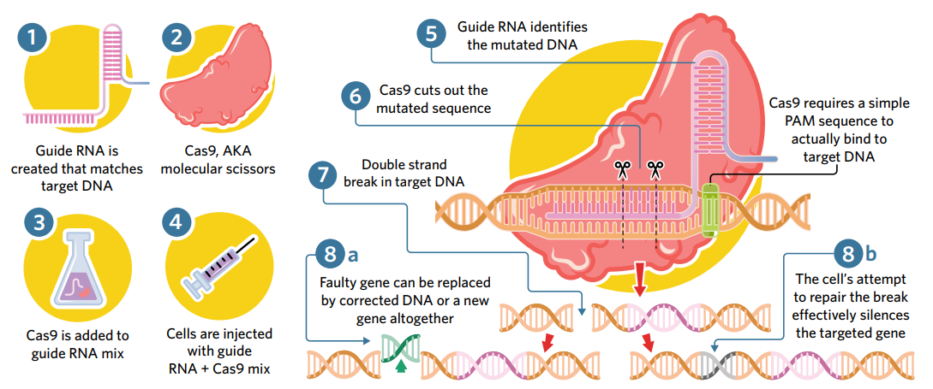
Summary

Slide 11
ACTIVITY
4B 1-5, 11-12

