Slide 1
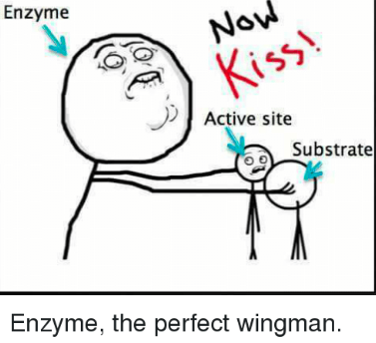
Learning Intention: To understand enzymes and their role in biochemical pathways. Success Criteria: I can define an enzyme, substrate, product, coenzyme I can state features of enzyme
Study design dot point:
proteins as a diverse group of molecules that collectively make an organism’s proteome, including enzymes as catalysts in biochemical pathways
the general role of enzymes and coenzymes in facilitating steps in photosynthesis and cellular respiration (AoS2)

Slide 2
What is an Enzyme
Enzyme is an organic molecule, typically a protein, that catalyses (speeds up) specific reactions.
Enzymes speed up biochemical reactions by lowering the activation energy required to initiate a given reaction.
Because the enzyme is considered neither a reactant nor a product,
it is written above the arrow in an equation.

Slide 3
Activation energy
The energy required to initiate a reaction is called activation energy.
It is defined as the minimum amount of energy required to energise atoms or molecules to a state where they can undergo a chemical transformation.
Enzymes function to lower the activation energy of chemical reactions by bringing reactants closer to the state they need to be in order to react

Slide 4
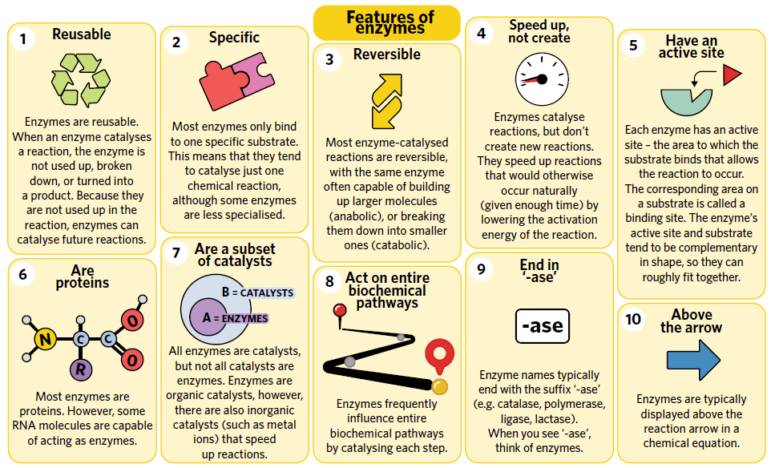

Slide 5
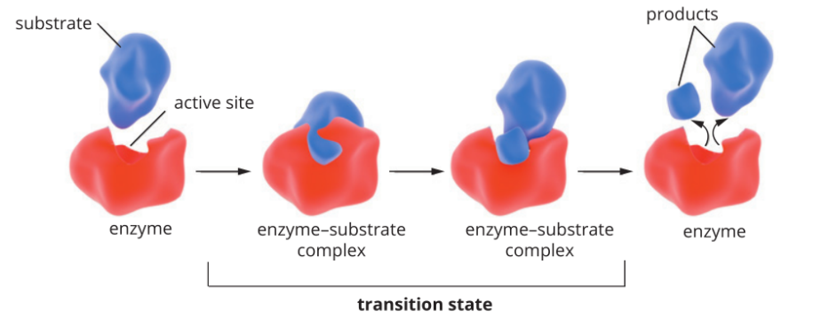
Enzyme-substrate complex
Enzymes bind to a molecule called a substrate.
Substrate is the name given to the reactant undergoing the reaction.
Upon binding, the substrate
undergoes a chemical reaction and forms a product(s), which then leaves the enzyme.

Slide 6
How enzymes work
Step 1: Substrate binds to an enzyme’s active site, together they form an enzyme-substrate
Complex.
Step 2: Active site and substrate undergo conformational change for stronger connection.
Step 3: Many chemical bonds (e.g. hydrogen bonds, hydrophobic interactions) hold
the substrate and active site together in the enzyme-substrate complex.
Step 4: The reaction then occurs
and the products (blue and red) leave the enzyme so that it can continue to catalyse
future reactions.

Slide 7
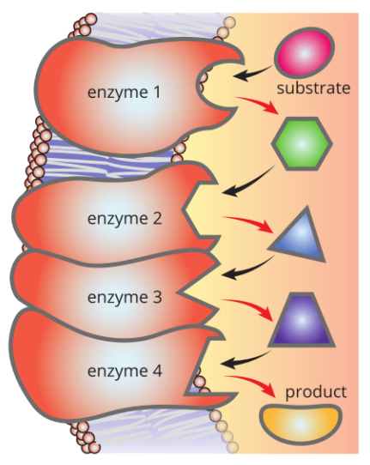
How do enzymes speed up the reaction??
Enzymes function to lower the activation energy of chemical reactions by bringing reactants closer to the state they need to be in order to react.
Enzymes are capable of catalysing reactions continuously, and frequently ‘team up’ to work in chains of reactions. In a biochemical pathway, one enzyme will function to catalyse a substrate into a product, which will then become the substrate of a second Enzyme.
Enzymes can sometimes work in both directions of a reaction, and can catalyst each step of entire metabolic pathways.

Slide 9
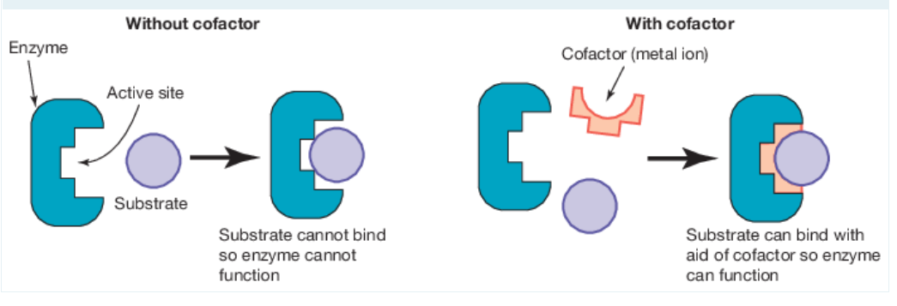
Cofactors
Some enzymes need additional non-protein component- cofactor- to enable them to catalyse a reaction, they contribute to the stability and activity of enzyme. Enzymes remain unchanged but coenzyme is changed after it gives the energy or molecule for the reaction.
If inorganic ions (eg: Mg2+) they are called cofactors.
If organic molecules they are called coenzymes.

Slide 10
Coenzyme
After the reaction, the coenzyme leaves the enzyme and is recycled by accepting more energy (known as cycling of co-enzymes)

Slide 11
Role of Enzymes and Coenzymes in Photosynthesis and Cellular respiration
Included among the many enzymes involved in photosynthesis are:
the water-oxidising enzyme
the ATP synthase enzyme
the Rubisco enzyme at the heart of photosynthesis
Examples of key enzymes involved in cellular respiration:
phosphofructokinase enzyme (PFK)
dehydrogenase enzymes.

Slide 12
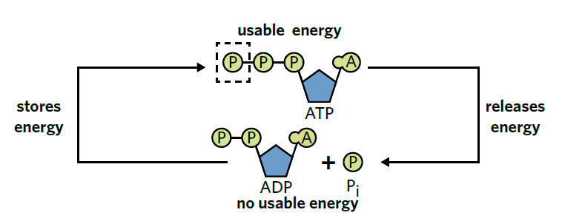
ADP and ADP
Very important coenzyme is adenosine triphosphate (ATP) and its partner molecule adenosine diphosphate (ADP)
ATP is the main energy transfer unit of the cell, as cells frequently rely on this coenzyme to donate energy to catalyse reactions

Slide 13
Hydrogen and electron carriers
Coenzymes may also transfer protons, electrons and/or chemical groups.
Loaded coenzyme- has a proton or electron to donate
Unloaded coenzyme- is free to accept a proton, electron or chemical group.
NAD+/NADH and FAD+/FADH2 are involved in the transfer of protons and electrons from hydrogen.

Slide 14
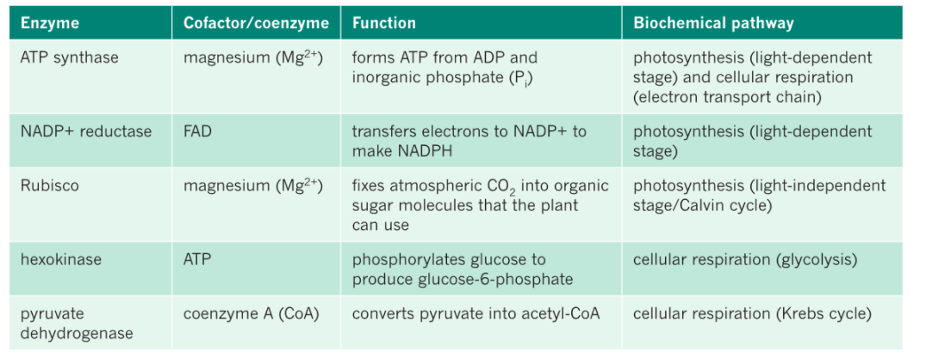

Slide 16
Summary
Enzymes increase the rate of reaction by lowering the activation energy.
Most enzymes are globular proteins, but some are made of RNA and are called Ribozymes.
A biochemical pathway is a sequence of biochemical reactions catalysed by different enzymes. The product of each reaction becomes the substrate in the next reaction.
Enzymes facilitate each reaction in biochemical pathways of cellular respiration and photosynthesis.
Co- factors are additional components required by some enzymes to function.

Slide 17
Activity
3A Q1-10

Slide 18
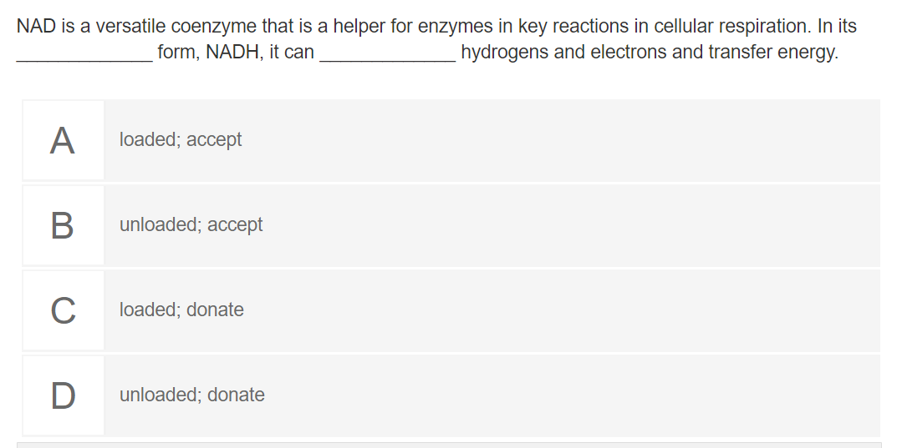
Reflection

Slide 19
Answer
loaded; donate

