Slide 1
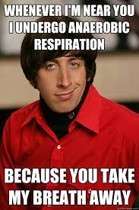
To understand about anaerobic fermentation in animals and yeast.
I can:
List the inputs and outputs of anaerobic respiration in animals and yeast
Explain the difference between aerobic and anaerobic respiration
Discuss why aerobic and anaerobic respiration has different outputs
Unit 3- AoS2 Anaerobic Respiration
- the location, inputs and the difference in outputs of anaerobic fermentation in animals and yeasts

Slide 2
KEY KNOWLEDGE FOR TODAY
Definition and location of anaerobic respiration
Alcoholic fermentation
Lactic acid fermentation

Slide 4
ANAEROBIC RESPIRATION
Occurs in the cytosol of the cell
No mitochondria required
No oxygen required
Still need glucose!
Evolved before aerobic respiration – is how all prokaryotes respire

Slide 5
ANAEROBIC PATHWAYS
All respiration in involves glycolysis as the first step
In anaerobic respiration, a different biochemical pathway occurs after glycolysis, using molecules other than oxygen as the final electron acceptor
Prokaryotes have evolved many anaerobic pathways
Eukaryotes commonly use two pathways
Alcoholic fermentation
Lactic acid fermentation

Slide 6
WHAT HAPPENS WHEN THERE IS NO OXYGEN
Remember glycolysis produces
Two pyruvate molecules
Two ATP
Two NAHD
In anaerobic respiration, the energy from the loaded NADH molecules is used in a different way, as these molecules do not enter the Krebs Cycle

Slide 7
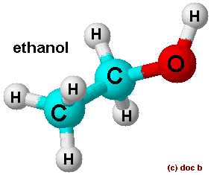
ALCOHOLIC FERMENTATION
The energy from NADH is used to recombine the pyruvate molecules with water to form two alcohol molecules (ethanol) and two carbon dioxide molecules
Occurs in yeast
Winemaking and breadmaking

Slide 8
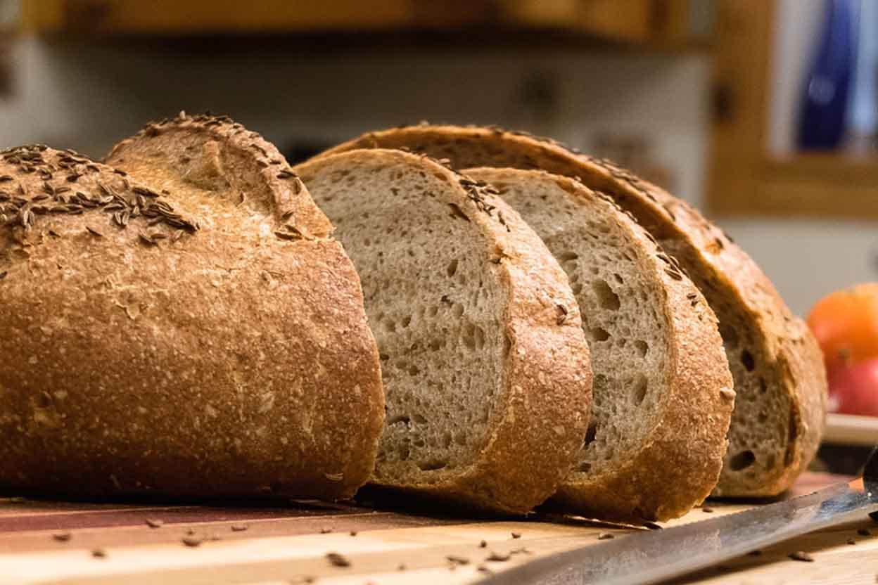
ALCOHOLIC FERMENTATION
C₆H₁₂O₆ 🡪 2CH₃CH₃OH + 2CO₂ + 2ATP + energy
Glucose 🡪 Ethanol + Carbon dioxide + ATP + energy

Slide 9
LACTIC ACID FERMENTATION
Also known as animal fermentation
Instead of the pyruvate molecules being turned into ethanol and carbon dioxide they are recombined to form lactic acid
Our muscle cells do this if no oxygen is available
Problematic because it lowers the pH in the cell, so can’t be kept up for long

Slide 10
LACTIC ACID FERMENTATION
C₆H₁₂O₆ 🡪 2CH₃CH(OH)COOH + 2ATP + energy
Glucose 🡪 Lactic acid + ATP + energy

Slide 11
EFFICIENCY OF ANAEROBIC RESPIRATION
Anaerobic respiration produces 2 ATP per molecule of glucose
Aerobic respiration produces 36 ATP per molecules of glucose
So aerobic respiration is more efficient
But anaerobic yields ATP faster than aerobic respiration
So if a cell needs energy really quickly, anaerobic respiration is best
So… be efficient and slow or wasteful and fast!

Slide 12
SUMMARY
Anaerobic respiration does not involve oxygen or the mitochondria
Anaerobic respiration yields 2 molecules of ATP
Alcohol fermentation produces carbon dioxide and ethanol
Lactic acid fermentation produces lactic acid

Slide 13
ACTIVITY
6B 1-4, 12-14, 20

Slide 14
Reflection
Venn diagram on similarities and differences of aerobic and anaerobic respiration

