Slide 1
Unit 3- AoS2 Factors that affect ROR of cellular respiration
To understand how factors can influence the rate of respiration.
I can:
List the factors that can influence respiration
Explain why temperature, pH, enzyme inhibitors and amount of glucose and oxygen affect the RoR.
- the factors that affect the rate of cellular respiration: temperature, glucose availability and oxygen concentration
- the general factors that impact on enzyme function in relation to photosynthesis and cellular respiration: changes in temperature, pH, concentration, competitive and non-competitive enzyme inhibitors

Slide 2
KEY KNOWLEDGE FOR TODAY
Effects of temperature on rates of cellular respiration
Effects of glucose availability on rates of cellular respiration
Effects of oxygen concentration on rates of cellular respiration

Slide 3
THREE STAGES OF AEROBIC RESPIRATION
Glycolysis – occurs in the cytosol
Krebs Cycle – occurs in the mitochondria
Electron transport chain – occurs in the mitochondria

Slide 4
INPUTS AND OUTPUTS OF AEROBIC CELLULAR RESPIRATION
INPUTS
Glucose
Oxygen
OUTPUTS
Water
Carbon dioxide
C₆H₁₂O₆ + 6O₂ 🡪 6CO₂ + 6H₂O

Slide 5
EFFECTS OF TEMPERATURE
At low temperatures, rate of respiration is low because molecules have less energy so aren’t moving around much
Some animals go into hibernation to reduce energy requirements for this reason
As temperature increases, molecules move around more, enzymes and substrate come into contact more often, so rate of respiration increases
But beyond a certain temperature, enzymes become denatured, and rate of respiration decreases

Slide 6
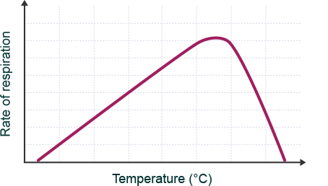
EFFECTS OF TEMPERATURE

Slide 7
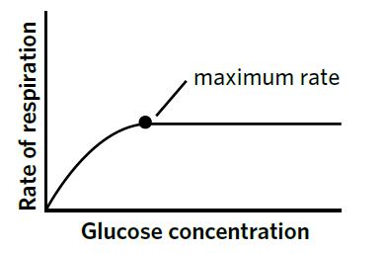
EFFECTS OF GLUCOSE AVAILABILITY
Generally, as glucose concentration increases, rate of cellular respiration increases
Cells need to constantly replenish their stores of glucose so glucose is available for respiration
Released from glycogen stores in animals
Plants store excess glucose as starch

Slide 8
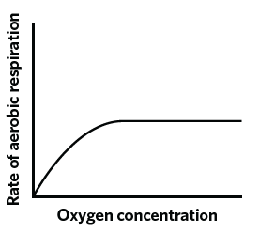
EFFECTS OF OXYGEN AVAILABILITY
Oxygen is an input to cellular respiration for the ETC
Some cells can switch to anaerobic respiration when oxygen levels are low

Slide 9
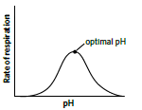
EFFECTS OF pH
Different enzymes function optimally at different pHs. For example, the cytoplasm
typically has a pH of around 7.2, so the enzymes involved in glycolysis (which occurs in the cytoplasm) function optimally under this condition. The intermembrane space of the mitochondria usually has a pH of around 7.0-7.4, while the matrix has a pH of 7.8. For this reason, the enzymes that support reactions at these locations may have slightly different optimal pH levels. Above or below the optimal pH, enzymes begin to denature and the rate of respiration slows

Slide 10
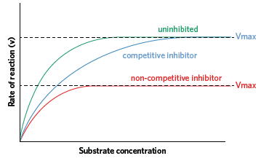
Inhibitors

Slide 11
SUMMARY
Increasing temperature increases the rate of cellular respiration up to a point where enzymes are denatured
Glucose is essential to both anaerobic and aerobic respiration, and is broken down from glycogen and fat stores
Oxygen is essential to aerobic respiration, and some cells may switch to anaerobic respiration if oxygen is unavailable

Slide 12
Activity
6C 1-5, 12-14

