Slide 1
Factors affecting enzymes
Unit 3: AoS2- factors affecting enzymes
Learning Intention:
To understand how different factors impact the function of enzymes required for photosynthesis and cellular respiration
Success Criteria:
I can:
List factors that affect enzymes
Explain why factors affect enzyme activity
the general factors that impact on enzyme function in relation to photosynthesis and cellular respiration: changes in temperature, pH, concentration, competitive and non-competitive enzyme inhibitors

Slide 2
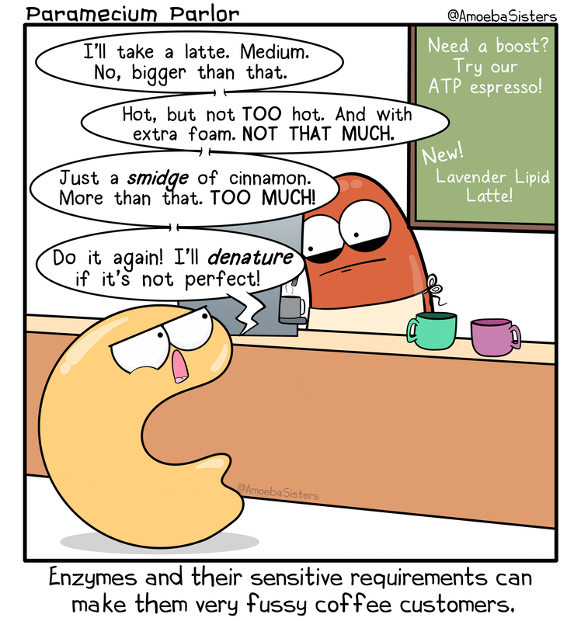
Factors impacting enzymes
Various factors that have an impact on enzyme activity include:
• temperature
• enzyme concentration
• pH
• substrate concentration.

Slide 3
Temperature
When the temperature increases, molecules
have greater kinetic energy resulting in
more collisions.
As temp increases, Enzymes and substrates move faster and collide with each other more frequently to form enzyme-substrate complex, allowing reactions to occur faster.
Each enzyme has its own specific optimal temperature (Temperature at which its activity of enzyme is greatest), meaning that the enzyme and substrate collide and bind most frequently.

Slide 4
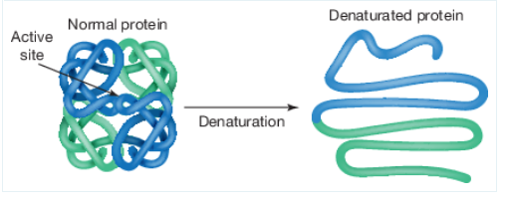
When it is too hot!
If the temperature goes beyond its optimal, an enzyme is at risk of denaturing.
Bonds that create its tertiary and quaternary structures are broken down.
Denaturation causes a change in the active site shape, causing the substrate to no longer fit.
This change is irreversible.

Slide 5
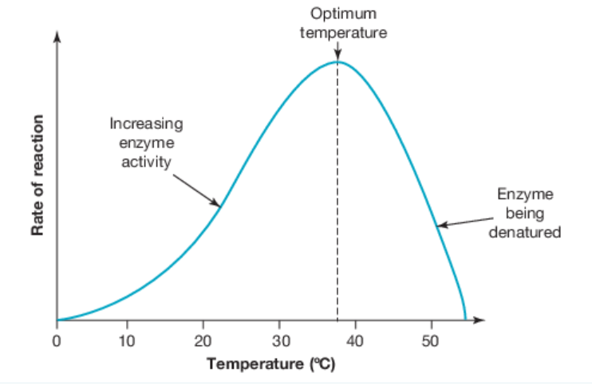
When it is too cold!
An enzyme’s activity decreases below the optimal temperature, as the enzyme and substrate molecules move slower and collide less frequently. When it becomes too cold, enzymes can freeze. Enzymes can regain functionality when reheated, no denaturation occurs.

Slide 6
Optimum range
Tolerance range
Beyond the optimal temperature, the narrow range at which enzyme function is best, is called the tolerance range.
The term tolerance range is used to describe the wider range of a given condition (like temperature) that an enzyme can function under.
For example, an enzyme might have an optimal temperature of 58–60 °C but could have a tolerance range of 30–70 °C. In this case, the enzyme will function variably within this range but might freeze if the temperature drops below 30 °C, or denature if the temperature goes above 70 °C.
The point at which for a given condition (e.g. temperature), the maximum function of an enzyme occurs.
Optimum temperature

Slide 7
Effect of enzyme concentration on enzyme activity
The concentrations of both substrate and enzyme molecules influence the overall reaction rate.
Substrate concentration:
If the enzyme concentration remains constant while the substrate concentration increases, then the reaction rate will increase. This is because there are more reactants available to undergo the reaction.

Slide 8
Saturation point
It is a point where there are so many substrate molecules that continuously occupy all active sites on the enzyme, meaning that the enzymes are saturated with substrate. After the saturation point is reached, the rate of reaction remains constant.
At the saturation point and beyond, the reaction is still occurring very quickly – the rate of
reaction, however, is no longer increasing.
At this point, even if the amount of substrate increases, the reaction rate can no longer increase.

Slide 9
Enzyme concentration:
If the enzyme concentration is high, then the reaction rate will be high. This is due to the large number of active sites available for the substrate to bind to

Slide 10
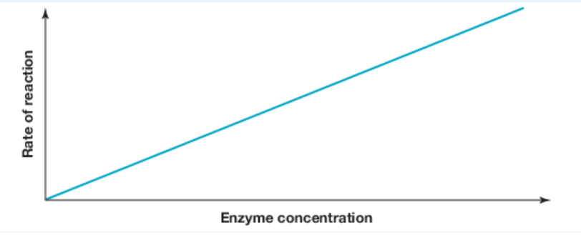
The relationship between enzyme concentration and reaction rate:
• If the enzyme concentration rises (while the substrate concentration is kept constant), then the reaction rate will increase.
• This is true until enzymes are in excess, at which point the reaction rate will plateau regardless of any continued increase in enzyme concentration.
Theoretically, with an ever-increasing enzyme concentration, a point will be reached where all the substrates are used up and the rate of reaction decreases rather than continuing to plateau.
But practically, in biological systems, there is typically far more substrate than enzyme, so an increase in the enzyme concentration usually always increases the reaction rate.

Slide 11
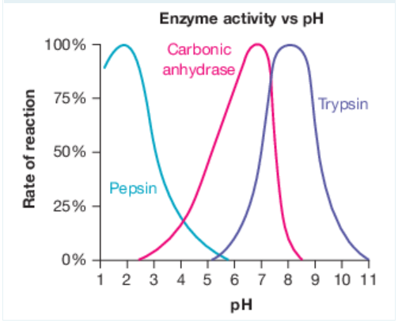
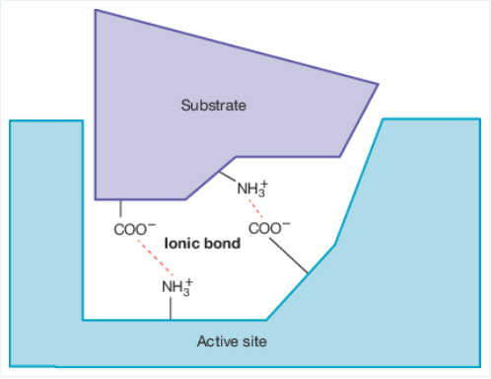
Effect of pH on enzyme activity
When the pH becomes too acidic or basic for an enzyme, it can denature because it disrupts the ionic bonds holding the substrate in place.
The pH ranges of different enzymes vary greatly depending on where the enzymes are located (e.g. pepsin is the main digestive enzyme in the human stomach and has an optimal pH around 1.5–2, whilst pancreatic lipase has an optimal pH of 8).

Slide 12
Activity
3.6 Modelling activity
3B Q 1-5, 10-12, 14-15

Slide 13
Reflection
Prove that you have met today’s success criteria!

