Slide 1
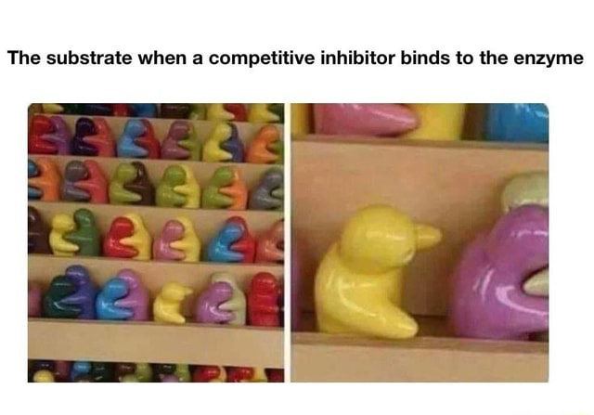
Enzyme Inhibition
Unit 3: AoS2- enzyme inhibition
LI: To understand how enzymes can be inhibitors.
SC:
I can:
List types of enzyme inhibition
Explain why enzymes are inhibited
the general factors that impact on enzyme function in relation to photosynthesis and cellular respiration: changes in temperature, pH, concentration, competitive and non-competitive enzyme inhibitors

Slide 2
Enzyme inhibitors
A molecule that binds to an enzyme, reducing its activity by interfering with it in some way.
Two ways:
Reversible
Irreversible
And
Competitive
non-competitive

Slide 3
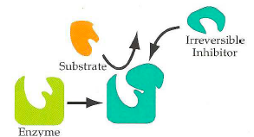
Irreversible Inhibition
A compound binds to one or more amino acids, forms a strong covalent bond and alters the structure of the enzyme, affecting its active site.
This permanently inhibits the enzyme as the change in the active site can not be reversed.
These compounds are also known as poisons.
E.g.
Cyanide – alters the key enzyme involved in the electron transport chain, stopping the production of ATP..
Penicillin – inhibits the enzyme involved in the formation of bacterial cell walls and prevents them from reproducing.

Slide 4
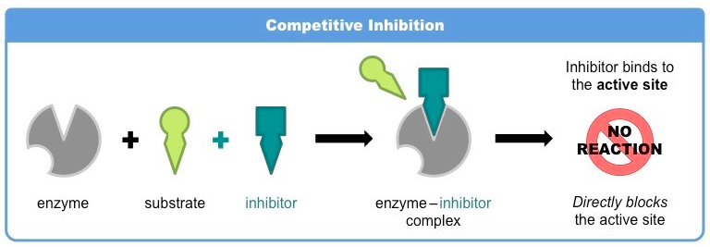
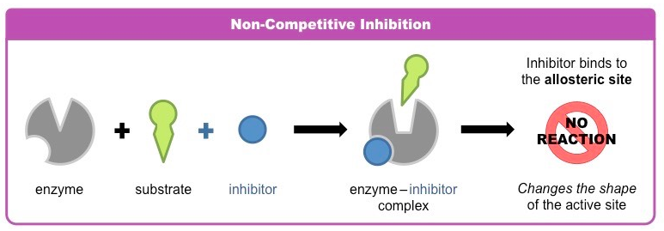
Reversible Inhibition
The enzyme is NOT permanently inhibited or damaged, only inactivates for a period of time.
They are able to dissociate from the enzyme, rendering it active once more.
Two types:
Competitive inhibition
Non-competitive inhibition .

Slide 5
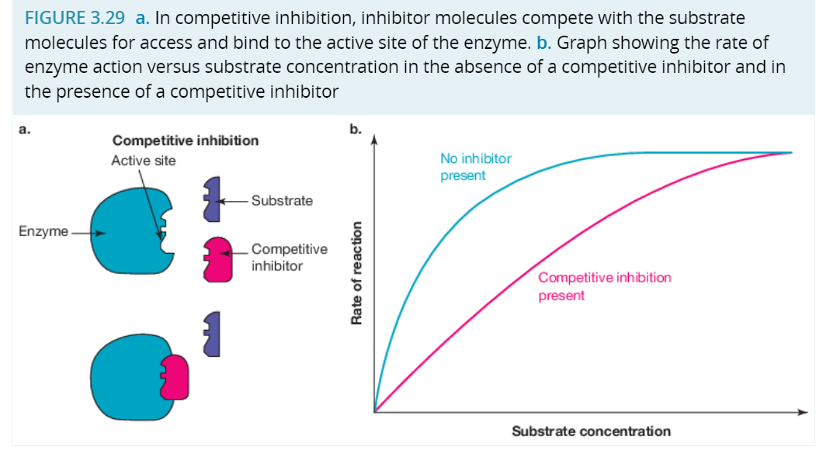
Competitive Inhibition
Contains a region with a shape that is similar to the usual substrate. They prevent E-S complexes.
Factors that affect competitive inhibition
the concentration of the inhibitor
the substrate concentration
the relative affinities of enzyme for the inhibitor and substrate

Slide 6
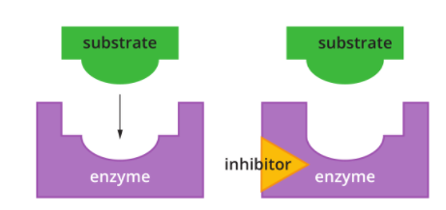
Non-Competitive Inhibition
- Inhibitor binds with the enzyme but at a site that is NOT the active site- called the allosteric site.
- This causes a conformational change, so the enzyme can not bind with the substrate.
- Increasing substrate will NOT remove the effect of the non-competitive inhibition.

Slide 7
Biochemical Pathway Regulation
Prevent waste (eg: ATP cannot be stored so excess ATP is a loss).
Prevent build up of products to potentially harmful levels
Prevent depletion of substrates

Slide 8
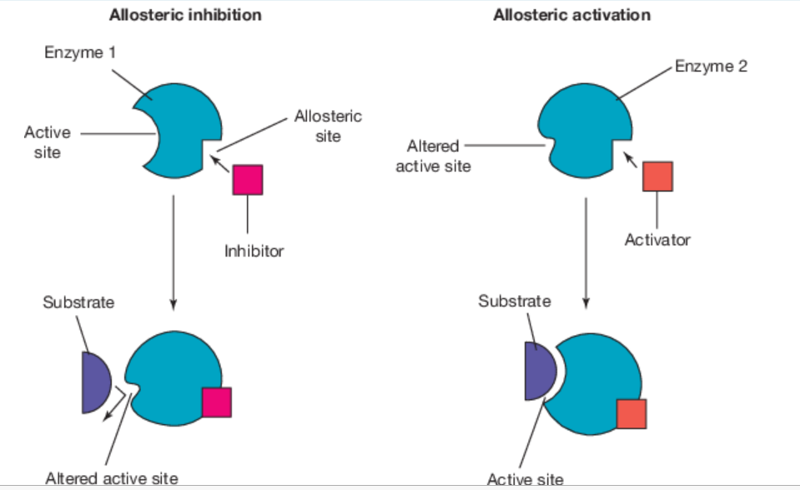
Biochemical Pathway Inhibition
Allosteric regulation
Regulator molecules may be:
allosteric inhibitors: their binding produces a change of shape in the enzyme that stops enzyme activity; they act like an OFF switch.
allosteric activators: the shape change resulting from the binding produces an increase in enzyme activity; they act like an ON switch
Feedback inhibition
The end product of a metabolic pathway acts as an inhibitor of the key enzyme that catalyses the first step in a pathway
When the end product falls to low levels, the inhibition ceases and the biochemical pathway resumes, replenishing the supply of the end product.

Slide 9
Activity
Biozone 39-40
Finish Edrolo 3B

