Slide 1
Light, Carbon dioxide, Water and temperature affecting photosynthesis
Unit 3: AoS2- Factors affecting rate of photosynthesis
Learning Intention:
To understand that the rate of photosynthesis is dependent on many factors.
Success Criteria:
I can:
List factors that affect photosynthesis
Explain why the amount of light, carbon dioxide, water and temperature affects the rate of photosynthesis.
- the general factors that impact on enzyme function in relation to photosynthesis and cellular respiration: changes in temperature, pH, concentration, competitive and non-competitive enzyme inhibitors
- the factors that affect the rate of photosynthesis: light availability, water availability, temperature and carbon dioxide concentration

Slide 2
Warm up
Turn and talk- what enzymes are involved in photosynthesis?
What affects ROR for Enzymes?

Slide 4
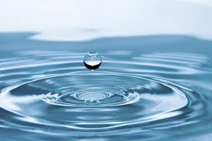
REQUIREMENTS OF PHOTOSYNTHESIS
Light energy
Chlorophyll or light-trapping pigments
Carbon dioxide
Water

Slide 5
LIGHT TRAPPING PIGMENTS
Located in chloroplasts
Chlorophyll (a, b, c, d)
Accessory pigments
Caretonoids
Phychoerythrin

Slide 6
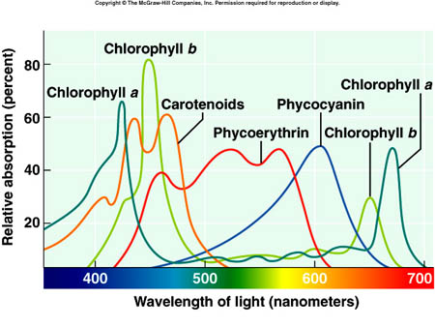

Slide 7
FACTORS AFFECTING PHOTOSYNTHESIS
Light availability
Carbon dioxide levels
Water availability
Temperature
There will always be a limiting factor preventing photosynthesis from happening at a faster rate

Slide 8
LIGHT
Light is required in the light-dependent stage to excite chlorophyll molecules and split water
Increasing light intensity will increase the rate of photosynthesis up to a point
This point is sometimes called the light saturation point

Slide 9
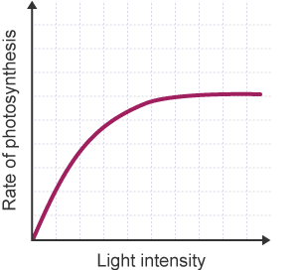
LIGHT
Past the saturation point, there is more ATP and NADPH being produced in the light-dependent stage than can be used in the light-independent stage

Slide 10
CARBON DIOXIDE
Usually the main limiting factor in photosynthesis
Used in the light-independent stage to build glucose
As the concentration of carbon dioxide increases, the rate of photosynthesis increases up to a point
Once all the enzyme sites are occupied, the rate of photosynthesis cannot increase any further

Slide 11
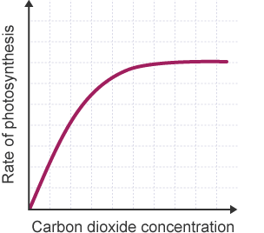
CARBON DIOXIDE
An increase in carbon dioxide concentration also raises the light saturation point, because if there is more carbon dioxide available in the light-independent stage, ATP and NADPH will be used up more quickly

Slide 12
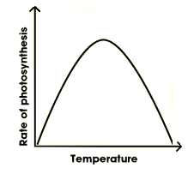
TEMPERATURE
increasing temperature increases the rate of chemical reactions because the molecules are moving around more so come into contact more
But above a certain temperature, the enzymes that catalyse reactions in photosynthesis will become denatured, and the rate of photosynthesis will reduce

Slide 13
SUMMARY
Temperature, carbon dioxide and light intensity affect the rate of photosynthesis
Increasing these inputs will increase the rate of photosynthesis up to a certain point:
Until the production of ATP and NADPH reaches a saturation point
Until all enzymes are occupied
Until enzyme become denatured

Slide 14
ACTIVITY-
5C 2-5, 11-15

Slide 15
REFLECTION
Prove that you’ve met the success criteria in 23 words or less

