Slide 1
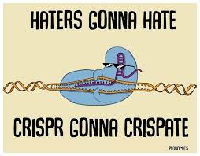
LI :To understand how CRISPR-Cas9 applications can improve the efficiency of photosynthesis in crops. I can: List uses of CRISPR-Cas9 Explain how CRISPR can improve efficiency of photosynthesis is crops
- potential uses and applications of CRISPR-Cas9 technologies to improve photosynthetic efficiencies and crop yields

Slide 2
Warm up

Slide 3
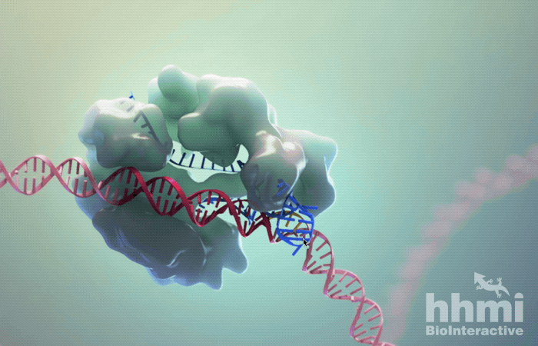
CRISPR Cas9
Bacteria can become infected by pathogens.
Viruses, known as bacteriophages can infect bacteria with their genetic material.
Some bacteria overcome this by the use of an acquired immune system known as: CRISPR cas9.

Slide 4
What is CRISPR Cas9?
CRISPR (Cluster regularly interspaced short palindromic repeats): are genes in a bacterial chromosome which transcribe a special type of RNA which is complementary to regions in an infecting viral genome.
CAS9: an enzyme encoded by a region of DNA called CAS genes. They function to snip the viral DNA at specific points.
CAS genes
CRISPR locus
Circular bacterial chromosome
Bacterial cell

Slide 5
Figure 1: prokaryotic cell acquiring immunity from bacteriophage infection
(1) Bacteriophage DNA invades cell
(2) Spacer region of viral DNA is obtained*
(3) Spacer is integrated into bacterial chromosome CRISPR locus
CAS genes
CAS genes
CRISPR locus
Bacterial Chromosome
Notes:
*excised from viral and plasmid genomes by the Cas adaptation machinery or, alternatively, reverse transcribed from foreign RNA https://journals.asm.org/doi/10.1128/mBio.01397-17

Slide 6
Figure 2: subsequent infections by the same viral DNA
(4) Same Bacteriophage infects bacteria again
(6) relevant CRISPR genes are transcribed to form guideRNA with complementary bases to the viral DNA
(7) CAS9 enzyme, gRNA, Viral DNA form a complex
CAS genes
(5) CAS genes transcribe/translate CAS proteins to form the CAS enzyme
Notes:
crRNA: crispr RNA
gRNA: guide RNA

Slide 7
(8) gRNA forms a complementary RNA/DNA hybrid with the viral DNA. This induces snipping at a specific nucleotide position.
(9) Viral DNA has now been degraded and can no longer infect the host cell

Slide 8
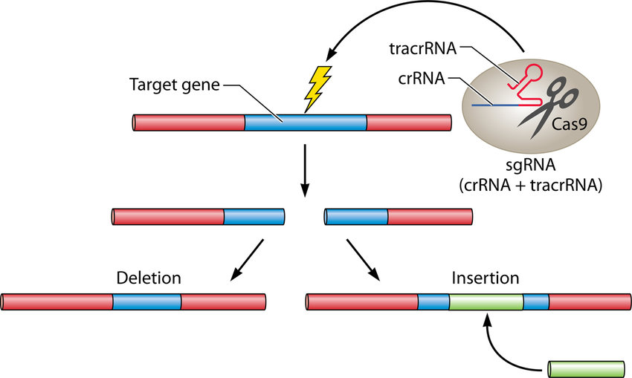
Using CRISPR cas9 in Genome Editing
Since the genetic code is universal (the same in all organisms) CRISPR cas9 can be used to target specific genes/nucleotides in other animals producing:
Knockout genes
Silence gene
Insert genes
Alter/repair genes

Slide 9
Steps for using CRISPR cas9 in genome editing
3. Scientists insert the replacement gene/nucleotides and cells natural DNA repair mechanisms insert additions into the genome
Scientists identify the target gene they want to remove and build a synthetic guide RNA and its related CAS9 enzyme complex.
2. Cas9 complex identifies the target DNA and snips both strands of target DNA
4. Cell induces DNA repair mechanisms which add nucleotides causing mutations that disable the gene (knockout)

Slide 10
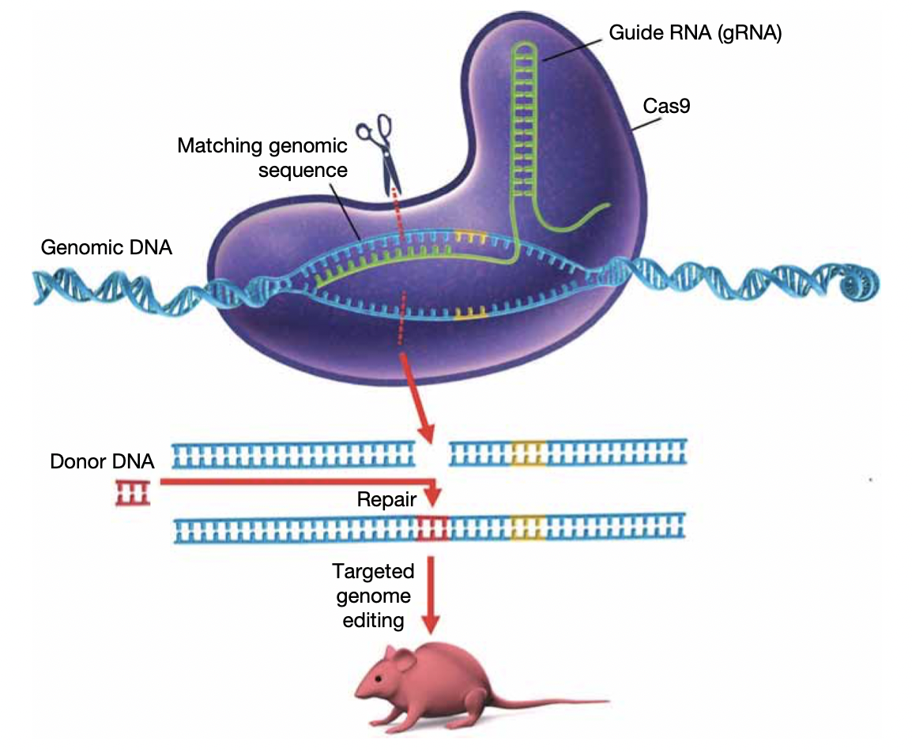
Using CRISPR cas9 in Genome Editing

Slide 11
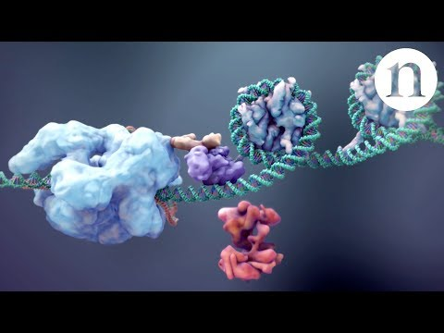
Applications of CRISPR in technology

Slide 12
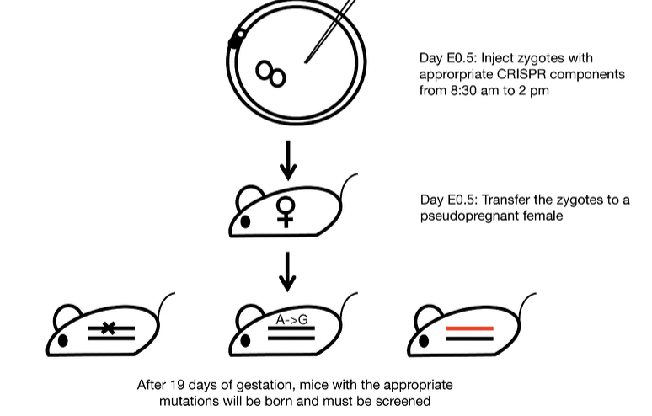
Gene knockout
Gene knockout refers to the silencing of a gene by altering its nucleotide sequence so that it cannot be transcribed/translated into a protein.
Can determine the function of a gene in model organisms
Can introduce a particular mutation which can then be studied

Slide 13
Gene knock-in
Adding a gene to an organism's genome
To introduce foreign DNA from other organisms, can be used in agriculture or to research gene in a model organism
E.g introduce a diseased human allele into a model organism to study potential therapeutics

Slide 14
Gene Repair
A diseased allele which has harmful nucleotide sequences can be repaired by:
Replacing a single nucleotide
Replacing a segment of the gene with a new segment

Slide 15
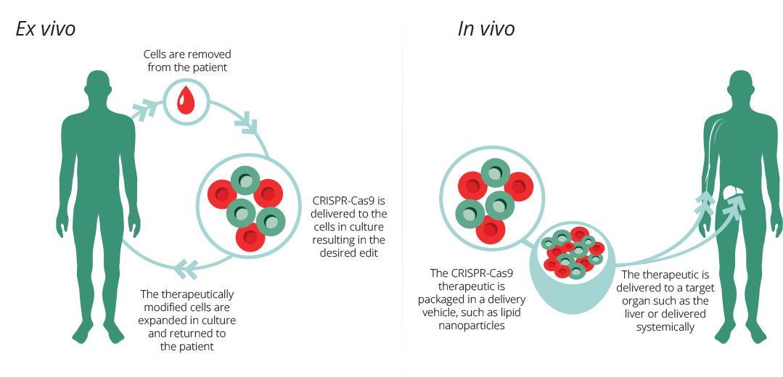
When can CRISPR be used?
Can be used in vivo, ex vivo, in vitro.
The effects on the organism will be different.

Slide 16
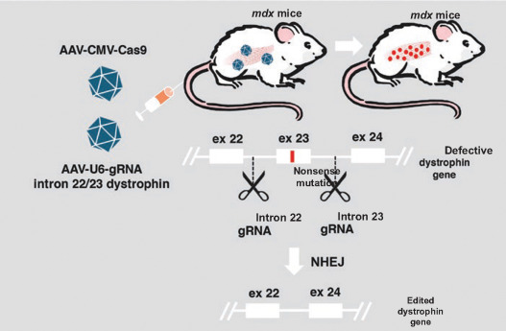
Pros of CRISPR cas9
CRISPR uses targeted gene integration whereas older styles were more random in their integration of DNA
Price: is relatively cheap.
Ease of access: very easy to use and acquire and most reliable.
The gold standard of genome editing.

Slide 17
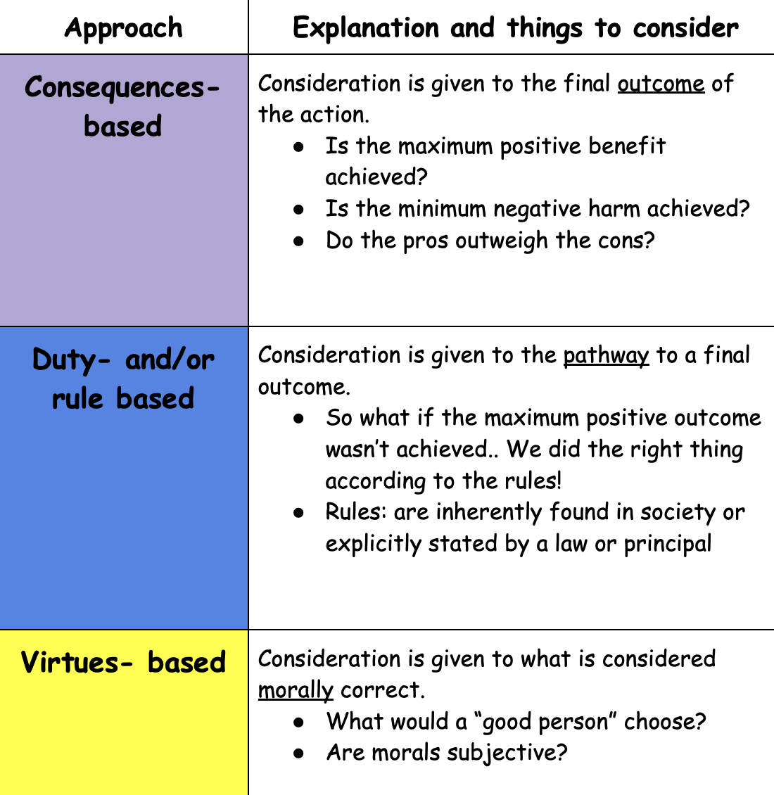
Ethics of CRISPR cas9
Consider each approach and determine
if CRISPR is ethical in human research to treat diseases

Slide 18
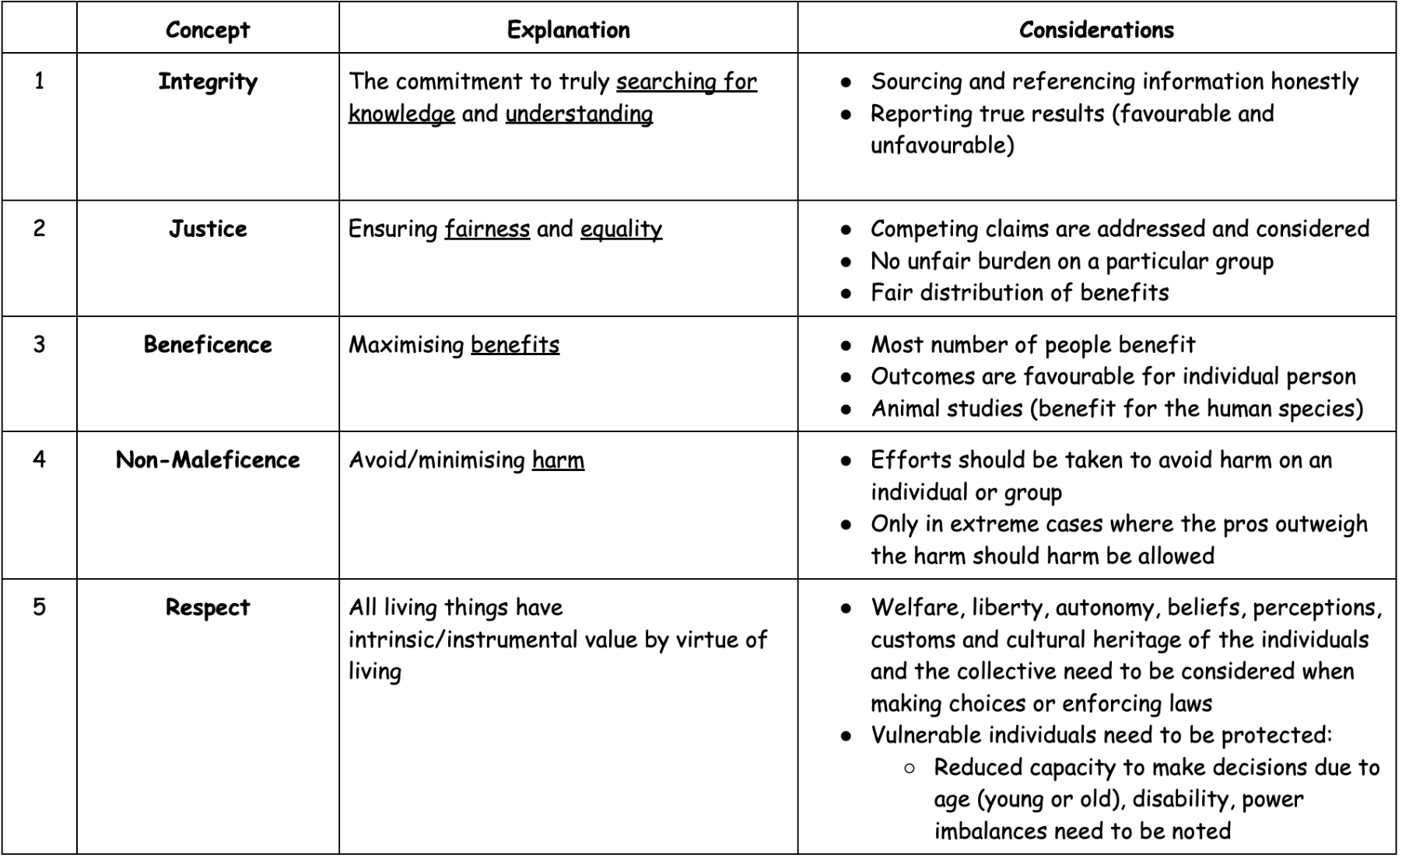
Further Ethical Considerations (read and evaluate: https://www.nature.com/articles/d41586-019-00726-5)

Slide 19
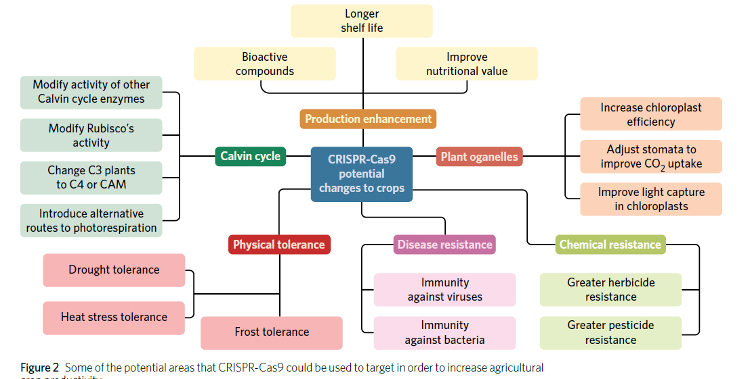

Slide 20
ACTIVITY
5D 1-4, 9-11, 14,

