Slide 1
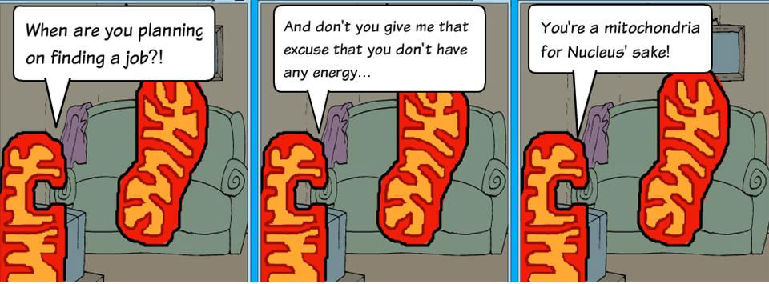
To understand the location, inputs, outputs of the three stages of respiration.
I can:
List the location, inputs and outputs of glycolysis
List location, inputs and outputs of krebs cycle
List location, inputs and outputs of the Electron Transport chain
Unit 3: AoS2- Aerobic Respiration
- the main inputs, outputs and locations of glycolysis, Krebs Cycle and electron transport chain including ATP yield (details of biochemical pathway mechanisms are not required)

Slide 3
KEY KNOWLEDGE
The purpose of aerobic cellular respiration
Three stages – inputs, outputs and locations:
Glycolysis
Krebs Cycle
Electron Transport Chain
Mitochondria (the powerhouse of the cell!)

Slide 4
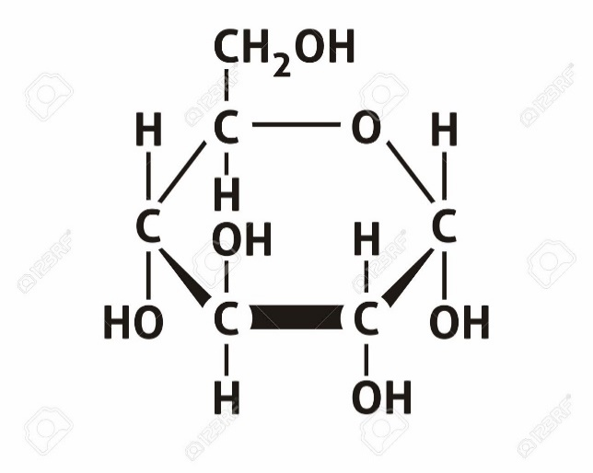
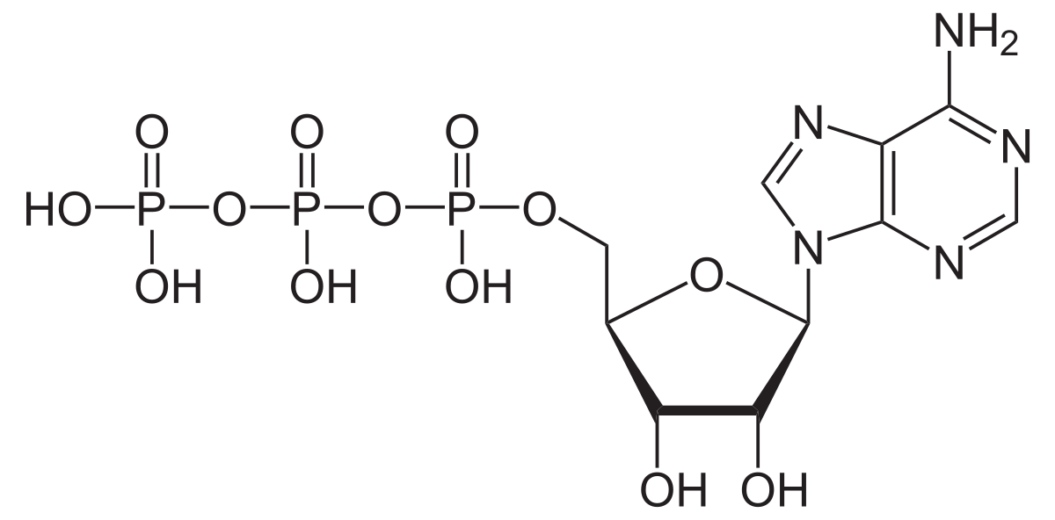
PURPOSE OF CELLULAR RESPIRATION
Transfer the chemical energy of glucose into the energy of ATP

Slide 5
To transfer the chemical energy stored within glucose into ATP.
There are two forms of respiration
Aerobic respiration – occurs in the presence of oxygen
Anaerobic respiration - occurs in the absence of oxygen

Slide 6
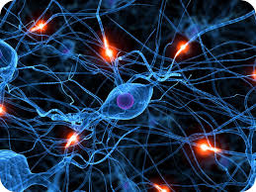
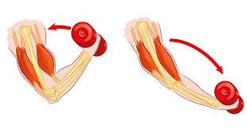
What is it for?
Homeostatic mechanisms
Excretory processes
Production of antibodies
Transmission of nerve impulses
Contraction of muscle cells

Slide 7
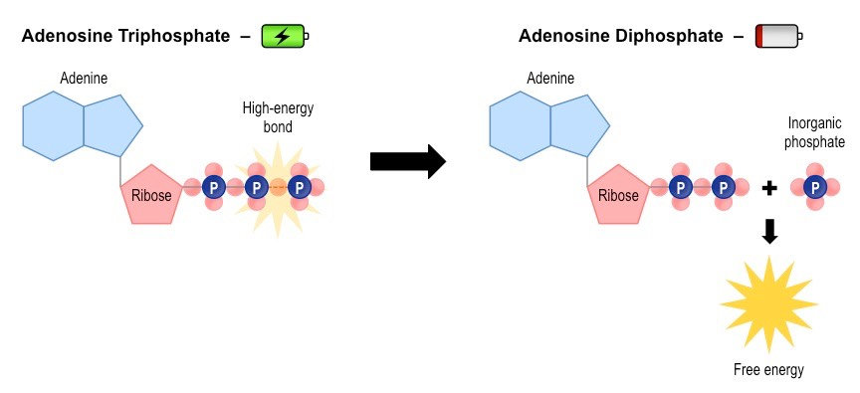
WHY ATP?
It can be easily released in one single step, making energy instantly available for use by cells.
ATP –> ADP + Pi + Energy

Slide 8
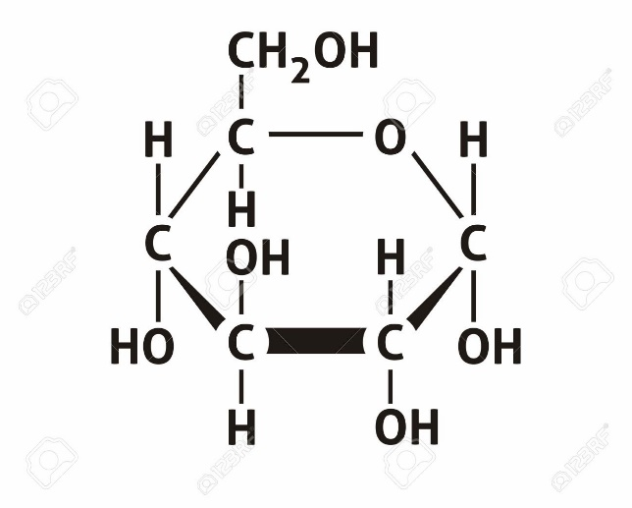
INPUT: GLUCOSE
Six-carbon sugar

Slide 9
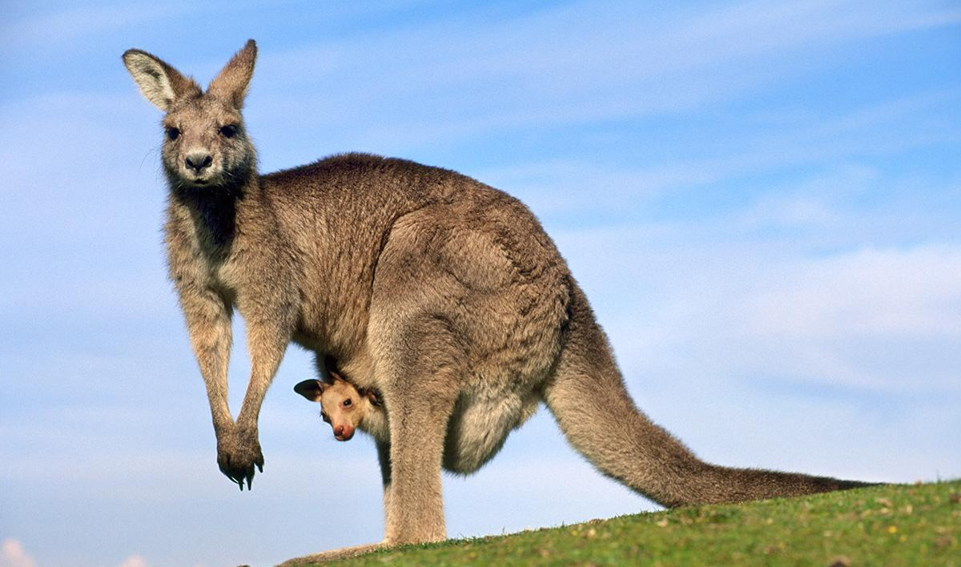
INPUT: GLUCOSE
Six-carbon sugar
Heterotrophs obtain glucose from their food
Broken down from complex carbohydrates
Autotrophs produce glucose through photosynthesis

Slide 10
WHY NOT JUST USE GLUCOSE?
Cells need an immediate source of energy
Too much energy – around 3000 kJ per mole

Slide 11
THREE STAGES OF AEROBIC RESPIRATION
Glycolysis – occurs in the cytosol
Krebs Cycle – occurs in the mitochondrial matrix
Electron transport chain – occurs in the mitochondrial membrane

Slide 12
THE MIGHTY MITOCHONDRIA
Membrane-bound organelle
Only found in eukaryotes
Theorised to have originated from a symbiotic relationship between prokaryotic cells

Slide 13
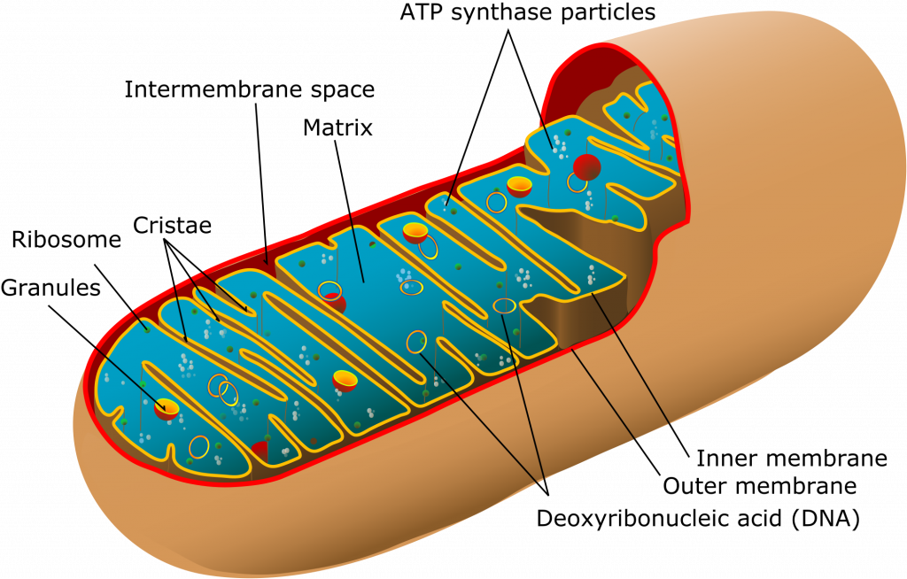
THE ENDOSYMBIOSIS THEORY
What evidence can you see that’s similar to bacteria?

Slide 14
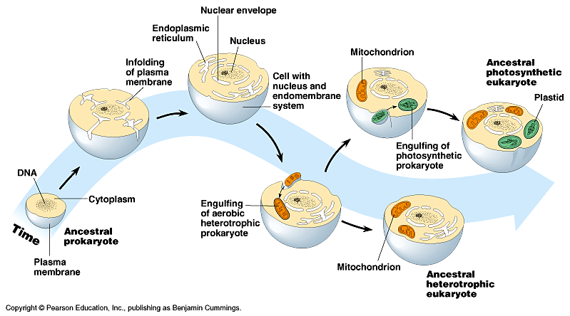
THE ENDOSYMBIOSIS THEORY

Slide 16
STAGE 1: GLYCOLYSIS
Occurs in the cytosol
Glucose is split into two pyruvate molecules, which are used in the next stage
Does not require oxygen
Produces two molecules of ATP

Slide 17
Pyruvate
C₆H₁₂O₆
2 hydrogen atoms
Pyruvate
NADH
NADH
Energy
“Loaded” acceptor molecules
ATP
ATP

Slide 18
INPUTS AND OUTPUTS OF GLYCOLYSIS
INPUTS
Glucose
OUTPUTS
2 molecules of ATP
2 pyruvate molecules
2 loaded NADH molecules

Slide 19
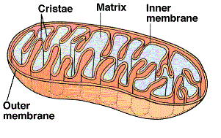
STAGE 2: KREBS CYCLE
Inner matrix of the mitochondria
Also called the citric acid cycle

Slide 20
STAGE 2: KREBS CYCLE
Inner matrix of the mitochondria
Also called the citric acid cycle
The two pyruvate molecules enter the mitochondria

Slide 21
INPUTS AND OUTPUTS OF THE KREBS CYCLE
INPUTS
2 pyruvate molecules
OUTPUTS
2 molecules of ATP
6 carbon dioxide molecules
NADH molecules

Slide 22
STAGE 3: ELECTRON TRANSPORT CHAIN
Occurs on the folded inner membrane, or the cristae, of the mitochondria
Series of enzyme complexes accept electrons from NADH and FADH₂ – this is how the energy is passed along
Reduced when they accept electrons
Oxidised when they pass them on
Redox reactions

Slide 24
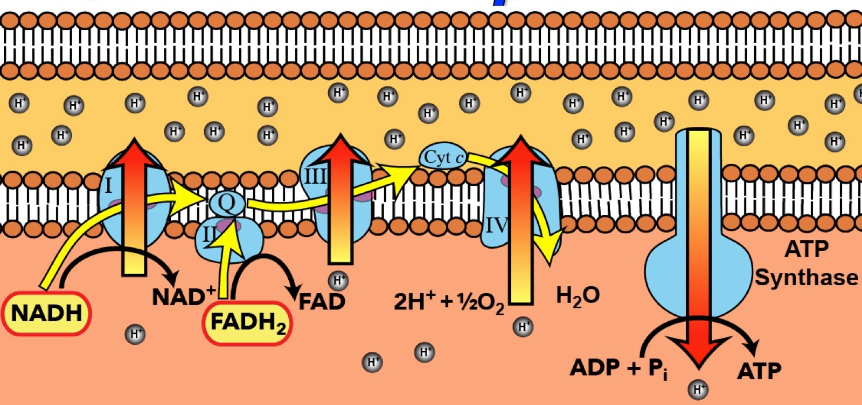
ELECTRON TRANSPORT CHAIN

Slide 25
NADH
NAD⁺
Gives up electrons

Slide 26
NADH
NAD⁺
Gives up electrons
FADH₂
FAD
Final electron acceptor is oxygen which is free in the mitochondria matrix

Slide 27
O₂ + 4e⁻ + 4H⁺ 🡪 2H₂O
2 electrons
O²⁻
H⁺

Slide 28
INPUTS AND OUTPUTS OF THE ELECTRON TRANSPORT CHAIN
INPUTS
NADH molecules
6 oxygen molecules
OUTPUTS
6 water molecules
32 or 34 ATP

Slide 29
INPUTS AND OUTPUTS OF AEROBIC CELLULAR RESPIRATION
INPUTS
Glucose
Oxygen
OUTPUTS
Water
Carbon dioxide
C₆H₁₂O₆ + 6O₂ 🡪 6CO₂ + 6H₂O

Slide 30
SUMMARY
The purpose of cellular respiration is to convert the energy from glucose into the energy of ATP
Three steps of aerobic respiration:
Glycolysis
Kreb’s cycle
Electron transport chain

Slide 31
ACTIVITY
6A 1-5
Biozone 52 & 53

Slide 32
Reflection
Quiz the person next to you about inputs and outputs of aerobic respiration

