Slide 1
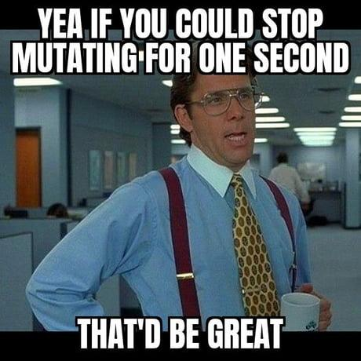
Learning Intention: To understand the significance of gene pools and allele frequencies. To understand how gene pool of a population causes changing of allele frequency To understand how mutations serve as the source of new alleles.
Success Criteria:
- I can state the significance of gene pools and allele frequencies. - I can explain the causes of changing allele frequency in the gene pool of a population. - I can explain how mutations serve as the source of new alleles.
Study design dot point
- causes of changing allele frequencies in a population’s gene pool, including environmental selection
pressures, genetic drift and gene flow, and mutations as the source of new alleles

Slide 2
Warm up
Survey of traits in the classroom
Students look around the classroom at their classmates and note the physical characteristics present in the room for eye colour, hair colour and hairline.
Students explain these similarities and differences?

Slide 3
Gene Pool and allele frequency
Key vocabulary
Gene- A sequence of deoxyribonucleic acid (DNA) that codes for a particular characteristic or trait. Slight variations in the DNA sequence of a gene can result in different forms of a trait. These variations of a gene are called alleles.
Gene pool the complete set of alleles present within a particular population.
Allele frequency the proportion of certain alleles in a gene pool.
Population a group of individuals of the same species living in the same location
Genotype the genetic composition of an organism at a particular gene locus
Phenotype the physical or biochemical characteristics of an organism that are the result of gene expression and the environment
Genetic diversity the variation in genetic makeup or alleles within a population

Slide 4
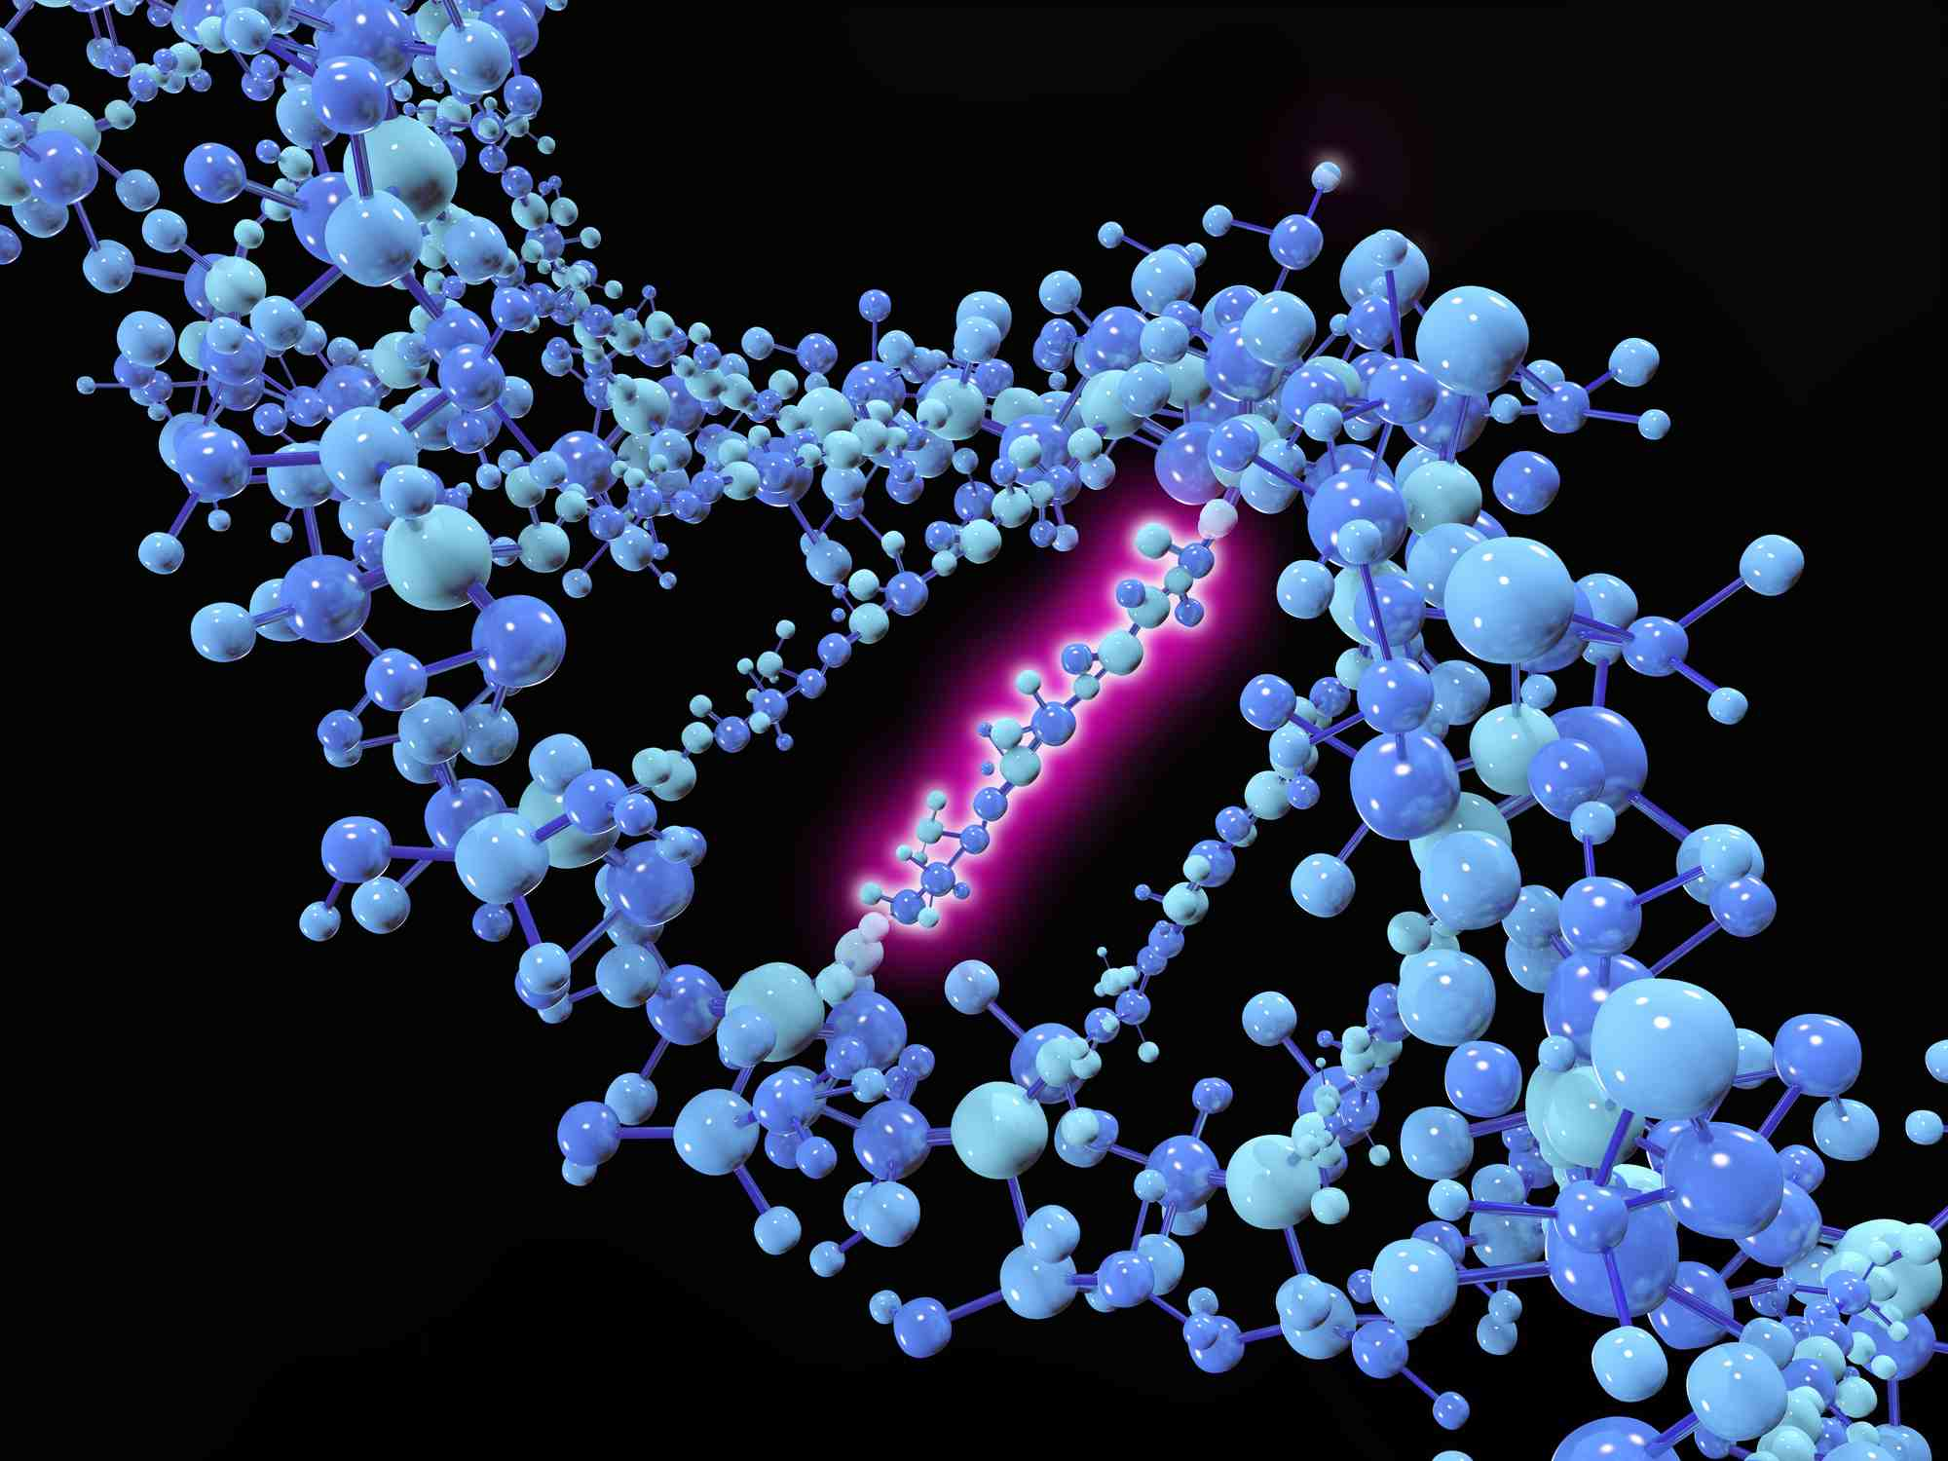
Changes to allele frequency
Different factors which influence gene pools and alter allele frequencies are:
- Mutations
- Environmental selection pressures
- Genetic drift
- Gene flow
- Artificial selection pressures.

Slide 5
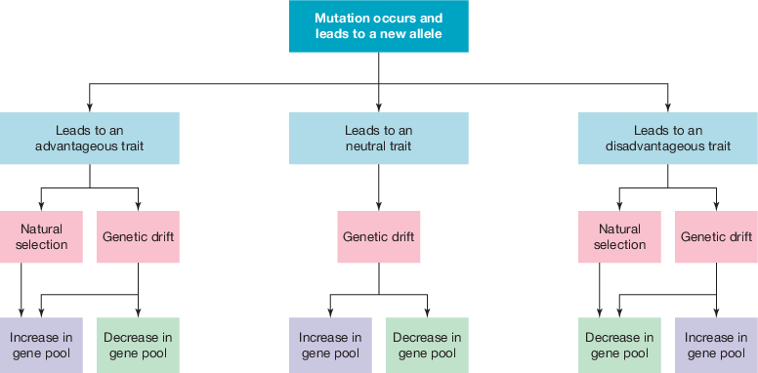
Mutation
Mutations is a permanent change to the DNA sequence of an individual
Based on occurrence it is of two types
Spontaneous
Induced – Induced by agents known as mutagens
A mutation can be categorised as beneficial, neutral, or deleterious, depending on the mutation’s overall effect on individual fitness.

Slide 6
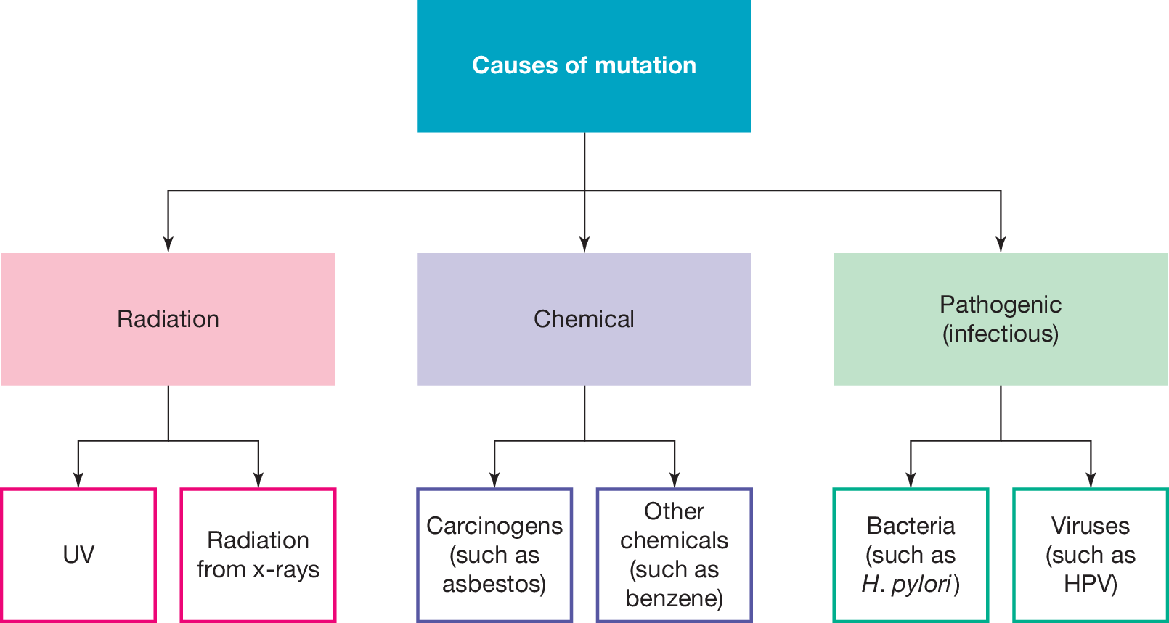

Slide 7
Types of mutation
Point mutations
Block mutation
1. Point mutation: Affect a single base in DNA by either:
a) Substitution mutations
b) Frame shift mutations
- Insertion
- Deletion
These may occur in structural or regulatory genes.

Slide 8
Substitution mutations:
Three type:
- Silent mutations: a mutation that does not result in the change of a polypeptide product encoded by a gene. (doesn’t change amino acid as still codes for same amino acid)
- Nonsense mutations: a base substitution that changes the DNA triplet, so that instead of coding for an amino acid it codes for a STOP signal.
- Missense mutations: a base substitution resulting in a single amino acid alteration within the polypeptide product. (One amino acid changes so protein will change). Can be further of two types:
Conservative: a change in amino acids with similar chemical properties – can be tolerated
Non-conservative: a change in amino acids with different chemical properties – polypeptide unable to carry out normal function

Slide 9
b) Frameshift mutation:
Frameshift mutations involve the addition or deletion of one or two nucleotides, which alters the reading frame.
Single base insertions and deletions that have a major effect on genes, as they alter the codon at the point of insertion or deletion and each codon thereafter.
Insertion: when one nucleotide base is inserted into the DNA strand
Deletion: when one nucleotide base is deleted from the DNA strand

Slide 10
2. Block Mutations
Block mutations are chromosomal changes affecting larger sections of DNA. They involve the alteration of
the structure of a chromosome by
inserting, deleting, duplicating, or swapping a cluster
of nucleotides, involving multiple different genes. These mutations
usually occur during the process of meiosis.
Position effects: the resulting effects of a block mutation that alters the activity or expression of a gene.

Slide 11
Summary
Mutations are changes to genetic materials which can results in new alleles.
Mutations may occur spontaneously or be induced by exposure to a mutagen.
Mutations which occur in germline cells can continue in a population's gene pool.
Mutations can result in faulty or non-functional proteins.
Point mutations can be classified as either substitution mutations or frameshift mutations.
Substitution mutations can affect the polypeptide chain differently and result in either silent, nonsense or missense mutations.
Silent mutations do not change the amino acid in a protein.
Missense mutations lead to the change in an amino acid in a protein. This can be conservative or non-conservative, which depends on the properties of the amino acid.
Nonsense mutations introduce a stop codon, leading to a truncated protein.
Frameshift mutations change the sequence of amino acids more significantly than most substitution mutations. This is because they alter the reading frame.
Other mutations can involve large sections of chromosomes (block mutations), multiple nucleotides or even entire chromosomes.

Slide 12
A gene pool is the sum of alleles within a given population
VCAA examination report note: The term ‘gene pool’ was not well understood. It is incorrect to state that it is the genes in a population. Incorrect responses given by students included variation (this could be environmental), genotypes, allele frequency or traits in a population, or the sum of alleles in an individual, species or community. 45 per cent of students answered this question correctly.

Slide 13
Reflection
Edrolo 9A Q 2-4, 10-13
Heinemann worksheet 30

