Slide 1
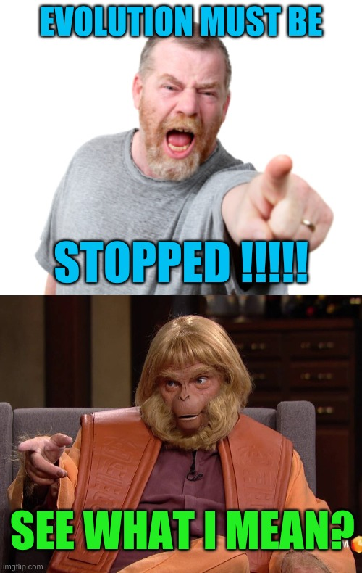
Learning Intention: - To study and interpret human fossil as an example of classification - To understand ways fossils and DNA are used to explain migration of human population - To state the evidence of interbreeding between different Homo species - To explain migration of Aboriginal and Torres Strait Islander populations and their connection to Country and Place
Success Criteria:
- I can interpret human fossil as an example of classification - I can explain the ways fossils and DNA are used to explain migration of human population - I can state the evidence of interbreeding between different Homo species - I can explain migration of Aboriginal and Torres Strait Islander populations and their connection to Country and Place
Study design dot point
the human fossil record as an example of a classification scheme that is open to differing interpretations that are contested, refined, or replaced when challenged by new evidence, including evidence for interbreeding between Homo sapiens and Homo neanderthalensis and evidence of new putative Homo species
ways of using fossil and DNA evidence (mtDNA and whole genomes) to explain the migration of modern human populations around the world, including the migration of Aboriginal and Torres Strait Islander populations and their connection to Country and Place

Slide 2
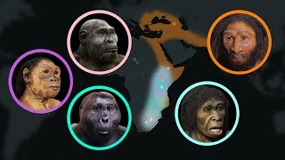
Warm up
Activity: Observe the skull and arrange them according to the evolution trend

Slide 3
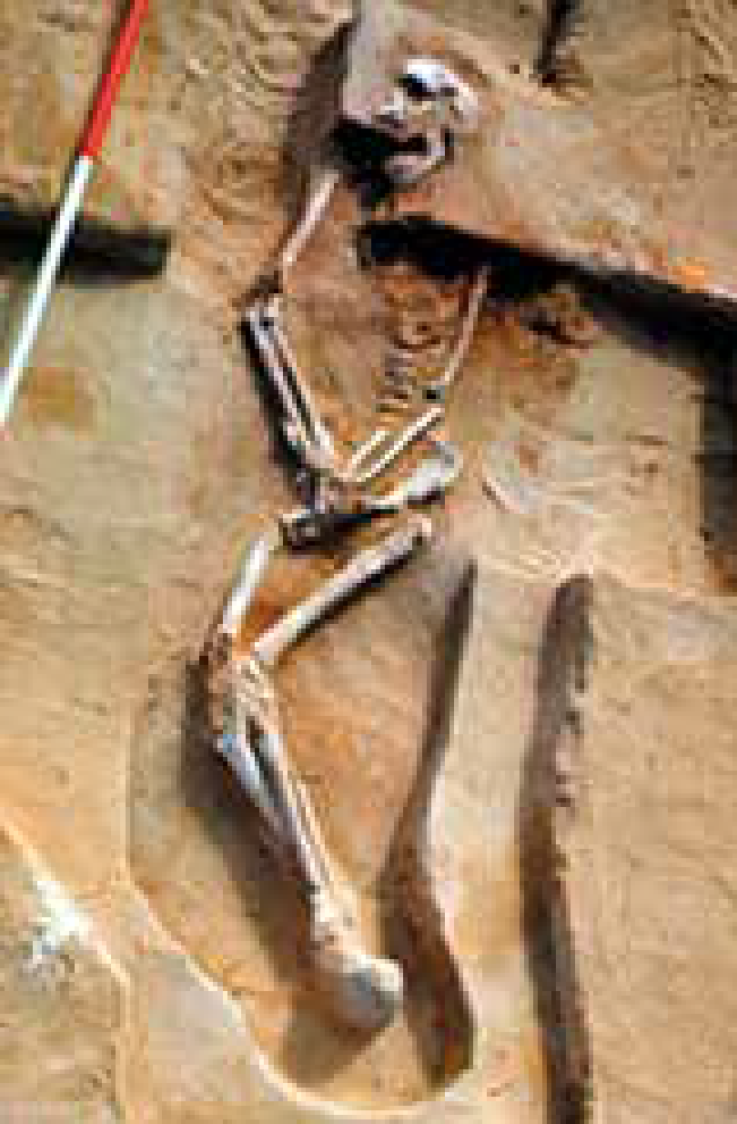
Interpreting the human fossil record
Interpreting the human fossil record is difficult because the record itself is not complete. This could be due to:
• Not all individuals die in conditions that promote fossilisation. For example, organisms might decompose completely or be eaten by scavengers when they die.
• Rock layers and the fossils they contain might erode and disappear over time.
• Many rock layers are still inaccessible to paleontologists, so not all fossils have been found

Slide 4
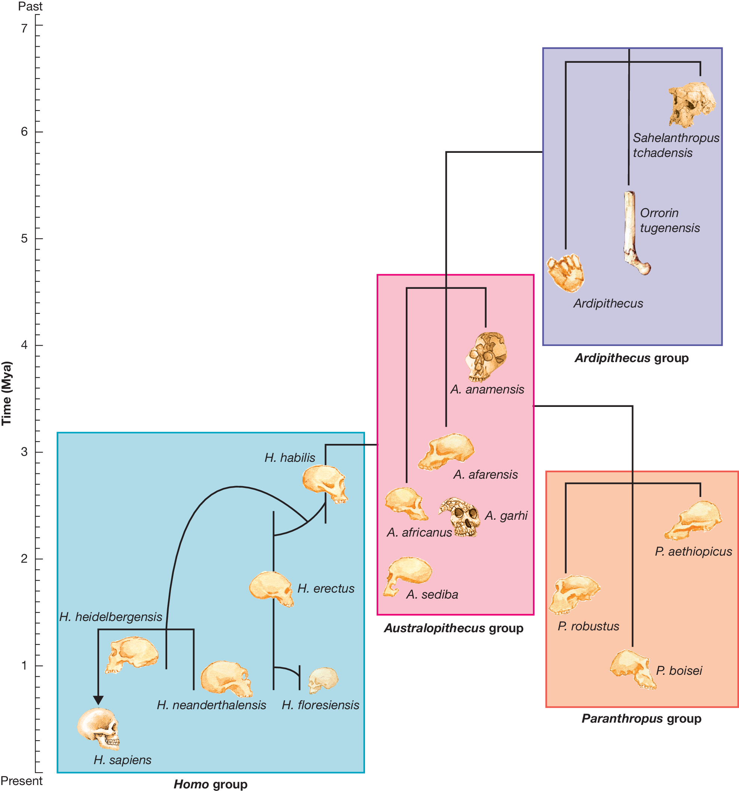
Example of fossil record
Each discovery of a fossil hominin may provide new information that can be used to test currently accepted hypotheses. Currently, it is not possible to identify the exact evolutionary pathway that links the first hominin species to the first Homo species. Much of the evidence we have is only based on fossils and DNA, and this evidence is largely incomplete. Thus, it is difficult to determine patterns, particularly when natural variation exists.
It is reasonable to speculate that the earliest hominins were ancestral to the australopithecines. From the australopithecines, one evolutionary line gave rise to the robust Paranthropus species, and a second line gave rise to the first members of the genus Homo — the first humans. The Paranthropus species were an evolutionary ‘dead-end
Evolutionary links between major hominin groups

Slide 5
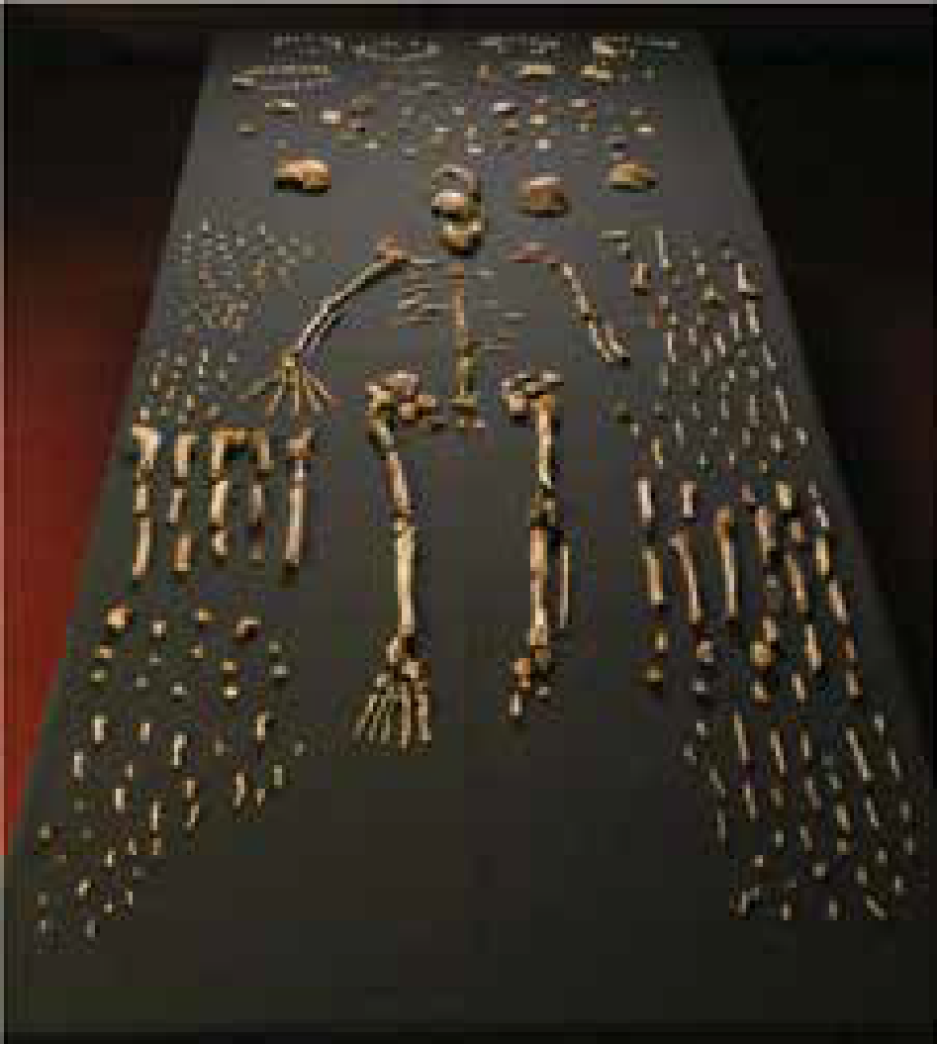
New fossil discoveries such as H. naledi, first and Denisovans, raise questions about their places in hominin evolution shown in previous image.
The fossils showed features resembling
those of both modern humans (Homo) and older hominins (Australopithecus) and some scientists suggested that it may be a transitional fossil between Australopithecus and Homo.

Slide 6
The implications for hominin evolution of three potential outcomes of H. naledi dating. Each outcome is dependent on the age of H. naledi fossils, as based on dating data.
Note: Later in 2017, the fossils were dated to around 250 000 years ago, matching up with outcome 3. This indicates H. naledi isn’t as old as suspected and actually lived alongside modern humans.
This is an example of the uncertainty shrouding our evolutionary history.

Slide 7
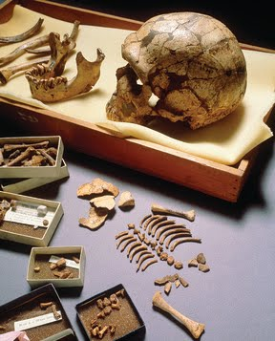
Neanderthals
Neanderthals share a lot of features with humans as they are closely related, but differ in a few important ways:
• a wider nose
• shorter limbs
• a stockier build
• a flared rib cage
• a sloping forehead
• an enlarged brow ridge
• a larger cranial capacity
• better resistance to colder climates.
Neanderthal fossil remains found in La Ferrassie in France

Slide 8
Evidence supporting Human-Neanderthal interbreeding
The physical differences and the genetic differences support the conclusion that we are separate species that shared a recent common ancestor around 400 000 years ago for example the mtDNA taken from Neanderthal fossils and compared with H. sapiens

Slide 9
A team of researchers at Princeton University were able to recover around 41% of the
total Neanderthal genome from a sample of 2500 individuals. Rather than directly sequencing the DNA of a Neanderthal, the researchers were able to string together bits and pieces of the Neanderthal genome from the small pieces of shared DNA found in the
individual genomes of modern humans in their sample.

Slide 10
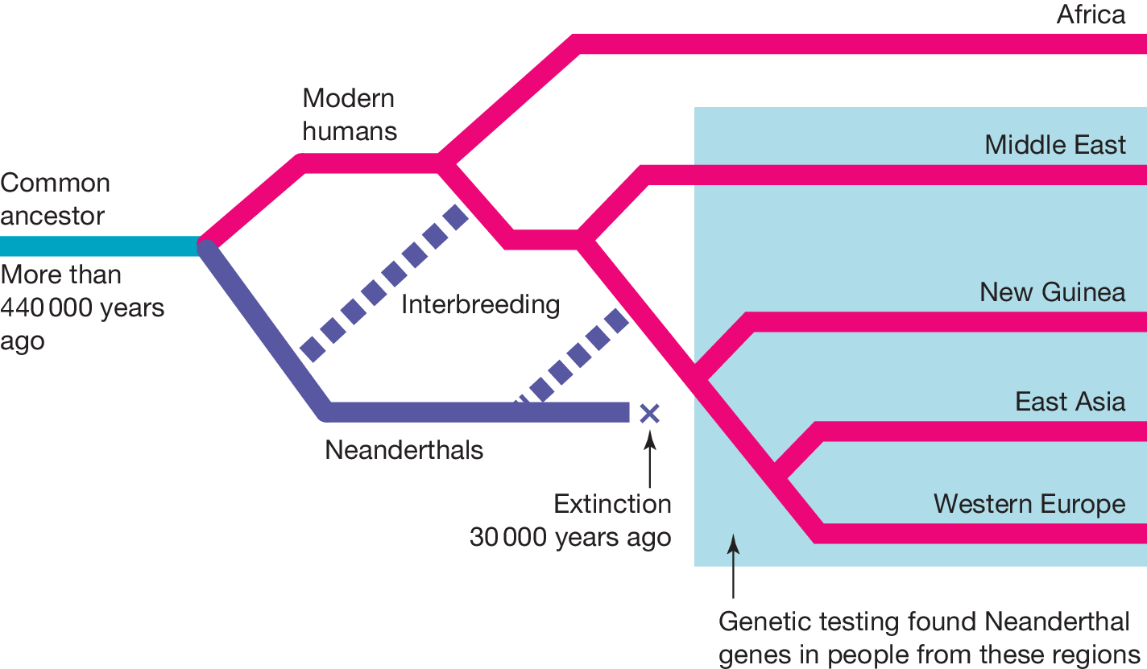
Neanderthal genes identified in the genome of modern humans today include those:
involved in features relating to skin and hair — thicker skin, paler skin and thicker hair
related to the function of the innate immune system.
All modern humans today — except Africans — carry in their genomes evidence of gene flow betweenH. neanderthalensis and H. sapiens, particularly humans of European or Asian background. In all, about 30 per cent of the total Neanderthal genome is represented in the gene pool of non-African modern humans.
Neanderthal and modern human

Slide 11
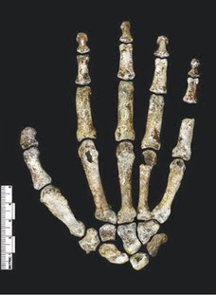
New hominin species
Some relatively recent discoveries of hominins of the Homo genus are:
- Homo naledi
- Homo luzonensis
- Denisovans
- Cro-Magnon (early Homo sapiens).
Homo naledi
The characteristics of the bones that are similar to the australopithecines are:
- the species' small brain (based on cranial capacity)
- their upper body (well-suited to climbing)
- their curved fingers.
In contrast, the characteristics similar to species in the Homo genus include:
- their feet
- their long legs (suited to walking long distances)
- their hands (well-suited to toolmaking)
The right hand of Homo naledi
Note: The hand has a very similar shape to a modern human hand, but the curved fingers and the strong thumb are more primitive

Slide 12
Homo luzonensis
On the island of Luzon, which is part of the Philippines archipelago, seven teeth and six small bones consisting of finger bones, part of a foot and part of a femur were discovered in the Callao Cave. Palaeoarchaeologists were able to classify the fossils as belonging to Homo luzonensis.
Characteristics of the fossil to classify as genus Homo
the fossilised teeth have structures in common with ancient hominin species, but other structures that are similar to modern humans. The teeth are similar in size and shape to modern humans but one of the premolars found has three roots, which is more similar to older hominin species.
one of the foot bones was curved like an australopithecine rather than straight like species in the Homo genus.

Slide 13
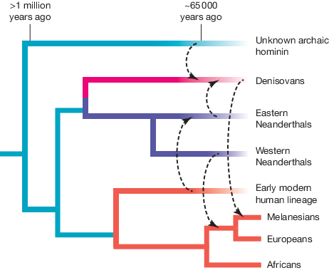
Denisovans
A tiny finger bone found in Denisova Cave in south-western Siberia came from a human female who lived about 40 000 years ago.
The DNA extracted from this bone yielded a partial mitochondrial DNA sequence. This DNA did not match that of modern humans, Neanderthals or any other known hominin.
The DNA was identified as that of a new human group that has been called the Denisovans.
The Denisovan female, her DNA included the gene variants (alleles) that would have made her brown-eyed, with brown hair and dark skin.
Comparative genomic studies revealed that the modern humans of that period interbred with Denisovans.
This interbreeding probably occurred when the ancestors of these present-day humans were migrating across southern regions of Asia.
Gene flow or interbreeding (denoted by dotted arrows) between hominin species. Neanderthals are shown as two geographically separated groups, but they are the one species. The fading of the lines for most groups denotes their extinction.

Slide 14
Measures used to demonstrate relatedness
1. The fossil record – we can use fossils as evidence for relatedness by pointing to comparative anatomy, particularly
the presence of homologous structures.
2. Molecular homology – we can use similarities between nucleotides in DNA sequences or amino acid sequences in
proteins as evidence for relatedness.
Human migration
the earliest known hominins namely the Australopithecines first evolved in Africa approximately 4 million years ago. These remained solely in separate regions of Africa and continued to evolve
Evolution resulted in the emergence of new species over time, including the earliest members of the Homo species (such as Homo habilis).
around 2–2.25 million years later these early hominin species began to migrate out of Africa and into the nearby regions of Europe and Asia. This feat is currently believed to have been accomplished by a small population of Homo erectus, whose fossils were the first to be found outside of the African continent (in China and Indonesia).
Fast forward another 2 million years and we Homo sapiens are the last remaining lineage of the Homo genus.

Slide 15
Two main hypotheses about how Homo sapiens made their way out of Africa–
the ‘multiregional’ hypothesis (Figure a)
the ‘Out of Africa’ hypothesis (Figure b)
Note: Almost all existing evidence supports the Out of Africa hypothesis and that this is generally taken as the accepted model of human migration.

Slide 16
Homo sapiens evolved in Africa around 200 000 years ago before spreading out across other continents. Each coloured section represents a different species. It can be seen that while H. erectus where the first to leave Africa (leading to lines that went extinct), the evolution of H. sapiens occurred within Africa before diverging out. Note that this is a simplification of the existence of these species, as there was some crossover in the extinction of one species and appearance of another species.
This would mean that all modern human beings are of African descent
Out of Africa hypothesis

Slide 17
Evidence for the Out of Africa hypothesis
Repeated large-scale analysis of the mitochondrial DNA (mtDNA) of modern humans demonstrates that our mitochondrial lineages can all be traced back to a common ancestor that lived in Africa between 140 000 and 290 000 years ago.
Modern-day humans show very little genetic diversity compared to other species
Some of the oldest Homo sapiens fossils found were uncovered in East Africa and dated to around 160 000 years ago, as well as later fossils uncovered in the Middle East and dated to 100 000 years. This suggests migration into and out of Northern Africa
DNA evidence and fossilised remains, have also uncovered other artefacts along the far north-west into deeper parts of Europe (and south-east into Asia). These include stone tools, carvings, and cave paintings, which indicate an increased complexity and cultural evolution
Proposed spread of Homo sapiens during their first migratory wave out of Africa.
Proposed second migratory wave of Homo sapiens further into Eurasia between 40 000 and 80 000 years ago.

Slide 18
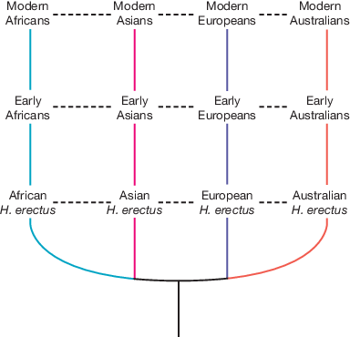
Multiregional hypothesis
This hypothesis suggests that the evolution of modern humans, from Homo erectus to Homo sapiens, was actually an ongoing process across all regions of the world with gene flow between different continental populations.
This would mean that all modern human beings are not of African descent, but rather descendants of smaller, localised populations of early hominins. For instance, modern Africans originated from early Africans that evolved from African hominins, whereas modern Asians came from archaic Asians that evolved from Asian hominins.
Evidence:
There is limited evidence to support the multiregional hypothesis today. Some proponents argue that the ancient fossil record demonstrates what are known as morphological
Clades. However, many critics of this theory argue that the fossil record is too incomplete to rely on morphological
Clades.
Note: Morphological clades- combinations of various physical characteristics that are unique to particular geographical regions across a wide timespan.

Slide 19
Evidence of migration
Comparison of mtDNA and DNA of the whole genome

Slide 20
Aboriginal and Torres Strait Islander people’s connection to Country and Place
The second wave of migration is believed to have led to the emergence of Indigenous populations in the Oceanic region, including the arrival of Aboriginal Australians between 50 000 and 65 000 years ago. Most of the genomes of modern-day Aboriginals can be traced back to the original ‘Out of Africa’ event in which the first ancient humans spread throughout the globe.
Task: Read page 631-633 of Edrolo Textbook and create a textbook page

Slide 21
Worked Example

Slide 22
Summary
Classification schemes are not fixed but may change when new information becomes available or when new interpretations that provide better explanations are formulated.
Classification of newly discovered species can be contested.
Comparative genomic evidence has identified the existence of a new Homo species called the Denisovans.
Comparative genomics provides evidence that interbreeding occurred between modern humans, Neanderthals and Denisovans.
The hominin evolutionary tree is highly branched and is subject to change as new hominin fossils are discovered.
The migration of modern humans out of Africa can be traced with fossil evidence.
The migration of modern humans out of Africa can be traced with DNA evidence from mtDNA and whole genome sequencing.
The migration path of modern humans is updated when new evidence is discovered.
The Aboriginal and Torres Strait Islander peoples have lived in Australia for a significantly longer time than the first European colonisers.
The length of time that Aboriginal and Torres Strait Islander peoples have lived in Australia has created a very strong connection to Country and Place

Slide 23
Reflection
Edrolo 11 C Q 1-4, 9-13
11 D Q 2, 9-11, 13

