Slide 1
Learning Intention: - To learn about speciation as a consequence of isolation and genetic divergence. - To learn about allopatric and sympatric speciation. - To study Galapagos finches as an example of allopatric speciation and Howea palms on Lord Howe Island as an example of sympatric speciation.
Success Criteria:
- I can explain speciation as a consequence of isolation and genetic divergence. - I can explain allopatric and sympatric speciation. - I can explain Galapagos finches as an example of allopatric speciation and
Howea palms on Lord Howe Island as an example of sympatric speciation.
Study design dot point
evidence of speciation as a consequence of isolation and genetic divergence, including Galapagos finches as an example of allopatric speciation and Howea palms on Lord Howe Island as an example of sympatric speciation.

Slide 2
Warm up
Think-pair-share
Tasmania separated from mainland Australia more than 10 000 years ago. What impact could this have on the populations of the same species found in both locations (for example, pademelon, Tammar wallaby, Eastern Quoll).
○ Think – Individually, students consider the question and make some notes.
○ Pair – Students then discuss their thoughts with a partner.
○ Share – Student pairs discuss their thoughts with the whole class.

Slide 3
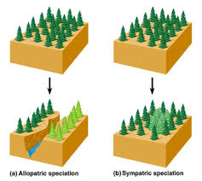
Speciation
Speciation is the process by which populations genetically diverge until they become different species.
A species is a population of individuals who can breed with each other to produce viable (able to survive) fertile (able to produce offspring themselves) offspring.
E.g. all cats are of one species, all dogs belong to one species.
Different evolutionary processes such as mutations, natural selection, genetic drift, and gene flow influence the frequency of alleles, leading to changes in the genetic composition and genetic diversity of a population. When genetic differences accumulate through these processes, speciation can occur.
How to distinguish a species
Amino acid sequence
DNA sequence
Structural features
Whether they can produce fertile offspring

Slide 4
Subspecies
It is important to remember that speciation is a slow and gradual process. Subspecies, which include individuals phenotypically different from their original population, can often arise. While these subspecies are phenotypically different from each other, they are still capable of interbreeding to produce viable and fertile offspring.

Slide 5
Isolating mechanisms
The mechanisms which prevent species from interbreeding to produce fertile and viable offspring
Note: While these isolating
mechanisms are unlikely to be assessed by the VCAA, they will help your understanding
of what prevents viable and fertile offspring from forming.

Slide 6
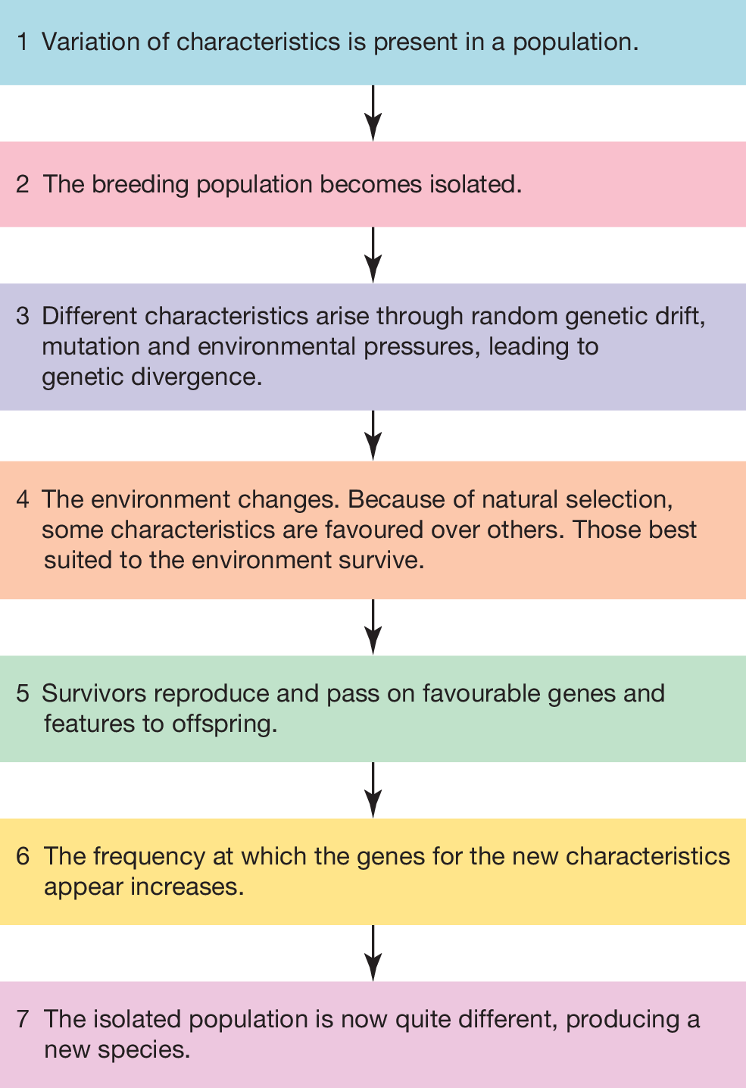
The process of speciation

Slide 7
Types of Speciation
Speciation can be categorised as:
Allopatric Speciation (requires geographical barrier)
Sympatric speciation (occurs within same geographic area)

Slide 8
Allopatric speciation
The geographic separation of a population from a parent population resulting in the formation of a new species.
Allopatric = ‘different homeland’
This may occur by habitat fragmentation :
fast acting – clearing or construction
slow acting – river changing course
even slower acting – uplift of mountains or rising sea levels

Slide 9
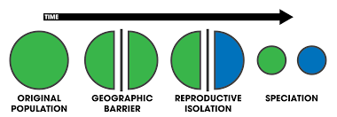
Process of Allopatric speciation
1. Initially a population (or populations) of the same species becomes isolated by a geographical barrier.
2. The isolated populations are exposed to different selective pressures.
3. Over time, sufficient differences accumulate in the two populations until they form new species.
4. Once these steps have occurred, the two populations could be reunited and would be unable to interbreed to produce viable and fertile offspring.

Slide 10
Process of allopatric speciation

Slide 11
Example of Allopatric speciation- Galapagos finches
Ecological niche- The specific environmental conditions and resources or selection pressures within a particular environment
The Galápagos Islands are a collection of 19 islands situated in the Pacific Ocean west of Ecuador. Each of the 19 islands represents a specific ecological niche, each with its own different selection pressures and species. These islands are separated by the ocean, which serves as a geographical barrier, preventing gene flow between them.
Currently, there are 18 known species of Galápagos finches (Darwin’s finches), belonging to various genera, with more species constantly being speculated and discovered.
It has been hypothesised that allopatric speciation resulted the formation of these different species of Galápagos finches. Main reasons are:
each of the islands is separated by the ocean, preventing gene flow
different islands have different food sources and each island presents its own selection pressures, selecting for different phenotypes (such as beak shape) and allowing for genetic differences to accumulate.
Subsequently, once sufficient differences accumulated and viable and fertile offspring could no longer be produced through interbreeding, new species of finches were formed.

Slide 13
Example of Allopatric speciation
A snapping shrimp population.
The population was separated by the Isthmus of Panama, a stretch of land in Central America that formed around 3 million years ago.
Populations either side of the land mass were subject to different selection pressures.
Over time, differences accumulated and new species formed.

Slide 14
Sympatric speciation
The divergence of a species from an original species without the presence of a geographical barrier.
Sympatric speciation can occur when gene flow is restricted by:
Environmental niche
Polyploidy
Change in sexual selection preferences
Environmental niche- Different selection pressures act on different phenotypes within a population, causing individuals with certain phenotypes to diverge from others and form a new species.
Two different Australian palms: a) H. forsteriana and b) H. belmoreana

Slide 15
Sympatric speciation due to environmental niche in Howea palms
Plants are generally tolerant to changes in their sets of chromosomes. Therefore, sympatric speciation arising from genetic abnormalities is nearly exclusively seen in plants.
Howea palms (found in Lord Howe Island, small Australian island located in the Tasman Sea), are serving as one of the most conclusive examples of sympatric speciation. Two species of particular interest include Howea forsteriana and Howea belmoreana.
Researchers hypothesised that differences in soil pH were the catalyst for speciation.
While Howea belmoreana inhabits neutral and acidic soils (low pH), Howea forsteriana inhabits a region of alkaline soil (high pH) known as calcarenite. This led researchers to suggest that Howea forsteriana diverged from its sister species Howea belmoreana after the initial population colonised the alkaline soil, which acted as a selection pressure.
One of the physiological differences that began to develop included changes in flowering times, which served as a reproductive isolation mechanism. Given the relatively small size of Lord Howe Island, it is unlikely that the Howea palms were ever geographically isolated from one another, further supporting the idea that the speciation event occurred sympatrically.

Slide 16
Sympatric speciation due to Polyploidy Sympatric speciation can also arise from genetic abnormalities that occur during gamete formation, producing polyploid variants (when an organism contains additional sets of chromosomes in its genome)

Slide 17
Sympatric speciation due to Sexual selection

Slide 18
Worked Example
D The species are not geographically isolated as they live in the same lake. Therefore, this is an example of sympatric speciation. As this is sympatric speciation, there would have been some gene flow initially between species

Slide 19
Summary
A species is a group of individuals that can produce fertile viable offspring when interbreeding.
Speciation is the process of forming a new species, which requires isolation and genetic divergence.
Species can be isolated from each other with the pre-zygotic isolating mechanisms; temporal, geographical, behavioural and mechanical isolation.
Species can be isolated from each other with the post-zygotic isolating mechanisms; incompatible gametes, zygote mortality, inviable zygote and sterility of zygotes.
Allopatric speciation occurs when there is geographical isolation to stop gene flow between populations. An example of allopatric speciation is seen in Galápagos finches.
Sympatric speciation occurs without geographic isolation. Initially some gene flow can still occur and is eventually prevented by another isolation mechanism (such as temporal isolation). An example of sympatric speciation is seen in Howea plants on Lord Howe Island.

Slide 20
Reflection
Edrolo 9D Q 2,3, 10-14

