Slide 1
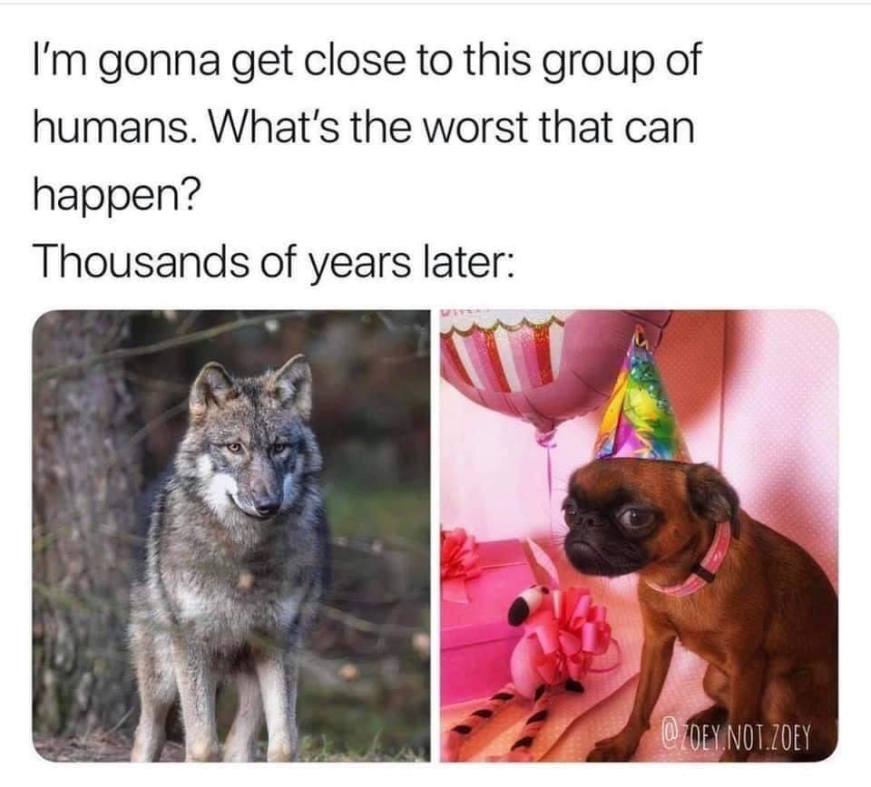
Learning Intention: - To learn how humans can select for particular traits in plants and animals and how this affects a population’s genetic diversity. - To learn about the development of antibiotic-resistant bacteria - To understand how viruses constantly change through antigenic drift and shift.
Success Criteria:
- I can explain the selection of particular traits by humans in plants and animals
and how this affects a population’s genetic diversity. - I can explain about the development of antibiotic-resistant bacteria - I can explain how viruses constantly change through antigenic drift and shift.
Study design dot point
manipulation of gene pools through selective breeding programs
biological consequences of changing allele frequencies in terms of increased and decreased genetic diversity
consequences of bacterial resistance and viral antigenic drift and shift in terms of ongoing challenges for
treatment strategies and vaccination against pathogens

Slide 2
Warm up
Divide class into pairs (or larger groups in a large class) and have each group take one of the following species used in agriculture:
○ Horse
○ Cow
○ Sheep
○ Wheat
○ Corn
○ Bananas
Students investigate how the species has been changed over time for agricultural purposes. Students should answer the following:
○ What traits have been improved?
○ How does that benefit human society?

Slide 3
Selective Breeding
The changing of a population’s gene pool due to humans altering the breeding behaviour of animals and plants to develop a selected trait.
Selective breeding is an example of artificial selection.
- Done to improve herd quality – the best males would be selected for mating with the best females.
- Genetic superiority – desirable characteristics such as: Meat yield, Low fat carcass, Milk yield, Milk quality, Wool quality, Fertility levels.
Selective breeding is the deliberate selection of specific animals to provide genetic material to the next generation.
It is very similar to natural selection, main difference lying in the origin of selection pressure.

Slide 4
Requirements for Selective breeding

Slide 5
Note: This is an extension. No direct questions will be asked based on technologies for selective breeding

Slide 6
The effect of selective breeding on genetic diversity and genetic fitness
Selective breeding can lead to smaller gene pools and overexpression of deleterious alleles, which can reduce adaptability and fitness within a population. The survival rate of a population, life expectancy is lowered and genetic diversity is lowered. Example:
Sphynx cats – no hair, can’t maintain body temperature
English bulldogs – short snouts, breathing issues
Jacobin pigeon – large feathers around the head, can’t see
If poor breeding practices are implemented, selective breeding can cause a human induced genetic bottleneck. The generational increase in the frequency of the selected allele will decrease genetic diversity as the phenotypes of the population are driven towards a specific allele.
For example, a human selection pressure that favours dark-coloured beetles will increase the prevalence of the dark-coloured allele within the resulting population.
Reduced genetic diversity can lead to increased inbreeding, which can increase the prevalence of deleterious alleles, and a lower adaptive potential.
Definitions:
Deleterious allele- An allele that has an overall negative effect on individual fitness when expressed
Adaptive potential- The ability for a population to adjust to new environmental selection pressures

Slide 7
Summary
Selective breeding is one form of artificial selection used in plant and animal breeding.
Selective breeding will select for desired traits for human benefit rather than traits which increase the survival chances of the population.
Selective breeding can decrease the genetic diversity of gene pools.
Loss of genetic variation in a population may result in failure of the population to survive environmental change

Slide 8
Bacterial resistance to antibiotics
The inappropriate use and overuse of antibiotics have led to the emergence of antibiotic-resistant bacteria.
Antimicrobial agent- An agent that kills or slows the growth of microorganisms. Examples include antiseptics, disinfectants, antifungals, antivirals, and antibacterial agents
Antimicrobial resistance- The ability of a microorganism to survive exposure to an antimicrobial agent.

Slide 9
Antibiotic resistance
The exposure to antibiotics serves as an environmental selection pressure for bacteria. Bacteria with resistance to a particular antibiotic will be conferred a selective advantage, allowing them to continue living and replicating within their host and increasing the allele frequency for antibiotic resistance. Bacteria which are susceptible to the antibiotic are killed by the antibiotic. Bacteria are also able to exchange genetic material with each other through a process known as bacterial conjugation (the process in which bacteria exchange genetic material via direct cell-cell contact), further spreading the alleles for antibiotic resistance.

Slide 10
Mechanisms of antibiotic resistance in bacteria
Variation and the emergence of new alleles conferring resistance against antibiotics is facilitated largely by mutations.

Slide 11
Factors which contribute to the formation of antibiotic-resistant bacteria

Slide 12
Viral antigenic drift and Antigenic shift
Viruses constantly adapt and modify their surface antigens through the processes of antigenic drift and shift, thereby increasing the difficulty of forming effective vaccines and medications against viruses.

Slide 13
Antigenic drift - involves small and gradual changes in the genes encoding for viral surface antigens. In the beginning, previous memory cells generated will be capable of recognising these mutated surface antigens. However, as the mutations continue to accumulate, a new subtype of virus can form, which will no longer be recognised by previously generated memory cells.
Antigenic shift- involves sudden and significant changes in the genes encoding for viral surface antigens. Two or more different strains of a virus combine when coinfecting the same host to form a completely new subtype through a process known as viral recombination. Natural immunity to this new virus subtype is likely to be uncommon, making it extremely infectious, with the potential to develop into an epidemic or pandemic.
The change in a virus's antigen through antigenic drift and antigenic shift

Slide 14
Antigenic drift and shift in influenza virus

Slide 15
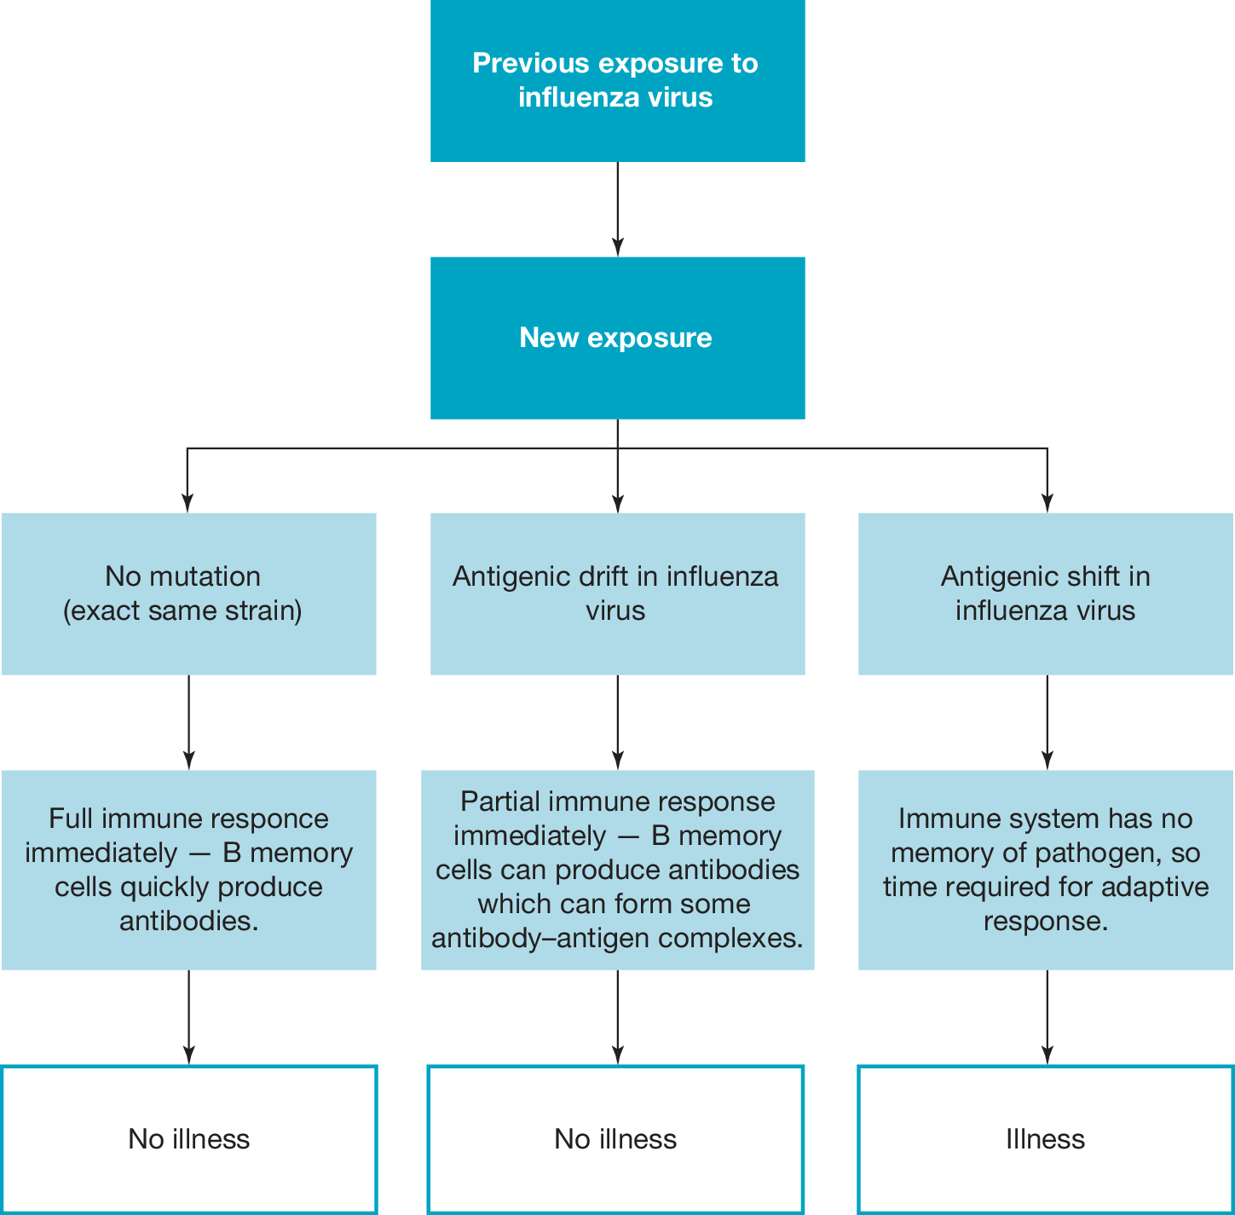
Consequences of antigenic drift and shift

Slide 16
Summary
Bacteria reproduce rapidly and this provides more opportunities for mutations to occur.
Bacterial resistance occurs through the process of natural selection, with resistant bacteria having a selective advantage.
Bacterial resistance genes can be acquired through horizontal gene transfer.
Some diseases are becoming increasingly difficult to treat with antibiotics.
The reduction and careful prescribing of antibiotics is required to reduce the rate of bacterial resistance.
Changes in viral antigens results from antigenic drift and antigenic shift.
Antigenic shift produces new strains of a virus which require a new immune response.
Viruses that have a rapid rate of antigenic drift and/or shift require the strains to be tracked and novel vaccinations produced.

Slide 17
Worked Example
a The key difference is that, with selective breeding, humans choose organisms with a desirable trait and breed them, whereas with random mating, each bull and cow have an equal chance of mating.
VCAA examination report note: It was important here that students made a comparison between the two.
b Selective breeding reduces genetic variability. VCAA examination report note: This part was well answered; however, many students did not gain the mark as they made further incorrect statements, such as that the number of genes were reduced. Students must realise that all members of the same species have the same genes; it is the alleles which may be different.
c Explanation should refer to artificial insemination influencing the frequency of certain alleles in the next generation by one bull contributing more frequently to the population.

Slide 18
Reflection
Edrolo 9E Q 2,3,5, 11-14
9F Q 2,3,10-12, 14

