Slide 1
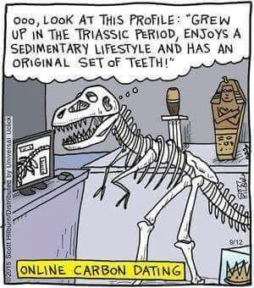
Learning Intention: - To explain what geological time is and provide examples of time periods within this - To explain how the fossil record has allowed for changes in species to be observed - To identify different types of fossils - To describe how fossils are formed through the process of fossilisation - To explain the use of relative dating and absolute dating
Success Criteria:
- I can explain what geological time is and provide examples of time periods
within this
- I can explain how the fossil record has allowed for changes in species to be
observed
- I can identify different types of fossils
- I can describe how fossils are formed through the process of fossilisation
- I can explain the use of relative dating and absolute dating
Study design dot point
changes in species over geological time as evidenced from the fossil record: faunal (fossil) succession, index and transitional fossils, relative and absolute dating of fossils

Slide 2
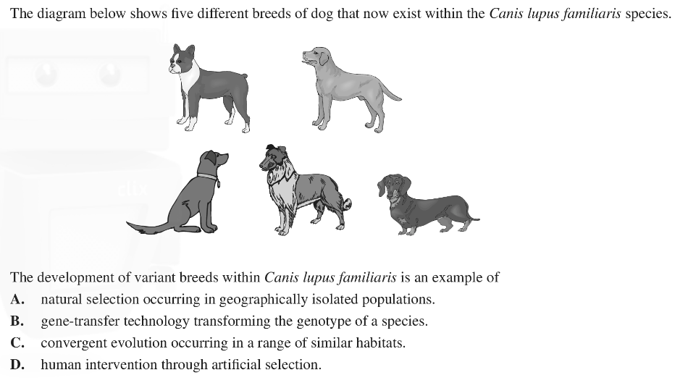
Warm up

Slide 3
Key events in our geological timeline
Note: for the purposes of VCE Biology, it is not necessary to
memorise the scientific names of different eras. Instead, this figure is provided to give context to the fossil record by showing when different life forms evolved. *mya = millions of years ago, bya = billions of years ago.

Slide 4
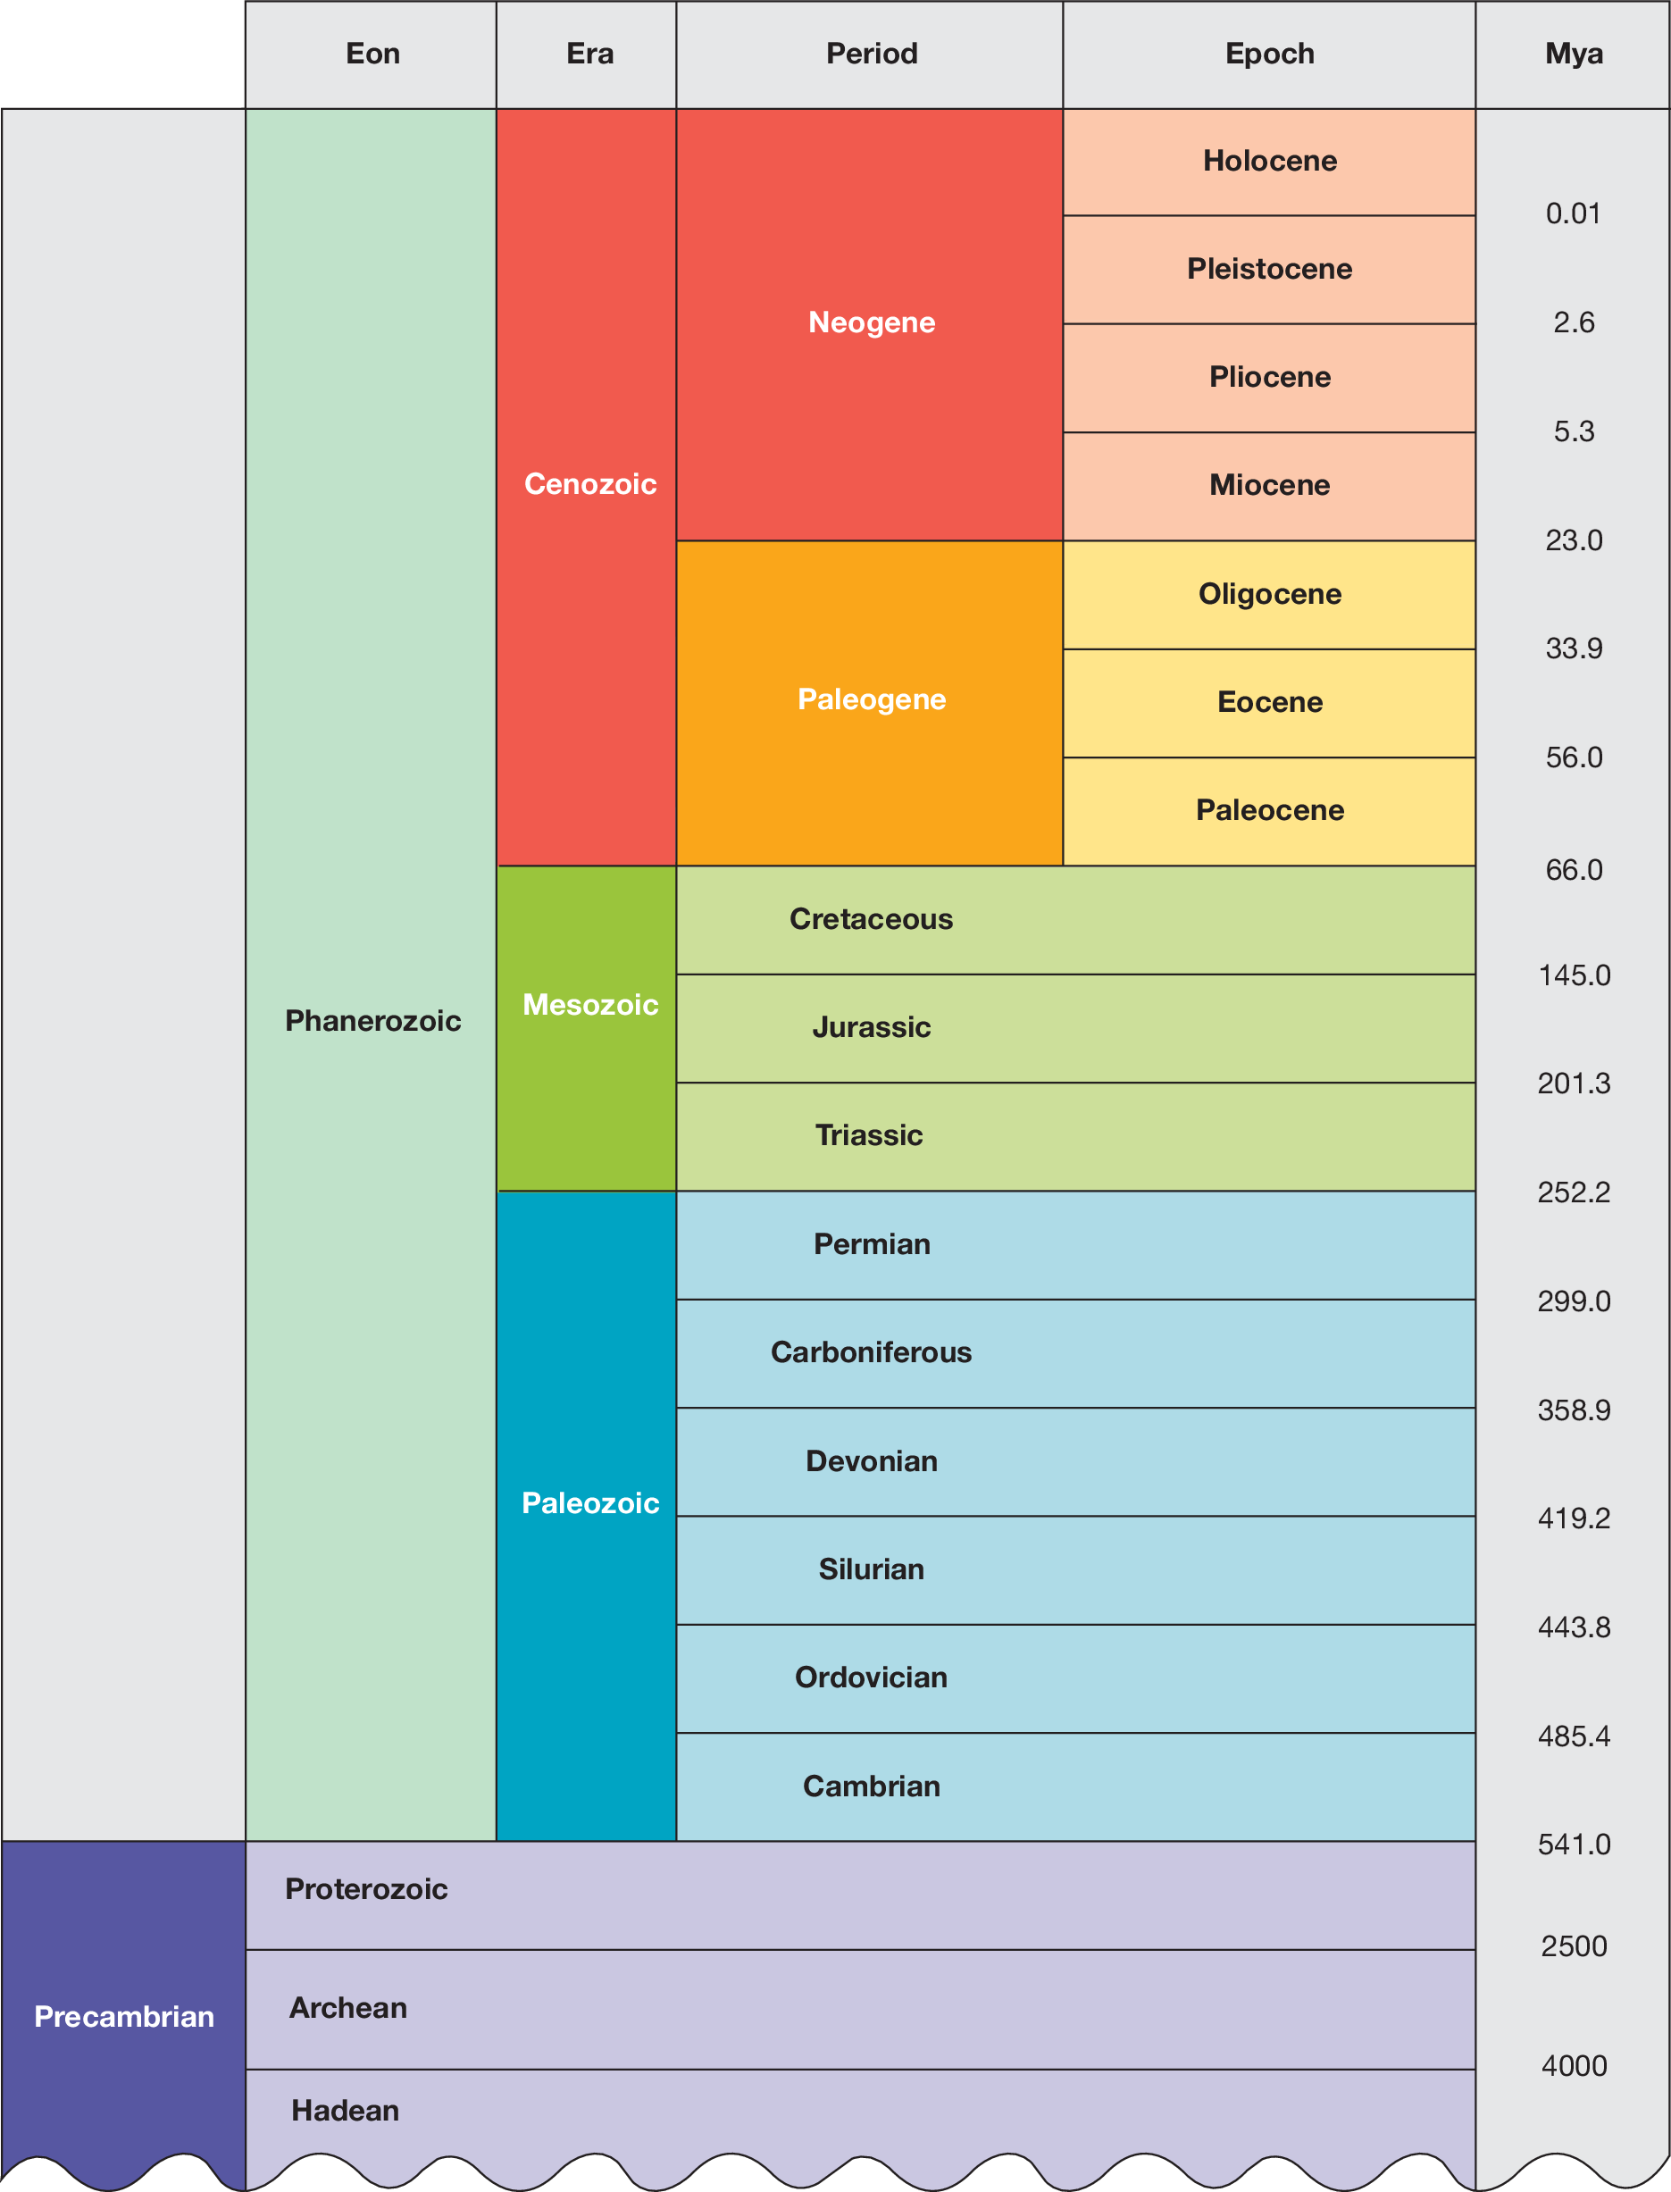
Time intervals in geological time
The geological history of the Earth is divided into various time intervals as a hierarchy that includes eons, eras and periods. From largest to smallest, these are:
eons →→ eras →→ periods →→ epochs →→ ages.
Note: You do not have to memorise these dates, you should understand that geological time is broken up into smaller groupings that often differ in their fossil records.

Slide 5
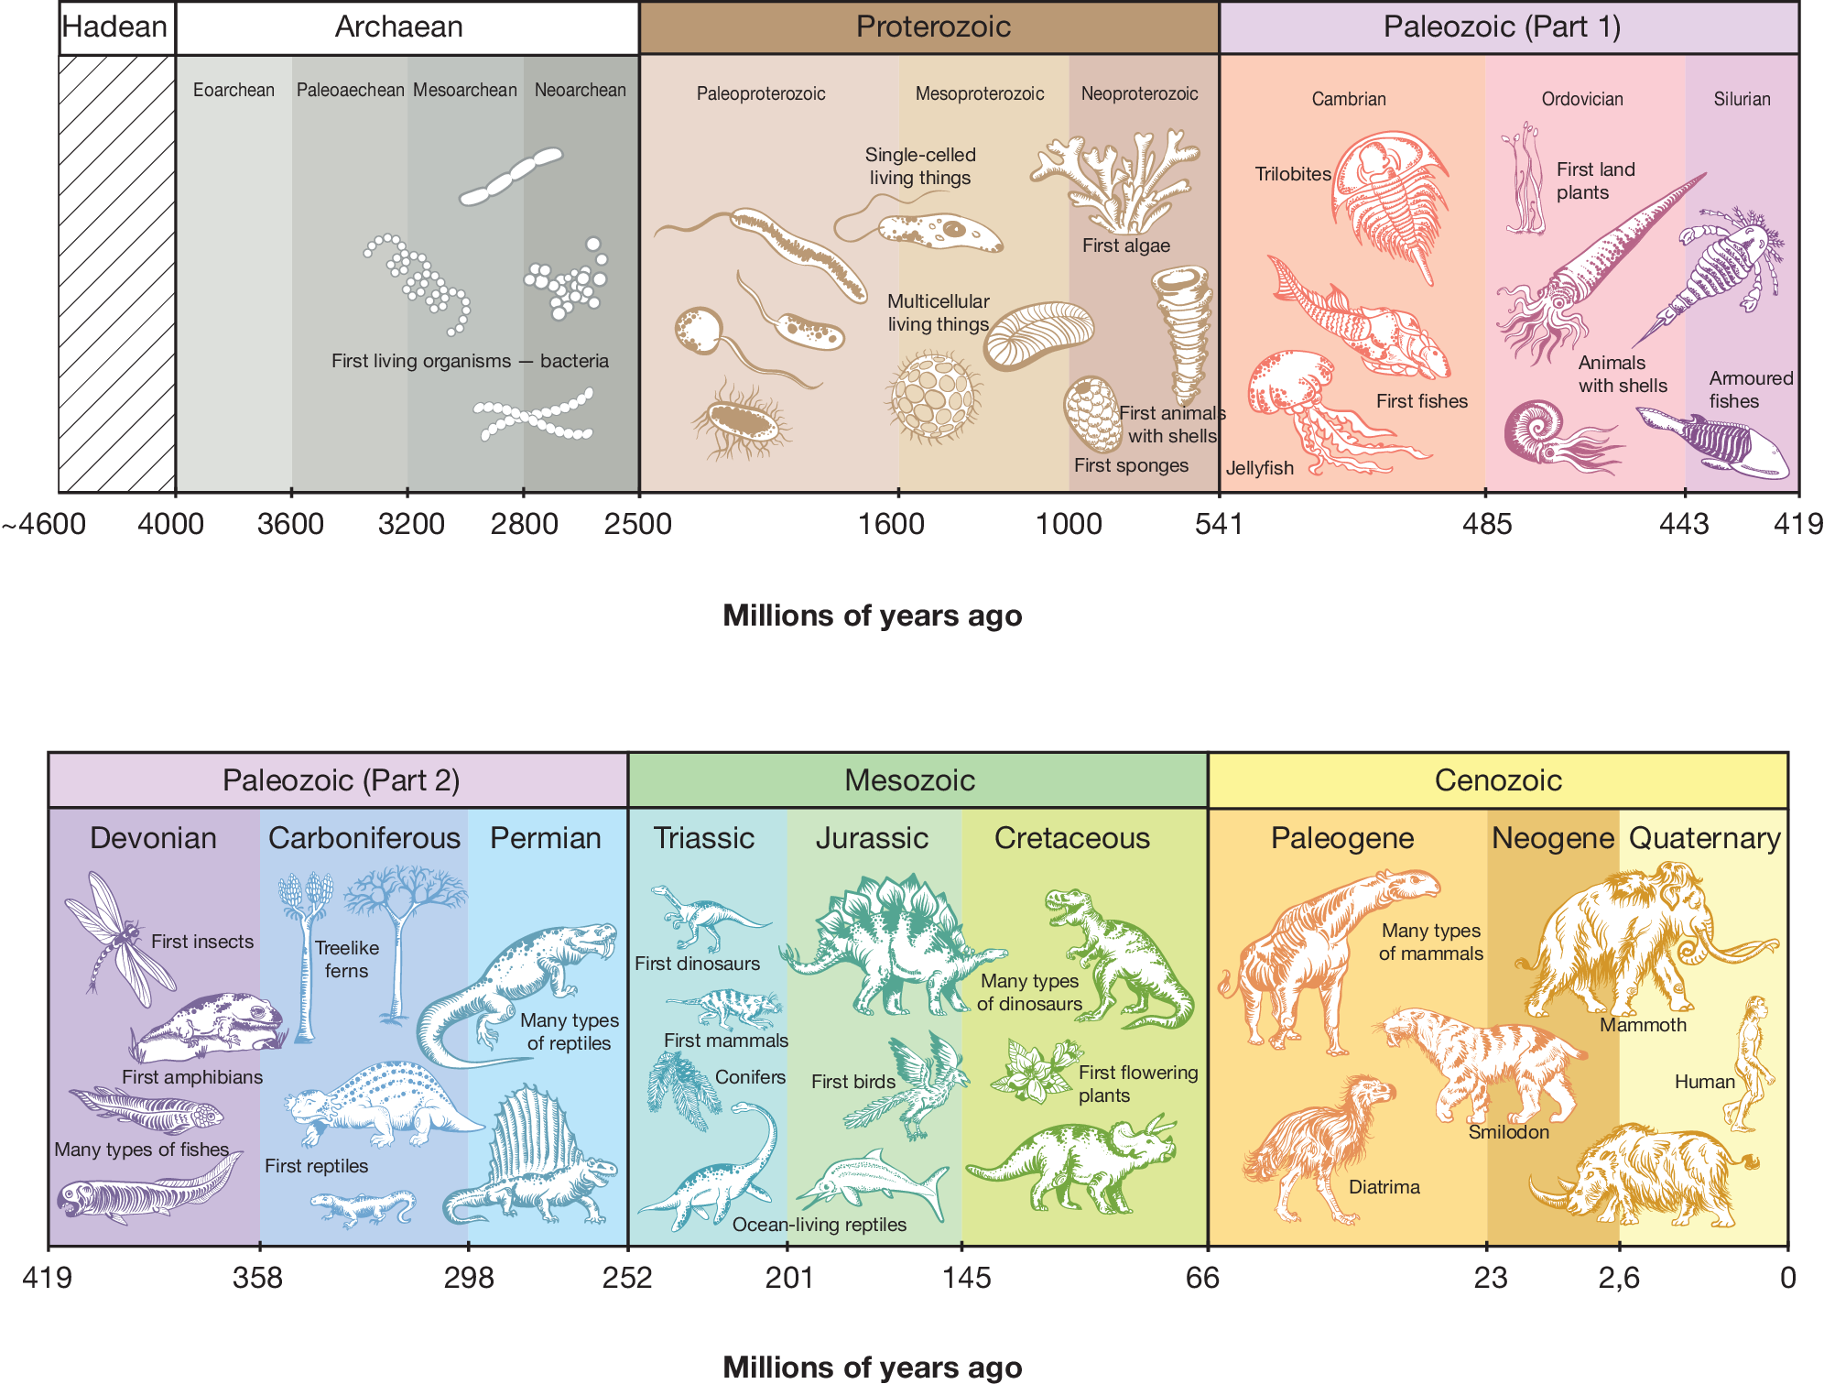
Changing life forms over time evidenced with fossils

Slide 6
Fossil record is the information derived from fossils. The fossil record is arranged in chronological order and helps us map the history of life on Earth, placing species in the appropriate geologic time frame.
Note: You do not need to memorise the dates at which different organisms were formed or fossils were found, but you should have a general idea about the order in which they appeared (for example, amphibians and reptiles came into existence before mammals).
Approximate times of appearance of various life forms on Earth.

Slide 7
Formation of fossils
https://www.youtube.com/watch?v=4-dTz416rYg
The process of fossilisation occurs when:
Remnants of an organism are rapidly covered by sediment- The dead organism is not exposed to oxygen, microorganisms, and other disturbances that would increase its rate of decomposition.
Over time, sediment layers build upon each other and compact, layer by layer, until pressure cements them together to form sedimentary rock.
Within this rock, the fossilised remains can take many forms, including a permineralised mould, or cast fossil.
The conditions that increase the likelihood of fossilisation include:
• physical protection from scavengers and decomposers (e.g. fungi,
bacteria)
• areas of rapid sediment accumulation
• constant cool temperatures
• low oxygen availability
• low light exposure.
The process of creating
sedimentary rock

Slide 8
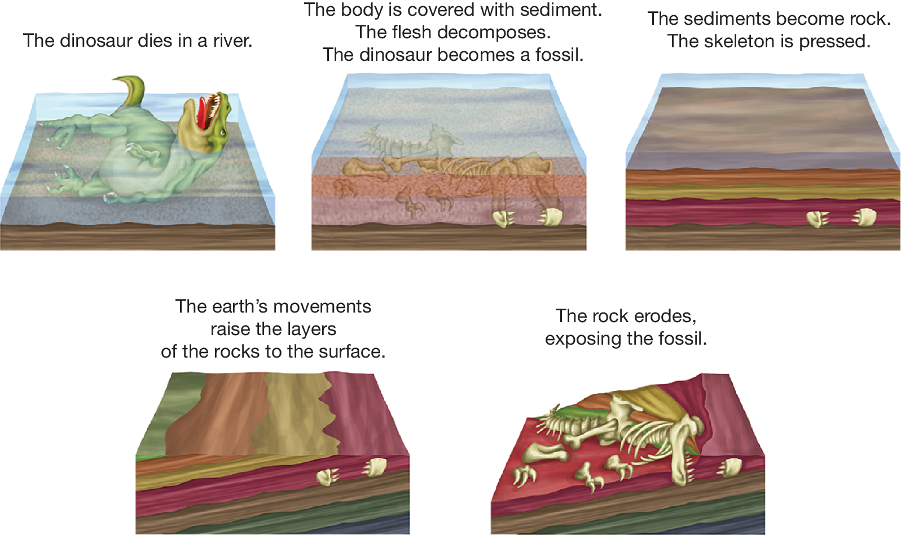
An example of how an organism may become fossilised

Slide 9
Types of fossils
Fossils can be categorised as:
1. Physical fossils — remains of structures- Physical fossils are the remains of all or part of the structures of organisms, such as bones, teeth or leaves. These fossils are commonly formed as mineralised fossils, fossil impressions or preserved organisms.
2. Trace fossils — evidence of activities- Trace fossils are preserved evidence of the activities of organisms, such as footprints, tooth marks, tracks, burrows and coprolites (fossilised dung)
3. Biosignatures — inferred evidence- Biosignatures or biomarkers provide evidence from which past life may be inferred to exist e.g. corrosion pits in rocks caused by chemosynthetic microbes
Physical fossils: a. mineralised fossil of an ammonite shell (Dactylioceras commune); b. impression fossil of the hard exoskeleton of a trilobite (Elrathia kingie)
Trace fossils a. A small part of the dinosaur trackway at Lark Quarry, near Winton in central Queensland. (Image courtesy of Judith Kinnear.) b. Coprolite fossil

Slide 11
Using the fossil record: Relative dating
There are two main techniques for dating fossils: Relative dating and Absolute dating.
Relative dating is based on the:
Law of fossil succession- States that because sedimentary rock is formed by the accumulation of sedimentary layers on top of each other, the fossils closer to the surface must be younger than those that are found below them
Geological time scale- The law of fossil succession also means that we don’t necessarily need to have another fossil to compare against in order to assign our new fossil a relative age. Instead, we only need to be able to determine the age of the rock stratum in which the fossil is found.

Slide 12
Index fossils- group of widespread fossils which existed for a short period and have a known age. Can be used as a reference to easily determine the age of unknown fossils. For the best index fossils, the species must be:
- physically distinctive
- have had a large population
- have existed in many geographical areas
- only lived within a known short period of time.
Transitional fossils- a fossil that shows traits that are common to both its ancestral group and its descendant group. These are useful when these two species are morphologically very distinct. They are called transitional fossils because they exhibit traits that are common to both an ancestor and its descendants.

Slide 13
Using the fossil record: Absolute dating
Absolute dating using half life of radioactive isotopes is based on the following three principles:
1. Radioisotopes are unstable elements that will break down over time into a more stable product.
2. On average the rate of breakdown is constant and can be modelled by calculating the half-life of that radioisotope.
3. Half-life describes the amount of time before half of the mass of a radioisotope is broken down into predictable and
stable products.
For example, carbon-14 is a radioisotope that has a half-life of 5 730 years. This means that after 5 730 years of an organism’s death, half of its carbon-14 atoms will have broken down into nitrogen-14 Atoms.
Half-life of radioactive isotopes- absolute dating techniques can be used to calculate the absolute age (an estimate of the age) of a fossil in years. Radioactive dating involves comparing the ratio of radioactive isotopes (radioisotopes) found inside the fossil to the relatively stable amount found in the atmosphere.

Slide 14
Regardless of the radioisotope used, scientists will measure how much of it is present in the fossil versus how much of its breakdown product is present. This ratio can be used to work out the time that would have needed to have passed to facilitate this amount of breakdown, which is the age of the fossil. The half-life varies between radioisotopes. Each radioisotope series will have a different dating period. Dating period, refers to the period of evolutionary time for which each radioisotope series is useful.

Slide 15
Radiocarbon dating
Radiocarbon dating uses the radioisotope series carbon-14 (14C) to nitrogen-14 (14N). The general principles are as follows:
1. All living things contain carbon. This carbon exists as a ratio of two
isotopes – 12C (a stable isotope) and 14C (a radioactive isotope). The ratio
of these two isotopes will be the same as the ratio in the atmosphere, given
that carbon is constantly being cycled between the organism and its
environment while it is alive.
2. When the organism dies, its 14C will begin to decay and breaks down into
14N (a stable isotope). While this decay occurs, the carbon in the dead
organism will not be replaced by existing carbon in the atmosphere. So,
levels of 12C (a stable isotope) will remain the same, while 14C decays at a
known rate–causing the ratio between the two isotopes to change.
3. At any point, scientists can measure the amount of 14C present in the fossil
and determine how long ago it died. This is done by comparing the 14C :
12C ratio in the fossil to the ratio of 14C : 12C in the atmosphere. The
longer ago the organism died, the less 14C will be present (having broken
down into 14N).

Slide 16
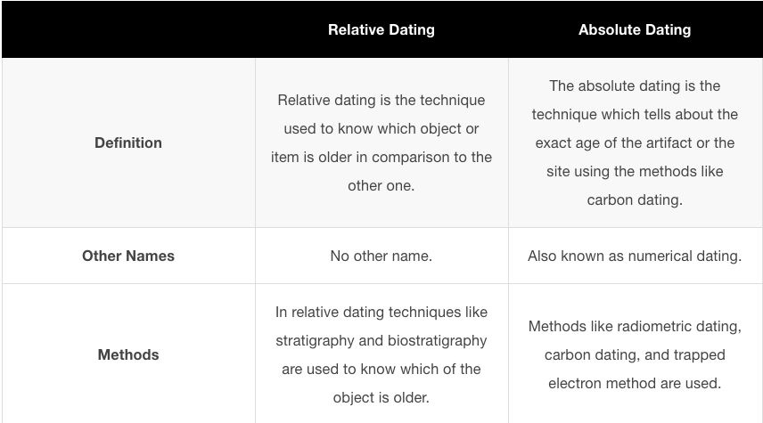
Summary

Slide 17
Evidence for biological change over time comes from the fossil record.
Faunal succession is the principle that fossilied organisms are arranged vertically within sedimentary rock in a particularly manner.
Index fossils are the fossils of widely distributed short-lived species that can be used to determine the age of other fossils.
Transitional fossils have intermediate features of two species and provide evidence for how species have changed over time.
The age of a fossil can be determined through relative or absolute dating.
Relative dating uses stratigraphy and the principle of superposition to determine the age of a fossil.
Relative dating relies on faunal succession and index fossils to provide the age of rocks and fossils.
Radiometric techniques or absolute dating are based on the decay of naturally occurring radiometric isotopes and can be used to estimate the absolute ages of rocks.

Slide 18
Worked Example
A
Tiktaalik is an example of a transitional fossil, showing
features of both fish and reptiles.
VCAA examination report note: From the diagram and the
description it can be inferred that the organism represented by
the fossil is a transitional form.

Slide 19
Reflection
Edrolo 10 A Q 2, 12-19

