Slide 1
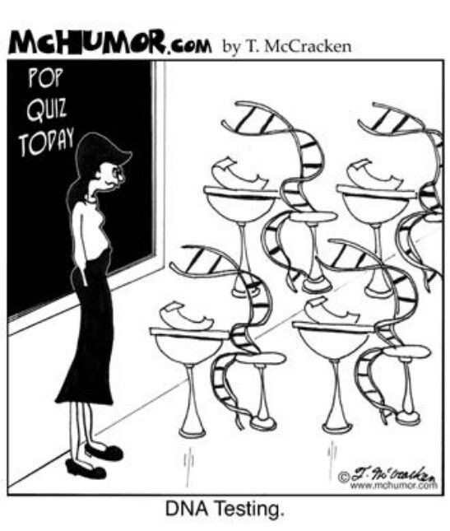
Learning Intention: - To describe what homologous and vestigial structures are, give examples and explain what evidence of relatedness they provide. -To explain how amino acids sequences and DNA sequence are compared and used to determine the relatedness between species - To compare the use of amino acid and DNA sequences, suggesting benefits of each
Success Criteria:
- I can describe what homologous and vestigial structures are, give examples
and explain what evidence of relatedness they provide.
- I can explain how amino acids sequences and DNA sequence are compared
and used to determine the relatedness between species
- I can compare the use of amino acid and DNA sequences, suggesting
benefits of each
Study design dot point
evidence of relatedness between species: structural morphology – homologous and vestigial structures; and molecular homology – DNA and amino acid sequences

Slide 2
Evidence to show relatedness between species
Many pieces of evidence are used to show relatedness between species. These include:
Structural morphology: comparing structures between individuals such as homologous and vestigial structures
(this is often done through the fossil record)
Molecular homology: comparing DNA and amino acid sequences
Developmental biology: comparing the embryonic development of different organisms
Biogeography: exploring the locations of different species (both living and extinct species over geological time
through fossils) and comparing this relative to continental drift.

Slide 3
Homologous structures
Homologous structures are physical similarities between two species which indicate that they have a common ancestor.
Homologous structures are features found in different species that may look and function very differently from one another but can be shown to have been derived from a common ancestor.
Homologous structures are physical evidence of divergent evolution, the evolutionary process where two or more populations of a single species accumulate enough genetic differences to be classified as different species. This process typically occurs as a result of individual populations adapting to different selection pressures or genetic drift which alters population genomes over extended periods of time.
They all share a similar bone structure but different function

Slide 4
Analogous structures
Structures that serve similar biological functions but are not derived from a common ancestor. Analogous structures are evidence of convergent evolution in which two or more distantly related species (without a recent common ancestor) can be seen to have independently evolved similar traits to adapt to similar environments and selection pressure.
A bird’s wing and an insect’s wing are analogous structures. A bird’s wing consists of several bones, while
an insect’s wing consists of a thin membrane without any bones.

Slide 5
Vestigial structures
Features that have lost all or most of their usefulness as a result of evolution by natural selection.
These structures found within organisms, once served a purpose for an organism’s ancestors but, due to changing selection pressures, have lost their original function and are no longer required for survival
Example- The human tailbone does not serve a significant function in modern humans. It is a vestigial structure, a remnant of our ancestors’ tail that was used to balance their bodies when they lived in trees.

Slide 6
DNA sequence similarity
Species that are most closely related are more biochemically similar. Species that have diverged from a common ancestor more recently have fewer base differences in their DNA, because there has been less time for mutations to accumulate in their genome than for species that share a more ancient common ancestor.
There are several ways that DNA can be compared between species, including:
DNA sequencing- Figure shows a comparison of the DNA sequence of humans, rats, and yeast at a particular segment of corresponding DNA. In this particular segment,humans and rats have three nucleotide differences, whereas humans and yeast have seven nucleotide differences, indicating that
rats are more closely related to humans than yeast.
DNA-DNA hybridisation- Estimating genetic similarity based on how much heat is required to separate a hybrid of DNA strands from the two species.
A method for comparing the degree of similarity between DNA from two species by joining (or hybridising) and testing how tightly joined they are.

Slide 7
Amino acid sequence similarity
Molecular homology is the study of the similarities between organisms at a DNA and amino acid level.
When studying amino acid sequence similarities, we analyse proteins from conserved genes which are found in a number of different species.
Conserved genes- Genes that have remained largely unchanged throughout evolution, and are found across the genome’s of many different species.
Example: An enzyme found in organisms from all of the five kingdoms is known as cytochrome c. Human cytochrome c has been compared with that from other organisms.
Comparison of the sequence of amino acid sub-units in cytochrome c from various species. Cytochrome c also occurs in yeast cells

Slide 8
Example: Haemoglobin
Figure shows a portion of the amino acid sequence of haemoglobin in humans and four other vertebrates. It can be seen that, compared to humans, chimpanzees have the highest level of similarity in their amino acid sequence for haemoglobin (no difference), followed by gorillas, and finally kangaroos. This suggests that chimpanzees are the most closely related to humans (and, by extension, share the most recent common ancestor) and kangaroos are the most distantly related.

Slide 9
Analysing amino acid sequences vs DNA sequences
There are fewer differences between organisms’ protein amino acid sequences than there are between their DNA nucleotide sequences, because frequently a mutation in the DNA sequence does not result in a change in the amino acid sequence. In these instances, scientists determine relatedness by comparing nucleotide sequences.
And for this reason, proteins (rather than DNA) are often used to compare the relatedness of more distantly related species.

Slide 10
Comparing whole genomes
The genome is the complete set of genes found in an organism. The more recent the divergence of two related species from a common ancestor, the greater the number of conserved DNA sequences and of their arrangement within the genome.
By comparing the genomes of living species, it is possible to:
- identify the degree of relationship between different species from the fraction of genes shared between their genomes
- make inferences about the phylogeny or evolutionary history of a species.

Slide 11
Summary
Evidence of relatedness between species can be shown with structural morphology as homologous structures and vestigial structures.
Homologous structures show similarities in structures of different species due to a common ancestor.
Homologous structures show how different species have adapted to different environmental selection pressures over time.
Vestigial structures are features of an organism that have lost all or some of their original function.

Slide 12
Worked Example

Slide 14
Reflection
Edrolo 10 B Q 2-4, 9-12
Jacaranda worksheet- Analysing and inferring evolutionary relationships

