Slide 1
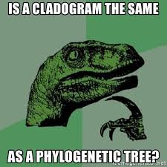
Learning Intention: - To describe how phylogenetic trees represent relatedness - To learn how to interpret a phylogenetic tree
Success Criteria:
- I can interpret and create phylogenetic trees to show relatedness between species.
- I can interpret uncertainties in the phylogenetic trees.
Study design dot point
the use and interpretation of phylogenetic trees as evidence for the relatedness between species

Slide 2
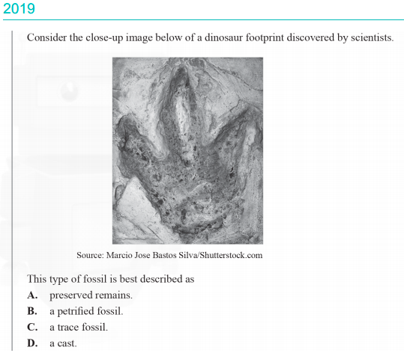
Warm up

Slide 3
Phylogenetic trees
Also called evolutionary trees, showing inferred evolutionary relationships or lines of descent between organisms from molecular data or other evidence. Phylogenetic trees are not fixed and may change when new information is evidenced.
They can be drawn using diagonal, vertical or horizontal lines.
They can be useful in displaying:
• the timeline of lineages
• relatedness between taxa
• shared characteristics of different taxa.
Lineage a direct sequence of species that evolved from a
common ancestor
Taxon- a unit of biological classification into which related organisms are classified. Taxa are arranged in a hierarchical rank from kingdom down to species, where members of a specific taxon typically share certain morphological characteristics

Slide 4
The structure of a phylogenetic tree
Components of Phylogenetic tree
Basic structure of Phylogenetic tree

Slide 5
Interpreting phylogenetic trees
Reading phylogenetic trees: Phylogenetic trees can be read backwards to determine the most closely related species to a particular taxon.
Example: you can trace back from the ‘human’ leaf to reach the next node (node A), which splits humans from monkeys, showing that monkeys are the closest relative to humans on this tree. You can trace the tree further back to the next node (node B), which separates humans and monkeys from dolphins and sheep, showing that humans are more closely related to monkeys than they are to dolphins and sheep. It’s important to note that the most recent common ancestor of humans and monkeys occurs at node A.

Slide 6
Phylogenetic trees may include a timescale in order to show the time points of divergence events.

Slide 7
Method 1
Step 1: Determine the number of differences between the different species or groups provided.
Step 2: Identify the sequences with the fewest differences.
Step 3: Connect these groups with the fewest differences as sister taxa, joined by a node.
Step 4: Determine the group with the fewest differences to the sister taxa and add this onto your tree as a branch.
Step 5: Continue this until all groups are added onto the phylogenetic tree.
Step 6: Determine the outgroup (if any), which is the most distantly related group (has the most differences to the other species). Place this on the phylogenetic tree
Constructing phylogenetic trees

Slide 8
Method 2
Step 1: Figure out the trait that is shared by the largest number of animals. In the example most of the animals have four legs, except for bony fish. Therefore, we can draw the bony fish lineage branching off from the rest of the animals.
Step 2: Then we look for the trait shared by the second-largest number of animals, which in this case is the fur. Only amphibians do not have this trait, so we draw the amphibians lineage branching off from the rest of the animals before the ‘fur’ label.
Step 3: Finally, it can be noticed that both marsupials and placental mammals have fur, so the marsupials and placental mammals lineages are branching directly from the trait fur.

Slide 9
Depicting uncertainties in phylogenetic trees
Since dating techniques are not always completely accurate and fossils are not typically perfectly preserved, the uncertainties can be expressed using phylogenetic trees in several ways:
The lack of a node between species Y and Z means that the exact divergence point is unknown.
The break between species W and X means that W is possibly an ancestor of X but there is no evidence of transitional fossils between the two species to support this hypothesis.
The branch with species S does not reach the end of the tree, indicating that it is extinct.
Nodes usually only split into two lineages, but sometimes they can split into three or more, as seen between species T, U, and V. This means that it’s unclear which species diverged from the others first. This occurs if there is insufficient data or if two speciation events occurred closely together – such as with adaptive radiation.
Sometimes genetic material is passed between groups after they have diverged. This is depicted using a line between branches (Figure 2)
Figure 2

Slide 10
Summary
Relationships between organisms can be shown in diagrams called phylogenetic trees.
Phylogenetic trees enable inferences to be made about the evolutionary history of groups of organisms.
Phylogenetic trees are typically based on molecular data, while cladograms use shared derived features (which can be molecular) that are inferred to have evolved from an original character present in an ancestral organism.
Molecular data, including differences in DNA base sequences and amino acid sequences of proteins, are used as a basis for constructing phylogenetic trees.
The greater the number of molecular differences between two taxa, the longer the period since they diverged

Slide 11
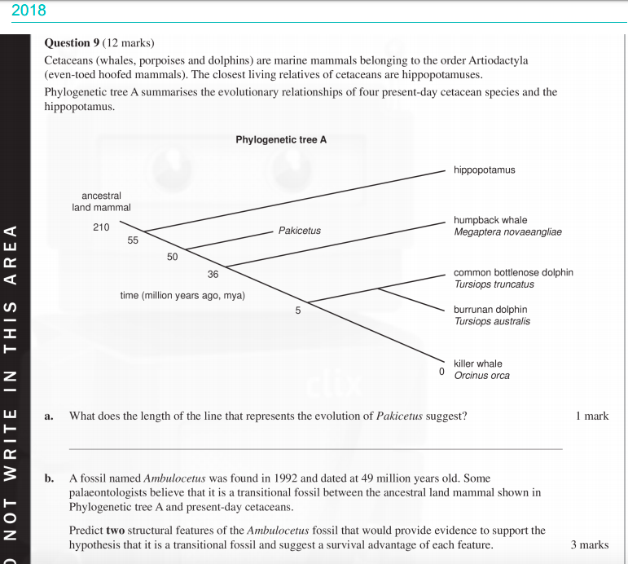
Worked Example

Slide 12
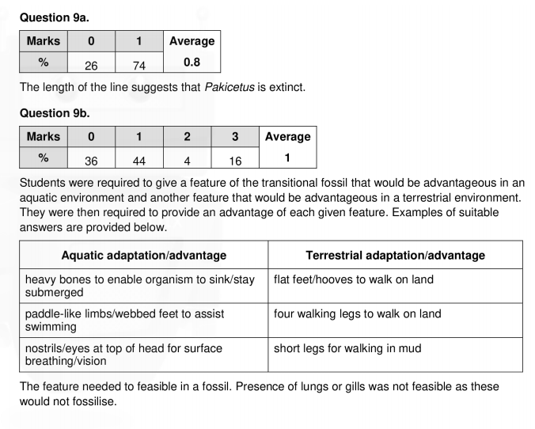

Slide 13
Reflection
Edrolo 10C Q 3-5, 10- 15

