Slide 1
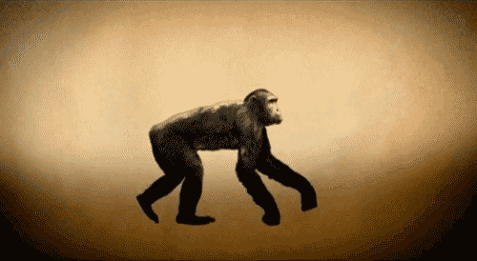
Learning Intention: - To understand the characteristics that define primates, hominoids and hominins - To describe major trends in hominin evolution from the genus Australopithescus to the genus Homo including change in brain size and limb structure.
Success Criteria:
- I can list and describe characteristics that define classification of primates, hominoids and hominins.
- I can describe major trends in hominin evolution from the genus Australopithescus to the genus Homo including change in brain size and limb structure.
Study design dot point
the shared characteristics that define mammals, primates, hominoids, and hominins
evidence for major trends in hominin evolution from the genus Australopithecus to the genus Homo: changes in brain size and limb structure

Slide 2
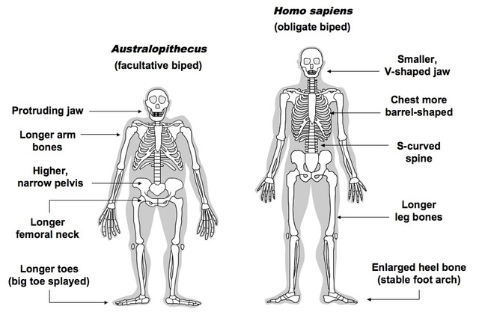
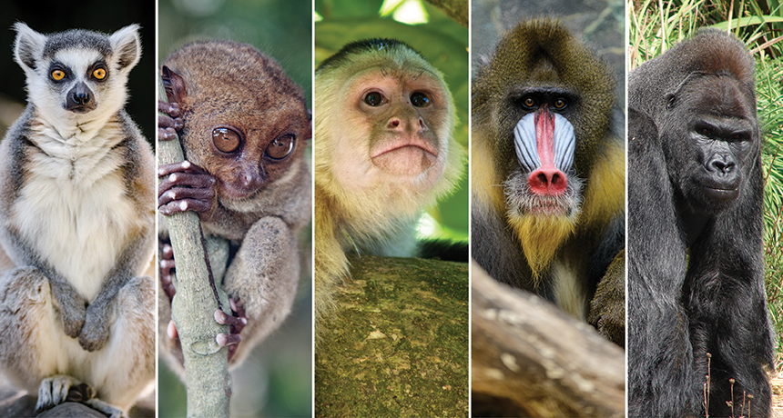
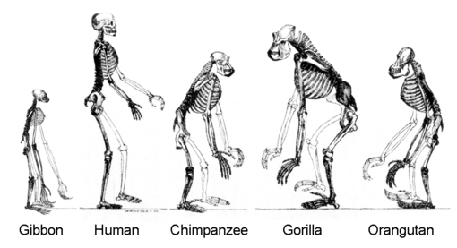
Warm up
Hominins
Primates
What do you think are the similarities and differences between them? Think pair and share!
Hominoids

Slide 3
Classification allows us to understand the relatedness between different species. For each step we take down the taxonomic levels, certain groups are excluded from that category.
Example: The animal world is organised into large groups called phyla (singularphylum). Members of one phylum share a common ancestor and show similarities in their body structures, both external and internal.
About 35 different phyla are recognised.
Modern humans are members of the phylum Chordata (animals with a notochord).
This phylum includes several classes, such as the class Mammalia, which includes humans.

Slide 4
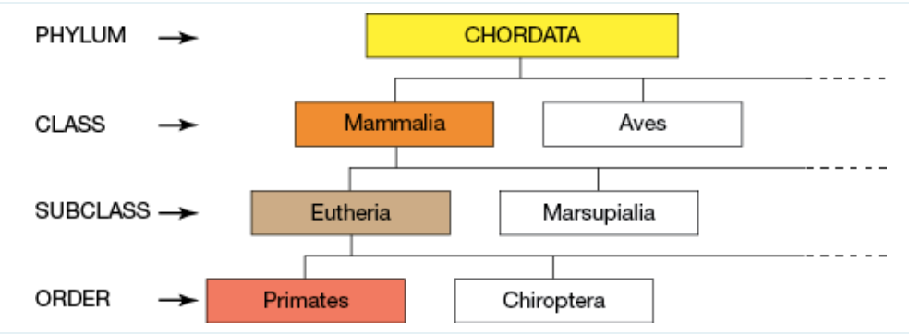
Classification of the Modern Human species
Based on molecular data, structural and physiological data
Phylum – larger groups of animals organised based on sharing a common ancestor with similarities in body structures – 36 in total today
Humans are apart of the Phylum Chordata, Class Mammalia and Order Primates

Slide 5
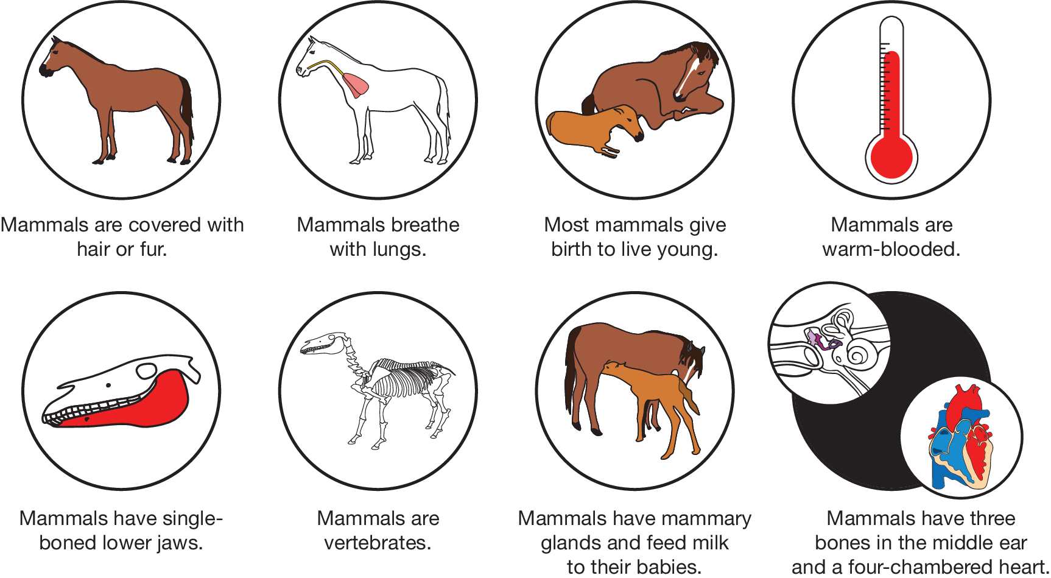
Shared characteristics of mammals
The characteristic features shared by all mammals are:
fur or hair over their body surface
milk-producing mammary glands
teeth comprising of incisors, canines, premolars and molars
a lower jaw made of a single bone
three bones in the middle ear
a diaphragm separating the chest cavity from the abdomen.
Different characteristics seen in mammals

Slide 6
The class Mammalia is further divided into 26 orders. Apes (including Homo sapiens), monkeys and prosimians are all members of the order Primates.
The different groups in the order of Primates

Slide 7
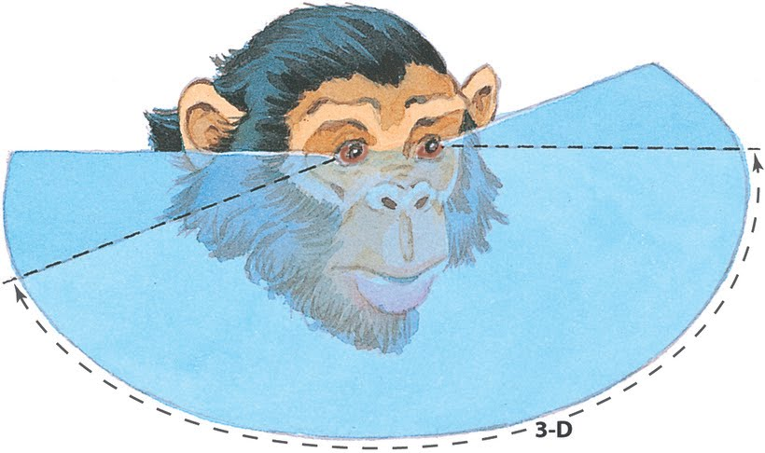
Shared characteristics of primates
Apes (including Homo sapiens), monkeys and prosimians are all members of the order Primates.
The characteristics of primates include:
opposable thumbs
flat nails on digits
binocular vision, colour vision and protective bone at the outer side of the eye socket
large brains relative to their body: Primates are often referred to as ‘the highest order of mammals’, given their large brain size (in relation to body size)
a long gestational period.
fully rotating shoulder sockets that are adapted to life swinging from branch to branch

Slide 8
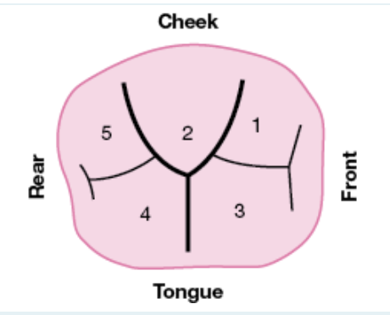
Features of hominoids
Within the order of primates, humans are further classified into the superfamily Hominoidea. Species belonging to this superfamily are called hominoids (or apes) and include.
• Great apes – orangutans, chimpanzees, gorillas, and humans
• Lesser apes – many different species of gibbons.
Monkeys have tails and narrow chests – Apes are tailless and have wide chests.
Shared features of hominoids (that distinguish them from other primates) include:
the absence of a tail
larger and more complex brains
distinctive molar teeth in the lower jaw with five cusps
relatively long upper limbs
a wider chest
shoulder joints that permit the arms to be rotated
larger and more complex brains (that allow for greater intelligence, problem-solving and communication).

Slide 9
Hominins
Hominins is the taxonomic point where humans are separated from all other species in the animal kingdom! Humans are hominins
Includes all members of the genus Homo (humans) and extinct erect-walking ancestors, like species Homo erectus and various species of Australopithecus.
Humans closest living relative is the common and pygmy Chimp from Tribe Panini.
The definitive feature of hominins amongst primates is our ability to walk upright on our hind legs. This ability, termed ‘bipedalism’, is unique to hominins
They use bipedal locomotion (two-footed) unlike other primates who use quadrupedal locomotion (four-footed).
Features include:
Modified feet, thigh bone, pelvis, and spine
Large cerebral cortex (forebrain)
Reduced canines (and teeth in general)
Prominent nose and chin, reduced eye ridges
Body hair short or very reduced to assist cooling
Highly sensitive skin
Complex social behaviour
Brow ridge smaller
Examples:
Australopithecus
Paranthropus
Homo
Ardipithecus

Slide 10
Hominin evolution
For the purposes of VCE Biology, it is only necessary to familiarise yourself with what it means to be a hominin, and with the general trends in hominin evolution across time,
starting with the genus Australopithecus, which existed around 4 million years ago (mya),
through to the genus Homo, which first appeared between 2 and 3 mya and continues to
exist to this day!

Slide 11
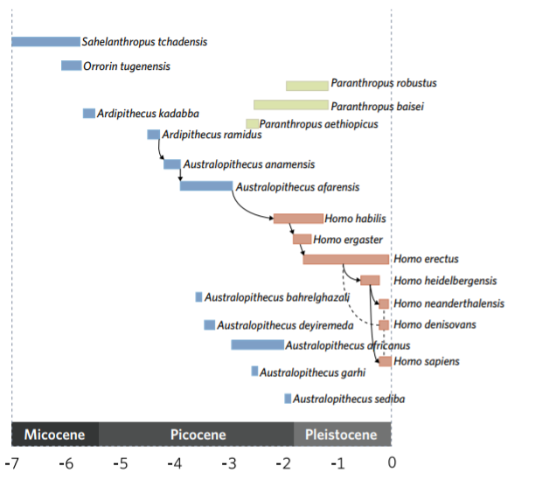
Family tree of hominin species and the rough timing in
which they existed
https://www.youtube.com/watch?v=DZv8VyIQ7YU

Slide 12
Changes in brain size
Hominin brains increased in size over time, resulting in the evolution of higher cognitive processes such as planning, speech, and abstract thinking. Brain size increased more than threefold from the earliest australopithecines to modern day human beings.
One of the most commonly accepted drivers of the change was the improved diet of hominin species over time, from earlier leaf-eating primates to more recent hominins who incorporated more fruit and animal products into their diets. This was further facilitated by the controlled use of fire which enabled our hominin ancestors to fuel brain growth through cooking and increased nutrition.
The cerebrum of hominin brains became more folded, resulting in more neurons and an increase in the number of connections between brain cells, leading to enhanced cognitive ability.
With this increase, came the ability to do activities including speech, the feeling of complex emotions, higher-order decision making, enhanced self-control, abstract thinking, and planning.
Expensive brain hypothesis, tries to understand advanced cognitive ability in terms of advantages like predation reduction and improved food production, compared to negative impacts such as increased energy requirements and higher childbirth complexity.

Slide 13
The structure of the hominin skull has also changed in a number of other ways since the early australopithecines
a more centralised foramen magnum (1)
a shrinking of the sagittal crest (2)
a lessening of the brow ridge (3)
a flattening of the face (4)
a less protruding chin (5)
a more domed skull (6)
smaller teeth (7)
Morphological changes to skull shape over time

Slide 14
Changes in limb structure
The arm to leg ratio of hominins decreased over time in response to an increased reliance on bipedal locomotion.
Shortening of the arms: When our ancestors changed from arboreal living to moving primarily on the ground, there was less of a need for available contact points on the forelimbs, ‘freeing’ the arms up for other tasks.
Lengthening of the legs: Longer legs were selected for in bipeds due to the fact that longer legs positively affect stride length and make upright walking more energy efficient
Changing of the pelvis shape: The pelvis shape of hominins also became shorter and more bowl-shaped over time to provided more support for the upper body whilst standing and walking upright. In later hominin species the leg attaches to the pelvis at an angle, allowing them to walk upright more easily. Further changes to pelvis shape occurred over time, due to different demands of childbirth as the cranial capacity of hominin babies increased

Slide 15
Larger brain size – over time, the hominin braincase has tended to increase in size. This included a range of other morphological changes, including a flatter face and a more domed skull.
Smaller arm to leg ratio – modern humans have a smaller arm to leg ratio than our earlier ancestors. This was due to a variety of reasons, including the fact that longer
legs were more energy efficient for bipedalism.
Changing pelvis shape – hominins evolved a narrower and more bowl shaped pelvis over time, which developed in relation to our bipedal lifestyle and larger brain cases.

Slide 16
Worked Example
D A key feature of a hominoid (compared to other primates) is the absence of a tail. All other listed features are seen in other primates and are not specific to hominoids. VCAA examination report note: Mammals all have hair. Hominoids, humans and their fossil ancestors the anthropoid apes lack tails.

Slide 17
B The evidence of a prominent brow ridge, relatively small brain case and large canine teeth indicate that X is most likely the skull of a chimpanzee. VCAA examination report note: The evidence of a prominent brow ridge, relatively small brain case and large canine teeth indicate that X is the most likely chimpanzee skull.

Slide 18
Summary

Slide 19
Summary

Slide 20
Summary
Humans are members of the class Mammalia and share a distinctive set of features with all other mammals, such as possessing hair/fur and milk-producing mammary glands.
Humans are members of the order Primates and share a distinctive set of features with all other primates, such as opposable thumbs and binocular vision.
Humans and the other apes are members of the superfamily Hominoidea, and are called hominoids. Hominoids, unlike other primates, do not possess prehensile tails.
Hominins, both living and extinct, are distinguished by the ability to walk upright.
The term hominin includes modern humans and extinct species of the genus Homo and the genus Australopithecus

Slide 21
Reflection
Edrolo 11 A Q 2, 12-19
11 B Q 2-4, 9-12

