Slide 1
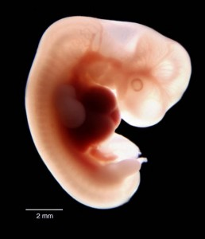
embryology
Chapter 12

Slide 2
Stem cells
Mitosis ensures that each daughter cell receives the same genetic material as the parent cell.
Therefore, every cell in the organism has the same genetic information.
However, as you may have noticed by now, most of the cells in the body, such as blood, liver, brain and nerve cells, are specialised to perform particular functions.
The process by which cells become specialised is called differentiation and this process is linked to cell division.
Stem Cells however, are undifferentiated cells that have the potential to replicate and to develop into many different kinds of cells.

Slide 3
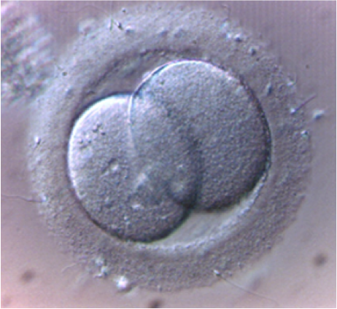
Potency of stem cells - totipotent
A fertilised egg has the potential to develop into a complete embryo. At this point, the fertilised egg is a totipotent (meaning total potential) stem cell, which means it has the potential to create any type of cell necessary for embryonic development, including the embryo itself.
In the first few hours, the totipotent stem cell undergoes a few divisions which produce identical totipotent stem cells. Those totipotent cells undergo several rounds of cell division.
Approximately 5 days after fertilisation, these cells begin to specialise and form a blastocyst.

Slide 4
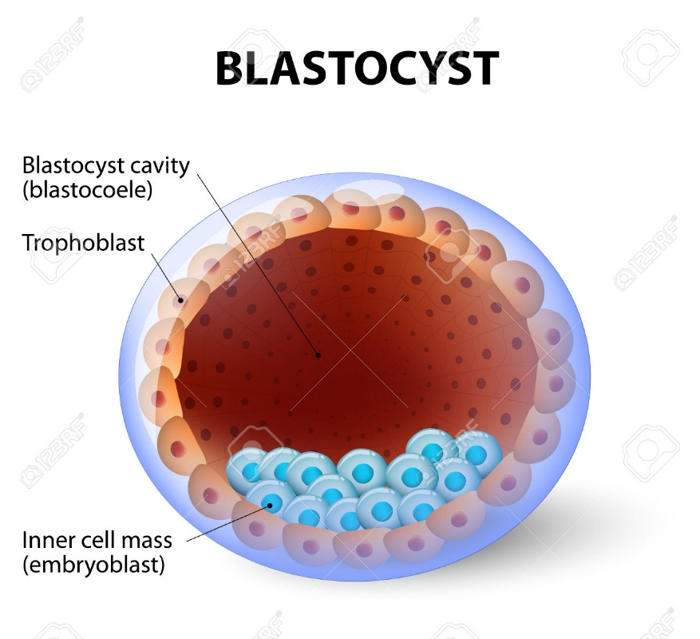
Potency of stem cells - pluripotent
The blastocyst is a ball of cells consisting of a hollow outer layer of cells, within which is a cluster of cells called the inner cell mass.
The outer layer of cells will eventually form the placenta (the organ that supplies all nutrients to, and removes all wastes from the foetus. The inner cell mass will form all the tissues of the human body; therefore these are the cells that form the foetus.
The cells of the inner cell mass are pluripotent stem cells.
This means that they are able to give rise to all cell types in a foetus.

Slide 5
Potency of stem cells - multipotent
Each pluripotent stem cell then undergoes further specialisation into another type of stem cell, a multipotent stem cell.
Multipotent stem cells give rise to cells that have a particular function.
Eg. Multipotent blood stem cells give rise to red blood cells, white blood cells and platelets, and multipotent skin stem cells give rise to all different types of skin cells.
Multipotent stem cells exist in both embryo’s and adults. The best example of this being blood stem cells which continually give rise to new blood cells in the bone marrow.

Slide 6
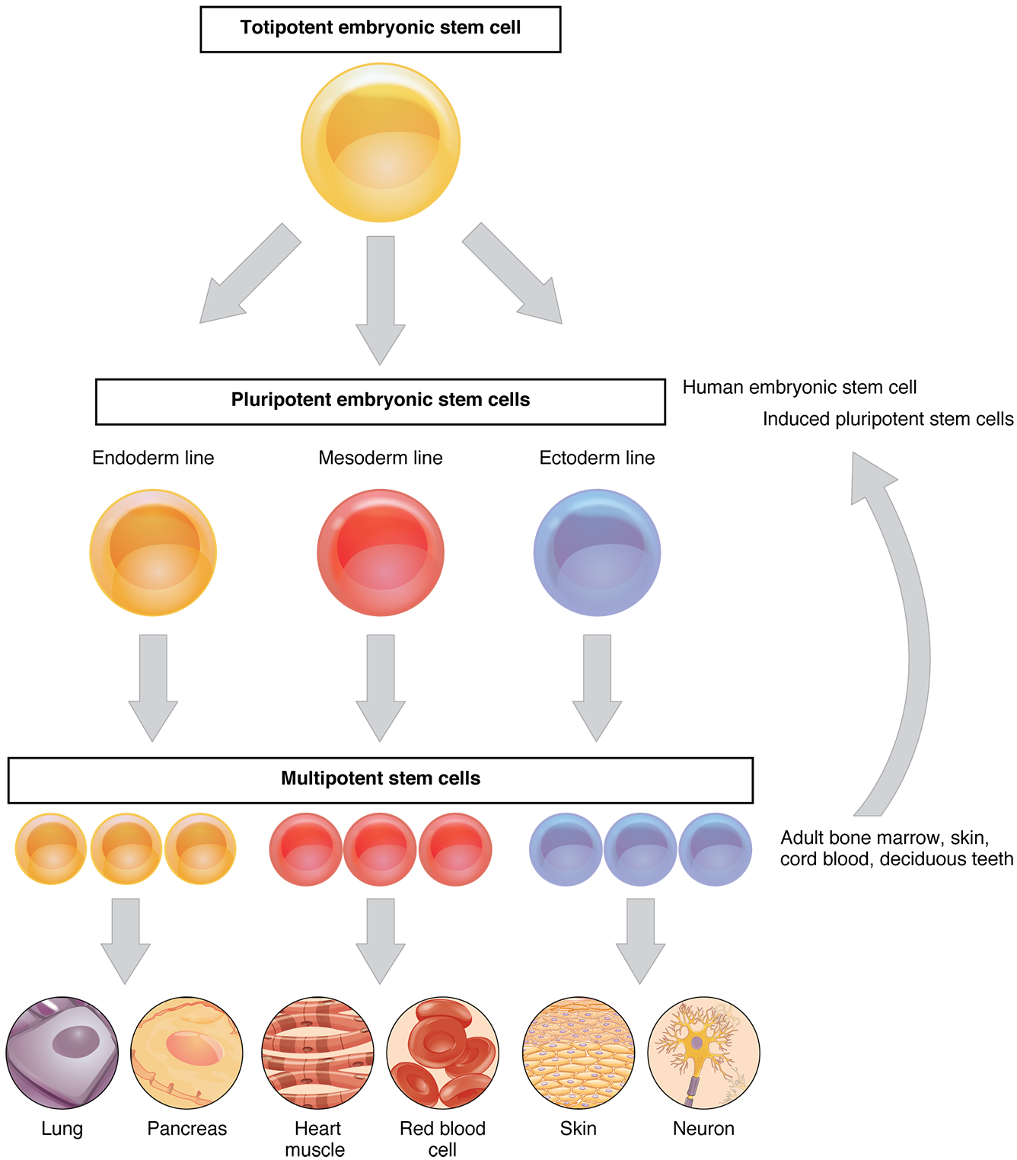

Slide 7
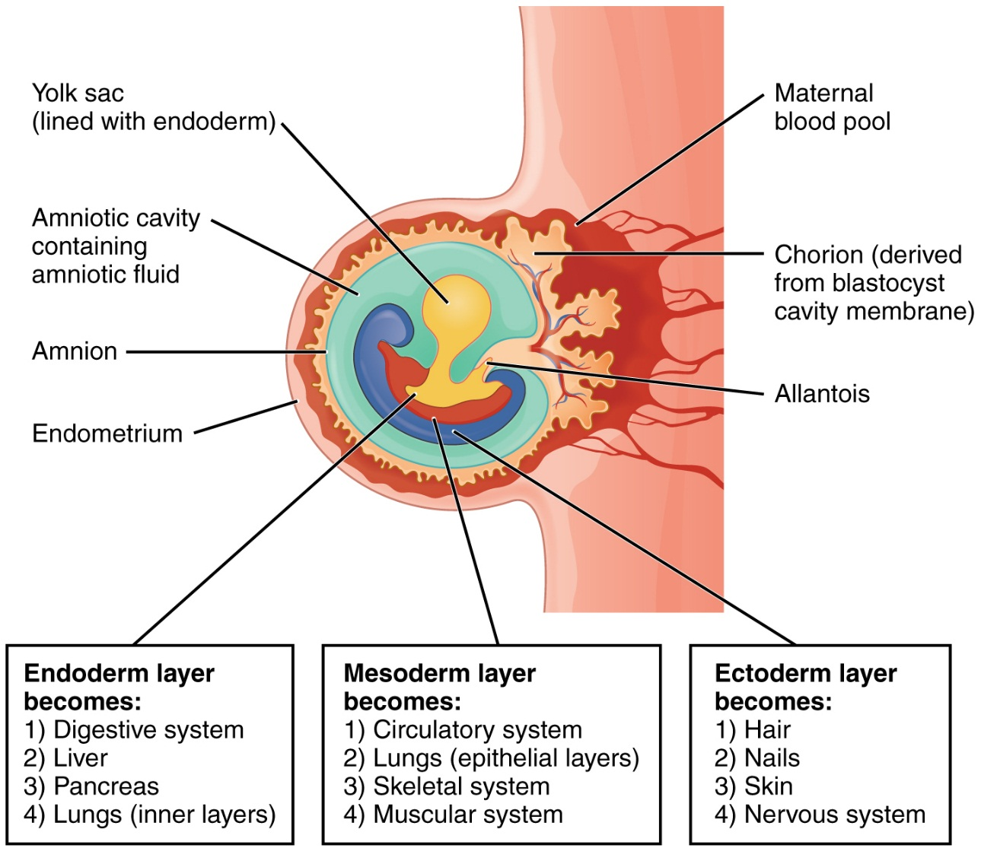
Development of germ layers in human development
While the blastocyst is implanting in the lining of the uterus, the inner cell mass undergoes changes resulting in the formation of three layers of cells, the primary germ layers.
These layers are called the ectoderm, mesoderm and endoderm.
They are the embryonic tissues that will develop into all the tissues and organs of the body.

Slide 8
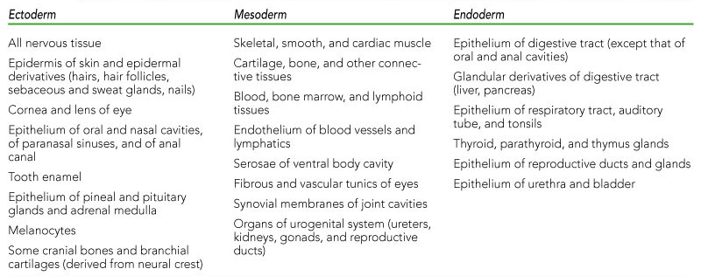
Structures formed by the three primary germ layers

Slide 9
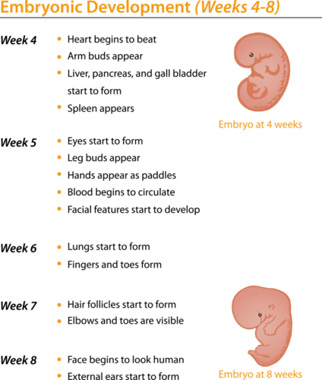
From embryo to foetus
After just one month of growth, the human embryo is just under 4mm long.
By the end of the first two months of embryonic life, the general body form of the infant has developed and the basic plan of the organ systems is in place.
The developing baby is now known as a foetus.

Slide 10
Sources of stem cells for research and therapy
Stem cells have the potential to be used as a form of therapy to replace damaged or degenerates tissues – for example, I Parkinson’s disease, diabetes and spinal injuries.

Slide 11
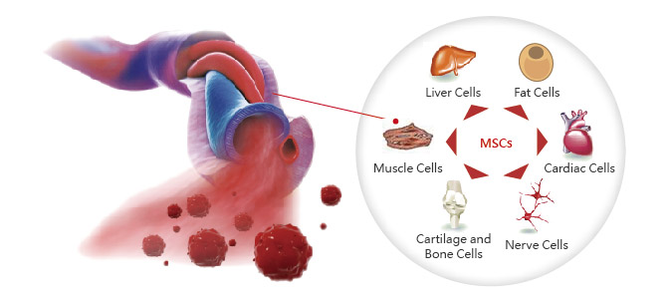
Umbilical cord blood & placental stem cells
Stem cells are present in the blood in the umbilical cord and the placenta
Once a baby is born, these cells can be extracted and stored to be used for the benefit of children and adults who suffer from blood and bone marrow diseases.
These stem cells are multipotent

Slide 12
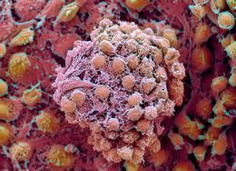
Embryonic stem cells
Embryonic stem cells are cultured from frozen embryos that are obtained from in-vitro fertilisation clinics.
Unused embryos from in-vitro fertilisation may be donated to research if a couple no longer wish to continue storage.
However, there are significant ethical issues surrounding embryonic stem cells, because obtaining them requires destruction of an embryo, and governments have strict regulations in place for controlling this type of technology.
Embryonic stem cells are pluripotent, they can become any of the cell types of the body, and therefore are more versatile than adult stem cells.

Slide 13
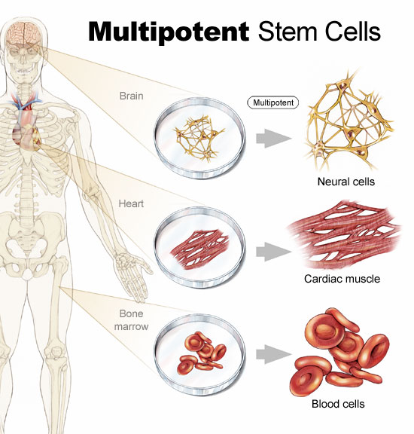
Adult stem cells
Multipotent adult stem cells can form cells of many types of tissue.
An advantage in therapy is that a patients own stem cells can be used for treatment. Risks are much lower as an individual’s immune system would not reject its own cells.
A disadvantage of adult stem cells is that they are pre-specialised, for example, blood stem cells can only make blood cell, brain stem cells can only make brain cells.
It appears that most of the organs of the body have their own cells so that they can replace dead or damaged cells.

Slide 14
mutagens
Mutagens are agents that alter the DNA molecule in cells.
Since DNA sequences are responsible for controlling cell processes, including growth, development and differentiation as well as programmed cell death (apoptosis), any interference in the structure or sequencing of the DNA can also interfere with its regulatory role.
This may mean the formation of developmental abnormalities or cancers.

Slide 15
cancer

Slide 16
Recap
Define differentiation.
Describe the three different types of stem cells.
Explain the importance of stem cells in the body.
Name the three primary germ layers
Give two examples of tissues that develop from each of the germ layers.
Distinguish between ‘embryo’ and ‘foetus’.
Name the three primary germ layers.
Give two examples of tissues that develop from each of the germ layers.
Distinguish between ‘embryo’ and ‘foetus’.
Explain and give two examples of mutagens.
Complete Biozone Worksheets

