Slide 1
Genetic Technologies
Unit 2 aos1

Slide 2
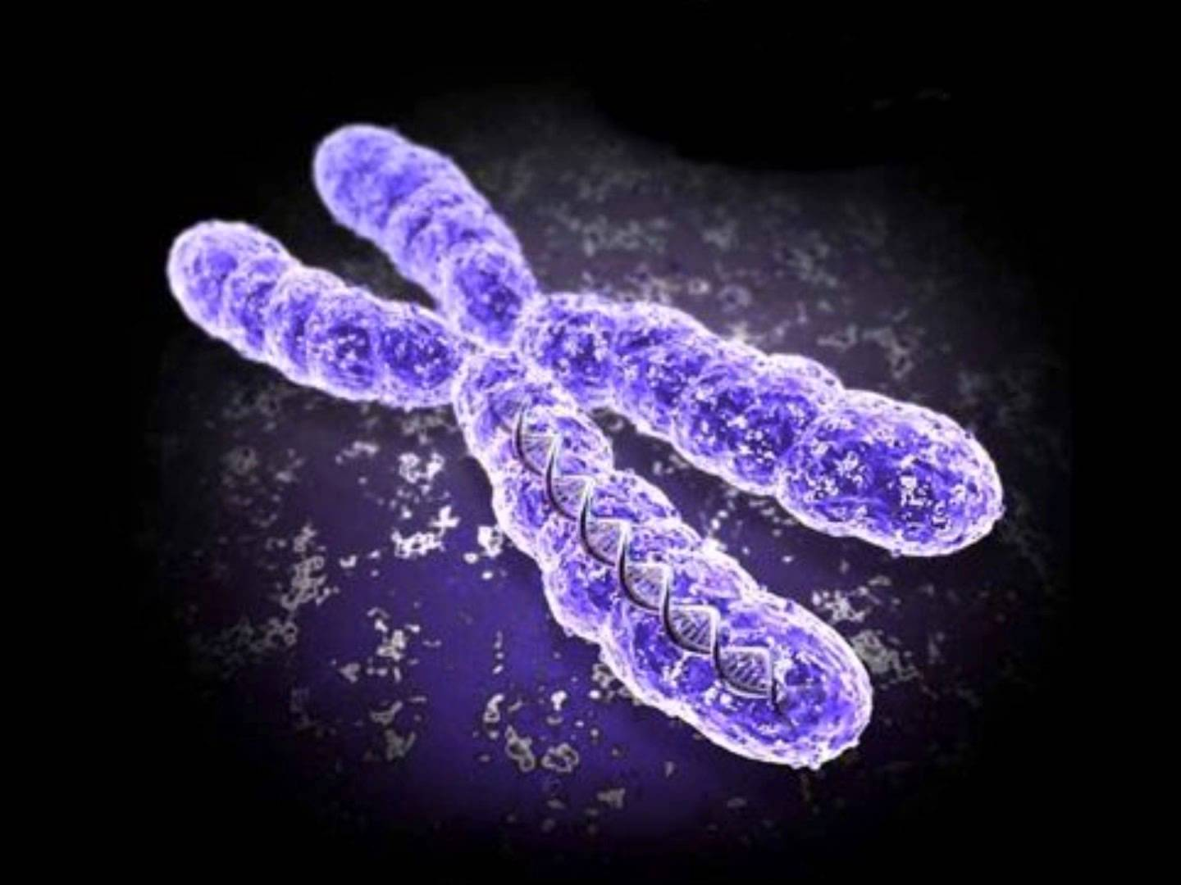
Genetic Technologies
A range of technological advances in genetics allows scientists to investigate, measure and manipulate the genetic information of species.
These include tools to sequence genomes, clone organisms, and diagnose & treat genetic disorders.

Slide 3
DNA Sequencing
Is a process that is used to determine the order of neucleotide bases along a segment of DNA
Bases are ‘tagged’ so that each appears a different colour when viewed under fluorescent light
Chromatography is used to observe the tagged bases in a series of coloured peaks
The order of the coloured peaks reflects the order of the bases in the DNA strand
Identifying the base sequence of the genome in the Human Genome Project is a classic example of the use of this technology

Slide 4
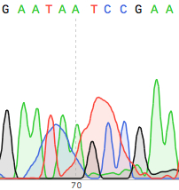
DNA Sequencing
DNA Sequencing Chromatogram

Slide 5
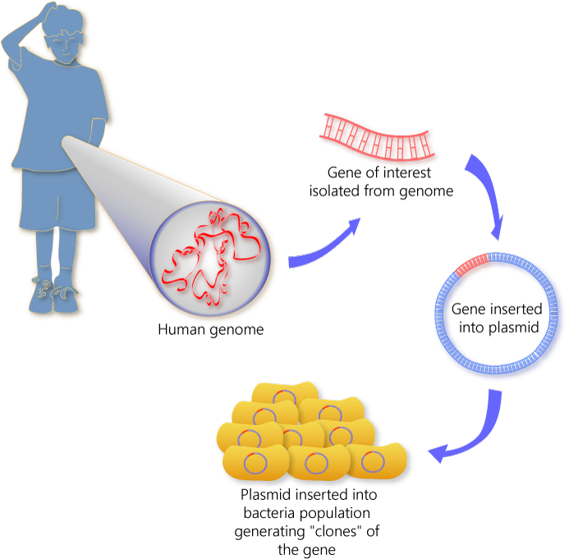
Gene Cloning
Gene cloning literally makes many copies of a particular gene
This technology involves the production of a transgenic (or recombinant) bacteria
As foreign gene is inserted into a bacterial plasmid and the bacteria are allowed to reproduce, thereby making many copied of the required gene
The cloned genes can then be delivered to the target tissue Eg. By using a disabled virus

Slide 6
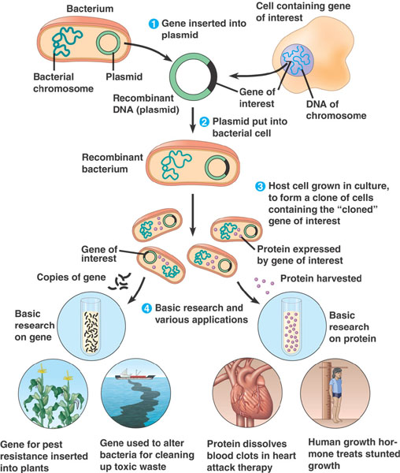
Gene Cloning
Gene cloning is widely used in the production of insulin for the treatment of Diabetes

Slide 7
Gene Therapy
Is a process used to treat patients with certain genetic diseases, such as cystic fibrosis
A normal gene from a healthy individual is inserted into the DNA of a vector, such as a disabled virus
The vector is then used to deliver the normal gene into the cells of the affected person
Transcription of the normal gene results

Slide 8
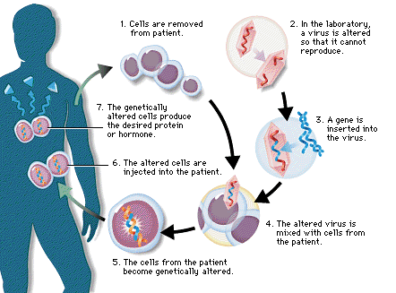
Gene Therapy

Slide 9
Cloning Technology
Cloning technology allows the production of genetically identical individual organisms.
Plant clones are easy to achieve using asexual reproduction.
Animal cloning involves inserting the nucleus of a mature body cell into an emptied ovum that is ready for fertilisation.
After a period of laboratory incubation, the new embryo is implanted into the uterus of an adult female where development proceeds the usual way.

Slide 10
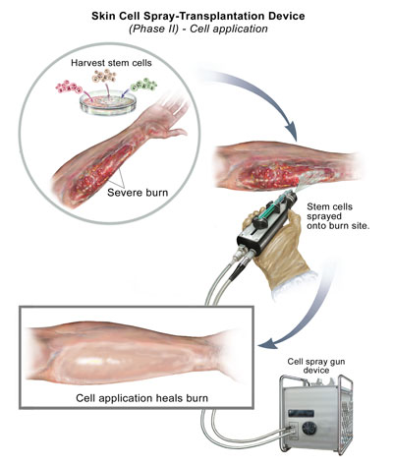
Cloning - Applications
Applications include the production of crops and stock with desireable characteristics.
Eg. Pest-resistant crops.
Theraputic cloning produces compatible tissue for transplanting in humans.
Eg. To treat burns victims with new skin

Slide 11
Karyotyping
Is a process of sorting chromosomes according to size.
In a karyotype, chromosomes are arranged in homologous pairs and usually organised in order from largest to smallest.
Karyotypes are used to determine gender and to diagnose chromosomal abnormalities
Eg. Downs Syndrome – in which there are three number 21 chromosomes

Slide 12
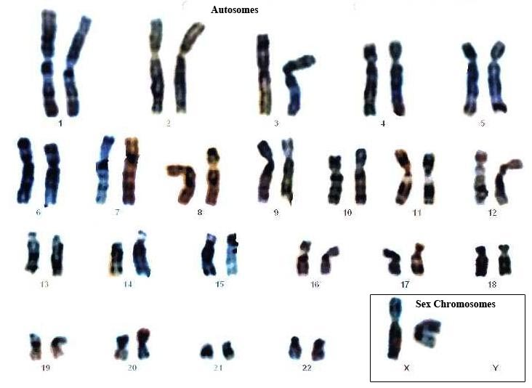
Human Karyotype - Normal

Slide 13
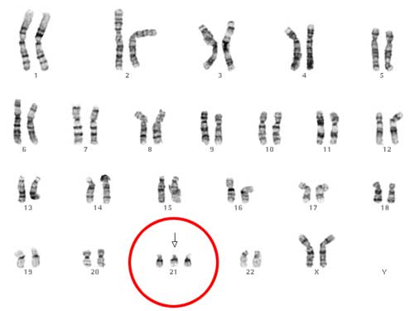
Human Karyotype – Down Syndrome

Slide 14
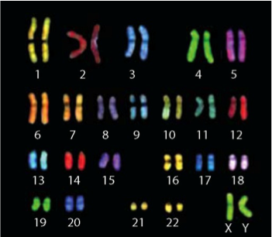
FISH (Fluorescent in situ Hybridisation)
FISH, also called chromosome painting, identifies particular entire chromosomes by applying a ‘colour tag’ that is specific for each homologous pair.
Homologous pairs of chromosomes are easily identified according to colour using the fluorescent dyes
This technique also allows the order of homologous pairs to be established.

Slide 15
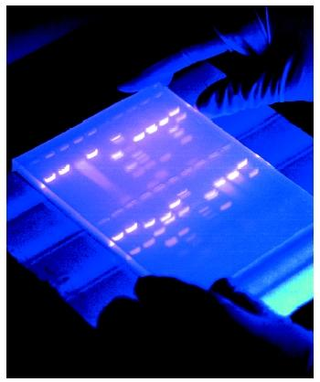
Genetic Profiling
A technique used by scientists to distinguish between individuals of the same species using only samples of their DNA

Slide 16
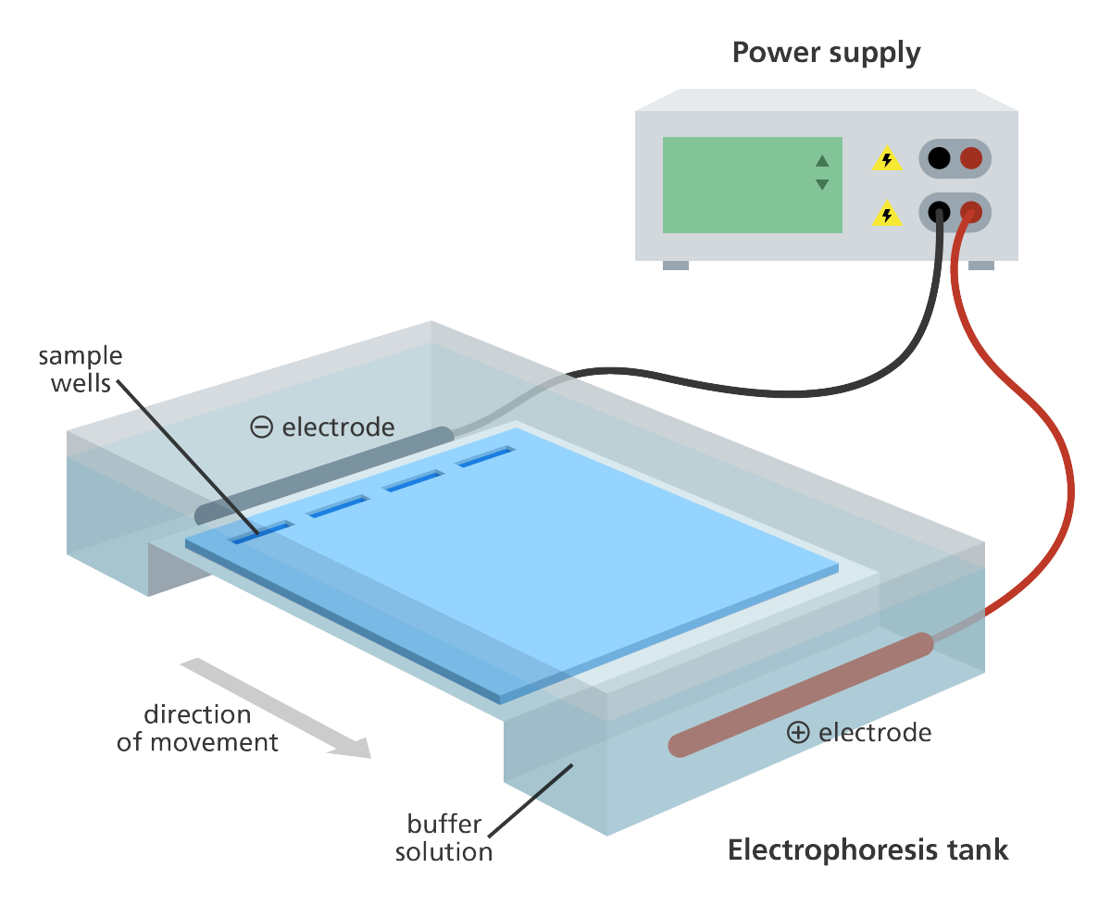
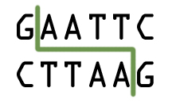
Stages of DNA Profiling
Stage 1
Stage 2
Stage 3
The DNA is cut into fragments using restriction enzymes.
Each restriction enzyme cuts DNA at a specific base sequence
The sections of DNA that are cut out are called restriction fragments.
This yields thousands of restriction fragments of all different sizes because the base sequences being cut may be far apart (long fragment) or close together (short fragment).
Cells are broken down to release DNA
If only a small amount of DNA is available it can be amplified using the polymerase chain reaction (PCR)
Fragments are separated on the basis of size using a process called gel electrophoresis.
DNA fragments are injected into wells and an electric current is applied along the gel.

Slide 17
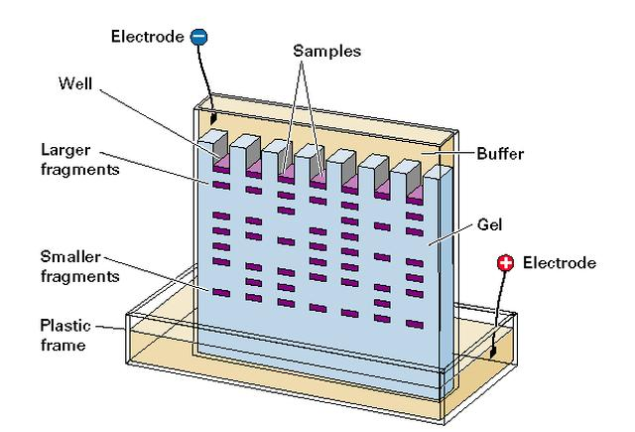
Gel Electrophoresis
DNA is negatively charged so it is attracted to the positive end of the gel.
The charged macromolecules migrate across a span of gel because they are placed in an electrical field.
The shorter DNA fragments move faster than the longer fragments.
DNA is separated on basis of size.
A radioactive material is added which combines with the DNA fragments to produce a fluorescent image.

Slide 18
Gel Electrophoresis
The gel acts as a sieve to retard the passage of molecules according to their size and shape.
A photographic copy of the DNA bands is obtained.

Slide 19
Biological Materials used for DNA Profiling
Blood
Hair
Saliva
Semen
Body tissue cells
DNA samples have been obtained from vaginal cells transferred to the outside of a condom during sexual intercourse.

Slide 20
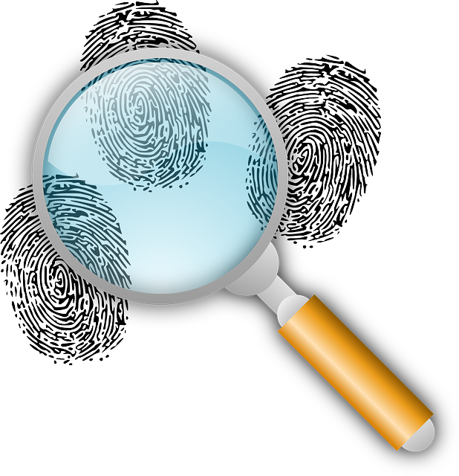
DNA Profiling - Crime
Forensic science is the use of scientific knowledge in legal situations.
The DNA profile of each individual is highly specific.
The chances of two people having exactly the same DNA profile is 30,000 million to 1 (except for identical twins).
The pattern of the DNA profile is then compared with those of the victim and the suspect.
If the profile matches the suspect it provides strong evidence that the suspect was present at the crime scene (NB: It does not prove they committed the crime).
If the profile doesn’t match the suspect then that suspect may be eliminated from the enquiry.

Slide 21
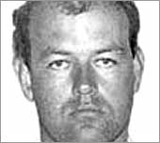
Colin Pitchfork
Colin Pitchfork was the first criminal caught based on DNA fingerprinting evidence.
He was arrested in 1986 for the rape and murder of two girls and was sentenced in 1988.

Slide 22
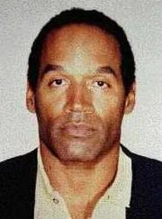
OJ Simpson
O.J. Simpson was cleared of a double murder charge in 1994 which relied heavily on DNA evidence.
This case highlighted lab difficulties.

Slide 23
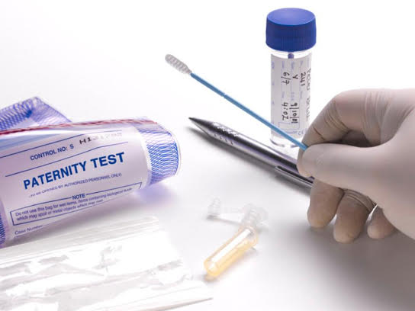
DNA Profiling – Solving Medical Problems
DNA profiles can be used to determine whether a particular person is the parent of a child.
A child’s paternity (father) and maternity(mother) can be determined.
This information can be used in
Paternity suits
Inheritance cases
Immigration cases

Slide 24
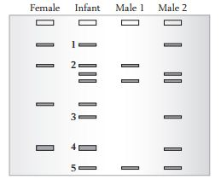
Paternity Testing
By comparing the DNA profile of a
mother and her child it is possible to
identify DNA fragments in the child
which are absent from the mother and
must therefore have been inherited
from the biological father.

Slide 25
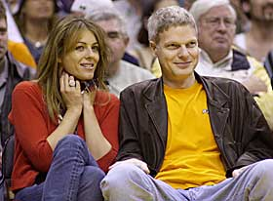
Famous Case!
In 2002 Elizabeth Hurley used DNA profiling to prove that Steve Bing was the father of her child Damien

