Slide 1
Rear Window: Essay Topics Breakdown
A brief guide on how to break down the topic.

Slide 2
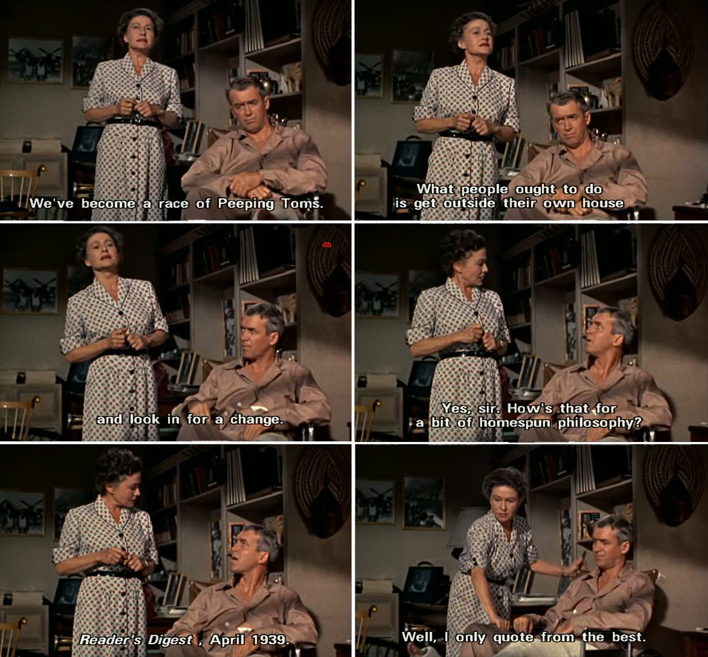
“We’re a nation of Peeping Toms.” To what extent does Hitchcock endorse this idea in ‘Rear Window’?
Agree
Challenge
Message

Slide 3
Hitchcock endorses both voyeurism and the male gaze.
Supports male gaze – women are objects from the beginning
Jeff does capture a murderer – evidence is collected
Voyeurism saves a life- Miss Lonely Hearts, Lisa
Protects the community
Supports the American ideologies/government & Culture

Slide 4
Hitchcock questions the 1950s society morality of watching through a ‘rear window’ of an apartment
Voyeurism invades personal lives/no boundaries
People who watch/observe experience a negative consequence
Self-loathing is experienced when you compare yourself to what is outside of your window
It is a form of avoidance of ones problems
Double standard of voyeurism

Slide 5
Hitchcock provides a social commentary on the absurdity of the McCarthy period, and ultimately mocks the paranoia of the anti-communist uprising.

Slide 7
‘Rear Window presents a cynical view of romantic relationships.’ Discuss.
Agree: Hitchcock’s ‘Rear Window’ portrays a cynical view of romantic relationships that follow the social conventions.
K.I.S.S.: The relationships that are conventional are shown to be bad.
Challenge: The less conventional romantic relationships, primarily the unmarried, are depicted as being happier within the film.
K.I.S.S: The unmarried relationships shown actually appear happier.
Message: Furthermore, Hitchcock encourages cinemagoers and viewers of the alike to adopt a more romantic approach when viewing marriage.
K.I.S.S.: Hitchcock does not show that he supports marriage, especially conventional marriage.

Slide 8
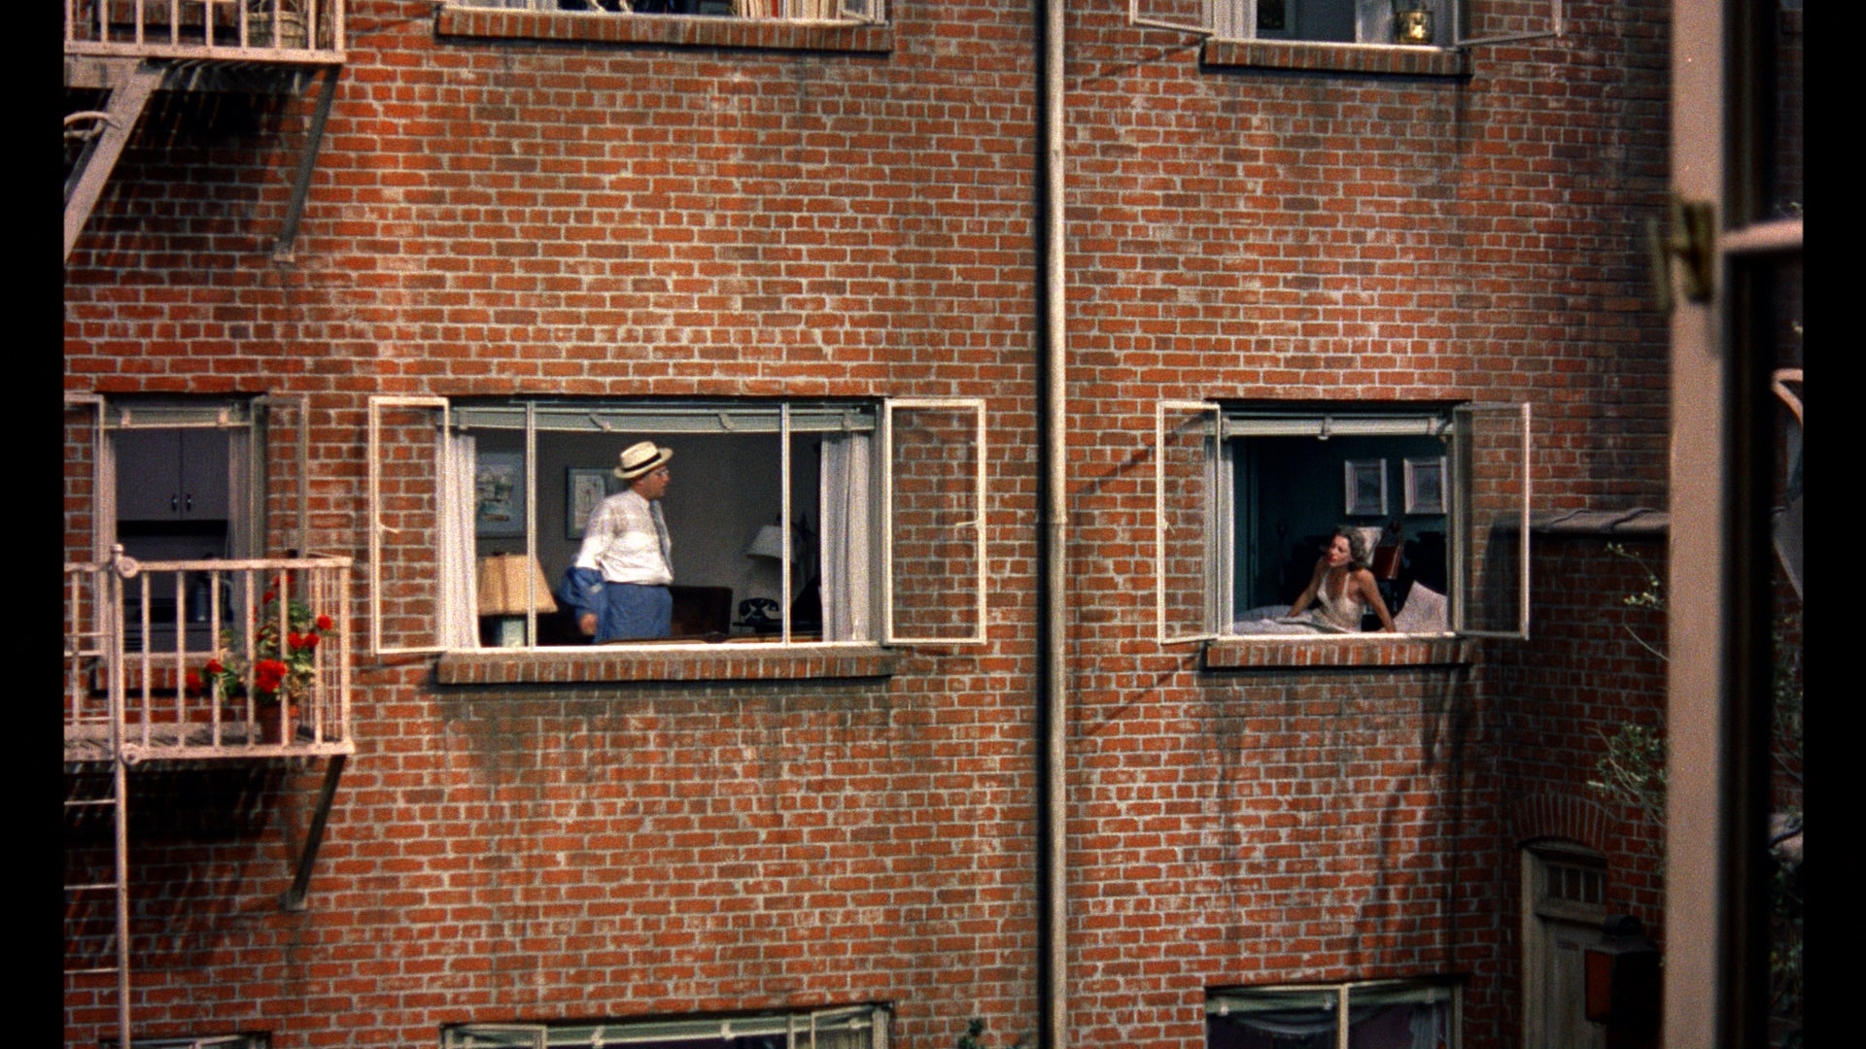
Agree: Hitchcock’s ‘Rear Window’ portrays a cynical view of romantic relationships that follow the social conventions.

Slide 9
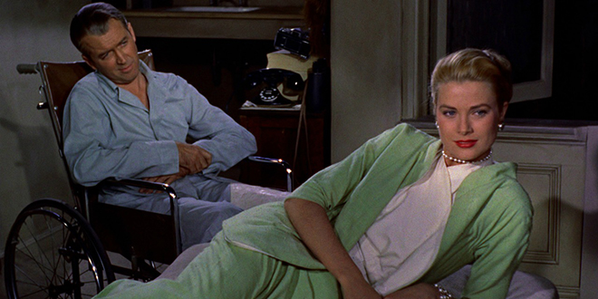
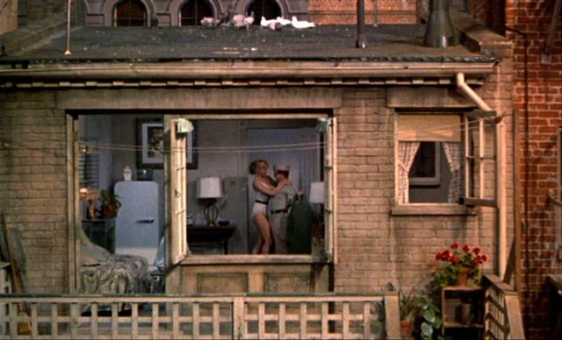
Challenge: The less conventional romantic relationships, primarily the unmarried, are depicted as being happier within the film.

Slide 10
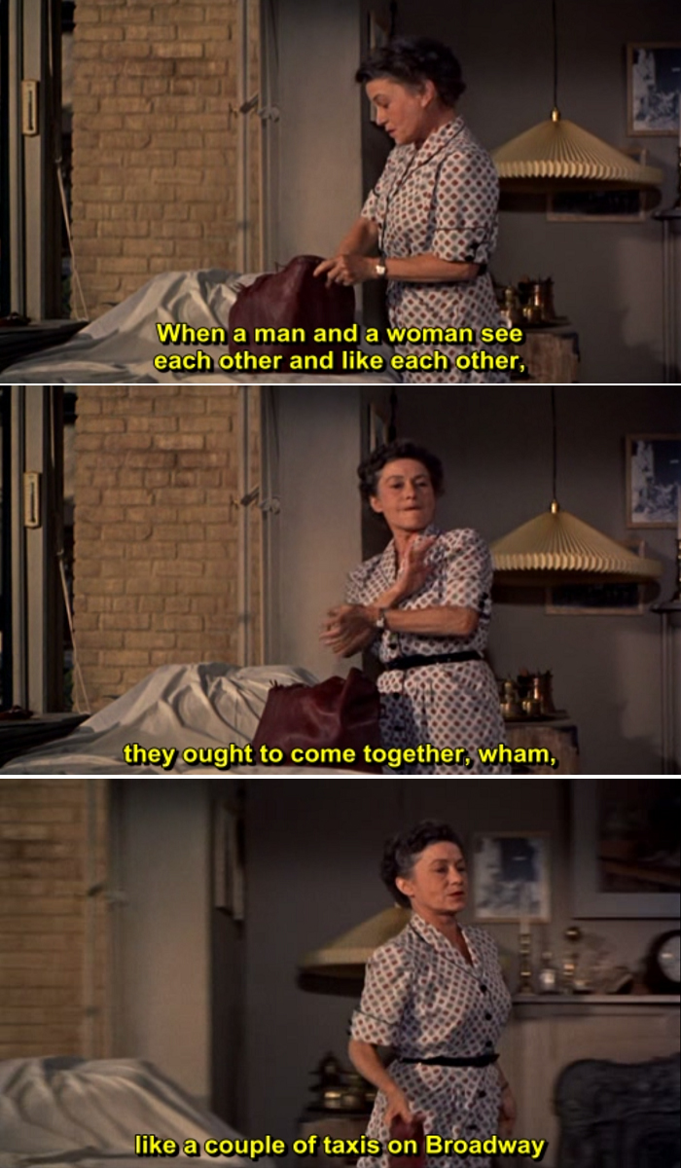
Message: Furthermore, Hitchcock encourages cinemagoers and viewers of the alike to adopt a more romantic approach when viewing marriage.

Slide 11
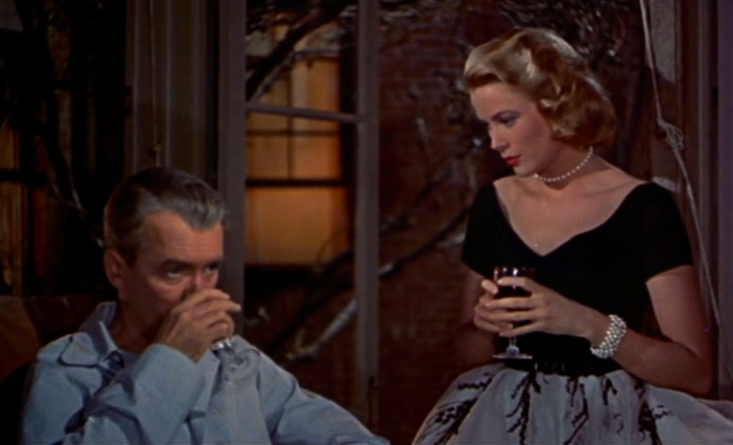

Slide 12
Rear Window exposes many facets on the loneliness of city life and demonstrates the impulse of morbid curiosity. Discuss.
Agree: Hitchcock’s film demonstrates that the urban landscape can be a breeding grown for isolation due to the busyness of individuals.
K.I.S.S.: The setting shows how life is lonely in the city.
Challenge: Moreover, Hitchcock also exposes that city life can also create boredom and dysfunction due to the quotidian life, which in turn makes people become “peeping toms”.
K.I.S.S: Hitchcock also exposes that the boredom of city life can caused people to become “peeping toms” and nosey neighbors.
Message: Furthermore, Hitchcock essentially critiques the morbid curiosity people have in delighting in others misfortunes which is essentially encouraged by the controlling and despotic American government.
K.I.S.S.: The 1950s society was obsessed with spying on each other in a morbid way.

Slide 14
Essay Topic Sentences
These are some suggested topic sentences, based around themes.

Slide 15
How to write a topic sentence?
The topic sentence will identify that main idea.
It will attempt to use keywords from the topics (use synonyms).
Offer your interpretation of the topic.
Be very clear and controlled to help the assessor/reader know the direction of your piece.
I stick to: Connecting word/Author name/idea with interpretation using key words.

Slide 16
Gender
Throughout the course of the film Hitchcock lends his to support for women physically meeting social expectations.
However, whilst Hitchcock encourages women to appear highly feminine throughout the film we see him offer his preference to independent and intelligent women.
Within the film we see men become emasculated by the women around them.
Hitchcock’s film ‘Rear Window’ offers a judgmental view of men whom become passive participants of their everyday life.

Slide 17
Gender- add an adverb
Adding an adverb offers YOUR interpretation in a subtle way!
Throughout the course of the cynical film Hitchcock lends his to support for women physically meeting social expectations.
Whilst Hitchcock fervently encourages women to appear highly feminine in support of the male gaze, throughout the sardonic film we see him offer his preference for independent and intelligent women.
Within the film we see men become subtly emasculated by the stoic women around them.
Hitchcock’s film ‘Rear Window’ offers a bitter and judgmental view of inadequate men whom become passive participants of their everyday life.

Slide 18
Voyeurism
Hitchcock endorses aspects of the American “race” of “peeping Toms”.
However, Hitchcock shows his confusion over the morality of “rear window ethics”.
Throughout the film we are shown that ultimately “peering” into someone's apartment due to a suspicion is an adequate reason for the 1950s time period.
Within the film, Hitchcock aims to shock his audience with the harsh reality that spying on ones neighbors is a fine line between completing our civic duty and intruding on ones privacy.
Moreover, Hitchcock ultimately suggests that voyeurism is natural for men, and women are merely objects to be gazed upon.

Slide 19
Marriage & Relationships
Within the film we are shown that most conventional 1950s marriages are dysfunctional.
Hitchcock showcases his preference for a marriage based on love rather than “logic”.
Throughout the film we see that women often manipulate the men in their lives to find their happiness.
Furthermore, Hitchcock suggests that the confines of marriage ultimately suffocates the male counterparts.

Slide 20
Morality
Nonetheless Hitchcock portrays all men as villains within his film for failing to meet the social conventions of the time.
Throughout the film Hitchcock depicts women as being the only characters made of purity, “ethics” and governed by selflessness.
The film ‘Rear Window’ ultimately suggests that there can be no “ethics” when peering through a telescopic lens into others lives.
Hitchcock reinforces the American governments belief that surveillance is necessary for the greater good, regardless of the privacy it invades.

Slide 21
Time Period/Values
Hitchcock showcases throughout his film the paranoiac fear of the communist regime during the Cold War.
It is through Hitchcock’s critical lens that we the growing tensions between men and women in post-war America.
The 1950s consumerist lifestyle and economic boom is reflected in the microcosmic Greenwich apartment block in ‘Rear Window’.
Set against the backdrop of a New York City skyline, the Greenwich apartment block shows the moral decay of the 1950s society.

