Slide 1
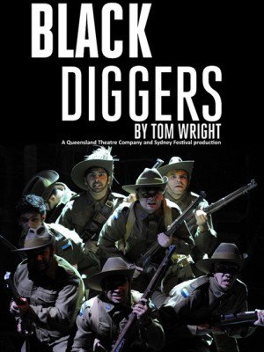
Black diggers
A play by Tom Wright Context & Background
Mrs Lock 2017

Slide 2
Tom Wright – Playwright
Tom Wright was born in 1968 I n Melbourne, Australia. He has been a member of may esteemed theatre companies as an actor and in the late 1990s he began writing plays.
Production History: Black Diggers was first produced by Queensland Theatre Company and Sydney Festival, and presented by Sydney Festival in association with The Balnaves Foundation, premiering in the Drama Theatre at the Sydney Opera House on January 18, 2014.

Slide 3
Notes:
Source: VATE Study Guide, 2016

Slide 4
Notes:
Source: https://www.artscentremelbourne.com.au/~/media/artscentre/files/about-us/media-centre/2015/03-march/20150318-mr-black-diggers-arts-centre-melbourne.ashx

Slide 5
Stories
Undeniably, any experience of war permeates the lives of all involved, both directly and peripherally. Black Diggers explores this broad impact on our society, through honouring the lives of Indigenous Australians who, despite not being acknowledged as citizens themselves, fought in wars past and present.
In Director Wesley Enoch’s foreword to the play, he describes the importance the research team ascribed to adopting “a broad acceptance of truth” when exploring the stories of those impacted by war.

Slide 6
Truth
This broad acceptance of the truth was inspired by post apartheid South Africa during the Truth and Reconciliation Commission whereby a four-part approach to uncovering the truth was employed:
Personal truth – the way we see the story (the one story of that one person)/ what you believe to be true.
Social truth – what a group believe to be true through discussion and debate
Forensic truth- the truth that can be proven through science and records e.g. names and places, dates, facts etc.
Public truth – shared, collective truth (relates to style… the ways of storytelling)

Slide 7
Forgotten Stories…
Despite the increasing academic and Indigenous interest in the history of Aboriginal and Torres Strait Islander military service, the topic still remains on the periphery of Australia’s popular memory and there have been few explorations of the theme of Indigenous military service in creative works.
Although many Indigenous Australians enlisted during WWI and other wars, their work, sacrifices and achievement have largely gone unnoticed.
“Hidden histories of Indigenous [Australians] in the … war reflect a wider Australian cult of forgetting Indigenous history” (Riseman, 2012).

Slide 8
Remembering the forgotten
To further build your understanding of the history of Indigenous Australian armed forces, watch this short fascinating documentary by Living Black: S18 Ep7 - Diggers Memorial & Bush TV Untold Stories – WWI.
https://www.youtube.com/watch?v=EZWpJEKi3aM
https://www.youtube.com/watch?v=9nCYboIUq1o

Slide 9
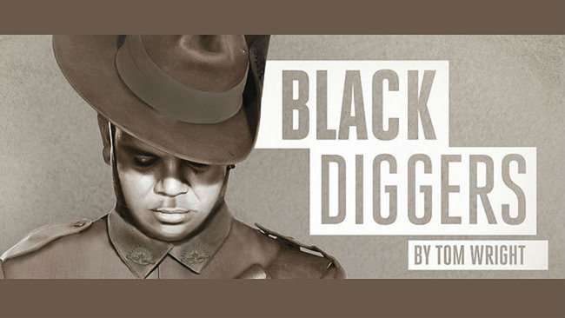
Who were the Black Diggers?
Black diggers are the Aboriginal and Torres Strait Islander service personnel who fought for the wars Australia has taken part in, such as the Boer Wars, WWI and WWII, the Vietnam and Korean wars.
When WWI began, Indigenous military men and women were not permitted to enlist on the grounds of their race. Nonetheless, many wanted to fight for Australia. By the time WWII commenced, they were allowed to join.
“There are as many Aboriginal and Torres Strait Islander histories of military service as there are Aboriginal and Torres Strait Islander people,” writes historian Noah Wiseman at the Australian National University.
Yet returning Indigenous service personnel were not afforded the same support and recognition as their comrades.
In recent times, rights groups have been pushing the government to properly recognise Indigenous men and women made to Australia’s military ever since.
Notes:
Source: SBS NITV, Who were black diggers? http://www.sbs.com.au/nitv/explainer/who-were-black-diggers

Slide 10
Honouring untold stories

Slide 11
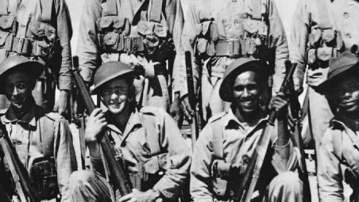
Experiences of War
Wright says the play takes the familiar tropes of World War I – Gallipoli, the trenches, the slouch hats and emu feathers – and "just puts black faces into it".
"In many ways what the black blokes experienced was exactly the same as their white colleagues," he says. "The same horrors, the same shell shock, the same awful deprivations, the same violence”.
"The difference was when they came back to Australia in the 1920s, they found it very hard, many of them, to find a place in white society and likewise found it hard to go back to their black communities”.
Notes:
Source: http://www.smh.com.au/entertainment/sydney-festival/exploration-of-black-diggers-experience-well-overdue-20140116-30x5l.html

Slide 12
Black Diggers: Challenging the ANZAC narrative
Watch this interesting interview with Tom Wright and Wesley Enoch from
The Guardian Black Diggers: Challenging the ANZAC narrative https://www.youtube.com/watch?v=etJZctAx0jY (5:54 mins)
Further reading: Black diggers are hailed on Anzac Day. But the Indigenous 'Great War' was in Australia by Paul Daley
https://www.theguardian.com/australia-news/2017/apr/23/black-diggers-are-hailed-on-anzac-day-but-the-indigenous-great-war-was-in-australia

Slide 13
Historical Context
Many historians refer to the colonisation of Australia as an invasion and the brutal systematic genocide of the country’s Indigenous people.
For Indigenous Australians, their involvement in the armed forces was not the first time they had been involved in a battle for their freedom. With the invasion of Australia in the 18th Century, many brutal massacres were executed and one such bloody scene is depicted in the opening of the play.
The confronting brutality of this scene serves to remind the audience of the injustices that occurred during this time, and those which continue to this day.
Further reading: ‘It’s not ‘politically correct’ to say Australia was invaded, it’s history’ by Paul Daley: https://www.theguardian.com/australia-news/postcolonial-blog/2016/mar/30/its-not-politically-correct-to-say-australia-was-invaded-its-history

Slide 14
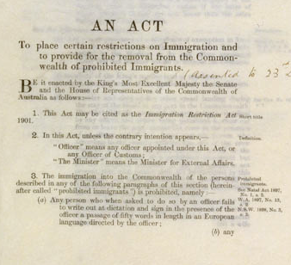
White Australia… a recent memory
The White Australia Policy was the unofficial name of the Immigration Restriction Act 1901. This was one of the first pieces of legislation passed by the parliament of the newly federated Australia.
The Act allowed immigration officers to exclude people subjectively (on the basis of race) by making them take a diction test in a European language of the officers’ choosing.
This test, and the discrimination that went along with it was still in operation in the 1950s.
Notes:
Source: Comparisons, Insight Study Guide, 2016.

Slide 16
Notes:
Source: VATE, 2016.
When soldiers were recruited for the 1914-18 war, they had to be "substantially European", a term that was vague enough for recruiters and medical officers to make up their own minds about what that meant. It worked both ways: some thought a willing body was all that mattered, others brought their prejudices to bear (Stephens, 2015).

Slide 17
Entrenched prejudice
Notes:
Source: VATE Study Guide, 2016.

Slide 18
The legacy of the past
In many ways ‘Black Diggers’ explores the fact that the past cannot be buried and the psychological trauma of from the war serves as a poignant metaphor for the human rights abuses towards Indigenous Australians from time of invasion to today.
We are reminded of this when Ern picks a picks a piece of shrapnel out of his skin (The Iron Harvest), decades after the war. A personal and collective decision to bury the truth from our memories.

Slide 19
Story telling on stage
Wright’s play consists of a series of vignettes that are connected by theme. Wright says the play follows the tradition of "pageant story telling" or "Brechtian, big picture stories”.
Wright explores the importance of hearing mulitple voices, stating that “if you focus on just two or three narratives, you're already misrepresenting history” (Taylor, 2014).

Slide 20
Story telling on stage
Enoch describes the process of selecting key scenes to use in the play with Write and others as creating "a prism through which to see all these stories and not be held back by the truth of any one story. So in a sense, we then tell a bigger truth“ (Stephens, 2015).
The rapid-fire transitions between the short, sharp scenes, along with the non-linear narrative time-frame reinforces the deliberate feeling of fragmentation, designed to make us feel as if the theatre itself is suffering shellshock (Matheson & Stracey, 2016).

Slide 22
Psychological Impact of War
When exploring the atrocities of war (a central idea of this play), the psychological short and long-term impact cannot be denied. The experience of shellshock (what we now refer to as Post Traumatic Stress Disorder, PTSD) are experiences that the stories of survivors have taught us as being the horrors of war.
The playwright Tom Wright described how the construction of the disparate storylines of the play metaphorically represent the fragmented and sever impact of war on the individual and society.
Watch this interview with Wright where he describes his purpose of using a “scattergun” of stories:
"What I've tried to write is 50 or 60 short, sharp scenes to get a scatter-gun, almost shell-shocked. impression of the war“ (Tom Wright).
https://www.youtube.com/watch?v=LLwqeVP2Njo&feature=player_embedded
Notes:
NB: Great link to a reading on PTSD on the next slide!

Slide 23
Trauma of War
Further reading:
For a very interesting article about the psychological impact of the horrors of war, read ‘From shell-shock to PTSD, a century of invisible war trauma’ by McDonald et al, :
https://theconversation.com/from-shell-shock-to-ptsd-a-century-of-invisible-war-trauma-74911
Even more historical background on shellshock: BBC History http://www.bbc.co.uk/history/worldwars/wwone/shellshock_01.shtml

Slide 24
SEEKING BELONGING

Slide 25
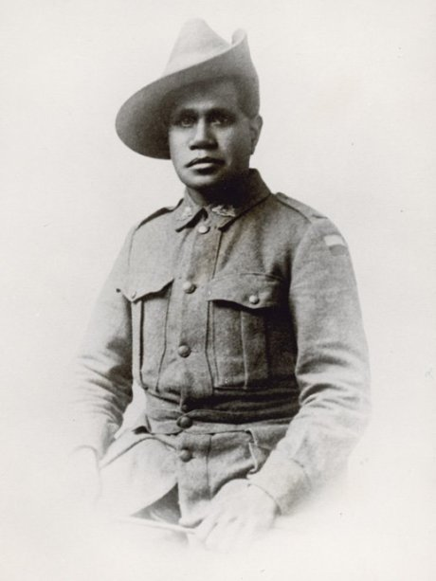
Persistence of Prejudice
Notes:
Source: VATE Study Guide, 2016.

Slide 26
Returning home
Although in many ways Indigenous soldiers did feel a sense of equality on the battlefield, when soldiers returned, the marginalisation and subjugation continued. Remember these were a people returning to a society hat did not acknowledge them as a citizens, whereby they could not vote, could not buy property, or enter bars.
Notes:
Source adapted from: VATE Study Guide, 2016.

Slide 27
The fight continues…
Notes:
Source: VATE Study Guide, 2016.

Slide 29
References
Arts Centre Melbourne Teacher’s Resource: https://www.artscentremelbourne.com.au/~/media/artscentre/files/about-us/media-centre/2015/03-march/20150318-mr-black-diggers-arts-centre-melbourne.ashx
Bolanger-Mashberg, A ‘Comparisons’, Insight Study Guide, 2016.
Matheson, L & Stracey, M Comparing The Longest Memory and Black Diggers, Pearson, 2016.
RISEMAN, N. Rectifying 'the Great Australian Silence'? Creative representations of Australian Indigenous Second World War service. Australian Aboriginal Studies. 2012, 1, 35-48, July 2012 (accessed 27/5/17)
SBS NITV, Who were black diggers? http://www.sbs.com.au/nitv/explainer/who-were-black-diggers
VATE Black Diggers Study Guide, 2016.
Exploration of black Diggers’ experience well overdue by Andrew Taylor, 2014 http://www.smh.com.au/entertainment/sydney-festival/exploration-of-black-diggers-experience-well-overdue-20140116-30x5l.html

Slide 30
Further reading
Take the time to read the play cover-to-cover, including the Director Wesley Enoch’s foreword (p.4) and Dr David Williams’ historical background (p.97).
Black diggers are hailed on Anzac Day. But the Indigenous 'Great War' was in Australia, Paul Daley, 2014 https://www.theguardian.com/australia-news/2017/apr/23/black-diggers-are-hailed-on-anzac-day-but-the-indigenous-great-war-was-in-australia
Black Diggers: the untold story of our Indigenous soldiers by Andrew Stephens, 2015 http://www.smh.com.au/entertainment/black-diggers-the-untold-story-of-our-indigenous-soldiers-20150328-1m9pme.html
Exploration of black Diggers’ experience well overdue by Andrew Taylor, 2014 http://www.smh.com.au/entertainment/sydney-festival/exploration-of-black-diggers-experience-well-overdue-20140116-30x5l.html
‘From shell-shock to PTSD, a century of invisible war trauma’ by McDonald et al, 2017 https://theconversation.com/from-shell-shock-to-ptsd-a-century-of-invisible-war-trauma-74911
Black Diggers brings Indigenous fighters' unknown stories to the fore, Ron Cerabona, 2015 http://www.canberratimes.com.au/act-news/canberra-life/black-diggers-brings-indigenous-fighters-unknown-stories-to-the-fore-20150212-13cuxn.html

Slide 31
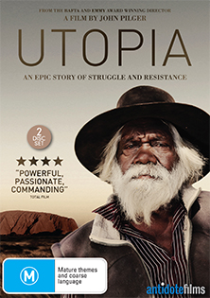
Even more further reading
John Pilger’s documentary Utopia (2013) is well worth watching to get a sense of the disparity that persists in Australia between Indigenous Australian and non-Indigenous Australians.
First Australians (2008) is another interesting documentary series that chronicles the collision of two worlds and the genesis of a new nation.

