Slide 1
BIOLOGICAL FACTORS
FACTORS THAT CONTRIBUTE TO VARIATIONS IN HEALTH STATUS

Slide 2
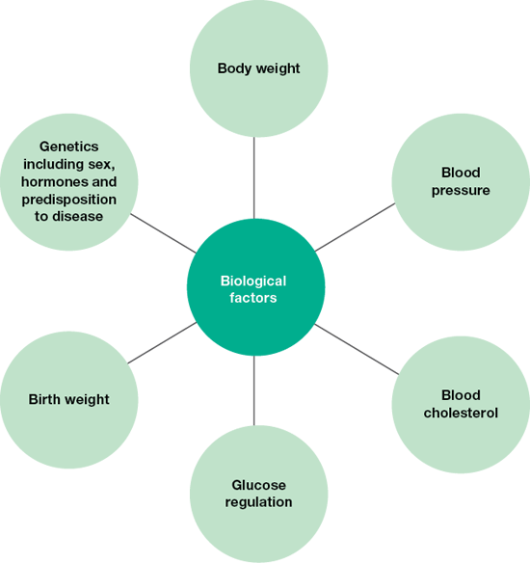
Biological Factors
Biological Factors are ‘factors relating to the body that impact on health and wellbeing’.
Examples include genetics, body weight, blood pressure, cholesterol levels, birth weight.

Slide 3
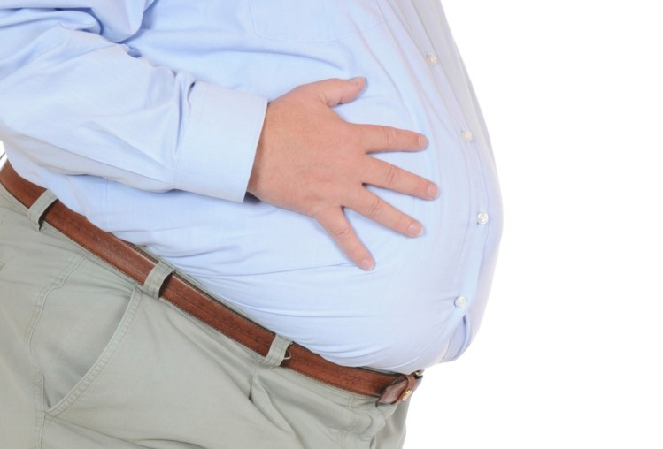
Body Weight
Body weight can be classified as:
Underweight
Healthy Weight
Overweight
Obese
Body weight is determined using BMI or waist measurement.
People who are overweight or obese are at increased risk of developing:
high blood pressure
high cholesterol
cardiovascular disease
some cancers (including colorectal cancer)
respiratory problems
type 2 diabetes
arthritis
self-esteem issues and depression
social exclusion.
Risks associated with abdominal fat

Slide 4
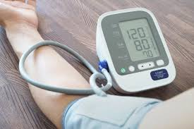
Blood Pressure
Learn about Blood Pressure
People with hypertension are at increased risk of:
Heart Attack
Stroke
Kidney Disease
Heart Failure
Who wants to check their blood pressure??
Does this person have healthy blood pressure?

Slide 5
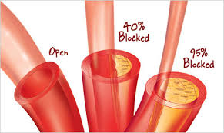
Blood Cholesterol
We learnt about blood cholesterol during out work on Chapter 3.
Let’s revise –
What is cholesterol?
Where is cholesterol produced in the body?
What are the 2 types of cholesterol?
What effect do these 2 types of cholesterol have on heart health?
People with high blood cholesterol are at increased risk of:
Atherosclerosis
Heart Attack
Stroke
Factors that increase the risk of having high cholesterol are:
Diets high in saturated and trans fats
Smoking
Lack of exercise
Excessive alcohol consumption
Being overweigh or obese
Genetic pre-disposition

Slide 6
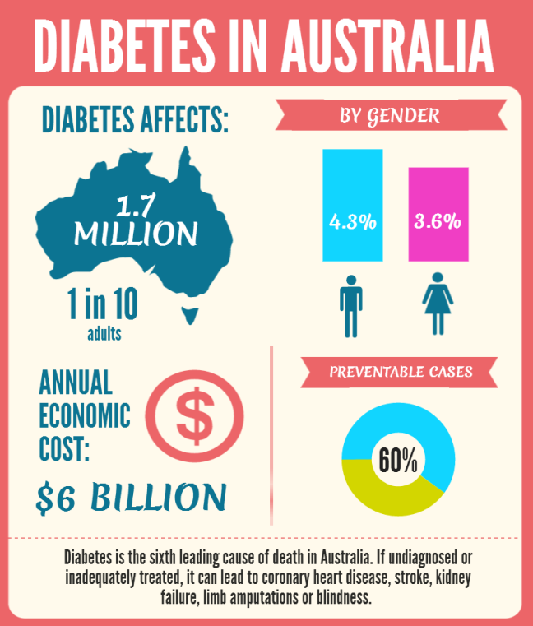
Blood Glucose Regulation
What is Blood Glucose Regulation?
When the process of blood glucose regulation doesn’t work properly, this is called ‘impaired glucose regulation’.
Impaired glucose regulation
increases risk of:
Type 2 diabetes
Factors that increase the risk of impaired glucose regulation include:
genetic predisposition
stress
pregnancy
lack of exercise
smoking
being overweight (particularly around the abdomen)
a diet high in fat, particularly trans fat
excessive alcohol consumption
high LDL cholesterol
high blood pressure.

Slide 7
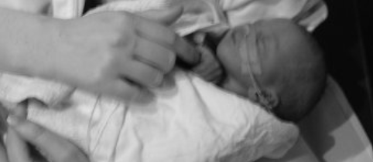
Birth Weight
Causes of low birth weight can include:
Pre-term birth
Age of mother – mums younger than 15 or older than 45 are more likely to have low birth weight babies
Maternal smoking or excessive alcohol or drug use during pregnancy.
Maternal nutritional status.
Illness of mother during pregnancy.
Birth weight is related to health outcomes directly after pregnancy and later in life.
The term low birth weight relates to a baby born with a weight under 2.5 kilograms.
Babies born with a low birth weight are more likely to:
have an underdeveloped immune system, making them more susceptible to infections.
suffer from premature death and significant disabilities such as speech and learning disabilities.
In later years, low birth weight babies are more likely to suffer from:
high blood pressure
type 2 diabetes
cardiovascular disease.

Slide 8
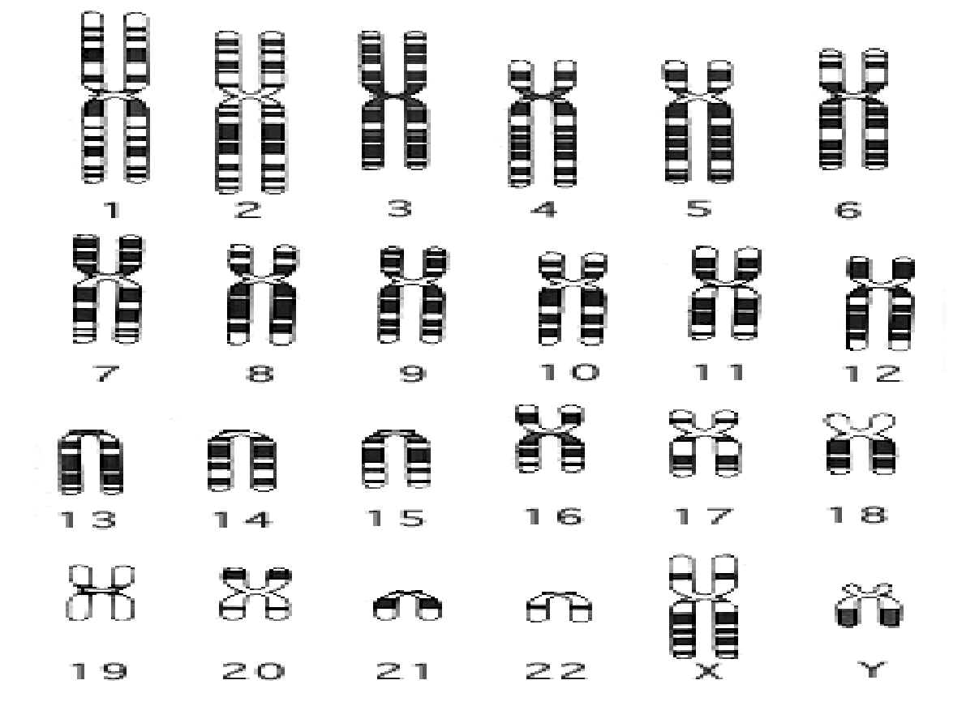
Genetics
A person’s genetics is determined at fertilisation. This is the moment that the sperm and egg cells fuse.
The genetic material contained in body cells controls many aspects of life that influence health status, such as
sex
body type
hormone production
predisposition to disease
aspects of personality

Slide 9
Genetics - Sex
Certain conditions are either exclusive to males or females or are more common in one of the sexes due to the biological differences between the sexes, which is caused by genetics.
For Example -
Women can’t get prostate or testicular cancer.
Men can’t get ovarian cancer.
Women are more likely to develop breast cancer (less than one per cent of all breast cancer cases occur in men), largely due to most women having more breast tissue than most men.

Slide 10
Genetics – Genetic Predisposition
Genetics can influence how likely someone is to develop certain conditions.
An increased risk is called a ‘genetic predisposition’ to that particular condition.
Genetic predisposition to disease often runs in families and ethnic groups, making some individuals more likely to experience some conditions than others. Other conditions that have a genetic predisposition include:
some cancers (including skin cancer, breast cancer and prostate cancer)
cardiovascular disease
diabetes (types 1 and 2)
hypertension
depression
obesity.

Slide 11
Genetics -
Hormones are chemicals that regulate many processes in the body
Hormones are also responsible for the formation of male and female sex characteristics that lead to differences in some of the conditions experienced by males and females.
Oestrogen
Oestrogen also helps to maintain bone density in women When a woman enters menopause, the levels of oestrogen decline. This decline leads to a loss of bone mass from the skeletal system, which can contribute to osteoporosis — a disease characterised by weak, porous bones that are more susceptible to breaks and fractures.
Oestrogen may have a protective role in the development of cardiovascular disease, which might explain the lower rates of this disease in women prior to menopause.
Oestrogen is also linked to distribution of fat in the body. Oestrogen tends to result in fat being deposited around the buttocks and thighs, whereas men and post-menopausal women tend to accumulate more fat around the abdomen, increasing the risk of heart disease.
Testosterone
Testosterone is mainly responsible for the male sex characteristics and the production of sperm, but may also play a role in increased risk-taking behaviours and aggression in males compared to females. Risks such as skylarking, violence and substance misuse can contribute to higher rates of injury and mortality compared to females.

Slide 12
Let’s Review
Complete Q 1-17 from section 4.2 of the text.
Pre-read section 4.3 of the text.
Continue working on your ‘Factors Effecting Health Summary Table’.

