Slide 1
ENVIRONMENTAL FACTORS
FACTORS THAT CONTRIBUTE TO VARIATIONS IN HEALTH STATUS

Slide 2
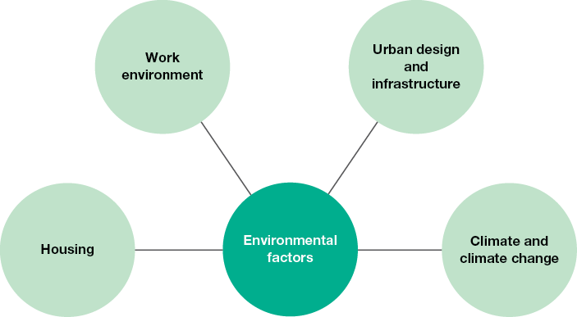
Environmental Factors
Environmental factors refer to the physical surroundings in which we live, work and play.
Examples include workplaces, housing, climate and climate change, roads and geographical access to resources such as healthcare.

Slide 3
Housing
People spend a significant amount of time in their homes. Some of the considerations regarding housing that can lead to variations in health status are:
Ventilation & Hygiene - Inadequate ventilation has been linked to increased rates of morbidity from infectious and chronic diseases. For example, a house that is damp and has poor ventilation can promote the growth of mould, which can increase the risk of developing respiratory and asthma-related symptoms such as coughing, wheezing and irritation of the upper respiratory tract by 30–50 per cent (AIHW, 2010).
Design & Safety- If not adequately maintained, features of houses such as stairs, floor surfaces (especially those that may become slippery when wet), bodies of water (such as ponds, dams and pools), balconies, electrical wiring and furniture can increase the risk of falls, cuts, drowning and electrocution. Young children and the elderly are often the most at risk of these injuries.
Security - Having a house that is not seen as secure from the elements and intruders can promote fear among the residents and lead to high levels of stress and anxiety.

Slide 4
Housing continued…
Overcrowding - Those living in overcrowded housing experience
higher rates of mental health issues because occupants find it
difficult to find their own space. Overcrowded conditions also place added strain on bathroom, kitchen and laundry facilities, which can lead to unsanitary conditions and increases the risk of infectious diseases.
Pollutants- Environmental tobacco smoke, asbestos, dust, pet hair and other pollutants in the home can lead to respiratory conditions such as asthma.
Sleeping conditions - Noise and overcrowding can impact on sleeping conditions and contribute to mental health issues.
Resources conducive to eating a nutritionally sound diet - If individuals do not have access to refrigeration and cooking facilities, they may rely on takeaway foods. Such foods may be high in fat and contribute to obesity and related conditions such as cardiovascular disease and type 2 diabetes.
Access to water and sanitation facilities - An adequate water supply and the infrastructure to deliver clean water to homes are required to access clean water, and this decreases the risk of infectious diseases. Sanitation facilities are essential to remove human waste from the immediate environment. This reduces the risk of infectious diseases, such as cholera, that are spread by contact with human waste.

Slide 5
Work Environment
UV exposure - Those working outdoors are more exposed to UV radiation. This can increase the risk of skin cancer among these workers.
Accidents and injuries - Many workplaces have risks associated with the specific environment in which the work is carried out. People working on farms and mining operations, for example, often use heavy machinery, which can increase the risk of injuries. Those working in transport, such as truck drivers and taxi drivers, may have an increased risk of road trauma as a result of spending extended periods on the roads. Those working with tools such as sewing machines and saws may have an increased risk of lacerations.
Exposure to hazardous substances - Hazardous substances such as paint, asbestos, fuels, gases, acids and corrosive chemicals are used in many workplaces; for example, those used for manufacturing and building. Although the use of protective equipment can reduce the risks associated with handling such substances, they still contribute to morbidity and mortality in the workplace.

Slide 6
Urban Design & Infrastructure
Geographic Location of Resources
Being close to supermarkets, shops and hospitals, and having the means to reach these resources, can decrease morbidity and mortality rates, because people can access the resources required to obtain adequate food and healthcare.
Being in close proximity to fast-food outlets may increase the frequency at which people consume such products. This can increase energy intake and contribute to overweight and obesity.
Industrial sites located in close proximity to residential
areas may increase noise pollution in the area. This
can increase the risk of mental health issues.

Slide 7
Urban Design & Infrastructure
Infrastructure
Roads - Adequately maintained roads and traffic systems such as traffic lights, signage and road lighting can improve safety and decrease the risk of morbidity and mortality from road trauma.
Public transport systems - Public transport can help people to access resources that can promote health status, such as food, employment, healthcare and social interaction.
ICT Resources - Information and communication technologies can assist in maintaining social connections, and this promotes mental health and wellbeing and can decrease the risk of mental illness. Internet connections can also promote education for those living outside major cities, and can help people access health information.
Electricity - Electricity is required for heating and cooling, cooking and refrigeration, tele-communications and recreation. All of these resources can assist in promoting health status.
Water - Water is required for drinking, bathing, cooking and sanitation. Having access to a clean and reliable water supply reduces the risk of infectious diseases.
Adequate sanitation infrastructure - Infrastructure such as sewerage systems, eliminates waste from the environment. Removing substances such faeces, solid wastes and domestic wastewater reduces the risk of infectious diseases such as cholera.
Recreation facilities - Having access to public spaces such as parks and gardens, walking paths, cycling tracks, basketball and tennis courts, means people are more likely to be physically active. This can reduce the risk of mental health problems and obesity.

Slide 8
Climate & Climate Change
CLIMATE
Australia is the driest inhabited continent on Earth, and is more susceptible to bushfires than many other countries as a result. As well as the loss of human life that occurs with bushfires, houses and infrastructure can also be destroyed. Access to resources such as water, food, electricity and healthcare can all be affected, further increasing morbidity and mortality rates in affected areas.
Ultraviolet radiation levels are comparatively high in Australia, contributing to Australia having the highest rates of skin cancer in the world.
An image of a power station being burnt during the weekend’s bushfires. What impact could this have on health & wellbeing?

Slide 9
Climate & Climate Change
Human settlement, industrialisation, land clearing and farming practices all affect environmental systems, including climate systems (AIHW, 2010).
There is increasing concern that changes to the environment are contributing to climate change, resulting in:
extreme temperatures,
rising sea levels,
increases in the occurrence of natural disasters
the spread of vector-borne diseases such as dengue fever and Ross River fever, which are spread by infected mosquitoes.
Which groups of people do you think will be most effected by the impacts of climate change?

Slide 10
Let’s Review
Define the following key terms
Sanitation
Infrastructure
Complete Q 1-5, 8-12 & 14 from section 4.4 of the text.
Continue working on your ‘Factors Effecting Health Summary Table’.
Optional (recommended) - Pre-read sections 4.5 – 4.9 of the text.

