Slide 1
SOCIOCULTURAL FACTORS
FACTORS THAT CONTRIBUTE TO VARIATIONS IN HEALTH STATUS

Slide 2
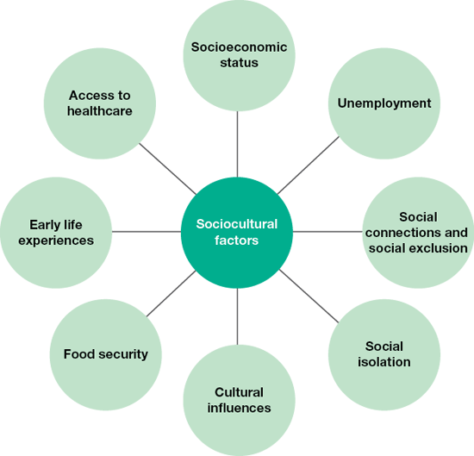
Sociocultural Factors
Sociocultural Factors are ‘the social and cultural conditions into which people are born, grow, live, work and age’.
Examples include socioeconomic status, social connections, family influences including culture, lifestyles and values, food security, early life experiences and access to affordable, culturally appropriate healthcare.

Slide 3
Socioeconomic Status
Socioeconomic status (SES) refers to a person’s position in society relative to other people based on three factors: income, occupation and education.
Income - can influence people’s ability to access resources such as adequate housing, food, healthcare (including private health insurance), recreation, transport and education.
Occupation - Some occupations (including many trades) involve manual labour, which can increase the risk of soft tissue injuries and back pain.
Other occupations are sedentary in nature (including many administrative roles), which can reduce levels of physical activity and increase the risk of obesity.
Manual workers (such as those working in factories) often come from a lower socioeconomic background and experience more occupational hazards than those in managerial/professional occupations.
Education - Those who are more educated are more likely to be health literate. Health literacy describes the degree to which individuals have the capacity to obtain, process, and understand the basic health information and services needed to make appropriate health decisions.
People with low levels of education are more likely to smoke, make poor dietary choices and misuse drugs and alcohol as they don’t understand the health risks attached.

Slide 4
Unemployment
There is a strong link between unemployment and poor health.
People who are unemployed are more likely to suffer from cardiovascular disease, lung cancer and have higher suicide rates than people who are employed.
The effects are even worse if a person is unemployed for a long period of time. This can be because of psychological concerns and financial pressures.
There is a two-way relationship between health status and unemployment. For some it is ill health that causes unemployment (such as an injury or illness), and for others it is unemployment that causes health problems (such as stress and depression).

Slide 5
Unemployment
Some health problems associated with unemployment, compared with employment.

Slide 6
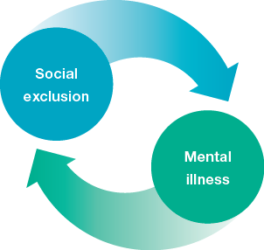
Social Connections & Social Exclusion
Social Connection
Social connections relate to the bonds between an individual and their relations, friends and acquaintances and the ability to participate in the society in which they live.
Social Exclusion
Social exclusion refers to the segregation that people experience if they are not adequately participating in the society in which they live.
It also includes those who experience feelings of disconnectedness and do not get opportunities to make use of the resources available to them in a society, such as education, employment, housing, healthcare and social security services.
Causes of social inclusion can include:
poor physical and mental health and wellbeing
disability
inability to access services such as healthcare, education, employment and social security
family breakdown
homelessness
discrimination, including racism
low income.
Social exclusion can lead to higher levels of psychological distress. This can then lead to an increased rate of risky behaviours such as tobacco and alcohol use, and increase the risk of a range of diseases that may otherwise be preventable, such as cardiovascular disease, respiratory diseases and some cancers.

Slide 7
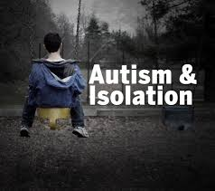
Social Isolation
Social isolation refers to individuals who are not in regular contact with others.
Causes of social isolation can include:
Geographical barriers
Disability
Illness
Lack of transport
Communication barriers
Regular social contact gives people the opportunity to communicate and socialise, which can promote physical, social, emotional, mental and spiritual health and wellbeing.
In times of difficulty, people who are socially isolated can feel they have no-one to turn to, and this can contribute to a range of mental health problems such as depression and stress.

Slide 8
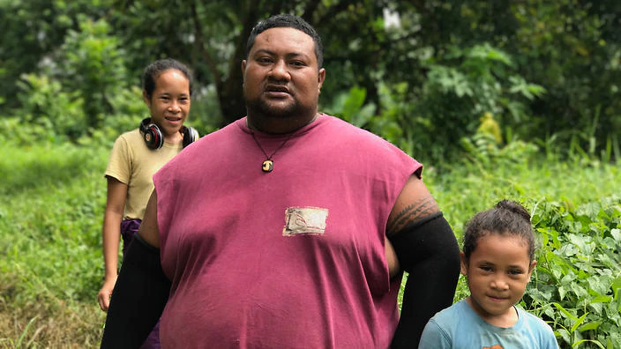
Cultural Factors
Dietary Intake
The dietary intake of cultural groups often evolves over a long period of time and influences the sorts of foods people consume.
Some cultural groups are more likely to have healthier diets than others.
Cultural influences relate to customs, ideas, values, and traditions of a particular society that are passed through generations.
Cultural influences that impact health status include gender stereotypes, food intake, attitudes and beliefs.
Gender Stereotypes
Gender stereotypes relate to behaviours that are culturally acceptable for males and females.
For example:
Males being ‘macho’ and needing to feel strong.
Males working and females staying at home to look after the children.
Samoa has some of the highest obesity rates in the world. Their dietary choices play a large part in this. Watch the following video if interested to learn more….
https://www.sbs.com.au/news/dateline/story/obesity-paradise

Slide 9
Cultural Factors continued…
Attitudes
Attitudes towards education and employment, recreation including substance use such as alcohol consumption, health and healthcare including traditional medicine, all affect health status.
Acceptance of Alcohol
Alcohol consumption is an accepted part of life for many Australians.
This contributes to a range of negative health outcomes for many, especially males, who typically consume more alcohol than females.

Slide 10
Food Security
When nutritional foods are lacking, people are more likely to develop deficiency diseases such as osteoporosis, anaemia and other vitamin deficiencies. They are more likely to have poor immune system function and be more susceptible to infections and other communicable diseases.
Food security exists when people can obtain nutritionally adequate, culturally appropriate, safe food regularly through local non-emergency sources.
Food insecurity occurs when people cannot access such foods.
When food is available in plentiful amounts, people are more likely to overconsume foods and develop conditions associated with overconsumption such as obesity, CVD and Type 2 diabetes.

Slide 11
Early Life Experiences
Every person is, in part, a product of their past experiences.
Behaviours of women while they are pregnant are early life experiences for unborn babies that can contribute to a range of health issues. Maternal tobacco, alcohol and drug use, and maternal nutrition and exposure to certain chemicals, bacteria and viruses during pregnancy, can all have significant impacts on the individual after birth and into adulthood.
Having optimal growth and strong emotional attachment in the early years can assist physical, social, emotional, mental and spiritual health and wellbeing in adulthood.
Infants who have experienced positive emotional stimulation are better prepared to take on the challenges of formal education and to exhibit positive behaviour, and are less likely to be socially excluded in adulthood.
Abuse or neglect during the early years affects brain function and development, and contributes to emotional and behavioural problems later in life, including tobacco and substance use.

Slide 12
Access to Healthcare
Healthcare refers to services that promote and preserve health and wellbeing. These services diagnose, treat and/or manage disease and illness. In Australia, these services are carried out by doctors, nurses, scientists, dentists, pharmacists and other health professionals such as physiotherapists and naturopaths.
There are many cultural, financial and other sociocultural barriers that prevent many Australians from accessing services they might otherwise use.
Some of the sociocultural reasons that might cause people to not use healthcare includes:
Language barriers
Cultural barriers, such as women from some religions requiring to see a female doctor
Cultural beliefs – Many indigenous Australians prefer to practice traditional medicine, so are reluctant to use Western Medicine. They also associate hospitals with death.
Cost – Patients sometimes have to pay for health services. For people from low socioeconomic status groups, this can be prohibitive.

Slide 13
Let’s Review
Complete Q 1-16 from section 4.3 of the text.
Pre-read section 4.4 of the text.
Continue working on your ‘Factors Effecting Health Summary Table’.

