Slide 1
Measurements of health status
Unit 3 Health and Human Development

Slide 2
What is health status?
The level of health being experienced by an individual or a population after taking into account factors such as life expectancy, disability rates and risk of disease
Health indicators
The collective term given to the variety of ways of measuring health status eg life expectancy, morbidity, mortality, burden of disease.

Slide 3
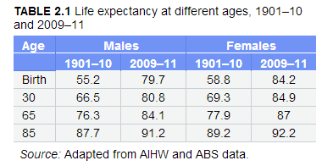
LIFE expectancy
An indication of how long a person can expect to live if the current death rates stay the same
Qn? Why does Life Expectancy increase as age increase?

Slide 4
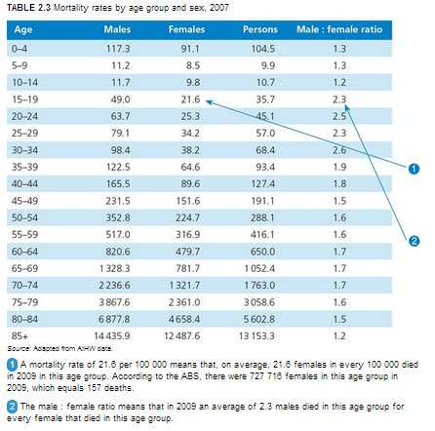
mortality
MORTALITY Deaths in a population
MORTALITY RATE
Indication of how many deaths occurred in a population in a given period of time for a specific cause/all causes

Slide 5
MORTALITY RATES
Write a sentence that shows two trends in this graph
TREND
A general movement or pattern

Slide 6
MORTALITY RATES
there is an unsteady decrease in the death rates per 100 000 from years 1970 until 2009 for australians aged 15-19 years old. from 1970, death rates for this age group were significantly higher highlighting a rate of 150 deaths, compared the death rate in 2009 which only had 40 deaths, 110 less from 1970.

Slide 7
YLL – YEARS OF LIFE LOST
Years of life lost due to premature death
Life expectancy minus age at death
Eg 80.6-63.6 = 17 YLL

Slide 8
MORBIDITY AND MORBIDITY RATE
MORBIDITY
The ill-health in an individual or the level of ill-health in a population or group. It includes disease, injury and disability.
MORBIDITY RATE
Rate of ill-health in a population at in a given period of time

Slide 9
Mortality rates
Under 5 Mortality Rate: ‘The number of deaths of children under five years of age
per 1000 live births.’ (WHO, 2008)
Infant death refers to deaths of young children, typically those less than one year of age. It is measured by the infant mortality rate (IMR), which is the number of deaths of children under one year of age per 1000 live births
Maternal death or maternal mortality is defined by the World Health Organization (WHO) as "the death of a woman while pregnant or within 42 days of termination of pregnancy, irrespective of the duration and site of the pregnancy, from any cause related to or aggravated by the pregnancy or its management but not from accidental or incidental cause

Slide 10
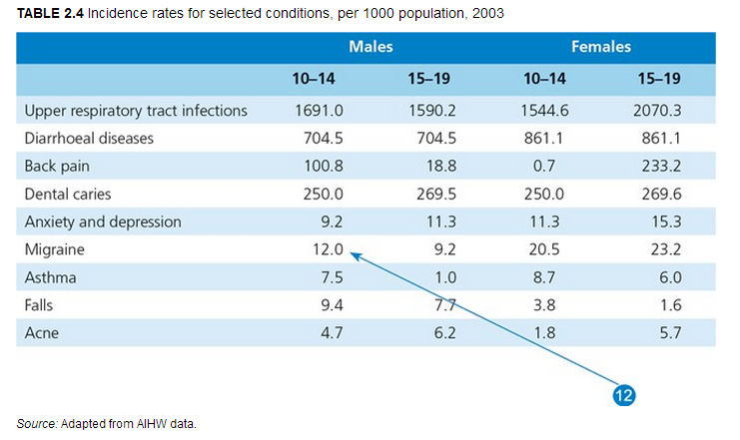
INCIDENCE
The numbers of new cases of a condition in a given period of time (usually 12 months)
Qn
Write a sentence that shows two trends from this table

Slide 11
prevalence
The total number of cases of a condition at a given time
Qn
Write a sentence that shows two trends from this table

Slide 12
YLD – YEARS OF LIFE LOST DUE TO DISABILITY
The number of healthy years lost due to disease, illness or injury. A measure of the impact of morbidity.
The WHO developed a system to calculate YLDs that allows comparison between such conditions: disability weights
Disability weights: a scale ranging from 0-1 that reflects the severity of a range of conditions.
0 = no impact
1 = death

Slide 13
YLD – YEARS OF LIFE LOST DUE TO DISABILITY
YLD = number of years a person suffers from a condition x the disability weight
Example:
If a person had asthma for 5 years, the ‘YLD’ for the condition would be:
YLD = 5 year x 0.43
= 0.215 of a year of ‘healthy’ life lost

Slide 14
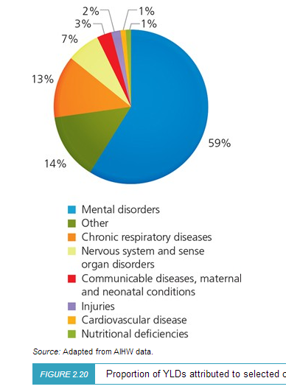
YLD con’td
Proportion of YLDs attributed to selected causes, males aged 10-19, 2003
Proportion of YLDs attributed to selected causes,
females aged 10-19, 2003

Slide 15
Health-adjusted life expectancy (HALE)
HALE is a measure of population health that takes into account mortality and morbidity. It adjusts overall life expectancy by the amount of time lived in less than perfect health.
Source: https://www.healthknowledge.org.uk/e-learning/health-information/population-health-specialists/lifetables-hales-dalys-pylls
If:
A = years lived healthily B = years lived with disability
A+B = life expectancy
A+fB = healthy life expectancy, where f is a weighting to reflect disability level.
N.B. This raises many moral questions about who defines and measures disability level and how they do it.

Slide 16
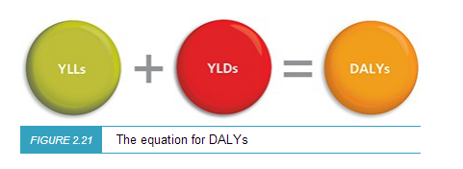
BURDEN OF DISEASE
A measure of the impact of diseases and injuries, specifically it measures the gap between current health status and an ideal situation where everyone lives to an old age free of disease and disability. Burden of disease is measured in a unit called the DALY (Disability Adjusted Life Years).

Slide 17
Burden of disease
Qn
Write a sentence that shows two trends from this table

Slide 18
Burden of disease
Qn
Write a sentence that shows two trends from this table

Slide 19
Burden of disease
Qn
Write a sentence that shows two trends from this table

Slide 20
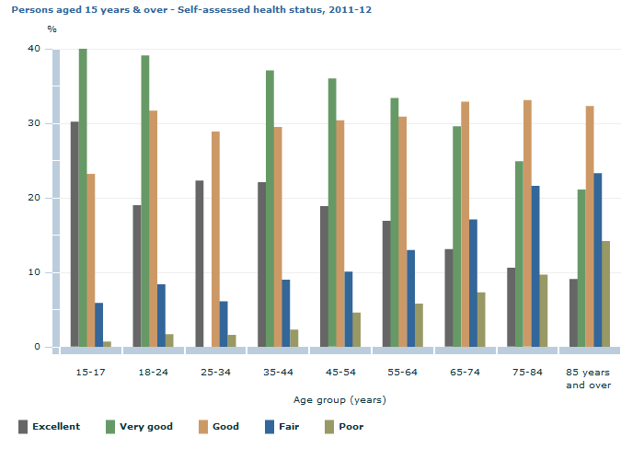
Self-assessed health status
Self-assessed health status is a commonly used measure of overall health which reflects a person's perception of his or her own health at a given point in time. It is a useful measure of a person's current health status, as well as providing a broad picture of a population's overall health.
Qn Write a sentence that shows two trends from this table
Is SAHS an accurate measure?
Source: ABS

