Slide 1
Unit 4
Global hhd
AOS 1 - Health and wellbeing in a global context

Slide 2
Outcome 1-Analyse similarities and differences in health status and burden of disease globally and the factors that contribute to differences in health and wellbeing
Part 1
- 8 Comparing health status and burden of disease across countries
Part 2
- 9 Sustainability and human development
- 10 Global trends and health and wellbeing
This area of study will be split in to TWO SAC’s 25 marks each
Unit 4 AOS 1 Part 1
Unit 4 AOS 1 Part 2
Chapter 8 & 9 definition Pre-test
https://quizlet.com/_4tqnph
Notes:
Play quizlet

Slide 3
Chapter 8
Comparing health status and burden of disease across countries
Key knowledge
Characteristics of high-, middle- and low-income countries
Similarities and differences in health status and burden of disease in low-, middle- and high-income countries, including Australia
Factors that contribute to similarities and differences in health status and burden of disease, including access to safe water; sanitation; poverty; inequality and discrimination (race, religion, sex, sexual orientation and gender identity); and global distribution and marketing of tobacco, alcohol and processed foods
Burden of disease is the impact of a health problem as measured by financial cost, mortality, morbidity, or other indicators. It is often quantified in terms of disability-adjusted life years (DALYs), both of which quantify the number of years lost due to disease (YLDs).
https://en.wikipedia.org/wiki/Disease_burden
Notes:
Go over key knowledge

Slide 4
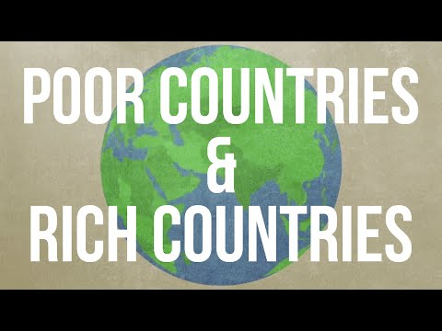
Explore both of these websites
https://www.livebelowtheline.com.au
https://actforpeace.rationchallenge.org.au
Then complete the following activity
As individuals you now all have $3.00AU
You can choose to group up and put your money together or stay seperate.
But you will need to eat for a week
Use the woolworths click and collect website to design your meal plan.
SHARE YOUR WEEKLY MEAL PLAN WITH THE CLASS
Notes:
Introduction video
https://www.livebelowtheline.com.au
https://actforpeace.rationchallenge.org.au

Slide 5
The differences between high-, middle- and low-income countries
· Teenage affluenza (https://www.youtube.com/watch?v=KFZz6ICzpjI)
· A tale of two girls (http://www.who.int/features/2003/11/en/)
Notes:
Watch the following video and slideshow and use them as the basis of discussion on the differences between high-, middle- and low-income countries:
· Teenage affluenza (https://www.youtube.com/watch?v=KFZz6ICzpjI)
· A tale of two girls (http://www.who.int/features/2003/11/en/)

Slide 6
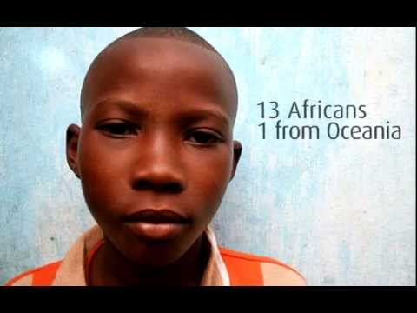
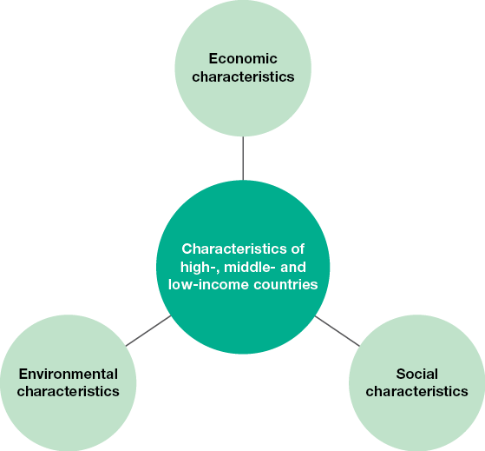
8.2 - Economic characteristics of high-, middle- and low-income countries
These are not necessarily common to all high-, middle- or low-income countries, but they represent differences that are often experienced between the three groups.
http://www.miniature-earth.com
Notes:
Group discussion:
1. Brainstorm the economic characteristics of high-, middle- and low-income countries.
2. Collect from the internet images of high-, middle- and low-income countries.

Slide 7
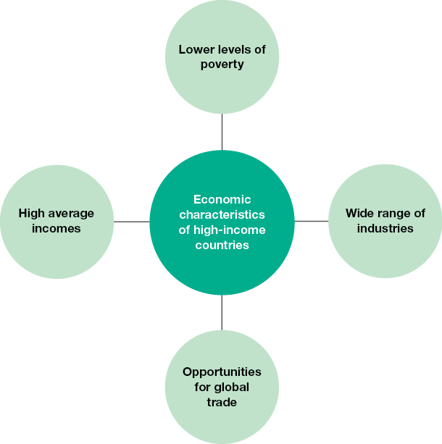
Economic conditions:
A range of factors relating to the financial or economic state of a country can influence the opportunities and resources that are available for its citizens.
Poverty = lack of access to resources
Extreme poverty = US$1.90 per day
Economic characteristics of high-income countries

Slide 8
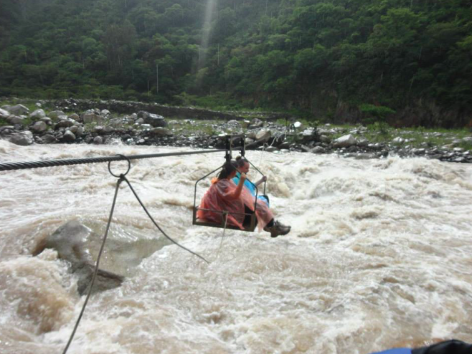
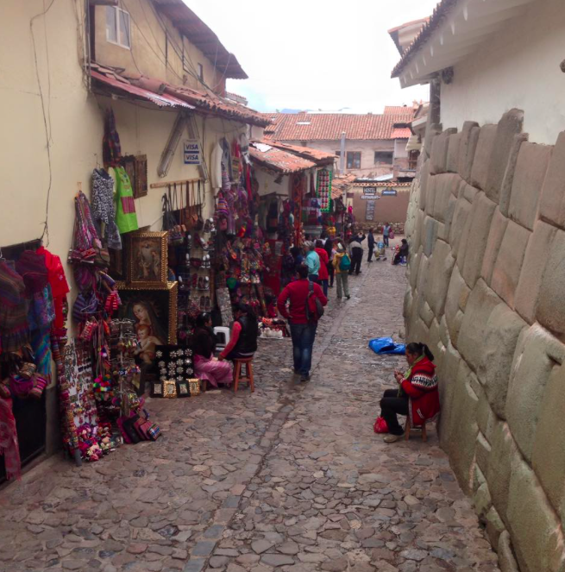
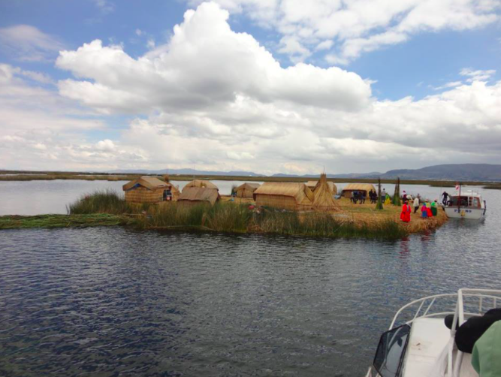
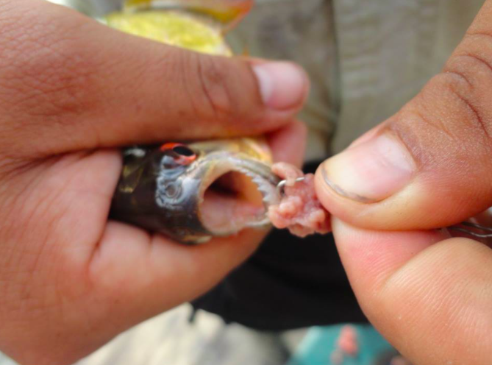
Notes:
Conversation about travel and the types of poverty and comforts/dicomforts that I saw overseas in South America

Slide 9
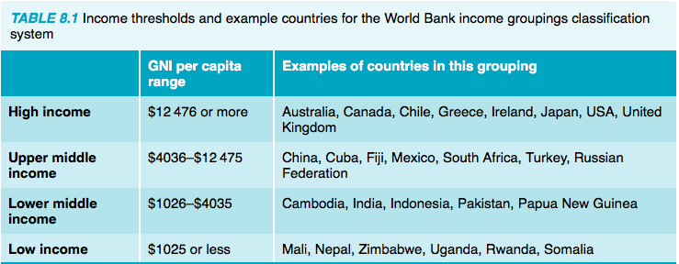
8.2
TYK
Question 1-5
AYK
Question 6 & 7
Gross National Income (GNI): a measure that reflects the economic state of a country. GNI is the total income generated by a country in a 12-month period once expenses owing to other countries have been paid.
Notes:
Test your knowledge
They are classifications of countries based on average income (GNI per capita). High-income countries have the highest average income and low-income countries have the lowest average incomes.
Characteristics:
Low- and middle-income countries have higher rates of poverty than high-income countries.
Low- and middle-income countries often don’t trade on the global market as much as high-income countries.
High-income countries often have a greater range of industries than low- and middle-income countries.
Low- and middle-income countries often have high levels of international debt and may not be as able to pay these debts as high-income countries.
According to the World Bank, in 2010 around 3 per cent of the workforce in high-income countries worked in agriculture, compared to around a quarter in middle-income countries and up to 50 per cent and higher in many low-income countries. This reduces the ability of low- and middle-income countries to trade on the global market, as they may not be able to generate goods that other countries require. Many low- and middle- income countries often lack the infrastructure, knowledge and production capabilities to produce a range of goods and services to trade on a global scale.
Infrastructure such as roads and ports allows goods to be transported around the country and around the world.
Extreme poverty is measured as living on less than US$1.90 per day.
Apply your knowledge
Having a diverse range of industries helps to bring income into the country and therefore reduces poverty.
Having a range of industries increases the chances that the goods and services produced will be sought after by other countries.
Many industries experience highs and lows in relation to production. If a country’s industries revolve around one resource (such as food production), events such as drought can have a significant impact on this industry, and trade can be adversely affected if there are no other industries to take their place on the global market. So having a range of industries increases the likelihood that at least some of the industries will experience positive production trends at any one time.
Examples
By wiping debts owed by developing countries
By providing direct financial assistance
By working with developing countries to help them trade on the global market
Individual response
High-income countries have the highest quality of infrastructure relating to ports (with a ranking of just over 5 out of 7), followed by middle-income countries (scoring around 3.5) and low-income countries (with a score of 3).
The level of extreme poverty (measured by people living on less than US$1.90 per day) is lowest in high-income countries (under 1 per cent of the population), followed by middle-income countries (around 10 per cent) and then low-income countries (around 46 per cent of the population).

Slide 10
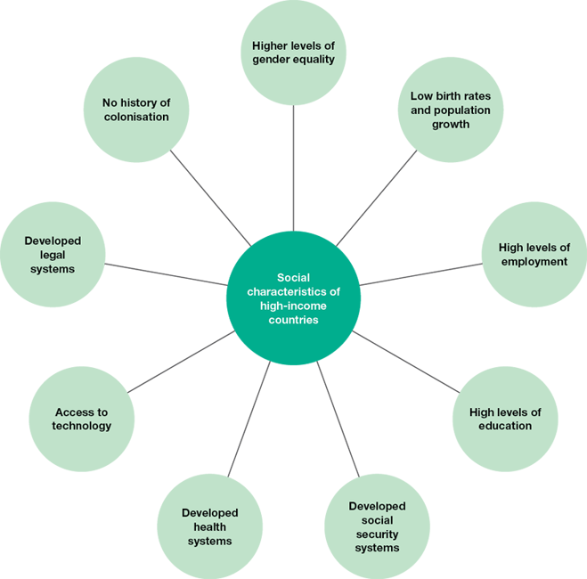
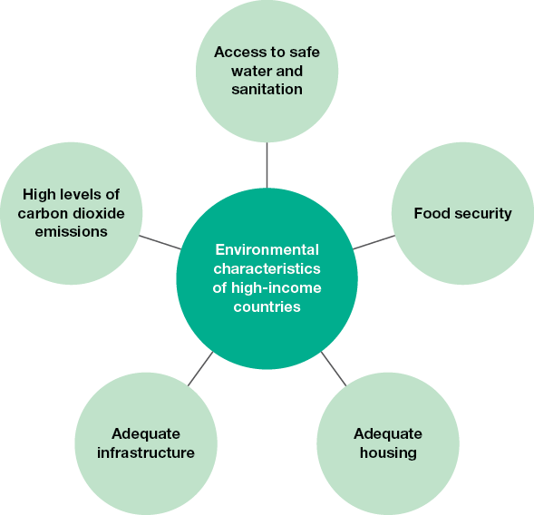
8.3 - social and Environmental characteristics of countries
Gender equality: when males and females have the same opportunities in society in relation to the goods and services available
Brainstorm the social and environmental characteristics of high-, middle- and low-income countries.
TYK
Q2,3 & 4
8.3 -Activity
Create a table for high-income, middle-income and low income countries
include:
three social characteristics
three environmental characteristics.
Notes:
Activity answers that could be included.
Social characteristics include:
Higher levels of gender equality — women have similar opportunities to men in high-income countries, whereas women in low- and middle-income countries often lack the opportunities available to males.
Low birth and population growth rates — high-income countries often have a lower rate of population growth than low- and middle-income countries.
High levels of employment — employment rates and choices in relation to employment are often greater in high-income countries than in low- and middle-income countries.
High levels of education — education systems are often more developed in high-income countries than in low- and middle-income countries.
Environmental characteristics include:
Safe water and sanitation — those in high-income countries often have greater access to clean water and adequate sanitation than those in low- and middle-income countries.
Access to food — those in high-income countries often have greater access to a reliable food supply than those in low- and middle-income countries.
Adequate housing — those in high-income countries often have higher quality housing than those in low- and middle-income countries.
Adequate infrastructure — infrastructure such as roads, electricity grids and telecommunications systems is often more developed in high-income countries than that in low- and middle-income countries.
TYK answers:
2.
Gender equality exists when males and females have the same opportunities in society in relation to the goods and services available.
If women can be educated and can work in productive employment, average incomes increase and governments have more money (through taxation) to provide goods and services to the people. This helps reduce poverty.
3. Technology can be used to assist countries in developing their economies, building trade opportunities, furthering education and treating ill health. This increases average incomes and can contribute to a country transitioning from being low-income to middle-income.
4. Access to contraception, choice in family planning, career choices, education and culture contribute to differences in birth rates.

Slide 11
KEY POINT
When we make a judgement about the HEALTH STATUS of a country we need to use KEY INDICATORS
MORTALITY
LIFE EXPECTANCY
BURDEN OF DISEASE
MORBIDITY
Notes:
Discuss as a group :
: what would you predict the health status of a high, middle and low country would be? (use health status indicators in your discussion)

Slide 12
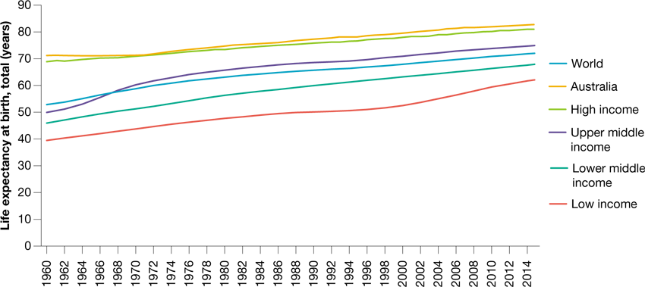
8.4 - Similarities and differences in health status and burden of disease in low-, middle- and high-income countries
Key concept:
Understanding the similarities and differences in health status and burden of disease in low-, middle- and high-income countries
Find and Share
Find 2 newspaper articles relating to the health issues (or related current events) experienced in a low- and a middle-income countries.
discuss briefly for each article
Which factors are mentioned as contributing to the problems being experienced?
FIGURE 8.17 Life expectancy at birth over time — globally, in Australia and in the World Bank income groups
Notes:
BOARD NOTES: - copy into your books
Life expectancy - There are occasionally fluctuations in life expectancy within countries, however, Low- and middle-income countries are more susceptible to fluctuations in life expectancy issues due to war, conflict and the spread of infectious diseases in a relatively short period of time.

Slide 13
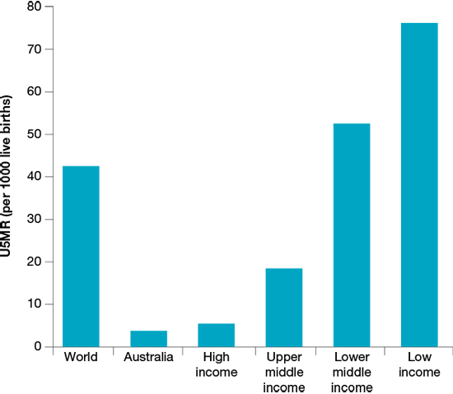
8.4 - Mortality and morbidity
This information tells us what the causes of death and illness is and what resources we can use to close the health gap (health promotional strategy)
Key point:
The survival of a child (U5MR) is reliant on a number of factors including
nutritional health status of mothers
health literacy of mothers
level of immunisation available
availability of maternal and child health services
income and food availability in the family
availability of clean water and safe sanitation
overall safety of the child’s environment.
Question: What are Australian children likely to suffer from compared to children in low and middle income countries? (Read Pg.303 and 304 table 8.2)
Notes:
Slide 13 Student activities:
Copy key point into your text-book
Identify 1 trend represented in Figure 8.19 Pg.303
Answer question from the yellow box into your book

Slide 14
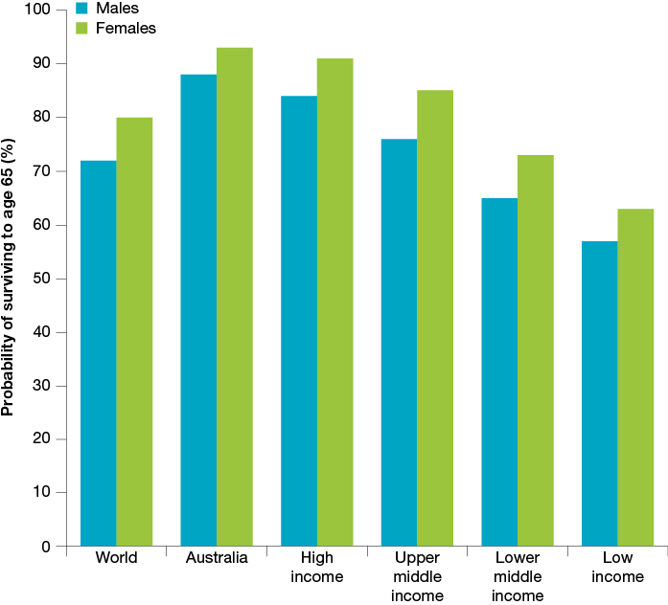
8.4 - Adult Mortality and morbidity
Mainly due to the impact of lifestyle factors such as tobacco smoking, excessive alcohol consumption and unsafe sex leading to HIV/AIDS.
Activity: Write in your book
Read pg. 305 and find out what a “DOUBLE BURDEN OF DISEASE IS”
Question: What are women in low and middle income countries dying from and why?
Watch and answer 9 question listed in Notes section below.
Premature mortality among adults generally increases as average incomes decrease. Figure 8.22 shows the proportion of people who can expect to live to age 65 globally, in Australia and in each of the four income groups. As with child mortality and morbidity, the causes of mortality and morbidity for adults differ depending on the level of income.
Notes:
Slide 14 student work
Read red box on the slide and write as notes into your book
Discuss the graph and identify what you can see is the major trend (answer in insert below graph)
Complete red solid box activity: Read pg. 305 and find out what a “DOUBLE BURDEN OF DISEASE IS”
Answer question: What are women in low and middle income countries dying from and why?
Watch: https://www.youtube.com/watch?v=I_o_wkr7N8A Take notes about Access the HIV/AIDS weblink in the Resources tab in your eBookPLUS to watch a video about HIV/AIDS.
How widespread is HIV?
What kind of infection is HIV?
Is there a cure for HIV?
Explain the difference between HIV and AIDs.
How do people become infected with HIV?
Can HIV be spread by kissing? Explain.
Is there a cure for HIV?
Can HIV be treated? Explain.
How can HIV transmission be avoided?

Slide 15
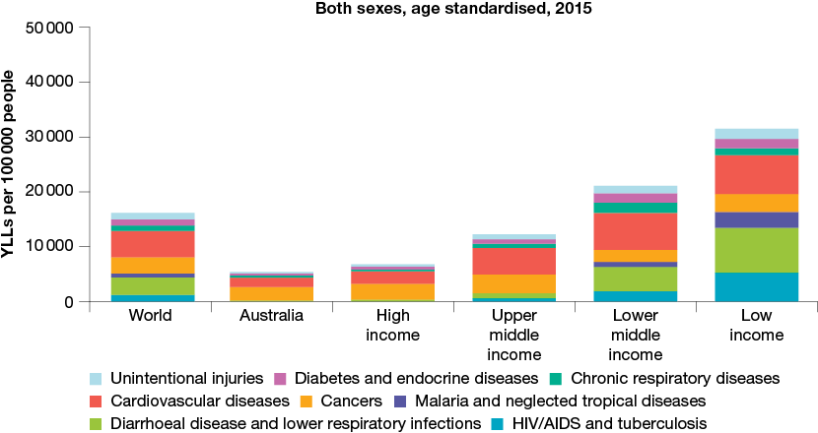
8.4 Burden of disease
FIGURE 8.26 YLL rate in selected groups and Australia due to selected causes, 2015
Years of life lost (YLL) rates for most causes are higher in low- and middle-income countries than in high-income countries, including Australia.
When comparing burden of diease in high-income to middle and low income populations, (EXAM ANSWERS)
High-income countries have well-developed health system therefore (linking word) disease and illness that can cause premature death are often effectively treated thus extending life expectancy and reducing the rate of YLL.
Treatment options are often limited in low- and middle-income countries, which can increase the risk of premature death and result in a higher rate of YLL.
Activity:
Identify and write the trend you can see in Figure 8.26 relating to YLL rates in selected groups compared to AUstralia.
Notes:
Slide 15 work
Copy notes on left that include exam answers highlighted in red and yellow
Complete red box activity: Identify and write the trend you can see in Figure 8.26 relating to YLL rates in selected groups compared to AUstralia. FIGURE 8.26 YLL rate in selected groups and Australia due to selected causes, 2015
Answer to trend question: When examining the proportion of total YLL contributed by non-communicable diseases such as cancer and cardiovascular disease, it can be seen that these conditions cause a higher proportion of YLL in Australia than in low-income countries (see figure 8.27).

Slide 16
8.4 - Summarising the similarities and differences in health status of high, middle and low income countries
MALARIA:
Watch video and answer
a. How many people do mosquitoes kill each year?
b. How many of these deaths are due to malaria?
c. What proportion of the population is at risk of malaria?
d. Who is most at risk of malaria?
e. How can malaria be prevented?
f. How can malaria contribute to poverty?
Complete Apply your understanding question Pg.309
10, 11, 15 and 16
Notes:
Slide 16 work
Complete Apply your understanding question Pg.309 10, 11, 15 and 16
Watch https://www.youtube.com/watch?v=Jt5u1lX9yZI and complete questions a-f
Answers:
10. Reasons that non-communicable diseases don’t receive a lot of attention in low-income countries include:
Even though they have higher rates of non-communicable diseases than Australia, low- and middle-income countries often have even higher rates of communicable diseases.
Communicable diseases often kill children and vulnerable groups, whereas non-communicable diseases may be more likely to affect older people.
Governments may prioritise the health of children as they have not yet lived a life.
11. Reasons that communicable diseases spread further in low- and middle-income countries include:
Low- and middle-income countries have lower levels of education.
There is more public health awareness in high-income countries such as Australia.
Governments in developed countries may take swift action by implementing measures such as quarantine.
Media such as television, radio and internet make it easier to broadcast health messages in developed countries.
15 Similarities include:
Injuries contribute a similar proportion of deaths in Australia and low-income countries.
Non-communicable diseases have the highest proportion of YLL in both Australia and low-income countries.
Differences include:
Communicable disease cause a much greater proportion of YLL in low-income countries compared to Australia.
Non-communicable diseases account for a greater proportion of YLL in Australia compared to low-income countries.
16 Reasons include:
This could be because life expectancy is higher in Australia compared to upper middle-income countries. Therefore as people get older, they are more likely to get sick from a range of conditions.
Healthcare may be more accessible in Australia than upper middle-income countries, which can mean that conditions are more likely to be diagnosed and data collected.
Because of greater access to healthcare in Australia, people may be more likely to survive with a condition rather than dying from it, so YLD rates may be higher in Australia than upper middle-income countries.

Slide 17
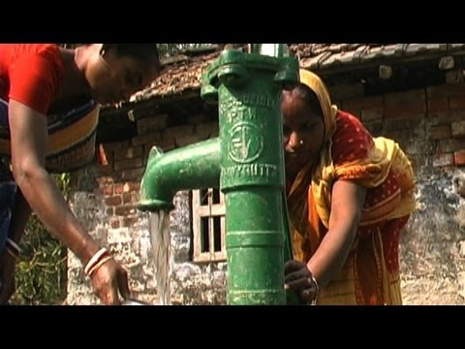
8.5 - Access to safe water and sanitation
Fun fact
DID YOU KNOW?
The average person requires a minimum of around 50 litres of safe water per day to survive,
safe water
Water that is not contaminated with disease-causing pathogens such as bacteria and viruses, or chemicals such as lead and mercury.
Question:
What are the 5 factors that contribute to similarities and differences in health status and burden of disease globally?
WHY?
Water is a significant component of many body tissues and is essential for the optimal functioning of every cell in the body. Humans can’t adequately store water, so it must be consumed daily. It is also required for washing, cooking and agriculture.
What diseases and illnesses does a lack of access to “safe water” cause? Pg.312
Notes:
Slide 17 Student activities:
Watch https://www.youtube.com/watch?v=pabor5Gd7yM
Discuss what water is required for in daily life.
Notes: What are the 5 factors that contribute to similarities and differences in health status and burden of disease globally?
Write into book definition: safe water
Copy the why water is important as notes into your book.
What diseases and illnesses does a lack of access to “safe water” cause? Pg.312
Answer to question:
Figure 8.29 - access to safe water, sanitation, poverty, global distribution and marketing of tobacco, alchol and processed foods and inequality and discrimination.

Slide 18
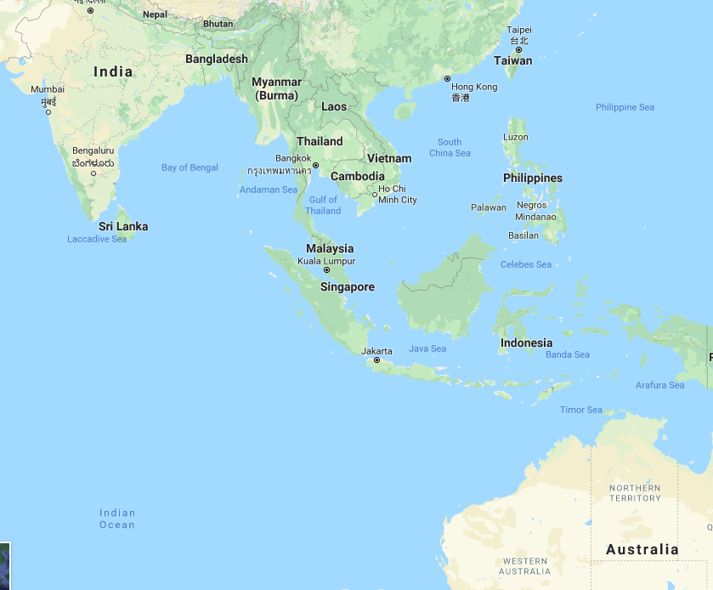
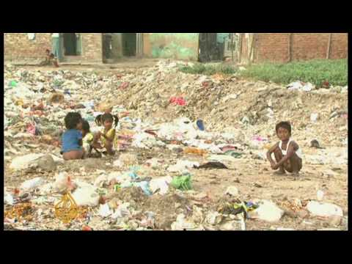
8.5 Access to sanitation
Sanitation: The provision of facilities and services for the safe disposal of human urine and faeces, but can also refer to the maintenance of hygienic conditions through services such as garbage collection and wastewater disposal.
Sanitation in India activity
Discuss how the lack of sanitation impacts on life in India.
What proportion of people in India have access to a toilet?
How much does it cost to use the public toilet?
Why doesn’t everyone use these facilities?
Globally 2.5 billion, or one in three, people lack access to basic sanitation. Almost one billion of these people defecate in the open, for example in street gutters, behind bushes or into open bodies of water.
Notes:
Slide 18 Activities
Definition: Sanitation
Watch https://www.youtube.com/watch?v=orIFs72HGmM and complete questions in blue box
Read: brown box of information
ANSWERS: india questions
People have to go out in the open to relieve themselves; it increases the risk of disease.
31 per cent
i. Less than 10 cents
ii. There are not enough and they are not affordable for many.

Slide 19
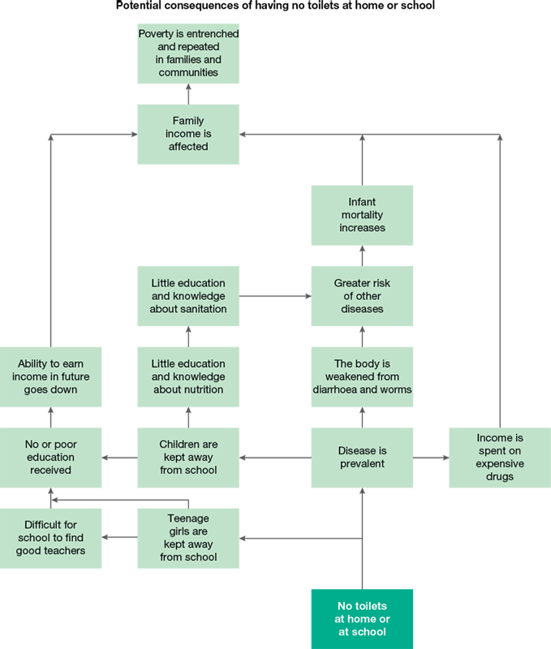
8.5 - access to sanitation
In some low-income countries girls don’t attend school especially when they are menstruating because
Toilets are not segregated
Not enrolled due to inadequate sanitation
Due to cultural beliefs girls are expect girls to wait until it is dark before they can relieve themselves. (exposes them to the danger of harassment, assault, animal attacks)
Therefore reduces their ability to receive an education or meaningful employment, driving them further into poverty and contributing to the differences in burden of disease between low-middle- and high-income countries.
Notes:
Slide 19 student work
Notes on the comparison of access to sanitation for females v males in low and middle income countries
Look at figure 8.36
Watch https://www.wateraid.org/us/media/1-in-3-women-lack-safe-toilets

Slide 20
8.5 - AYK and TYU
Complete questions
VERBALLY
Question 1-6 (as a class or with a friend if teacher is away)
WRITTEN INTO BOOK
Question 7 and 10
Notes:
Answers
Test your knowledge
Safe water refers to water that is not contaminated with disease-causing pathogens such as bacteria and viruses, or chemicals such as lead and mercury.
Water is a significant component of many body tissues and is essential for the optimal functioning of every cell in the body. Humans can’t adequately store water, so it must be consumed daily. It is also required for washing, cooking and agriculture.
Lack of clean water is generally not an issue in Australia because there is adequate infrastructure to provide clean water, and emergency provisions can generally be supplied when clean tap water is unavailable.
Children are particularly susceptible to the impacts of unsafe water as they are likely to experience repeated infection; this is why children account for a high proportion of total deaths from water-related causes.
Lack of access to safe water in these countries contributes to hundreds of millions of missed school days each year, which reduces levels of education and the potential to earn a decent income in the future. It is often women who have to trek long distances to collect water and then carry it back. They may have to make this trip many times in one day, reducing their ability to pursue education or paid employment, which also contributes to poverty.
In this course, sanitation generally refers to the provision of facilities and services for the safe disposal of human urine and faeces, but can also refer to the maintenance of hygienic conditions through services such as garbage collection and wastewater disposal.
Many schools do not have female toilets, and this prevents many girls from gaining an education. Without private toilets, many cultures expect girls to wait until it is dark before they can relieve themselves. This exposes them to the danger of harassment, assault, animal attacks, discomfort, loss of dignity and sometimes illness. According to WaterAid, women and girls living without a toilet spend 266 million hours each day finding a place to relieve themselves.
Unregulated water courses such as swamps and dams can provide a breeding ground for disease-causing parasites such as malaria-carrying mosquitoes. This increases malaria infections.
7. gastroenteritis
diarrhoea
dysentery
cholera
malaria
8 . Examples include:
Lack of access to clean water increases the risk of infectious diseases such as gastroenteritis, which contributes to a large number of childhood deaths in middle- and low-income countries compared to high-income countries. This contributes to the differences in YLL experienced.
Lack of clean water contributes to a range of diseases and infections that can last a long period of time, contributing to higher rates of YLD in low- and middle-income countries compared to high-income countries.
9. Sanitation contributes to around 6 per cent of deaths in low-income countries, around 4 per cent in lower middle-income countries, around 0.3 per cent in upper middle-income countries and no deaths in high-income countries.
10. Lack of sanitation contributes to disease. A sick population may not be able to work or go to school. Parents may also have to stay home to care for ill children, reducing income for the family. Money may be spent on medical treatments, which increases poverty. If children miss out on education as a result of illness or no toilets (especially girls), they may be forced into low-paid employment.

Slide 21
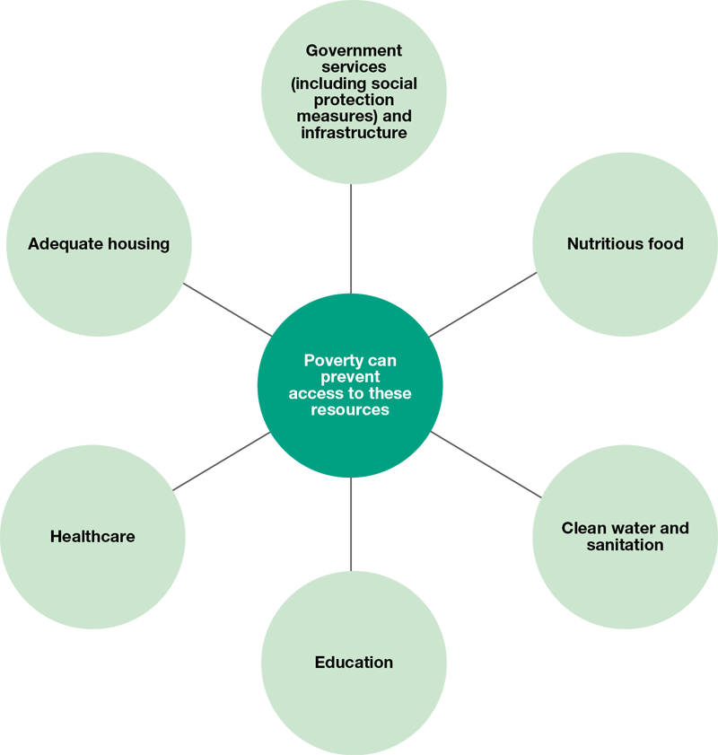
8.6 - how poverty contributes to similarities and differences in health status and burden of disease
Impact of poverty on I’ll health
http://www.who.int/hdp/publications/dying_change.pdf?ua=1
Absolute poverty: Those living on less than US$1.90 a day
Relative poverty: Those living on less than 50% of their country’s average wage.
Notes:
1st thing - Class discussion
Discuss how income could be used to improve health status and burden of disease among populations.
Discuss how governments work to reduce burden of disease in Australia. Would these interventions be possible without adequate financial resources?
Discuss how governments can use financial resources to promote health status and burden of disease in low-income countries.

Slide 22
8.6 - poverty and disease
The level of GNI affects the government’s ability to provide access to clean water, sanitation, health services, public education and social protection measures (such as pensions, welfare and disability payments).
The more money the government generates through taxation and investment, the greater the opportunity it has to provide these resources to its citizens.
Gross National Income (GNI)
Total value of goods and services a country’s citizens produce, including the value of income earned by citizens who may be working in an overseas country.

Slide 23
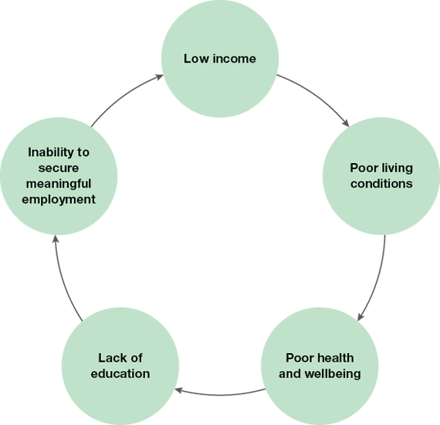
Here’s a thought
The cycle of poverty can be broken with education, but education often requires payment.
Notes:
What is the solution?

Slide 24
Apply your knowledge
1 a. Using figure 8.37 discuss the difference in the levels of poverty between high-, middle- and low-income countries.
Explain three ways this difference can contribute to differences in burden of disease.
2. A. Identify two groups within Australia that are more likely to experience poverty than the rest of the population. (You may need to refer to topic 4.)
B. Outline two similarities between the groups identified in part (a) and those living in low- and middle-income countries.
3. Explain two ways that poverty can increase the risk of infectious diseases such as malaria, HIV/AIDS and/or diarrhoeal disease.
Notes:
Apply your knowledge
Virtually none of the population lives in extreme poverty in high-income countries compared to around 2.5 per cent of those in upper middle-income countries, 16 per cent in lower middle-income countries and around 46 per cent in low-income countries.
Examples include:
There is less money for healthcare in low-income countries, so conditions can go untreated. This increases the number of premature deaths and YLL compared to high-income countries.
There is less money for nutritious food, increasing the risk of infectious diseases, especially among children. This increases the rate of DALY for this group in low-income countries compared to high-income countries.
Extreme poverty reduces the ability of people to afford clean water and adequate sanitation, increasing the risk of diseases such as cholera and dysentery. This increases DALY in low-income countries compared to high-income countries.
Answers include Indigenous Australians; people from low SES backgrounds; and those living outside of Australia’s major cities.
Both populations have:
higher rates of morbidity and mortality
reduced access to healthcare
higher rates of malnutrition
higher U5MR
higher rates of many preventable diseases
Examples include:
Poverty contributes to lower rates of education, so those living in poverty may not have the knowledge to reduce their risk of conditions such as HIV.
Poverty can mean reduced access to clean water, increasing the risk of diarrhoeal disease.
Those living in poverty may be forced into dangerous jobs such as the sex trade which increases their risk of HIV.
Poverty means that people may not be able to afford resources that reduce the risk of malaria such as mosquito nets.

Slide 25
8.7 Factors that contribute to similarities and differences in health status and burden of disease — inequality and discrimination
 | Impact on Health status
Race
Religion
Sex
Sexual orientation
Gender identity
Human rights: relates to the freedoms and conditions to which every person is entitled
Activity:
Draw or create the table and fill in the impact on health status each inequality has on population groups.
Notes:
LI - Understanding how inequality and discrimination contribute to similarities and differences in health status and burden of disease
Read 8.7.1 - fill in top of table

Slide 26
8.7 inequality and discrimination - religion
Religious discrimination has been shown to contribute to increased rates of:
anxiety
depression
psychiatric disorders
stress
decreased life satisfaction
self-rated poor health status
cigarette smoking
alcohol abuse
drug use.

Slide 27
8.7 inequality and discrimination - sex
Case study review
Explain why these murders may be known as ‘honour killings’.
In 2014, 20 per cent of the government of Pakistan was made up of women. Explain how having women more widely represented in governments could improve health status among women.
Explain how not being able to choose their own husband could impact on the health and wellbeing of women in countries such as Pakistan.
What are two different scenarios shown in this video.
Notes:
Watch youtube: The girl effect and Answer question
Read case study and answer questions
Discuss forced marriage and female mutilation
Fill in table for gender
Case study review: Honour killing family poisoned sister
They are called ‘honour killings’ because the people who carry out the killings say they are done to maintain the honour of the family.
Having women in government means that women have a voice in the policies and laws created. This can increase the rights that women have in the country; for example, the right to vote or own land. This increases the opportunities that women have and gives them a say in the society in which they live. Having more women in government can mean that women’s issues and concerns are more likely to be raised and acted on. Issues such as honour killings may be treated with more urgency if women are involved in planning solutions.
If women are not able to choose their own husbands, they have fewer choices in their lives. This can prevent them from developing a sense of purpose in life (spiritual health and wellbeing). It also means that they can’t marry someone with whom they share qualities, which may decrease their chances of having a happy marriage and the opportunity to contribute to a fulfilling life (mental health and wellbeing).

Slide 28
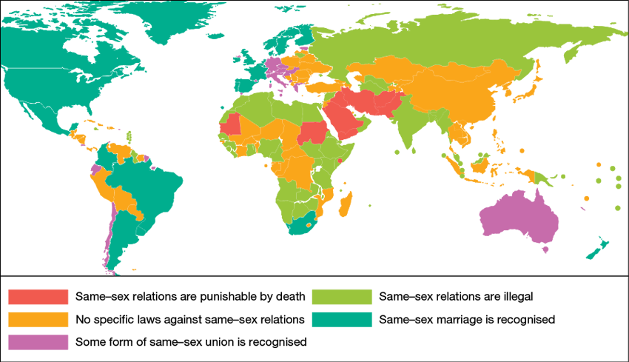
8.7 inequality and discrimination - sexual orientation
Heterosexual (those attracted to members of the opposite sex);
Homosexual — usually described as gay (males who are attracted to males)
Lesbian (females who are attracted to females)
Bisexual (attracted to both sexes);
Asexual (not attracted to either sex).

Slide 29
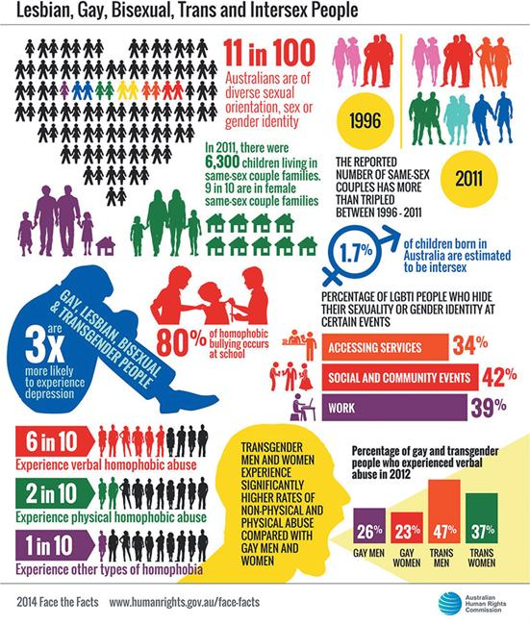
8.7.5 - gender identity
Gender identity
How individuals perceive themselves as male, female, a blend of both, or neither. One’s gender identity can be the same or different from the sex assigned at birth.
Higher rates of mental disorders
Higher rates of physical and sexual assault
Increased rates of self-harm including suicide.
Notes:
Copy in definition for gender identity
Discuss and fill in table how this can impact on health and wellbeing using the pink scroll
Look at stats in figure and answer
Use figure 8.50 to answer the following questions.
What proportion of Australians are thought to be of diverse sexual orientation or gender identity?
What change was there in the number of same-sex couples between 1996 and 2011?
What proportion of LGBTI (lesbian, gay, bisexual, transgender and intersex) had hidden their sexuality or gender identity when accessing services? How could this impact on health and wellbeing?
How much more likely are gay, lesbian, bisexual, transgender people to experience depression?
What types and rates of abuse are experienced by those with diverse sexual orientation or gender identity?

Slide 30
8.7 AYK
Explain how displacement of people from their homes can impact health and wellbeing, health status and burden of disease.
Do you think the status of women in Australia is the same as it is for men? Explain.
Explain how sexual orientation and gender identity can contribute to variations in health status within countries.

Slide 31
8.8- Global distribution and marketing of tobacco, alcohol and processed foods
Understanding how the global distribution and marketing of tobacco, alcohol and processed foods contribute to similarities and differences in health status and burden of disease
Better technology
GLOBALISATION
Improved communication, trade and transport between countries
Explore
The World Bank site has sections on many related issues including globalisation:
http://www.worldbank.org
Think about : How does globalisation reduce barriers between countries?
What advances in technology have occurred over the past 100 years that have led to an increase in global marketing?
Notes:
Read key concept
Discuss “What advances in technology have occurred over the past 100 years that have led to an increase in global marketing?
Show globalisation picture and state how better technology improves communication, trade and transport (globalisation)
Explore the world bank website -
Globalisation is the process whereby boundaries between countries are reduced or eliminated, allowing individuals, groups and companies to act on a global scale. It can be described as transforming the different societies of the world into one global society. A reduction in barriers to trade, communication and transport contributes to this process.
NOTES FOR BOARD: Examples of ways in which globalisation can improve health status include:
Aid in times of emergencies (such as natural disasters) can reach people faster.
Knowledge can be shared more easily through media such as the internet.
Resources and skills can be shared among countries; low- and middle-income countries can benefit from increased tourism.
Low- and middle-income countries may be able to export goods to other countries.

Slide 32
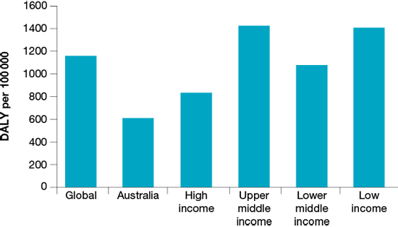
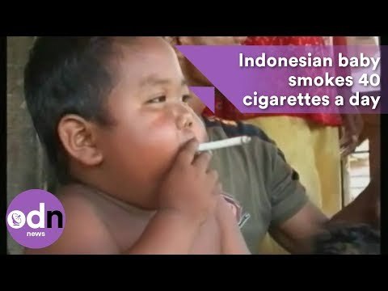
8.8 - Tobacco, alcohol and processed foods
Tobacco
Companies target low and middle income countries to make up for lost revenue $$$ in high income countries
Why?
Health promotion, laws and taxes in high income countries has decrease the rate of smoking.
Global marketing: The advertising and supply of products on a global scale; for example the global marketing of alcohol, tobacco and processed foods.
Processed food
More rural people have moved to cities and abandoned traditional diets
Processed food is High in fat, salt and/or sugar and contribute to a more energy-dense diet.
The WHO predicts the incidence of stroke deaths will double in the low- and middle-income countries over the next 20 years.
Alcohol
Alcohol manufacturers are increasingly marketing their products towards people in low- and middle-income countries.
Alcohol use is associated with about 3.5% of global deaths.
Increase in alcohol consumption are often those that have no cultural relationship with alcohol consumption and lack the resources to educate.
Notes:
Watch youtube video https://www.youtube.com/watch?v=x4c_wI6kQyE
Read tobacco notes
Look at alcohol graph and discuss global trends
Read notes
Read processed food summary
Complete notes on differences in global health and burden of disease
Notes: Impact on differences in global health status and burden of disease
Tobacco:
Increased burden of disease, particularly an increase in premature death as a result of cancer, cardiovascular disease and respiratory conditions associated with smoking.
Low - middle income countries have limited fund and spend their money on tobacco THEREFORE have less money for food, clothing, education and basic healthcare THUS increases the risk of conditions that are not necessarily caused by tobacco use itself, such as infectious diseases.
Alcohol:
Obesity, type 2 diabetes, cardiovascular disease, cancers, mental health disorders and liver disease. These conditions contribute to premature death and illness, increasing the rate of YLL and YLD.
If an individual’s limited income is spent on alcohol, there may be less available to spend on food, clothing, shelter and healthcare. This directly impacts on the standard of living and increases the burden of disease.
Processed food:
High in fat, salt and/or sugar and contribute to a more energy-dense diet contributing to an increased incidence of lifestyle diseases such as obesity, hypertension and cardiovascular disease.

Slide 33
PAIRS ACTIVITY INSTRUCTIONS – CHARACTERISTICS OF HIGH-, MIDDLE & LOW INCOME COUNTRIES
1. Spin wheel number one: Click here to spin the wheel.
2. State whether it is a characteristic of a low- or a high- income county.
3. State whether your characteristic is an economic, social or environmental characteristic.
4. Briefly explain the characteristic to your partner.
5. Spin wheel number two: Click here to spin the wheel.
6. You need to make a link from the characteristic to whatever you spin on the second wheel (burden of disease, health status or health and wellbeing).
7. Then, draw a link from your characteristic to another characteristic that you know of. E.g. low-income countries usually have low average incomes which may result in food insecurity, if people do not have money to purchase adequate food.
8. Swap roles – your partner’s turn now. Take in turns doing this until you have got through as many characteristics as possible.
Revision

Slide 34
Unit 4 AOS 1 Part 1
Chapter 8
Topic summary
Examination preparation question 1 and 2
Topic 8 test 1 and 2 (printed)
LET’S EXPLORE: This is EXCITING STUFF!
https://www.aihw.gov.au/getmedia/7c42913d-295f-4bc9-9c24-4e44eff4a04a/aihw-aus-221.pdf.aspx?inline=true
Notes:
8.9 Key skills
Answers: Practise the key skills
Economic characteristics common among high-income countries:
There are generally low rates of poverty in high-income countries.
High-income countries have high average incomes.
High-income countries generally have a range of industries.
High-income countries generally trade on the global market.
Environmental characteristics common among high-income countries:
Those in high-income countries often have access to clean water and adequate sanitation.
Those in high-income countries often have access to a reliable food supply.
Those in high-income countries often have high quality housing.
Infrastructure such as roads, electricity grids and telecommunications systems are often more sufficiently developed in high-income countries.
Similarity: Maternal mortality rates have decreased in both Australia and Sri Lanka between 2000 and 2015, from around 10 to 8 per 100 000 live births in Australia, and from around 58 to 30 per 100 000 live births in Sri Lanka.
Difference: Rates were significantly higher in Sri Lank compared to Australia in 2015 (around 30 and 8 per 100 000 live births respectively).
Sanitation generally refers to the provision of facilities and services for the safe disposal of human urine and faeces, but can also refer to the maintenance of hygienic conditions through services such as garbage collection and wastewater disposal.
Sanitation contributes to many infectious diseases, especially in low- and middle-income countries. This contributes to more DALY in these countries compared to high-income countries.
The provision of sanitation allows girls to go to school, which increases their sense of purpose and meaning in life, therefore enhancing spiritual health and wellbeing. It means that girls are less likely to get sick, which promotes physical health and wellbeing. They will not have to walk out in the community looking for somewhere to relieve themselves, which can reduce levels of stress and thereby promote mental health and wellbeing. They are more likely to attend school, which can provide opportunities for socialisation and thus promotes social health and wellbeing.
Low-income countries experience mortality rates from communicable diseases at around 400 per 100 000 people, compared to around 50 per 100 000 people in high-income countries.
Reasons include:
Lack of clean water in low-income countries compared to high-income countries, which increases the risk of infectious diseases such as cholera.
Women in low-income countries often lack access to education due to poverty, resulting in some women being forced into sex work. This contributes to higher rates of death from HIV/AIDS compared to those in high-income countries.
Poverty in low- and middle-income countries contributes to higher levels of malnourishment than in high-income countries, which increases the risk of infectious diseases due to decreased immune function.
Reasons include:
Transgender people are often discriminated against, which increases the risk of mental health disorders such as depression.
Transgender people may not feel accepted in their community, which contributes to low levels of self-worth and an increased risk of depression compared to those who are cisgender.
Transgender people may be denied employment opportunities, which can contribute to higher rates of depression.
Transgender people are more likely to be abused by others compared to cisgender people, which contributes to higher rates of depression.
Answers: Exam preparation
Question 1
Answers include:
lower levels of poverty
wide range of industries
opportunities for global trade
higher levels of gender equality
low birth and population growth rates
high levels of employment
high levels of education
social security systems
developed health systems
access to technology
developed legal systems
no history of colonisation
safe water and sanitation
access to food
adequate housing
adequate infrastructure
high levels of carbon dioxide emissions.
Question 2
The U5MR have decreased in both high- and low-income countries between 1964 and 2014, from around 290 to 75 per 1000 live births in low-income countries and from around 35 to 5 per 1000 live births in high-income countries.
Examples include:
Poverty rates have decreased over time in most countries. This means that there may have been more resources available to prevent under-five deaths such as immunisation and healthcare.
The proportion of people with access to clean water and sanitation has improved over time in most countries, reducing the risk of children under five dying from infectious diseases.
The U5MR has consistently been higher in low-income countries compared to high-income countries (e.g. around 75 and 5 per 1000 live births in 2015 respectively).
Examples include:
Housing is poorer in low-income countries than in high-income countries, which can contribute to higher rates of respiratory disease deaths in those aged under five due to poor ventilation.
Levels of poverty are higher in low-income countries compared to high-income countries, so there is less money available for adequate food and healthcare. This contributes to more under-five deaths.

Slide 35
Sac study
SAC study Unit 4 AOS 1 Part 1
The relevant dot points from the Study Design for this task are:
Key knowledge
characteristics of high- , middle- and low-income countries
similarities and differences in health status and burden of disease in low- , middle- and high-income countries, including Australia
factors that contribute to similarities and differences in health status and burden of disease, including access to safe water; sanitation; poverty; inequality and discrimination (race, religion, sex, sexual orientation and gender identity); and global distribution and marketing of tobacco, alcohol and processed foods
Key skills
describe characteristics of high-, middle- and low-income countries
evaluate data to analyse similarities and differences between countries in relation to health status and burden of disease
analyse factors that contribute to health status and burden of disease in different countries and discuss their impact on health and wellbeing
compare health data and other information to analyse reasons for health inequalities within and between nations
Notes:
Monday 25th June

Slide 36
Unit 4 AOS 1 - Part 2
Chapter 9 and 10

Slide 37
Key knowledge
The concept and dimensions of sustainability (environmental, social, economic) and its role in the promotion of health and wellbeing.
Dimensions of sustainability = + +
The concept of human development, including advantages and limitations of the Human Development Index.
Implications for health and wellbeing of global trends including:
–climate change (rising sea levels, changing weather patterns and more extreme weather events)
–conflict and mass migration
–increased world trade and tourism
–digital technologies that enable increased knowledge sharing.
Notes:
https://www.aihw.gov.au/getmedia/7c42913d-295f-4bc9-9c24-4e44eff4a04a/aihw-aus-221.pdf.aspx?inline=true

Slide 38
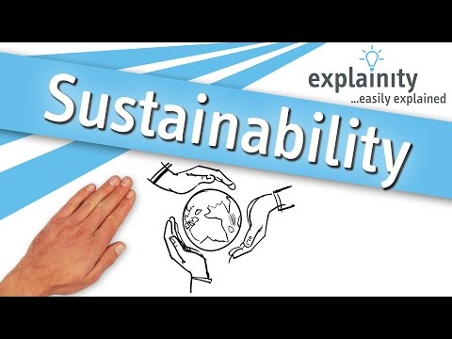
9.1 - Understanding the concept of sustainability — Economic sustainability
Discuss
What are the possible impacts on health and wellbeing if these characteristics could not continue in Australia into the future?
What are the possible impacts on health and wellbeing in low- and middle-income countries if we could promote these characteristics and ensure they could continue into the future?
Sustainability is defined as ‘meeting the needs of the present without compromising the ability of future generations to meet their own needs’.
Notes:
9.1
Discuss What are the possible impacts on health and wellbeing if these characteristics could not continue in Australia into the future?
What are the possible impacts on health and wellbeing in low- and middle-income countries if we could promote these characteristics and ensure they could continue into the future?
Watch youtube https://www.youtube.com/watch?v=_5r4loXPyx8
Copy definition in orange box (Sustainability is defined as ‘meeting the needs of the present without compromising the ability of future generations to meet their own needs’).

Slide 39
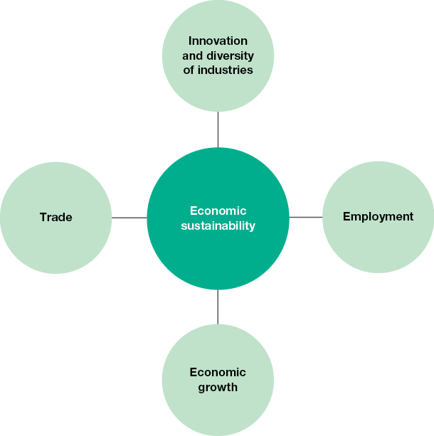
9.2 Economic sustainability
Economic sustainability
ensuring that average incomes in all countries are adequate to sustain a decent standard of living and continue to rise in line with inflation and living costs in the future
9.2 TYK
4. Explain why the development of new industries is important for low- and middle-income countries.
5. Explain why the development of new industries is important for high-income countries.
Notes:
Slide 38
9.2 economic sustainability
Write definition for economic sustainability and the 4 dots points that make up economic sustainability in a country.
Read innovation and diversity, employment, economic growth and trade.
Complete TYK question 4 and 5
Answers:
4. Many low- and middle- income countries rely on agriculture as their sole industry. This sector is heavily dependent on factors such as weather patterns and global markets, which are unstable and can prevent the economy from growing. A range of industries are required to ensure that interruptions to specific industries will not cause economic catastrophe within a country.
5. Many of the established industries in high-income countries are undergoing significant change due to technological advancements including robotics and automation. So new and innovative industries must be developed to ensure employment opportunities exist for the next generation.

Slide 40
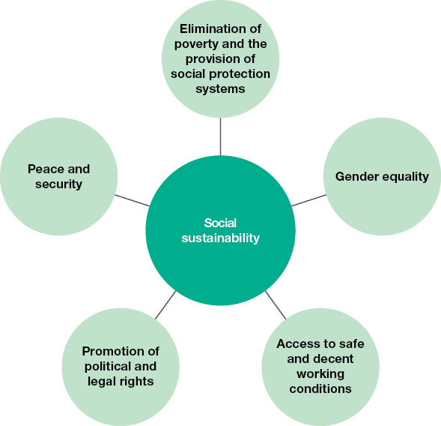
9.3
Discuss
What are the possible impacts on health and wellbeing if these characteristics could not continue in Australia into the future?
Social sustainability:
creating an equitable society that meets the needs of all citizens and can be maintained indefinitely
Improved physical health and wellbeing, as women will be less likely to experience injuries as a result of violence
Student activity:
Using 9.3
Draw the spider diagram “social sustainability” and one way that each of the listed bubbles can assist in promoting health and wellbeing (Example included)
Notes:
Slide 39
Discussion tips Review the social characteristics of countries explored in subtopic 8.3 of the student text.
What are the possible impacts on health and wellbeing if these characteristics could not continue in Australia into the future?
What are the possible impacts on health and wellbeing in low- and middle-income countries if we could promote these characteristics and ensure they could continue into the future?
Write definition: social sustainability
Draw the spider diagram “social sustainability” and one way that each of the listed bubbles can assist in promoting health and wellbeing (Example included)
Answers:
Elimination of poverty and the provision of social protection systems — this means ensuring that no one lives in poverty, including those who can’t earn an income. This promotes mental health and wellbeing as people are less likely to experience stress related to accessing resources such as food.
Gender equality — relates to females having the same opportunities as males. This promotes social health and wellbeing as females are more empowered to make their own decisions about their lives, such as who they marry.
Access to safe and decent working conditions — means that all people can access meaningful employment, including women, young people and those with disabilities. It also means that no one would be forced into dangerous work. This promotes spiritual health and wellbeing as people are more likely to feel connected to the world in which they live and have a sense of purpose.
Promotion of political and legal rights — means that all people have equal rights relating to issues such as voting and protection under the law. This can reduce levels of stress, which promotes mental health and wellbeing.
Peace and security — means that there is no conflict and people feel safe in their daily lives. This can promote emotions such as happiness, which enhances emotional health and wellbeing.

Slide 41
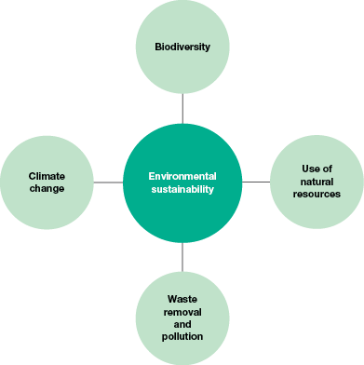
9.4
Environmental sustainability:
Ensuring the natural environment is used in a way that will preserve resources into the future.
Discuss
What are the possible impacts on health and wellbeing in low- and middle-income countries if we could promote these characteristics and ensure they could continue into the future?
Which dimension of sustainability is most important. Why?
Notes:
Slide 40
9.4 environmental sustainability
Discuss: What are the possible impacts on health and wellbeing in low- and middle-income countries if we could promote these characteristics and ensure they could continue into the future? And which dimension of sustainability is most important. Why?
Copy orange definition environmental sustainability

Slide 42
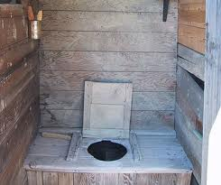
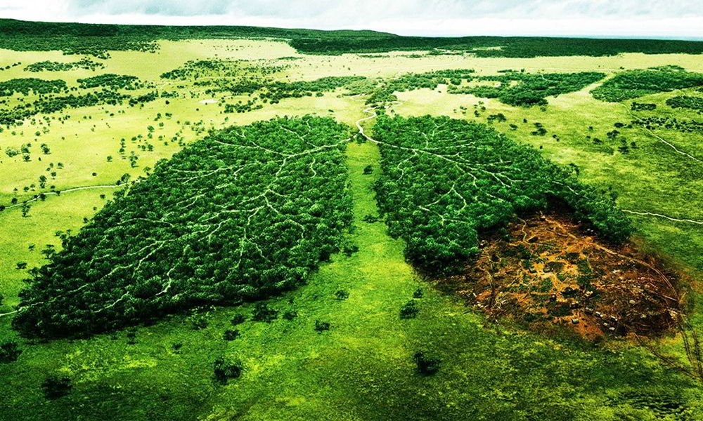
9.4 summarised
Use of Natural resources
Renewable
Allows future generations to be able to earn an income by utilising natural resources, which can assist in providing a range of goods and services required for optimal health and wellbeing such as food, shelter and healthcare.
Preserves natural environments that many people value for cultural reasons, which promotes spiritual health and wellbeing. Natural environments also be used for socialising and relaxation, which promotes social and mental health and wellbeing.
Children are able to complete homework under artificial light, which increases their ability to escape poverty and positively affect all dimensions of health and wellbeing.
Future generations can access transport systems, which can assist in maintaining social connections and promote social health and wellbeing.
Waste removal and pollution- Benefits for health and wellbeing by:
Ensuring sustainable access to clean water. This can prevent infectious diseases and promote physical health and wellbeing. Individuals will not have to spend hours collecting water each day so can instead pursue employment, which can promote feelings of satisfaction and achievement, which promotes emotional health and wellbeing.
Biodiversity The variety of different plants, animals and micro-organisms, their genes and the ecosystems of which they are a part
provision of oxygen and removal of carbon dioxide
protection of water resources
nourishment of plants and animals that are used for food
wood products used for building, heat and cooking
resources used for medicine
opportunities for recreation and tourism improving physical health and wellbeing
Notes:
Slide 41
Read through and summarise how each category of environmental sustainability can improve health and wellbeing.

Slide 43
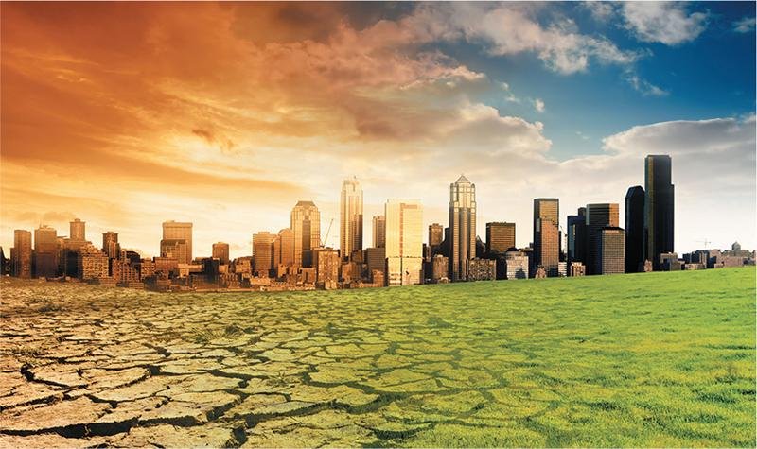
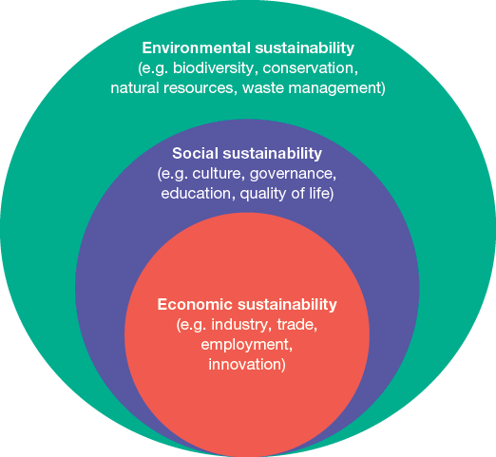
9.4 summary continued
Apply your knowledge
6a) Outline the four factors that are important for environmental sustainability.
6b) Explain how each factor outlined in part a) can promote health and wellbeing.
7a) What does it mean when the three dimensions of sustainability are said to be interrelated?
7b) Provide examples of how the three dimensions are interrelated.
Without access to natural resources, humans cannot survive, let alone earn an income
Climate change
Promoting health and wellbeing:
Weather and rainfall patterns will stabilise, which may reduce the rate and severity of natural disasters. This will reduce the number of injuries and deaths that occur as a result of these events, which will promote physical health and wellbeing and assist in maintaining infrastructure that is required for social, emotional, mental and spiritual health and wellbeing. Predictable rainfall allows crops to be grown and promotes food security, which will promote physical health and wellbeing.
Communicable disease rates will decrease, improving physical health and wellbeing. Preventing further climate change will prevent disease carrying organisms from spreading to other areas as environmental conditions will not support their migration.
Notes:
Slide 42
Summarise how climate change impacts on health and wellbeing
Apply your knowledge question 6 and 7
Green box main point when discussing the interrelationship of the three dimensions
Answers to AYK:
6. a. and b.
Biodiversity — relates to the variety of life forms and the ecosystems in which they live. Achieving balance in biodiversity means that resources required for health and wellbeing will be available such as food, water and clean air.
Use of natural resources — means that resources such as fish and timber will be available for future use. This promotes health and wellbeing as people will be able to access food and building materials for shelter, which reduces the risk of infectious diseases.
Waste removal and pollution — relates to removing human waste and ensuring clean ecosystems. This will assist in providing resources such as clean water that are essential for human life.
Climate change — this relates to rising temperatures that influence weather patterns and sea levels. Reducing the effects of climate change will mean greater food availability and fewer natural disasters. This reduces the risk of illness and injury, and promotes physical health and wellbeing.
7.
Being interrelated means that they all impact each other.
Examples
A sustainable environment provides clean water and food. This can ensure that all people have their human rights for these resources met (social sustainability). Adequate food and water means that people are less likely to be sick, so they can work and earn an income (economic sustainability).
Social sustainability includes poverty reduction, which means children can receive an education instead of having to work at an early age. This means that they are able to get a higher paid job in the future, which increases average incomes (economic sustainability). This provides revenue for the government, which can invest money in preserving natural resources instead of exploiting them for financial gain (environmental sustainability).

Slide 44
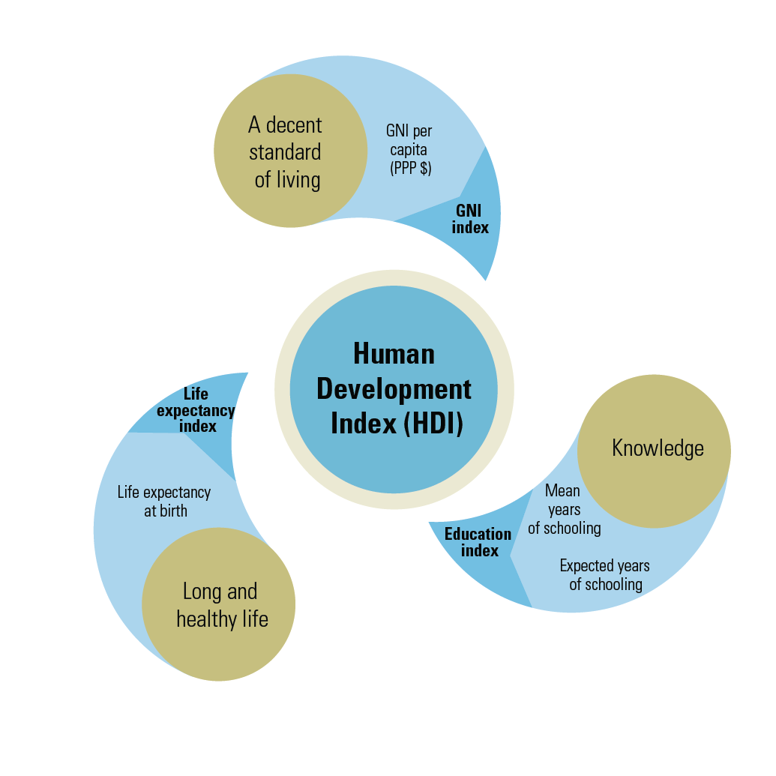
9.5 - Human development - The key component of human development is equity
The concept of human development can give a more accurate picture of how well people are living within particular countries.
1.People
2.Opportunities
3.Choices
As defined by the United Nations, human development is about much more than income: it is about:
The level of wellbeing of people and an environment where people can lead long, healthy and fulfilling lives in accordance with their needs and interests.
Discuss
What are some examples of choices that people can make in life to enhance their human development?
Monetary measures, such as GDP per capita, are inadequate proxies of development. The first Human Development Report introduced the Human Development Index (HDI) as a measure of achievement in the basic dimensions of human development across countries.
Notes:
9.5 human development
In your own words write down the what human development is and how it is used for looking at the differences and similarities between countries around the world in addition to classifying countries as low-, middle- and high-income.
Discuss yellow box “What are some examples of choices that people can make in life to enhance their human development”. Answers could include:
what level of education a person pursues
where a person lives
what a person eats
what a person does for fun or leisure
who a person socialises with
what sort of job a person does.
Look at the HDI diagram and discuss each element of the diagram. Link to diagram and soundcloud you can listen to is added here :hdr.undp.org/en/humandev
Pink box is a summary of the 3 parts of human development.
If students need more understanding read the case study and compare Ken and Briony level of human development.
Answers: Differences in human development
Ken has a high level of human development. He has access to the resources required for a decent standard of living such as healthcare and education, and can participate in the decisions that affect his life such as what job he pursues and if and when he gets married.
Briony is experiencing a low level of human development. She has not been able to access the resources required for a decent standard of living, such as education, and has not been able to participate in the decisions affecting her life such as if and when she got married and what she does for a job.

Slide 45
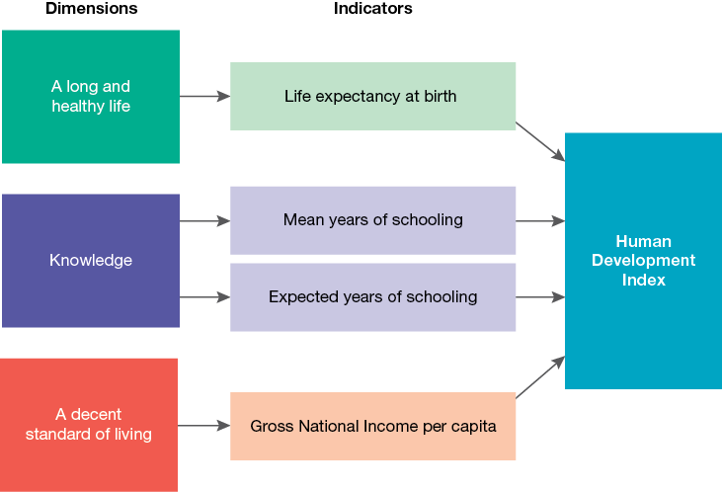
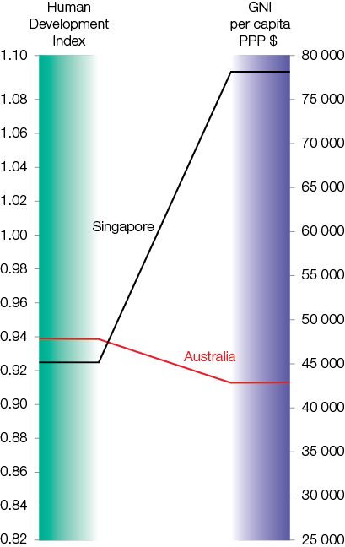
9.6- The advantages and limitations of the Human Development Index
The HDI is a number between zero and one (0–1).
The closer to one, the greater the level of development experienced.
As the HDI uses more than just economic indicators, a clearer picture of the overall standard of people’s lives can be seen.
Notes:
9.6- The advantages and limitations of the Human Development Index
DISCUSS: What would be the benefit of measuring human development in different countries? What sort of information would you want to access if you were trying to measure the level of human development experienced in a country?
Look at the 3 dimensions and read the textbook to explore these in more detail. (I ask one student to start reading and when they have had enough they say next, helps get through the more wordy parts of the text).

Slide 46
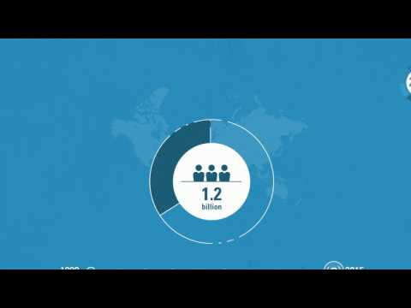
9.6 - HDI
Explore:
http://www.zolabo.com/projects/hdi/
Advantages
Disadvantages
The HDI takes more than just average incomes into account.
It provides an indication of opportunities for education, which reflects access to knowledge.
Average income reflects the ability to access the resources required for a decent standard of living.
The HDI only reflects selected aspects of human development and therefore does not capture the richness and depth of human development.
The HDI, although moving beyond economic indicators, is still based on averages. Therefore it does not provide an indication of the inequalities that exist within countries.
Apply your knowledge
Outline two reasons that may account for Australia having a higher HDI than China.
Using your knowledge of the HDI, explain why Australia has a higher index than Singapore, yet Singapore has a higher income (see figure 9.21).
Explain two likely differences in human development between Australia and Central African Republic based on their respective Human Development Indices (refer to table 9.1).
Write one more advantage from the text
Write one more disadvantage from the text
Notes:
Watch: https://www.youtube.com/watch?v=4KIoYPyCJMo
explore : the HDI tree and make your own human development tree:http://www.zolabo.com/projects/hdi/
Summarise the advantages and disadvantages of the HDI.
Apply your knowledge Q4-6 in text book
ANSWERS to AYK
Factors could include:
Australia has a higher life expectancy at birth than China.
China has lower mean years of schooling than Australia.
Australia experiences higher expected years of schooling than China.
China could have a lower gross national income per capita than Australia.
Singapore may have a higher GNI per capita, but may not have as high a level of life expectancy at birth, or mean or expected years of schooling as Australia. This difference could contribute to Singapore’s lower HDI.
Example: Australia has a higher HDI than Central African Republic. This may mean that:
life expectancy is significantly higher in Australia, so people here have a greater opportunity to develop to their full potential
mean years of schooling are significantly higher in Australia, so people here may have greater opportunities in relation to their employment
GNI per capita is significantly higher in Australia, so people here may have a greater opportunity to access the resources they require for a decent standard of living such as food, water, shelter and healthcare.

Slide 47
9.7 - chapter summary
Practice the key skills
Exam preparation
Notes:
Answers: Practise the key skills
Economic sustainability means ensuring that average incomes in all countries are adequate to sustain a decent standard of living and continue to rise in line with inflation and living costs in the future. Financial resources must be available in the future so future generations can also benefit from them. Economic sustainability is important as money is required to purchase goods and services that promote health and wellbeing around the world such as food, water, shelter and healthcare.
Environmental sustainability means ensuring the natural environment is used in a way that will preserve resources into the future. Humans rely on many aspects of the environment such as air, food, water, shelter and employment. If the resources are not available to access these requirements, health and wellbeing will decrease globally.
The Human Development Index is a tool developed by the United Nations to measure and rank countries’ levels of social and economic development. It provides a single statistic based on three dimensions — a long and healthy life, knowledge, and a decent standard of living — and four indicators — life expectancy at birth, mean years of schooling, expected years of schooling, and Gross National Income per capita.
The HDI takes more than just average incomes into account, so it provides a more comprehensive representation of the level of human development experienced, but there are many other aspect of human development that are not reflected by the HDI including freedom, choices and capabilities.
Answers include:
The USA may have a higher GNI per capita than New Zealand.
The USA may have higher mean years of schooling than New Zealand.
The USA may have higher expected years of schooling than New Zealand.
Average income does not indicate how evenly wealth is spread. Quite often, there is a small proportion of a population who control the majority of the wealth, so the majority do not experience the benefits that can accompany high average incomes.
Answers: Exam preparation
Question 1
Human development refers to creating an environment in which people can develop to their full potential and lead productive, creative lives according to their needs and interests. It is about expanding people’s choices and enhancing capabilities (the range of things people can be and do); having access to knowledge, health and a decent standard of living; and participating in the life of their community and decisions affecting their lives.
Question 2
The Human Development Index is a tool developed by the United Nations to measure and rank countries’ levels of social and economic development. It provides a single statistic based on three dimensions — a long and healthy life, knowledge, and a decent standard of living — and four indicators — life expectancy at birth, mean years of schooling, expected years of schooling and Gross National Income per capita.
Central African Republic would have the lowest HDI because it has the lowest GNI per capita and the lowest life expectancy of the four countries shown. These are the only indicators shown that are used to calculate the HDI, and Central African Republic has the lowest levels of both these indicators.
One advantage of the HDI is that it takes more than just average incomes into account. One disadvantage is that, although it is moving beyond economic indicators, HDI is still based on averages and therefore does not provide an indication of the inequalities that exist within countries.

Slide 48
CHAPTER 10- GLOBAL TRENDS AND HEALTH AND WELLBEING
KEY TERMS
Greenhouse gases Acidification Globalisation
Asylum seeker Displaced people Glacier
Biodiversity Statelessness Ecosystem
Desalination plant Aquifer Fossil fuels
Chapter 10 definitions
https://quizlet.com/_51dol2
Notes:
Complete quizlet on key terms.

Slide 49
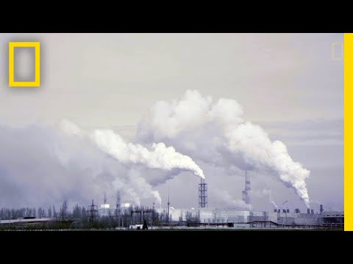
Climate Change what is it?
Discuss
1- Recall some facts from the video.
2- Why are the current levels of atmospheric carbon dioxide levels more relevant today than ever before?
3- What are some sustainable energy sources that can be used?
Write
How can climate change affect health and wellbeing? List 2-3 examples under the following 4 categories.
-Oceans
-Weather
-Food
-Health
Notes:
Discuss questions- Answers
Recall 5 facts from the video- Student lead
Why are the current levels of atmospheric carbon dioxide levels more relevant today than ever before? Highest they have ever been in human history.
What are some sustainable energy sources that can be used?- Solar, wind farms, hydro
Complete the Write task.

Slide 50
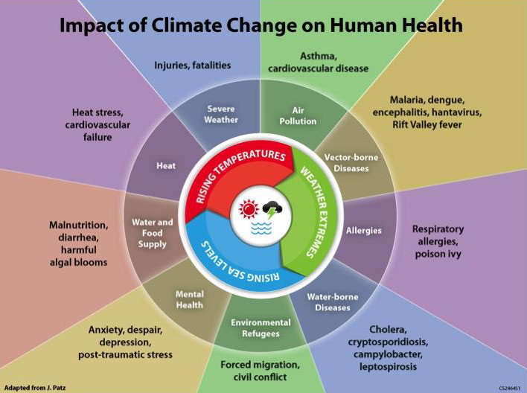
10.2.1- Climate change effects
Over the last 50 years, the burning of fossil fuels to provide energy has resulted in a 20 per cent increase in the production of carbon dioxide and other greenhouse gases.
Melting glaciers have led to rising sea levels, changing weather patterns and more intense and frequent extreme weather events such as floods, cyclones and heatwaves.
Extra tasks (optional)
Good article on climate change and effects on health.
http://theconversation.com/climate-policy-needs-a-new-lens-health-and-well-being-62482
Or video about the (thunderstorm asthma that occured in Melbourne in Nov ‘16.
https://www.youtube.com/watch?v=oBXM45LvW8E
The quality of the air and water and the availability of food and shelter are all affected by climate change and will have significant effects on health and wellbeing.
Notes:
Optional extra tasks.Complete

Slide 51
10.2.2-4- Climate change
effects
Increased in infectious diseases
Reduced agriculture and food supplies
Impact of changing weather patterns and extreme events
Impact of rising sea levels
Reduced availability of
fresh water
Reduced access to fresh water
Extreme temperatures
Relocation of villages and
farms
estibulm conue
Changes in types of crops that can be grown
Changes in biodiversity
Student activity:
Draw the two diagrams above and using pages 370-72 summaries 2 bubbles from each and explain how this will affect health and wellbeing.
Notes:
Copy diagrams into book. Choose 2 from each and summaries what effect this has on health and wellbeing.
Summaries of diagrams (examples):
Relocation of villages and farms — rising sea levels mean people living in coastal areas will
lose their villages and farms due to flooding and will be forced to relocate. This brings about
stress and poor mental health and wellbeing. It also places strain on infrastructure such as
safe water and sanitation services, housing and healthcare services which contributes to
mortality and morbidity from communicable diseases. Relocating can interfere with social
networks within the community and reduce levels of social health and wellbeing.
Reducing the availability of fresh water — as sea levels increase, salt water gradually seeps
into fresh water sources underground. This destroys fresh water sources that will result in
widespread water scarcity and increased morbidity and mortality from diarrhoea and other
water-borne diseases. Water scarcity can also lead to greater poverty as people must pay
large amounts of money to purchase clean water for drinking.
Reduction in agriculture and food supplies — salt water is unsuitable for many trees, plants
and crops and will reduce the foods that can be grown. Oceans can also become more
acidified. This reduces marine life such as clams, oysters and sea corals, which in turn lead to
less fish and seafood, and this reduces food sources available. Rising sea levels could bring
about reductions in food supply and further widespread hunger and undernutrition, which
reduce the overall level of health and wellbeing. Physical health and wellbeing is affected by
hunger and malnutrition which lead to micronutrient deficiencies, lack of energy and
stunting in children, and reduced immune levels.
Ways that changing weather patterns will affect health and wellbeing include:
Increasing the incidence of infectious diseases — many infectious diseases are spread by
mosquitoes that breed in surface water that becomes stagnant, and thrive in humid
conditions. This could result in an increase in diseases such as malaria, dengue and yellow
fever, and their spread into countries that were previously unaffected. Floods and droughts
will increase the risk of diarrhoeal diseases as well as cholera, giardia, typhoid and
hepatitis A.
Bringing about extremes in temperature – there will be more heatwaves and cold spells
which can kill people, particularly those who suffer from cardiovascular and respiratory
diseases, the elderly and young children. Pollen levels increase during periods of high heat
and can trigger asthma, which already accounts for a high burden of disease.
Changing the types of crops that can be grown — this may lead to some countries not
having enough food and experiencing high levels of hunger and undernutrition.
Reducing access to fresh water —clean water may become unavailable for drinking,
increasing the incidence of water-borne diseases such as diarrhoea, typhoid and giardia.
Flooding is also responsible for drownings and physical injuries.

Slide 52
10.3- Conflict and mass migration
Discuss
List some of the possible effects of conflict on health and wellbeing.
Write some of these down in workbook.
Conflict has a widespread effect on health and wellbeing. These can include effects on the physical, emotional, spiritual, social, mental health of individuals as well as the physical environment.
PH- Injuries from war.
EM- Feeling of being unsafe.
PH- Mortality from conflict, SoH- Loss of close social connections.
MH- Post traumatic stress (PTS) and other after effects of conflict.
SpH- Loss of sense of belonging.
SpH- Loss of cultural environment (religious landmarks etc.)
PH- Lack of access to basic amenities (food, water etc.)
PH- Destruction of infrastructure leading to less access to healthcare.
Notes:
Quickbreak before activity- Thumb Wars.
List things from the students. (p.374-5)
Write these down in book afterwards.

Slide 53
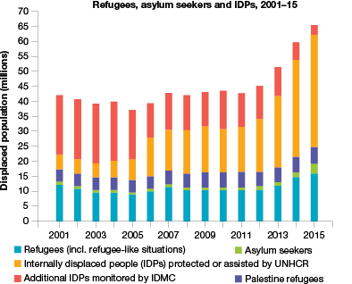
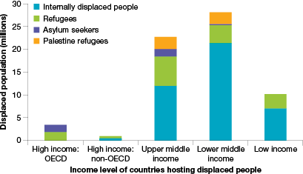
10.3- Conflict and mass migration
TYK in workbook.
1, 2, 4, & 6.
AYU in workbook.
9 & 10
Mass migration often occurs as a result of conflict.
Notes:
TYU p.377- answers
1-Conflict can be described as a global trend because, according to the World Health Organization,
armed conflicts are now at a level where they are the largest and longest experienced since the
end of World War II. The number of refugees and displaced people as a result of conflict is also
at its highest since World War II.
2. ‘The nature of conflict has changed’ is referring to the fact that international humanitarian law is
now being largely ignored. There is deliberate bombing of healthcare facilities, and siege and
starvation are being used as weapons of war.
4. When conflict occurs, women are at greater risk because they have a high risk of rape and abuse
as they lack protection from rival forces. Women are left without an income earner, as their
partner is killed. This can force women and their children into poverty.
6. Internal displacement refers to people seeking refuge within their own country as a result of
having to leave their home and community due to war and conflict.
9. The trends that are evident in figure 10.8 in relation to internally displaced people, refugee status and all displaced people shows a relatively steady proportion until 2011 after which time there has been a steadily increasing number.
10. Figure 10.9 shows that most of the world’s displaced people relocate to low- and middle-income countries.
· Africa hosted 29 per cent of those who relocated, the Middle East and North Africa hosted 39 per cent, and Asia and the Pacific hosted 14 per cent of those who are displaced. Many countries in these regions are classified as middle- and low-income countries.
· This can create a huge burden on economies that are already struggling, put additional pressure on infrastructure and affect the security and society of these countries.
· The mass migration of people also has the potential to contribute to the spread of infectious diseases. This adds further to the stress placed on the healthcare systems of countries that are already struggling to meet the health needs of the population.

Slide 54
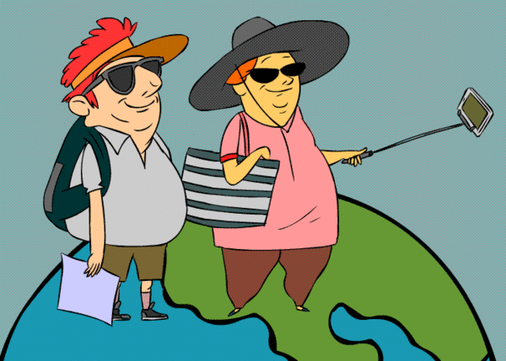
10.4-World trade and tourism
Discuss
Why does world trade occur?
Has the trading of goods and services between countries contributed positively to global health?
Sustainable tourism is ‘tourism that takes full account of its current and future economic, social and environmental impacts, addressing the needs of visitors, the industry, the environment and host communities’.
Notes:
Complete discussion questions.
Copy definition of ‘sustainable tourism’

Slide 55
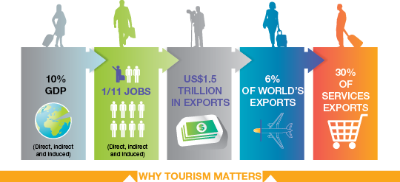
Benefits of tourism which promote health and wellbeing
Promotion of mutual understanding, peace and security.
Promotion of inclusive and sustainable growth.
Contribution to social inclusion and employment.
Preservation of cultural values, diversity and heritage.
Promotion of resource efficiency and environmental protection.
AYK p.381
8 & 9 in workbook.
Notes:
Copy diagram into workbook. Select 3 of of these benefits and add further explanation about how they promote health and wellbeing.
Provide 2 challenges that can be brought on by tourism.
Complete AYK questions 8 & 9 p.381.
Answers
Tourism and world trade can help achieve gender equality:
Almost twice as many women are employed in the tourism sector compared to any other
sector. This provides women with employment opportunities and increased empowerment,
which enhances gender equality.
Money from tourism can be reinvested in healthcare and services. These can improve
maternal health, reduce child mortality and prevent diseases, giving women greater
opportunities to work because they are less likely to have to care for sick family members or
become sick themselves.
A well-trained and skilled workforce is important for tourism to prosper. The tourism sector
can provide incentives to invest in education and vocational training that can benefit
women, because so many of them work in this sector, and help achieve gender equality.
9. Tourism can contribute to social inclusiveness through the need to have a well-trained and
skilled workforce for tourism to prosper. Tourism can provide incentives to invest in education
and vocational training, which is often targeted towards youth, women, older people and those
with special needs. This has the potential to promote inclusiveness, the value of the culture of
tolerance, peace and non-violence, and all aspects of global exchange and citizenship.

Slide 56
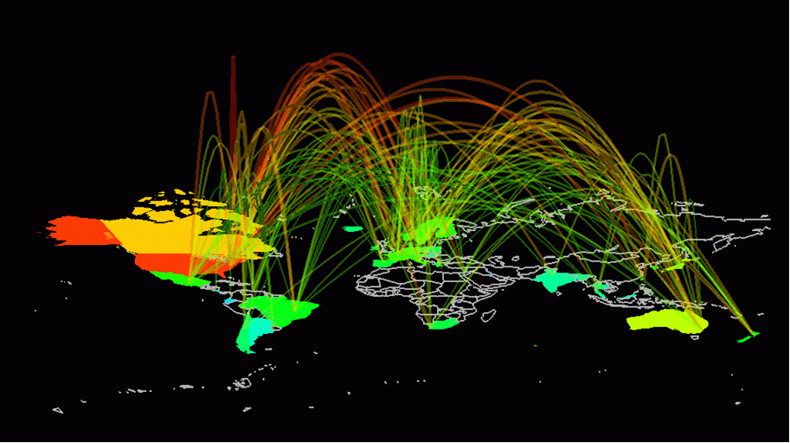
10.5- Digital technologies = increased knowledge sharing
Task -Read through as a group the implications of Digital Technologies. -Write down 5 important statements/facts about what was read.
Benefits
-Used for communication as well as health related information.
-Access to digital technologies is greater than it has ever been (mobile phones exceeds world’s population.
-Promote health and wellbeing by reducing stress levels and have greater access to healthcare information.
-Self diagnosis which allows for greater communication between healthcare worker/patient.
\
Challenges
-Access to privacy information can be taken or given to the wrong people.
-Greater exposure to sensitive information can have an impact n emotional and mental wellbeing.
Notes:
-Read through as a group the implications of Digital Technologies.
-Write down 5 important statements/facts about what was read (both benefits and challenges)

Slide 57
10.5- Digital technologies = increased knowledged sharing
Crossword- http://www.jacplus.com.au/secure/Searchlight?searchbox=int-6897
Notes:
Case Study Answers
The benefits of increased phone connectivity relates to its potential to change the way
healthcare information and services are being delivered, particularly to those living in low- and
middle-income countries.
2. Mobile technology has changed the way healthcare information and services are being delivered
by using SMS technology to track malnutrition, remind patients to take their medicine, and
provide pregnant mothers with health information necessary to achieve a healthy pregnancy.
3. The use of mobile technology has increased the accuracy and timeliness of information while
reducing its cost by shifting the reliance from paper-based records to online systems. For
example, SMS can be used to registered babies born outside of hospital in Africa and to deliver
test results for HIV.
4. Smart phone apps have empowered users in relation to their health. Apps can enable users to
identify their symptoms and contact the closest medical clinic for advice. They can also be used
to monitor and report conditions such as heart disease and diabetes. This helps improve health
and wellbeing.
5. Barriers that need to be overcome before digital technologies can be used on a larger scale to
promote health and wellbeing:
Standardisation of technology — operating systems are not yet standard across all countries,
limiting the ability to transfer a technological solution and the data collected. Using open
source platforms for SMS or smartphones could be a way to increase compatibility, allowing
anyone with a smartphone to use the application no matter where that person is located.
Standardisation of regulations across countries — policies and frameworks to regulate and
control the use of digital technologies are needed to ensure the privacy and confidentiality
of health records and information.
Financing — most of the funding has come from public finance or governments but it is
important to have private sector investment as well. This requires evidence that digital
technologies can bring about improved health and wellbeing and not just an increased flow
of health-related information.

Slide 58
SAC Preparation-
SAC study Unit 4 AOS 1 Part 2
The relevant dot points from the Study Design for this task are:
Key knowledge
the concept and dimensions of sustainability (environmental, social, economic) and its role in the promotion of health and wellbeing
the concept of human development, including advantages and limitations of the Human Development Index
implications for health and wellbeing of global trends including:
climate change (rising sea levels, changing weather patterns and more extreme weather events)
conflict and mass migration
increased world trade and tourism
digital technologies that enable increased knowledge sharing.
Key skills
explain sustainability (environmental, social, economic) and its importance in the promotion of health and wellbeing in a global context]
explain the Human Development Index and evaluate its usefulness in measuring human development of countries
analyse the implications for health and wellbeing of particular global trends.
REVIEW- Chapter 8 & 9 definition Pre-test
https://quizlet.com/_4tqnph

